Slide 1
MD-gated dendritic plasticity: progress update
Does the mediodorsal thalamus gate which dendritic branch learns — enabling context-specific learning without catastrophic forgetting?
Raghav · PI meeting 2026-10-15 · Thalamocortical Gating Model (spiking, Brian 2)
Notes:
Open: it's been a while since we met — the setup moved from Windows to Linux in between, so this is the first update since then. I rebuilt everything and used the gap to close the three questions we'd flagged as open. Quick background first for context, then three results, then where I think we go next. Aim for ~10-12 min, leave time for the scaling decision at the end.

Slide 2
Background — the question
While reading in a noisy café, the brain routes attention without erasing what it knows.
Hypothesis: the mediodorsal (MD) thalamus acts as a meta-controller that selects WHICH dendritic branch of a prefrontal pyramidal neuron is allowed to undergo plasticity.
→ Different contexts write onto different physical branches instead of overwriting the same synapses — context-specific learning without catastrophic forgetting.
Two papers grafted together (neither answers it alone):
  Yang, Murray & Wang 2016 — the mechanism: spiking reduced-compartment pyramidal neuron, dendritic disinhibitory circuit (VIP→SOM→dendrite, PV→soma), calcium-based Graupner–Brunel plasticity.
  Zhang et al. 2025 — the MD wiring: MD→PV (gain) + MD→VIP (disinhibition) as the context/meta-control signal.
Notes:
The core idea in one sentence: instead of different contexts fighting over the same synapses — which causes catastrophic forgetting — the MD thalamus routes each context to a different dendritic branch, so they don't overwrite each other. Neither source paper does this alone: Yang 2016 has the single-neuron dendritic gating mechanism but no thalamus; Zhang 2025 has the MD control wiring but not the plasticity. The project is grafting them. If asked 'is this just Yang replication?' — no, the MD-as-context-controller for plasticity is the novel part.

Slide 3
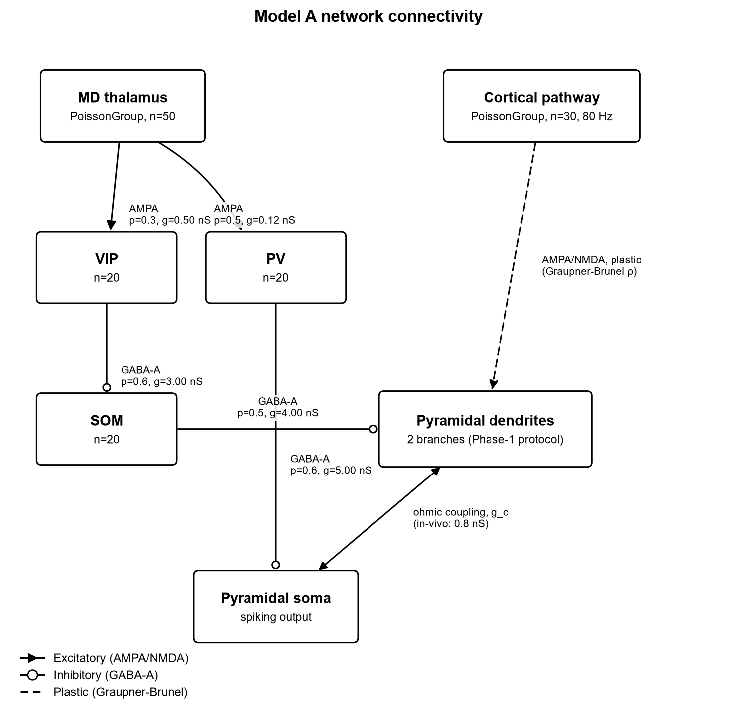
Background — the model (Model A, spiking, Brian 2)
One pyramidal neuron: soma + 2 dendritic branches.
Each branch has an independent plastic cortical input (Graupner–Brunel calcium rule, Yang Eqs. 32–35).
SOM inhibits a branch → shunts its calcium → gates its plasticity.
MD sets the context via PV (somatic gain) and VIP→SOM (branch disinhibition).
Readout: gating ratio = rho(free branch) / rho(inhibited branch). Ratio > 2 = gating works.
Notes:
Walk the diagram right-to-left: the cortical pathway (dashed) is the plastic input onto two dendritic branches — that's where learning happens, via the Graupner-Brunel calcium rule. SOM (bottom left) inhibits a branch and shunts its calcium, which is how a branch gets gated off. MD (top left) is the controller: MD→PV sets somatic gain, MD→VIP→SOM sets which branch is disinhibited. The one number to remember all talk: the gating ratio — free-branch rho over inhibited-branch rho. Above 2 means gating works. Everything that follows is measured against that readout.

Slide 4
Since the last meeting
Environment moved from Windows to Linux; rebuilt the Brian 2 stack and verified bit-exact reproduction of all committed results.
Then closed the three open questions that were blocking confidence in the model:
  1. Gating reliability — why did a few random seeds fail?
  2. SOM-rate divergence — why does the model need ~2× Yang's firing rate?
  3. No catastrophic forgetting — does the core claim actually hold?
All three resolved, committed, and pushed to GitHub. Details follow.
Notes:
Honesty note on the move: I verified the Linux rebuild reproduces the old results bit-for-bit before trusting any new number — same RNG stream, same ratios. So nothing here is an artifact of the environment change. The three questions were the ones I'd have been nervous presenting without answers: a couple of seeds failing, the 2x firing-rate gap vs Yang, and whether the headline no-forgetting claim actually holds when tested directly. All three are now answered — next three slides.

Slide 5
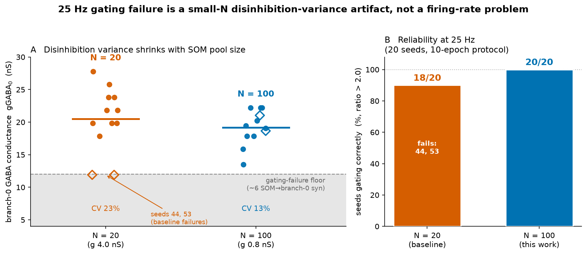
Result 1 — Gating reliability: a small-N variance artifact
Problem: at the 25 Hz baseline, 2/20 random seeds failed (gating ratio ~1).
Diagnosed: the inhibited branch draws a small, random integer number of SOM synapses (p=0.5 over only 20 SOM cells). Too few → weak shunt → branch depolarizes → NMDA opens → calcium escapes → gating lost.
Not a firing-rate or timing problem; a population-size variance effect.
Fix (controlled): hold mean inhibition constant, enlarge the SOM pool so the variance self-averages.
Result: N=100 → 20/20 seeds gate (full 10-epoch protocol).
Notes:
Story: a few seeds failed and I wanted to know if it was a real bug. It's not — it's a finite-size effect. With only 20 SOM cells at p=0.5, the inhibited branch sometimes draws ~6 synapses instead of ~10, inhibition is too weak, and that branch escapes. Left panel: the spread in branch-0 inhibition (gGABA) at N=20 vs N=100 — the two red diamonds on the floor are the failing seeds. The clean test: I held the MEAN inhibition fixed and only shrank the variance by enlarging the pool. Right panel: 18/20 goes to 20/20. So it's variance, not insufficient inhibition and not firing rate. Caveat if pushed: this is the reduced circuit; the fix is a population-size argument, which the full network will have naturally. Takeaway for the PI: the 30 Hz baseline we'd been using masks this; the real knob is pool size.

Slide 6
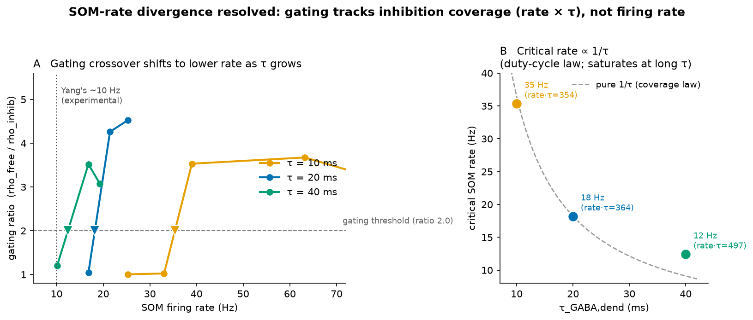
Result 2 — SOM-rate divergence from Yang, resolved
Reviewer question: Yang gets gating at ~10 Hz SOM; our model needs ~18–21 Hz at the SAME τ_GABA = 20 ms. Why 2×?
Answer: gating tracks the DUTY CYCLE of inhibition (rate × τ), not the rate alone. Our spiking calcium is event-driven, so it needs fuller coverage than a rate-averaged rule.
Proof: critical rate scales ~1/τ (rate×τ constant to <3%, 10→20 ms). Same spike train + longer GABA tail rescues gating.
The model recovers Yang's ~10 Hz regime at τ = 40 ms — a quantified consequence of spiking calcium, not a bug.
Notes:
This is the reviewer-proofing one — the question a referee WILL ask: Yang gates at 10 Hz SOM, why does ours need ~20? I checked the paper directly: Yang's 10 Hz is an experimental number, and his GABA decay tau is 20 ms — same as ours. So it's not a parameter mismatch. The answer is that what matters is COVERAGE — rate times tau, the fraction of each inter-spike gap the inhibition actually covers — not the rate alone. Our calcium is event-driven (spiking), so an uncovered gap lets calcium escape; a rate-averaged model like the mean-field reading of Yang doesn't feel that. Proof on the right: critical rate scales as 1/tau — double tau, halve the rate needed — and at tau=40 ms we gate at ~12 Hz, essentially Yang's regime. Same spike train, longer GABA tail, gating comes back. So the divergence is understood and quantified, not a bug. Caveat: single seed, reduced circuit; the scaling is clean for 10->20 ms and saturates a bit by 40 ms, which is expected.

Slide 7
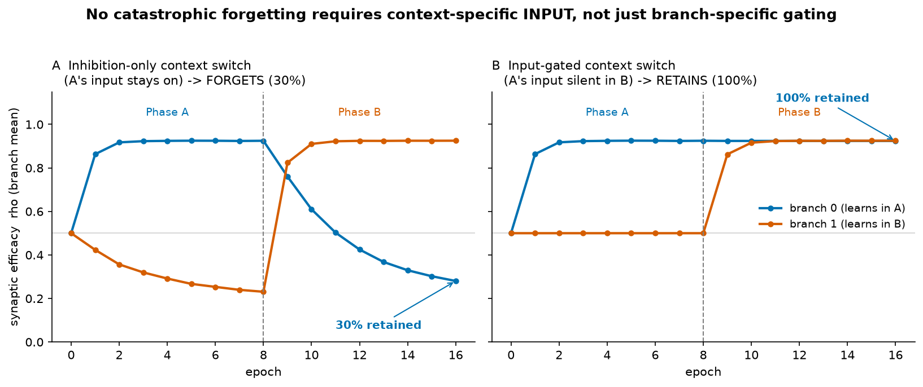
Result 3 — No catastrophic forgetting (the core claim)
First direct test: learn context A → switch to B → is A retained?
Branch separation ALONE is not enough: inhibition-only switch → A's memory 70% erased (30% retained).
Why: gating is not protection. A shunted branch still gets input + bAP calcium, sits in the LTD band, and is actively depressed (Yang plasticity has no frozen state).
Memory is protected only when context A's INPUT is silent during B → 100% retained, while B learns on its own branch.
Sharper claim: no forgetting needs context-specific gating of BOTH the disinhibition AND the input.
Notes:
This is the headline claim, and it had never actually been tested — so I ran it: learn A on one branch, switch context, learn B on the other, check A survives. First result was a surprise and I want to present it honestly: with branch separation alone, A was 70% ERASED (left panel, blue line collapsing). So 'different branches' is NOT by itself enough. The reason is mechanistic: a gated branch still receives its input plus back-propagating-AP calcium, which sits in the LTD band — Yang's plasticity rule has no frozen state, so shunting slowly depresses the old memory rather than protecting it. The fix — and I'd argue this is the actual scientific result, not a patch — is that the memory is protected when context A's INPUT goes silent during B (right panel: flat, 100% retained). So the real claim is sharper and more defensible: no forgetting needs context-specific gating of BOTH the disinhibition AND the input — which is exactly what a real context switch is. Frame this as a strengthened claim, not a problem. Caveat: reduced circuit, context abstracted, 8 epochs of interference.

Slide 8
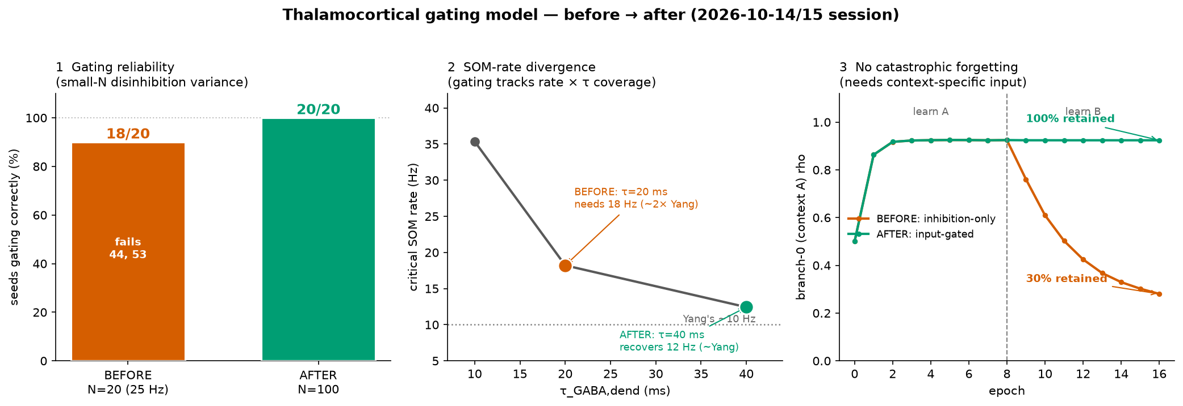
Summary — before → after (this session)
All panels from committed simulation data. Orange = baseline/broken; green = resolved.
Notes:
One-slide recap if we're short on time, or the landing slide. Three before/after pairs, all from real simulation data: reliability 18/20 to 20/20; the Yang rate gap explained and the 10 Hz regime recovered; forgetting 30% to 100% retention. The through-line: in every case the model does what we claimed, once the mechanism is understood properly. Orange is where we were, green is where we are.

Slide 9
Where this leaves us / next steps
Settled: gating reliability, SOM-rate calibration, and the no-forgetting mechanism — all verified in the reduced circuit and documented.
Next — scale to a ~3000-neuron network (Yang scale):
  Now unblocked in principle, but it MUST preserve input context-sparsity — not just branch-specific gating — or it will forget at scale.
  Repeat the key tests across seeds and in the full MD→VIP→SOM circuit.
Open decisions for discussion: ambition (faithful replication + modest extension vs. full novel network for publication); MD fidelity (Poisson vs. full PFC↔MD loop).
Notes:
The ask. The three prerequisites we wanted settled before scaling are settled, so the network build (~3000 neurons, Yang scale) is unblocked. One hard constraint I want to flag: Result 3 means the network must keep inputs context-SPARSE — different contexts can't share persistently-active inputs, or it'll forget at scale for the same reason. Two decisions I'd like your steer on: (1) ambition — faithful replication plus a modest extension, or push for a full novel network aimed at publication? (2) MD fidelity — keep MD as a Poisson drive, or build the full PFC↔MD loop? My lean: lock the scaling scope with the input-sparsity constraint, keep MD as Poisson for the first network pass, and decide publication ambition once it holds at scale. Open the floor here.

