Slide 1
Thalamocortical Gating Model
Progress meeting - what we replicated, what broke, what we fixed, and what needs a decision. All figures below are real simulation output.

Slide 2
The question and the approach
• Question: can MD thalamus control WHICH dendritic branch of a pyramidal neuron
• is allowed to learn - so different contexts write onto different branches
• instead of overwriting the same synapses?
•
• Approach: combine two papers that don't talk to each other.
• Yang, Murray & Wang 2016 - the gating mechanism itself (dendrite + calcium +
• plasticity). No thalamus - just an abstract control input.
• Zhang et al. 2025 - the MD thalamus wiring (MD -> PV, MD -> VIP). No dendrites,
• no plasticity - a trained network, not a mechanistic one.
•
• Canonical model ("Model A"): 1 soma, 2 dendritic branches, 20 of each
• interneuron type (PV / SOM / VIP), Brian 2 spiking simulation.
• Scope check: we borrow Zhang's wiring labels only, not his trained task or
• behavior; not yet at Yang's ~3000-neuron network scale.

Slide 3
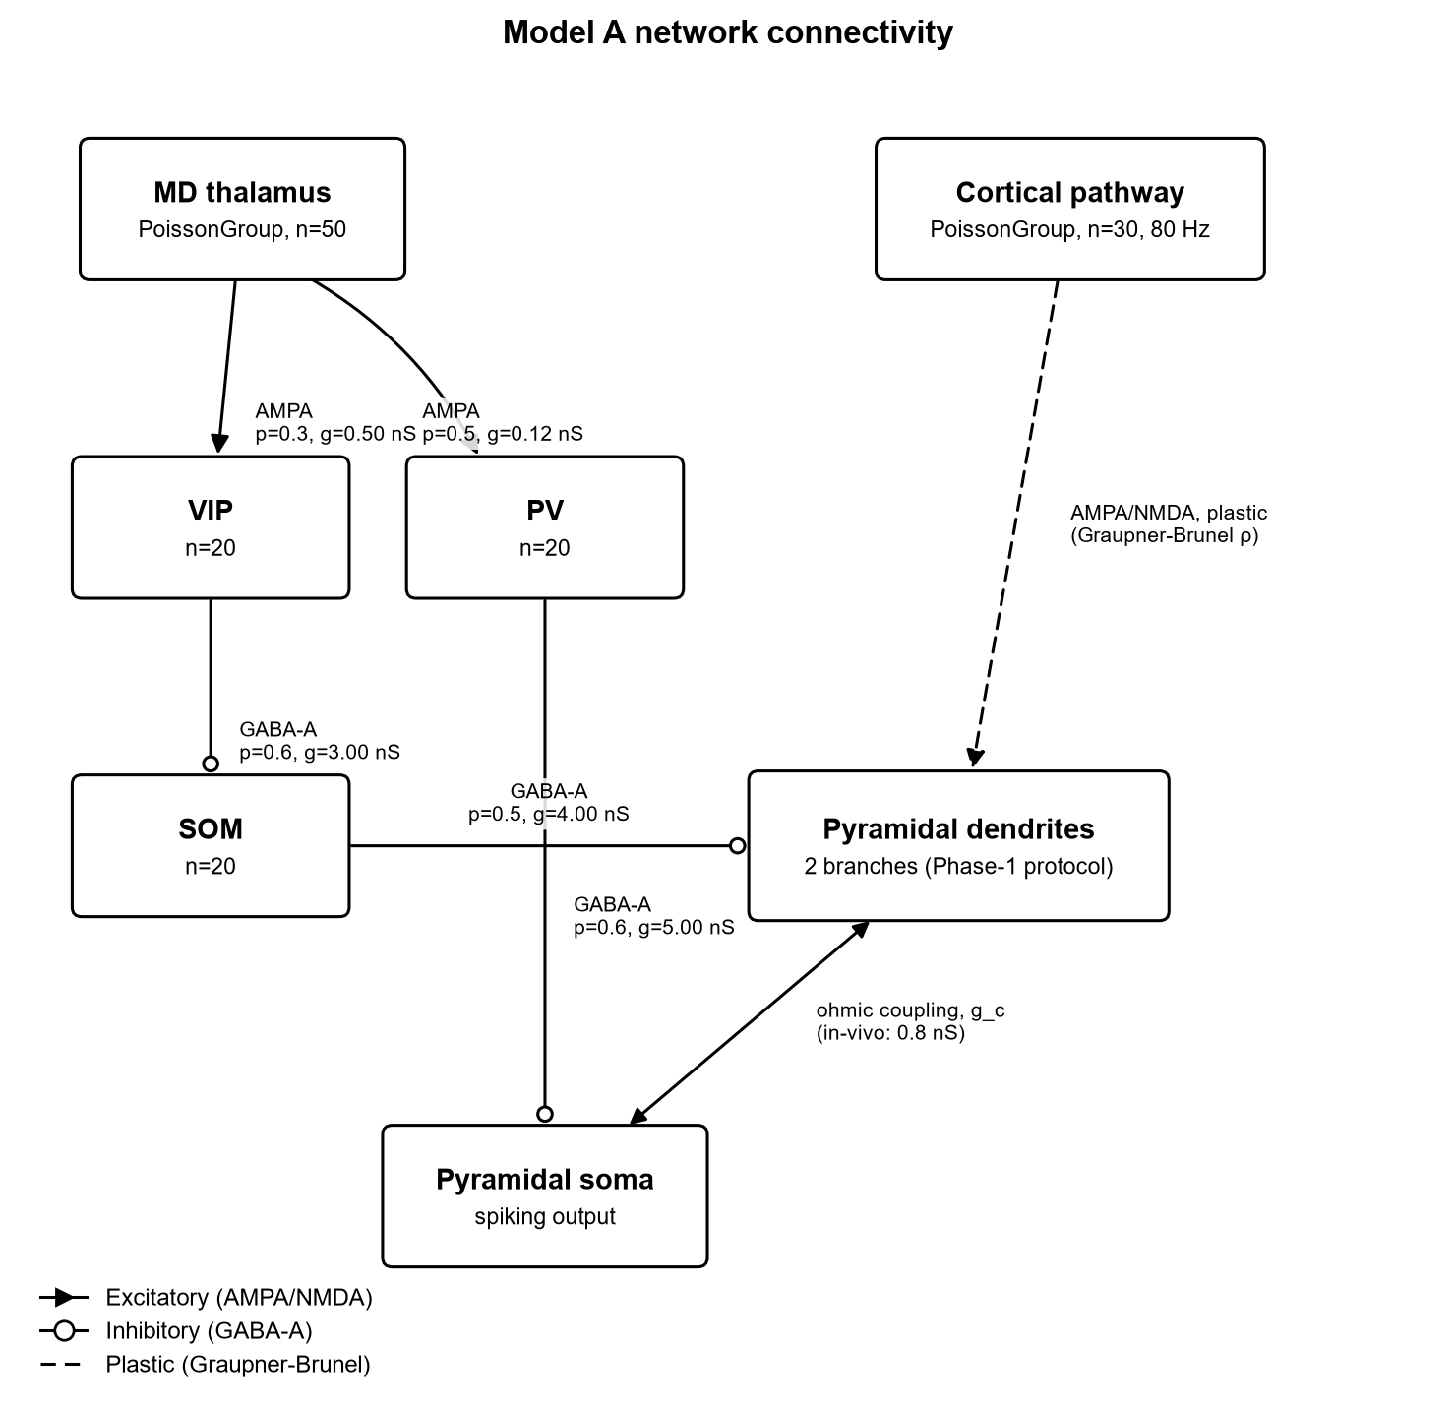
Model architecture
Model A connectivity.
MD thalamus (Poisson input) drives PV and VIP.
VIP inhibits SOM (disinhibition).
SOM inhibits one dendritic branch only.
PV inhibits the soma.
Weights / probabilities read directly
from model/parameters.py.

Slide 4
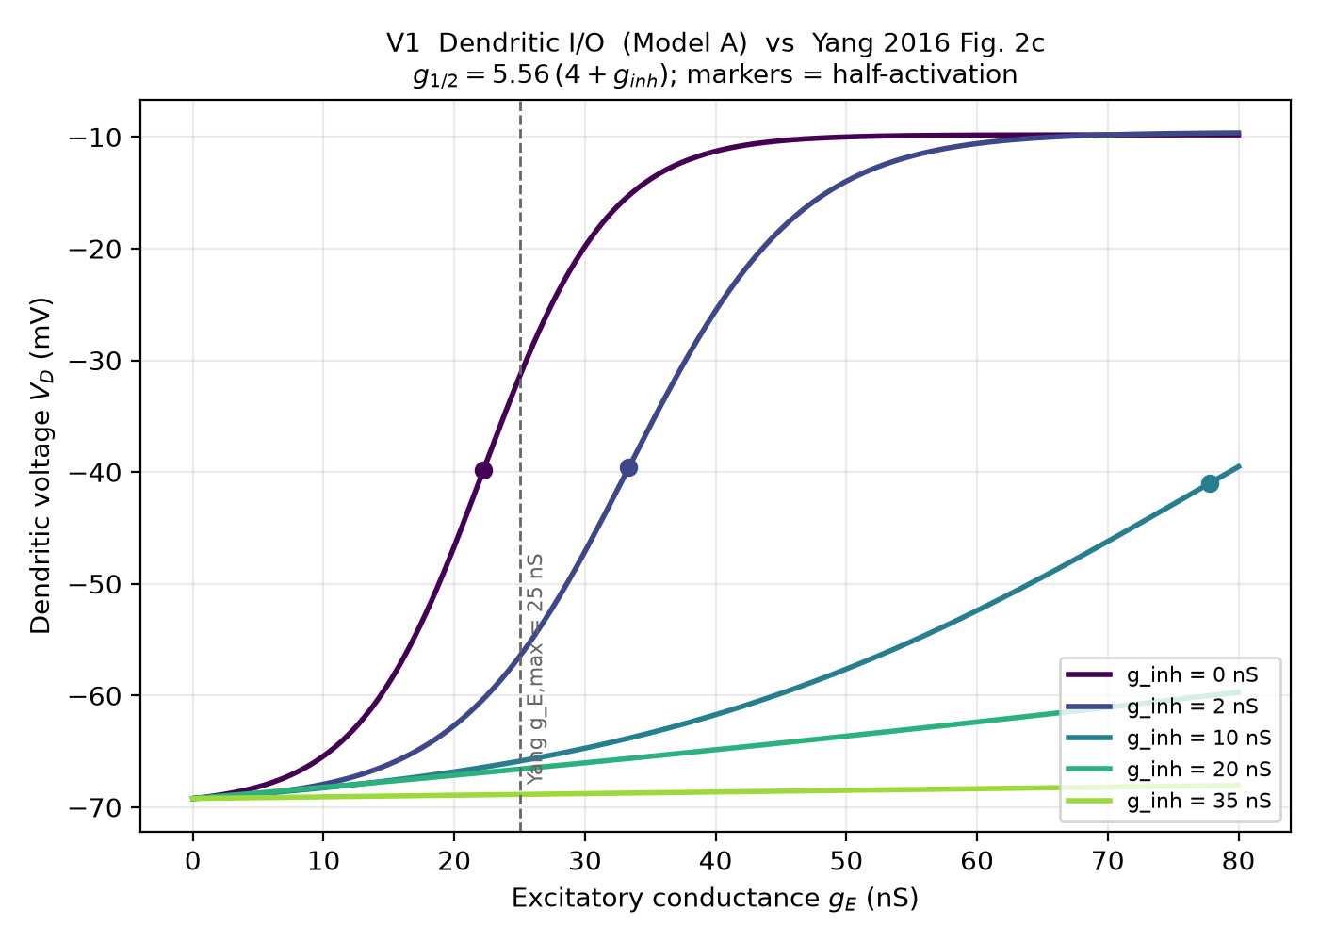
Bug 1 + Bug 2 fix - validation
Bug 1: coupling constant was 4.0 nS,
should have been Yang's 0.8 nS.
-> soma fired at 201 Hz instead of ~10 Hz.
Bug 2: calcium model wasn't Yang's leaky
integral - old version capped at 1.328,
below LTP threshold (2.78). LTP impossible.
After both fixes, measured dendritic
half-activation vs. Yang's own formula
g(1/2) = 5.56 x (4 + g_inh):
22.24 / 33.36 / 77.83 / 133.42 / 216.81 nS
matches Yang's formula to the digit
at all 5 inhibition levels.

Slide 5
Bug 1 + Bug 2 - sanity check number
• Free branch rho = 0.78
• Inhibited branch rho = 0.02
• (seed 42, exc = 80 Hz, post = 10 Hz, coupling = 0.8 nS)
•
• First working separation between the two branches after both fixes.
•
• Caveat found later: this specific ratio was inflated by a separate,
• then-undiscovered bug (the 346x plasticity-timescale bug - next section).
• The dendritic I/O match on the previous slide is the cleaner check,
• since it does not depend on the plasticity equation at all.

Slide 6
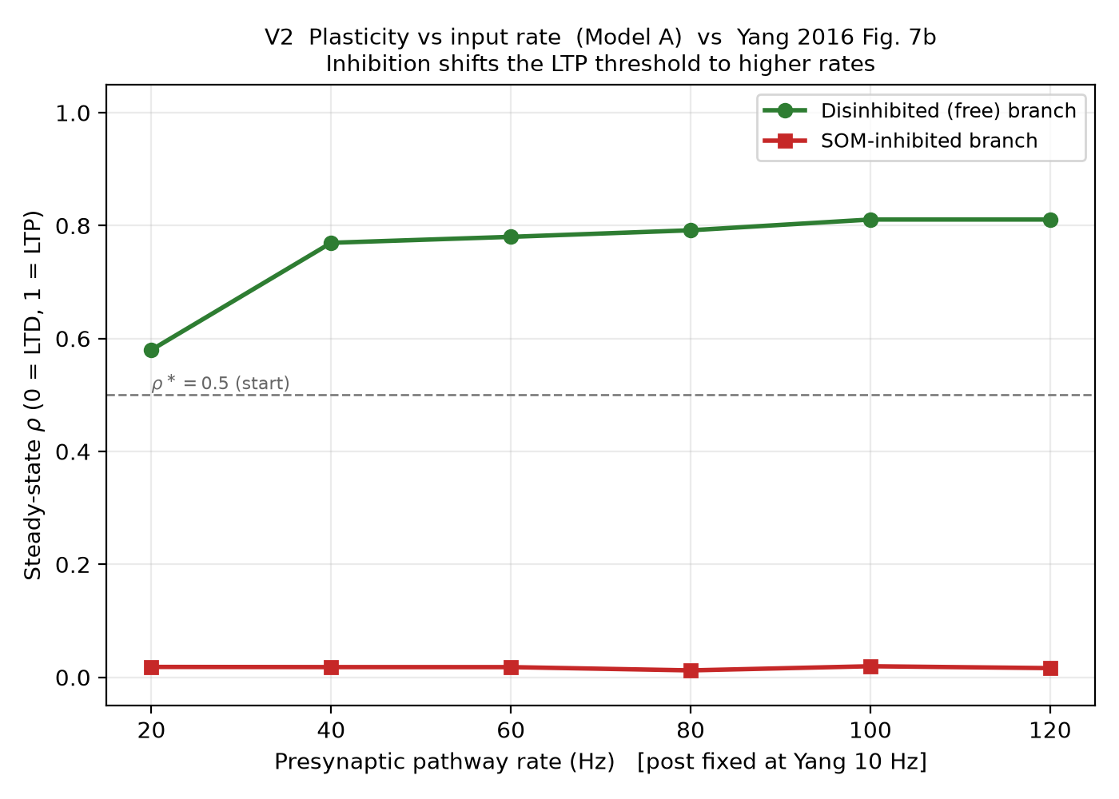
V2 - LTP threshold shifts with rate (Yang Fig. 7b)
Presynaptic rate (Hz):
20 40 60 80 100 120
Free branch rho:
0.58 0.77 0.78 0.79 0.81 0.81
Inhibited branch rho:
stays ~0.012-0.020 across the whole range
Free branch potentiates more as rate rises;
inhibited branch never does, at any rate.

Slide 7
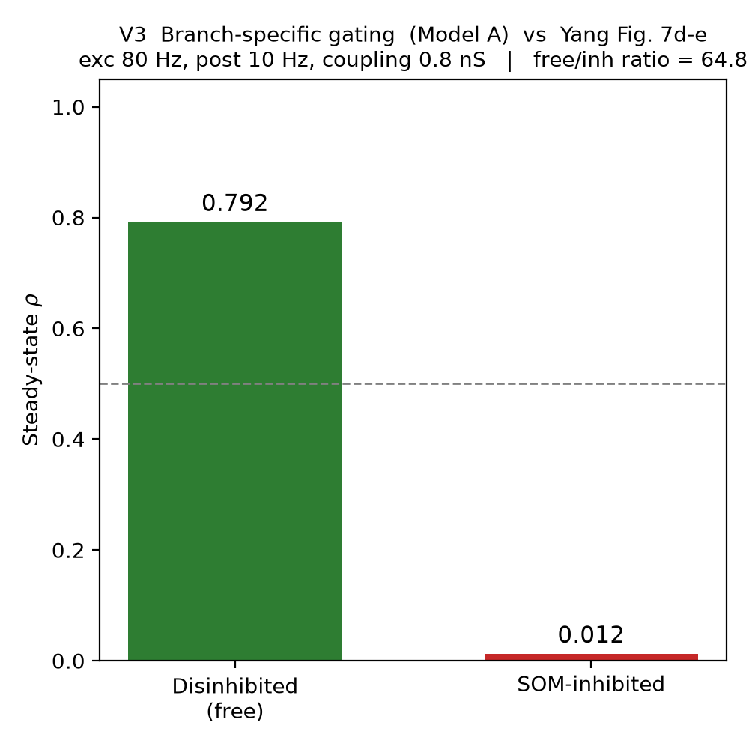
V3 - gating at Yang's own operating point
exc = 80 Hz, post = 10 Hz
(Yang's own stated operating point)
Free branch rho = 0.792
Inhibited branch rho = 0.012
Ratio = 64.83
(One of 3 different measurements of the
same nominal number that didn't agree with
each other - flagged, not hidden - see
Progress_Report.docx Section 2.2.)

Slide 8
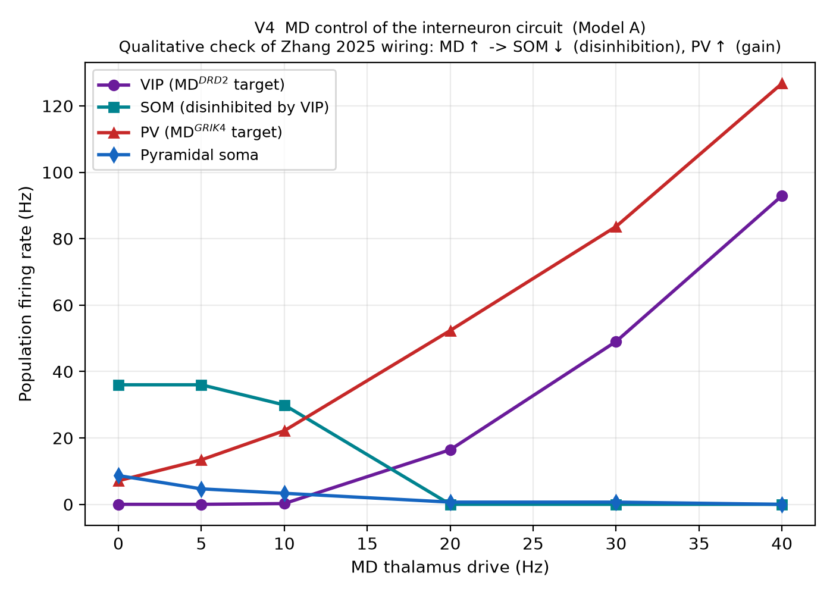
V4 - does MD control the interneurons the way Zhang says?
MD drive (Hz): 0 5 10 20 30 40
PV rate (Hz): 7.1 13.4 22.2 52.3 83.7 126.7
SOM rate (Hz): 36.0 36.0 29.9 0.0 0.0 0.0
VIP rate (Hz): 0.0 0.0 0.2 16.4 49.0 92.9
As MD rises, VIP rises and suppresses SOM
(36 -> 0 Hz) - disinhibition works as Zhang's
wiring predicts. PV rises in parallel
(separate gain-control arm).
Qualitative check only - we borrow Zhang's
wiring labels, not his trained behavior.

Slide 9
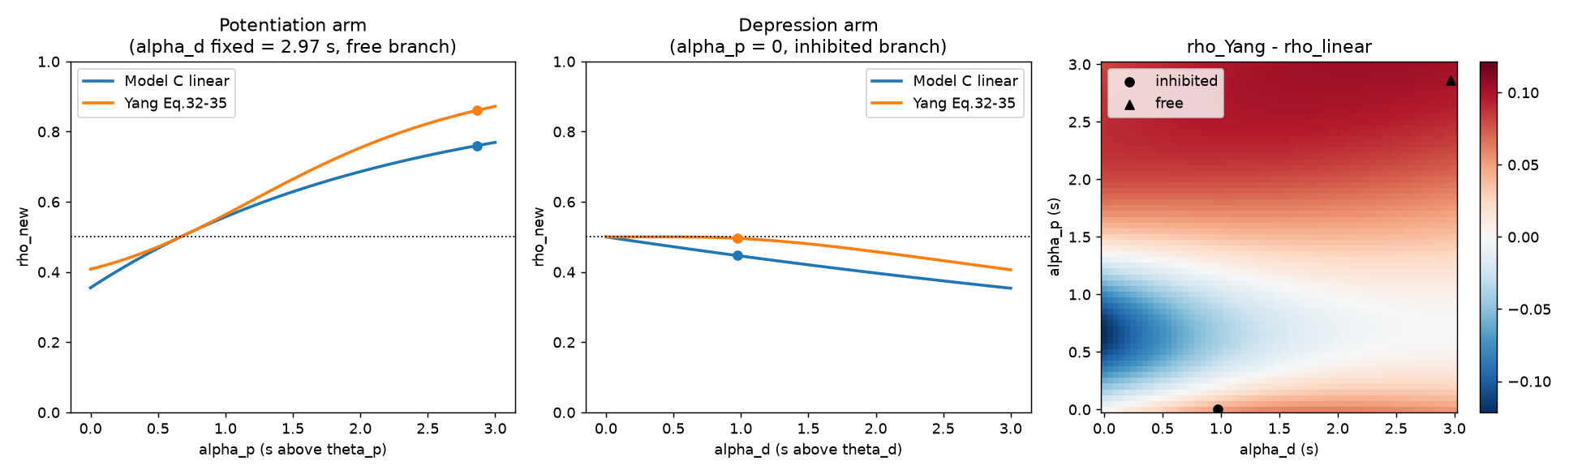
The 346x plasticity-timescale bug
tau = 346.36 s (Yang's own published time
constant) - but the project's ODE only
divided part of the equation by tau.
Ratio of what was written vs. correct: 346.
Form rho_inhib rho_free ratio
As-committed 0.018 0.779 42.76
Canonical(fixed) 0.424 0.638 1.51
(both at T = 3 seconds)
Canonical form run for 300 s (~1.7 hrs
wall-clock): oscillated 1.49-2.83,
never converged. Motivated switching to
Yang's actual closed-form equation instead
of patching this ODE further.

Slide 10
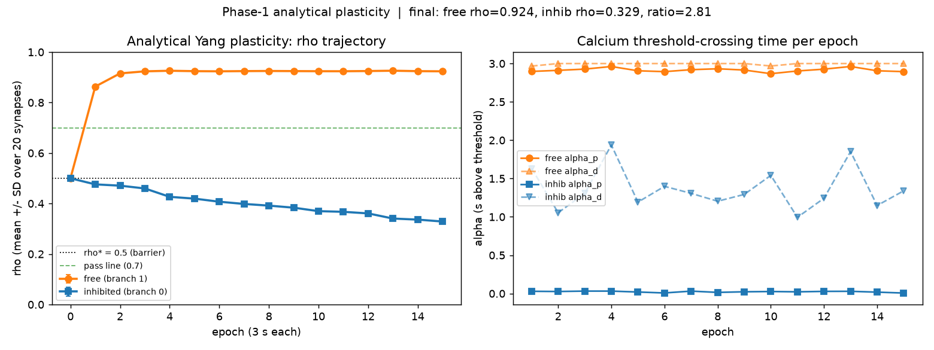
Multi-epoch result with Yang's real equation
Yang's closed-form epoch update
(his Eqs. 32-35), not a continuous ODE.
epoch: 0 1 2 3 5 8 15
free rho: .50 .86 .92 .92 .92 .93 .92
inhib rho:.50 .48 .47 .46 .42 .39 .33
Final ratio = 2.81
Much lower than the old 42.76 headline -
because 42.76 was never real (previous slide).
This number is honest.

Slide 11
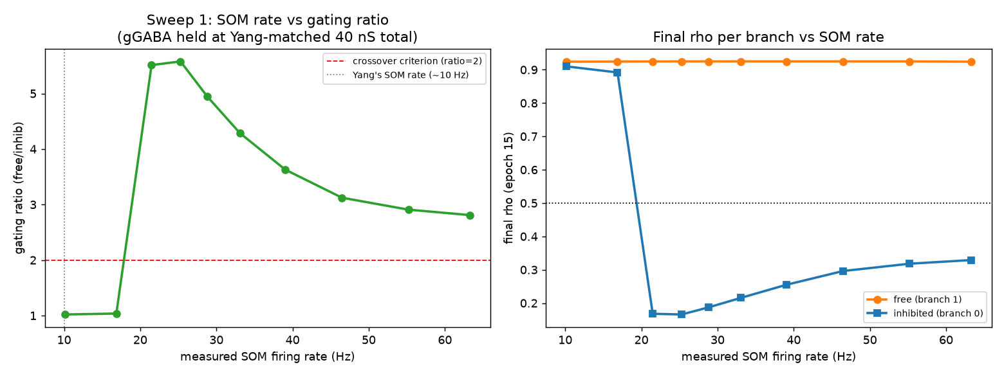
Sweep 1 - SOM firing rate (this is where 25 Hz comes from)
gGABA held fixed at Yang-matched 40 nS.
SOM rate (Hz): 10 17 21 25 29 33 39 46 55 63
ratio: 1.0 1.0 5.5 5.6 5.0 4.3 3.6 3.1 2.9 2.8
Sharp STEP between 17 and 21 Hz, not gradual.
Peak ratio 5.58 at 25.3 Hz.
Ratio then DECLINES past the peak -
more SOM drive is not always better.

Slide 12
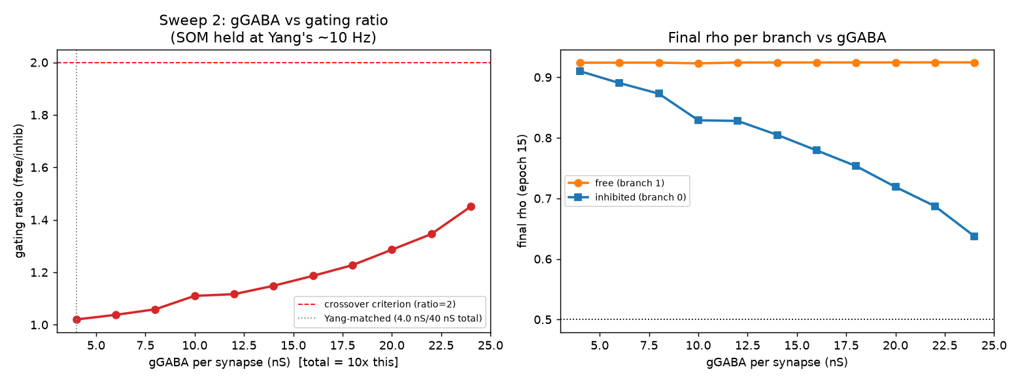
Sweep 2 - GABA conductance amount (this one failed)
SOM held at Yang's own ~10.15 Hz.
gGABA per synapse swept 4 -> 24 nS.
Ratio only climbs from 1.02 to 1.45,
even at 6x Yang's own conductance spec.
Never reaches the ratio = 2 pass line.
Conclusion: it's SOM's RATE / TIMING that
matters for gating, not the total amount
of inhibitory conductance.

Slide 13
Validation summary: paper result vs. our model
Everything above this slide, side by side. Only checks done under matched conditions (same formula / same operating point) are marked as a real match.
Check | Paper (Yang 2016 / Zhang 2025) | Our model
Dendritic I/O curve (Yang Fig. 2c) | g(1/2) = 5.56 x (4 + g_inh) (closed-form formula) | Matches to the digit at all 5 tested inhibition levels
LTP threshold vs. rate (Yang Fig. 7b) | Inhibition raises the rate needed for LTP (qualitative) | Directional match: free rho 0.58->0.81 (20->120Hz); inhibited stays ~0.01-0.02
SOM->PV connection (Yang Fig. 6) | P = 0.8 | Was missing in our code; added, now matches at P=0.8
MD->interneuron wiring direction (Zhang 2025) | MD->VIP disinhibits SOM; MD->PV is separate gain control | Matches direction: VIP 0->93Hz, SOM 36->0Hz, PV 7->127Hz as MD rises 0->40Hz
SOM baseline firing rate (Yang Methods) | ~10 Hz | *Not matched - model needs >=~21Hz minimum to gate at all; current default is 30 Hz
"Gating selectivity" (Yang Eq. 1) | (r_on - r_off)/(r_on + r_off), bounded 0-1. Reports ~0.5 (network-scale) and ~0.7 (task-trained subset) | *Not directly comparable - we report a different, unbounded ratio (rho_free/rho_inhib); different setup entirely (single neuron vs. network/task model)
Red/italic rows = open gaps or metric mismatches, not resolved matches - listed so nothing is silently dropped.

Slide 14
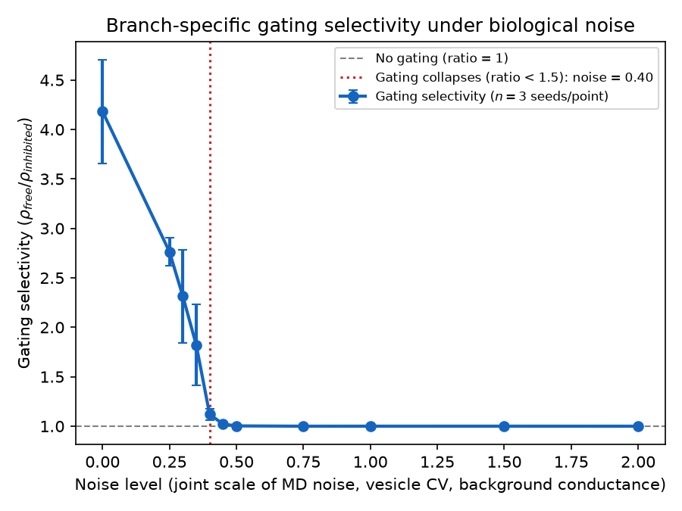
Noise robustness
How much biological noise can gating
tolerate before it stops working?
3 noise sources scaled together:
MD noise input, vesicle-release variance,
SOM/VIP background fluctuation.
Gating degrades gradually, then collapses
sharply past a breaking-point noise level.
(current baseline: SOM at 30 Hz)

Slide 15
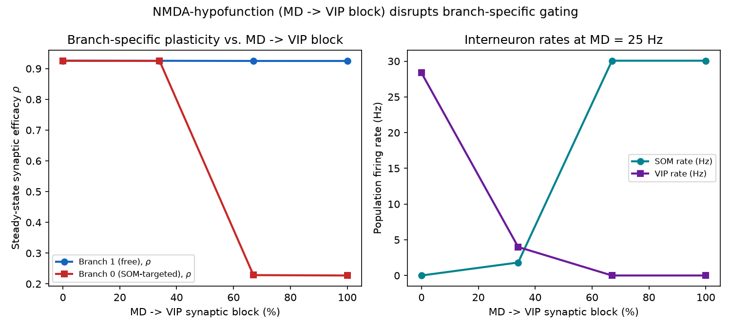
Ketamine / NMDA-hypofunction simulation
Models a standard schizophrenia-dysfunction
circuit disruption: block NMDA on VIP,
i.e. block MD -> VIP synapse (0% -> 100%).
Below ~50% block: MD can still pick which
branch learns.
Above ~50% block: SOM returns to its own
baseline rate, permanently shuts its
branch - MD's signal no longer matters.
Reading: loss of CONTROL over learning,
not a general shutdown of learning.

Slide 16
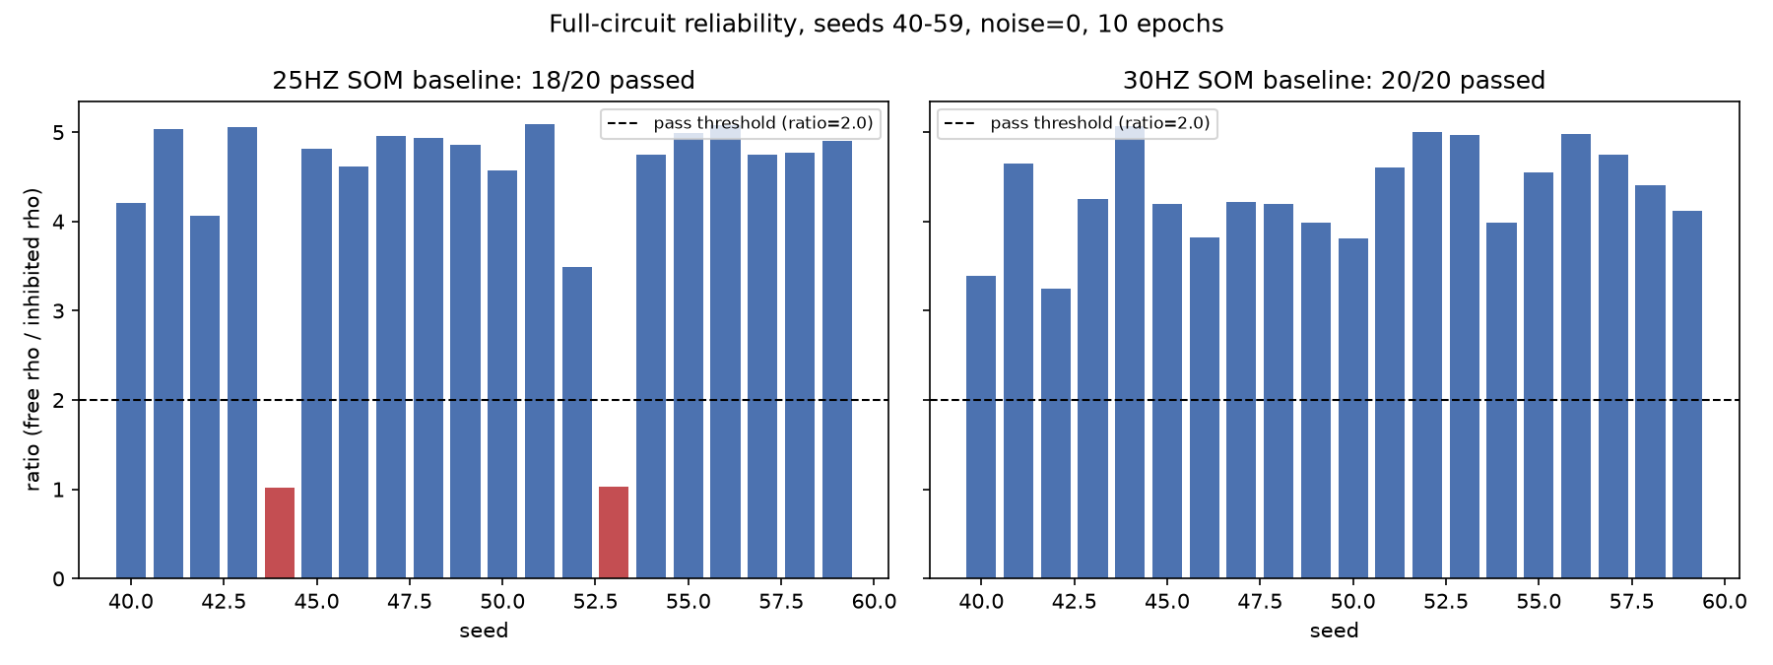
Reliability check: does 25 Hz actually hold up?
20 seeds (40-59), full circuit, noise = 0.
25 Hz: 18 / 20 seeds pass
(seeds 44 and 53 both fail,
ratio ~1.02 - a real ~10% failure
rate, not a fluke)
30 Hz: 20 / 20 seeds pass
(ratios 3.25 - 5.07)
Result: SOM baseline relocked to 30 Hz.
This is the current committed default.

Slide 17
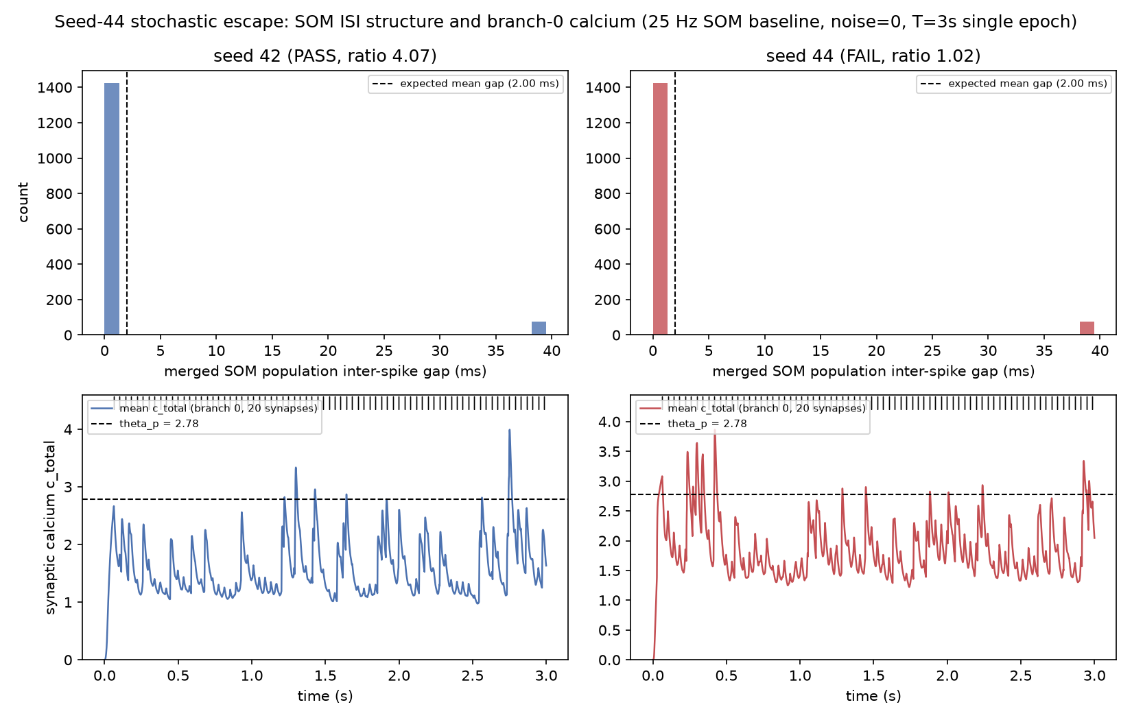
What actually differs in a failing seed?
Seed 42 (pass, ratio 4.07) vs.
seed 44 (fail, ratio 1.02), both at 25 Hz.
SOM inter-spike-gap histograms:
statistically indistinguishable between
the two seeds - the clean "SOM got an
unlucky gap" story does NOT show up here.
What DOES differ: seed 44's calcium trace
sits higher and crosses the LTP threshold
more persistently through the run.
Honest status: escape is real, mechanism
only partially characterized - not a
single isolated cause yet.

Slide 18
Where things stand right now
• Model: Model A (Brian 2), SOM baseline = 30 Hz, Yang's real Eqs. 32-35 plasticity.
• Reliability at current baseline: 20/20 seeds, full circuit, noise = 0.
• Both papers' core wiring/mechanism replicated and independently checked
• (dendritic I/O formula match, V2-V4 battery, Zhang MD->interneuron direction).
•
• What this demonstrates so far: the gating mechanism is real, mechanistically
• grounded, and now stress-tested for reliability - not just a single lucky seed.
• What it does NOT yet demonstrate: MD-gated plasticity at network scale, or any
• of the novel predictions that would be this project's actual contribution
• beyond replicating the two source papers.

Slide 19
Proposed next steps
• Near-term (finish what's already open):
• 1. Characterize the seed-44-style escape mechanism properly - larger seed batch,
• test whether it's SOM-timing-specific or a joint SOM/excitatory-drive coincidence.
• 2. Diagnose Test 5 (reproducibility) - same seed currently gives different output.
• Blocks fully trusting any single headline number until resolved.
• 3. Reconcile the 3 disagreeing Phase-1 ratio measurements (43 / 64.8 / 42.76) -
• likely the same root cause as (2), worth confirming together.
•
• Medium-term (before claiming novel results):
• 4. Resolve the Graupner-Brunel/Yang parameter provenance gap - several plasticity
• constants have no traceable published source in this codebase's history.
• 5. Decide on Models B/C (NumPy prototypes) - repair to match Model A, or retire.
•
• Longer-term (the project's actual novel contribution, per the roadmap):
• 6. Scale to a network (Yang's ~3000-neuron regime) - currently 1 soma/2 branches.
• 7. Test no-catastrophic-forgetting: learn context A, switch to B, verify A retained.
• 8. A healthy vs. pathological (schizophrenia-framed) phase diagram at network scale.

Slide 20
Open questions for discussion
• 1. Calibration gap: the model needs SOM to deliver ~2x Yang's rate (>=~21 Hz vs.
• ~10 Hz) and, on the conductance axis, gating never recovers at Yang's own SOM
• rate even at 6x his GABA conductance spec. Is this a defensible 'this spiking
• implementation's own operating regime,' or does it point to a miscalibration
• further upstream (e.g. NMDA/calcium sensitivity) that should be revisited?
•
• 2. How much weight should the seed-44 reliability finding carry? It's a real
• ~10% failure rate at 25 Hz, resolved by moving to 30 Hz - but the mechanism
• is only partially characterized. Worth a deeper mechanistic dig before
• treating 30 Hz as final, or is empirical 20/20 reliability sufficient to move on?
•
• 3. Prioritization: diagnose reproducibility (Test 5) and parameter provenance
• first, or proceed toward network scale and treat those as caveats to flag
• rather than blockers?
•
• 4. Is the current scope of 'borrowing Zhang's wiring labels only' sufficient for
• the project's claims, or does the novel contribution need more of Zhang's
• model (e.g. the PFC<->MD feedback loop) to be defensible?

