Slide 1
Thalamocortical Gating Project
Model Progress, Phenomenological vs Mechanistic Approaches, and New Protocols

Slide 2
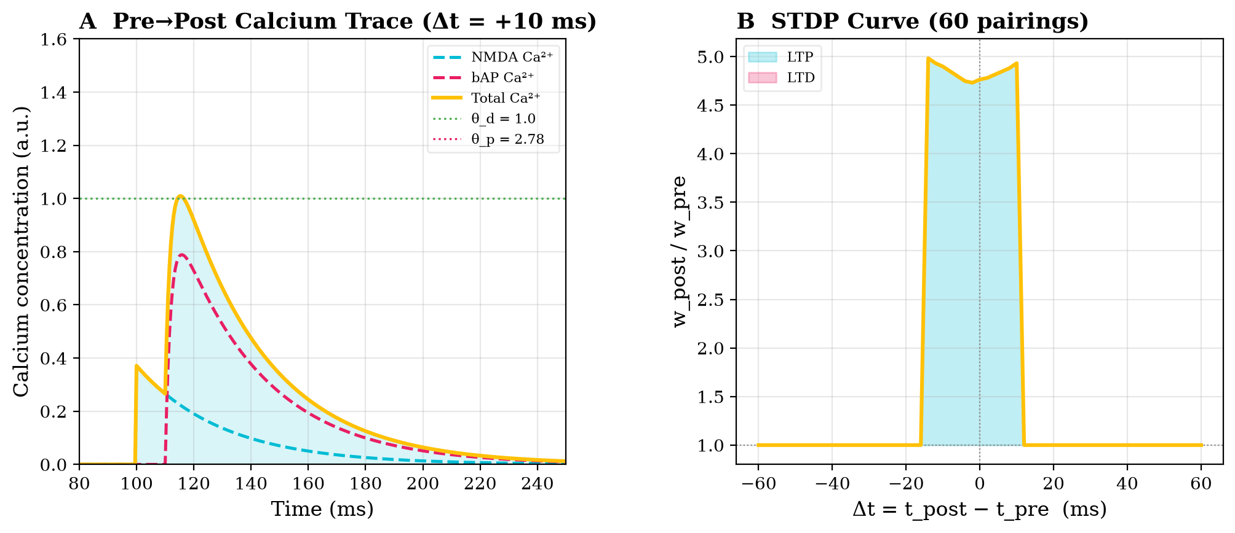
1. Phenomenological Model: Calcium Plasticity

Slide 3
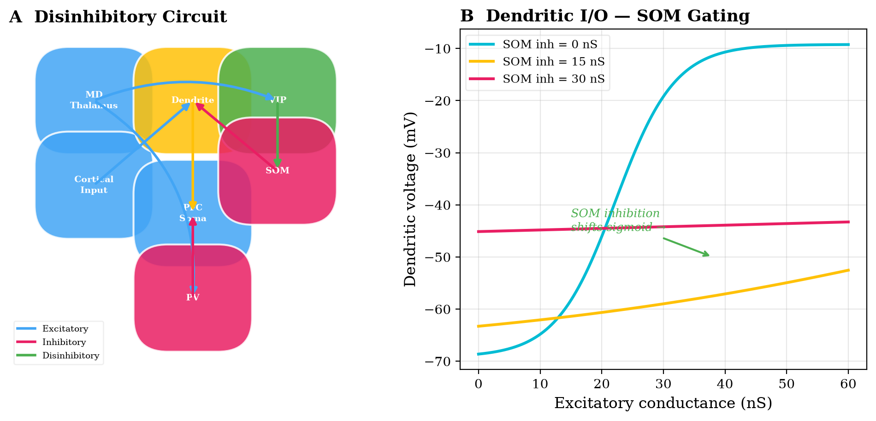
2. Phenomenological Model: Dendritic Gating

Slide 4
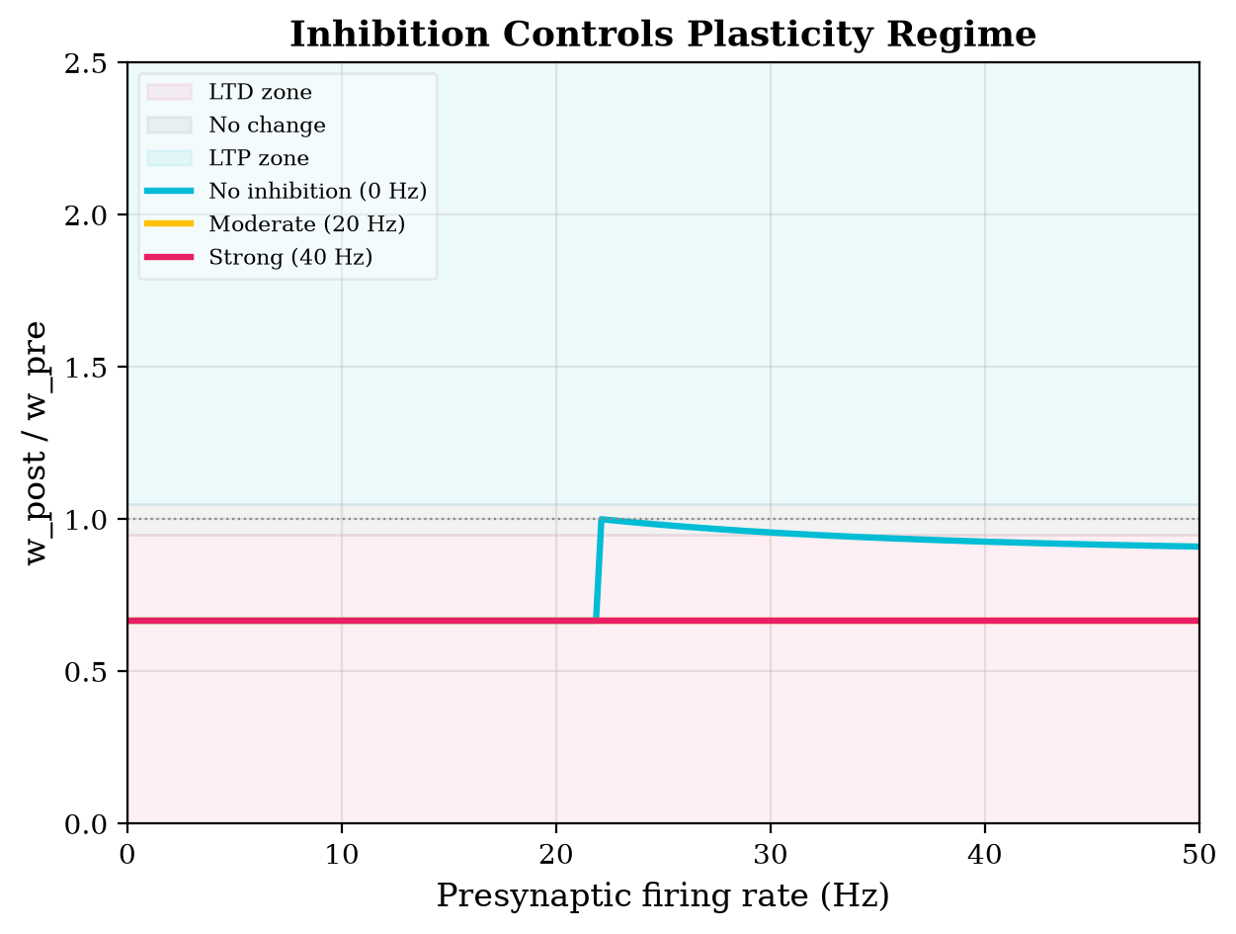
3. Phenomenological Model: Inhibition vs Plasticity

Slide 5
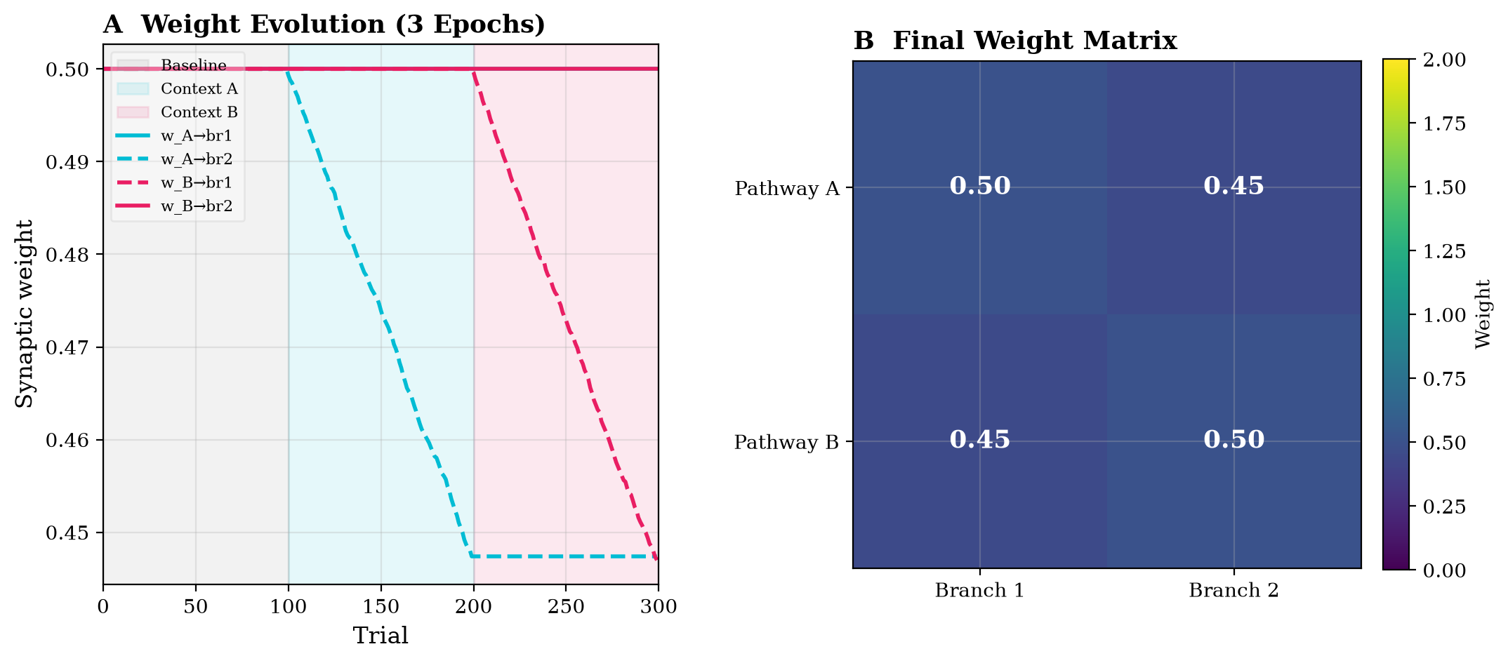
4. Phenomenological Model: Branch-Specific Learning
Original Approach (Yang et al. 2016):
• Uses hardcoded inhibition values (e.g., 2 nS vs 35 nS) to force gating.
• Proves the mathematical concept of Graupner-Brunel plasticity.

Slide 6
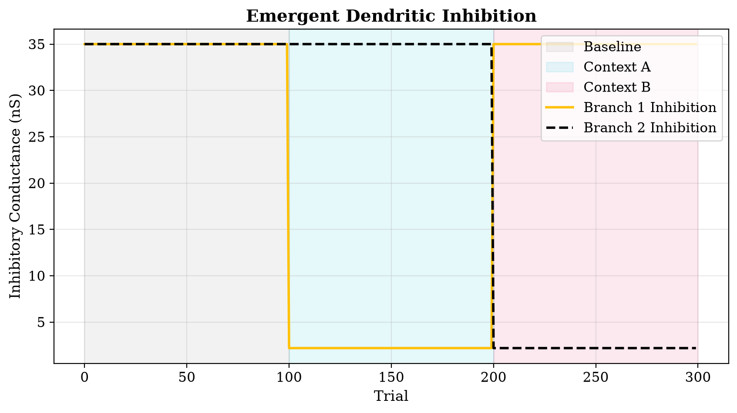
2. The Emergent Mechanistic Model
Our New Mathematical Architecture:
• Inhibition is dynamically calculated using firing rates: MD Thalamus -> VIP -> SOM.
• VIP successfully suppresses SOM, dropping dendritic inhibition organically to ~2 nS.

Slide 7
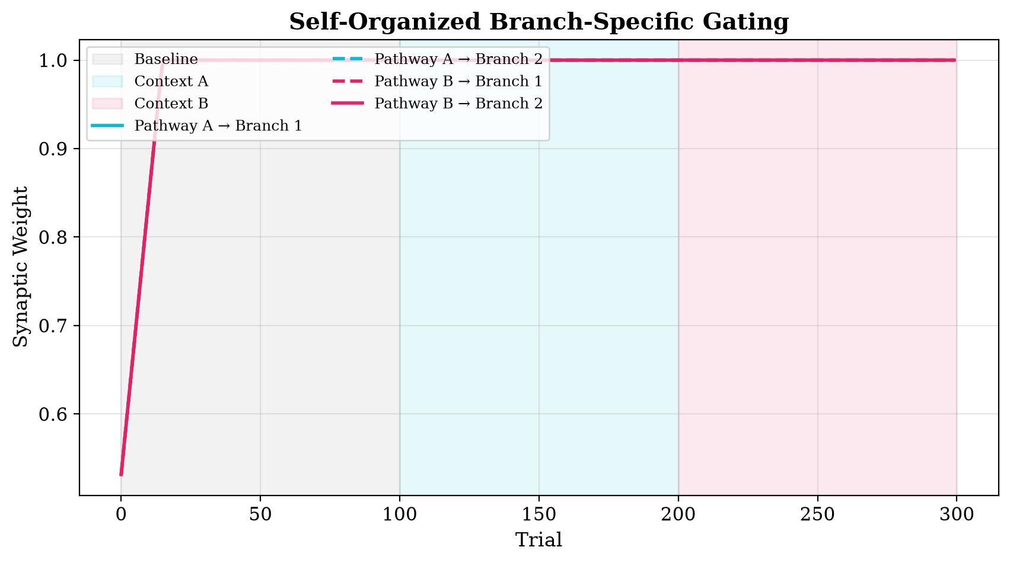
3. The New 3-Epoch Protocol
Continuous 300-Trial Simulation Paradigm:
• Baseline (0-99): No MD drive, SOM inhibition at maximum.
• Context A (100-199): MD activates VIP 1. Branch 1 learns.
• Context B (200-299): MD activates VIP 2. Branch 2 learns.

Slide 8
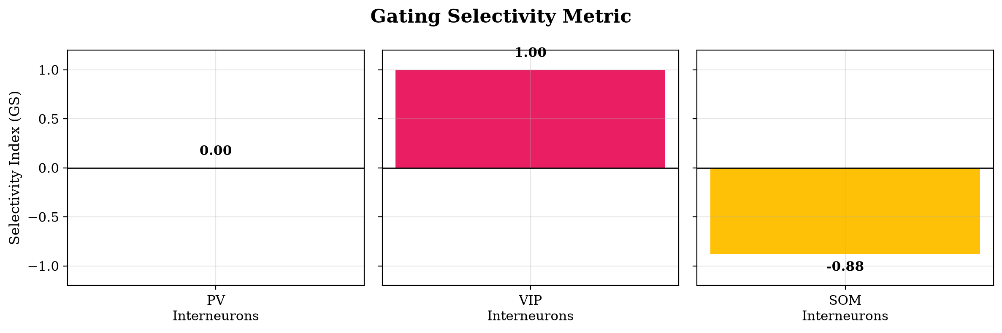
4. Gating Selectivity Index (GS)
Quantifying interneuron behavior:
• VIP GS = 1.00 (Highly selective for preferred context)
• SOM GS = -0.88 (Anti-selective, strongly suppressed by VIP)
• PV GS = 0.00 (Global, non-selective drive)

Slide 9
5. Future Directions
Inject Biological Realism:
  Introduce stochastic variance (Gaussian noise) to firing rates and synaptic weights.
Signal-to-Noise Ratio (SNR) Paradigm:
  Test the circuit's ability to fork pathways in high-noise vs low-noise surroundings.
Simulate Ketamine/NMDA Hypofunction:
  Degrade MD->VIP synapses and observe emergent gating failure (Schizophrenia model).

