Slide 1

Risk Driven V&V of Software System Bank Application
Priyanka Deoskar
Devang Parekh
Sagar Chavan
Jobin Kanichirayil George
Liang

Slide 2
Roles:
Devang Parekh - Withdraw Money
Jobin Kanichirayil George - View Balances
Liang Shen - Transaction History
Priyanka Deoskar - Deposit Money
Sagar Chavan - Credit Transactions

Slide 3

System Introduction
Bank Application
A simple bank application that allows users to deposit money, withdraw money, view their balances, credit transactions, view transaction history and login via user authentication.

Slide 4
Unique Hardware/Software needs to develop and implement this system
Hardware Needs :
The user should have the app installed on their local machine. The app shall work for Python 3.9 and newer versions. The system running the application has to be maintained, monitored and patched. Software Needs : We need the software to be kept updated with the latest version code. The application is currently written in python and we plan on developing newer features using the same. There are going to be unit and system tests designed around it and we plan on using CI CD platforms to manage rollout and automation.

Slide 5
Features/capabilities
View Balance: The user should be able to view their bank account balance.
Deposit Cash : The user should be able to deposit money to his account.
Withdraw Cash : The user should be able to withdraw the specified amount from their account. The withdrawal amount is checked to be a valid number meaning that the withdrawal amount should be less than the account balance.
Transaction History : The app keeps track of the previous transactions carried out by the user in records for underwriter purposes in furue credit or loan and lease needs.
Credit Transactions : The application approves or rejects a “credit” transaction based on a set credit limit.
Authentication: Have a user enter credentials to start the application before they can use any features.

Slide 6
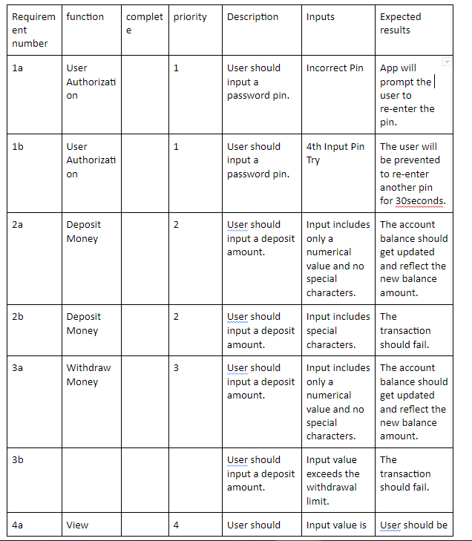
Test Cases and V&V

Slide 7
Risk-Driven Requirement V&V

Slide 8
Traceability Matrix for Withdraw Money from Bank CLI - Risk Score - Capability 1
Sr No Risk Associated Comments Risk Number L x C Score
1 Not sure if the user is the intended user. (no MFA ) High Risk 5 x 5 25
2 User tries to withdraw more than current balance Medium Risk 3 x 5 15
3 Risk of user enter wrong number High Risk 5 x 5 25
4 Risk of user entering wrong currency High Risk 5 x 5 25
5 Risk of user making any typo or Medium Risk 3 x 5 15

Slide 9
Mitigation strategy for Withdraw Money discussed risk - Capability 1
We can reduce impact of the high risk by having a multi factor authentication feature implemented in the banking application
It is a medium risk if the user tries to withdraw more than the balance amount form the bank. We should ideally place a check that does not permit this operation, and also does not crash the banking application.
Another risk is user enter the wrong number, currency or space will either result in the wrong amount being withdrawn by the user, or it can result in a cancelled transaction. We want to avoid either of these by having enough input validations so that the user does not enter wrong text.
Alternatively the user should be provided with an option to correct the entered text in case they change their mind or find out there was a mistake while trying to withdraw the amount.

Slide 10
Requirements of withdrawing balances - Capability 1
Risk Driven Requirements V&V
We need to have a hard requirement on the authentication feature set up
We need to ensure the withdrawal operations are tested end to end and that illegal withdrawal operations are not allowed. We need to setup testing plans so that each operation can be tested.
Ensure we have enough testing plans setup to make sure the all inputs are validated. We will have to

Slide 11
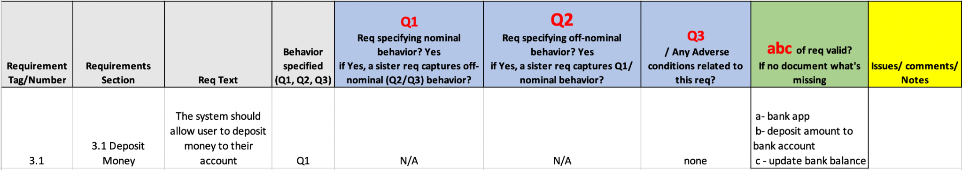
Capability: Deposit Money
The system should allow user to deposit money to their account
Traceability Matrix:

Slide 12
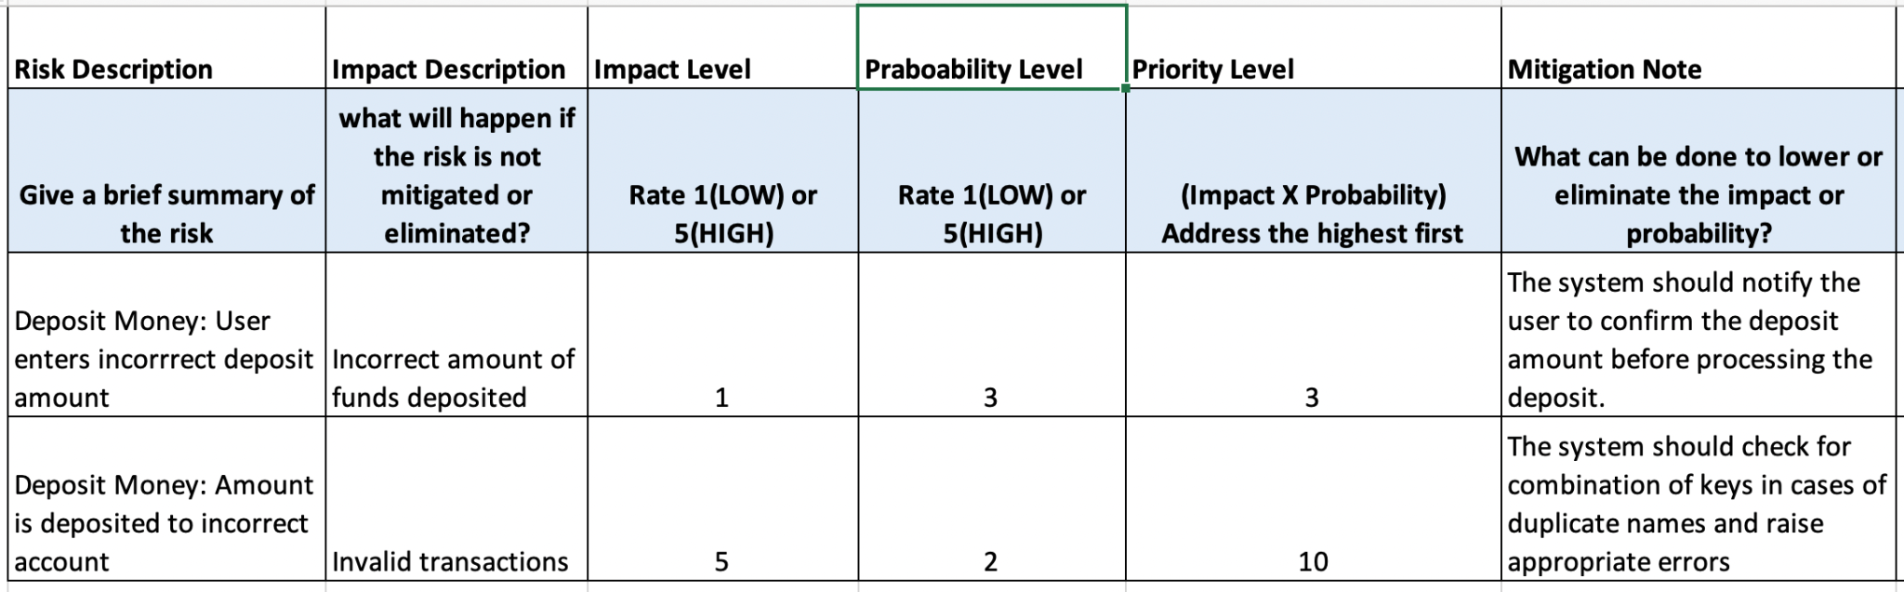
Risk Model

Slide 13
Mitigation strategy for Risks Involved with Deposit Money
A high impact risk is related to colliding usernames that may lead to error conditions or invalid transactions. We can mitigate this risk by putting plenty of checks for a combination of keys to ensure that the input amount is deposited to the appropriate account and if need be then raise relevant errors so the user can be notified.
Another risk is that a user may enter the wrong value, currency or invalid characters that may result in the wrong amount being deposited by the user. The mitigation strategy is to avoid such a condition by implementing enough input validations so that the user does not enter a wrong value.

Slide 14
Mitigation strategy and Risk Involved to View Balance
Authentication is the highest risk associated with view balance.It could be reduced by using MFA.Everyone uses mobile application for banking purpose so Face recognition one method to reduce the risk. Email notification or phone message notifications are integrated for MFA. This would help to prevent unauthorized access.
Current View balance should work when the user click on it.Application should not be frozen. It should bring accurate balance.All transaction history should be up to date and it should be tracked

Slide 15
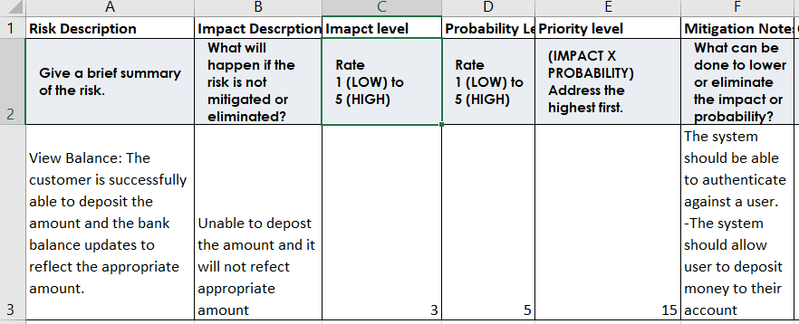
Risk Model

Slide 16
Requirements for View Balance.
1. MFA feature should be incorporated, and it should be monitored
2. Transactions should be tracked and updated so that accurate balance would be displayed.

Slide 17
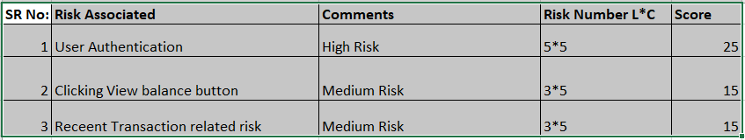
Traceability Matrix for View Balance

Slide 18
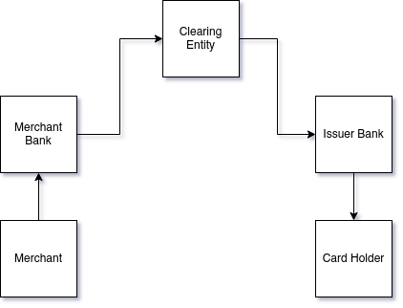
Credit Transaction

Slide 19
Credit Transaction Requirements
Objective: Provide an interface/API to the bank to process credit transaction.
CAPABILITIES: Credit card transaction processing
Requirements:
1. Validate the provided authentication and authorization parameters
2. Process payments for given transaction
3. Maintain credit balance
4. Show credit transaction history

Slide 20
Credit Modules Risk Models.
Risk | Description | Likelihood | Impact | Score | Mitigation Strategy
1 | Card number is not valid or is not present in the system | 1 | 4 | 4 | Given the low likelihood we accept the risk, and reject the transaction
2 | Card security pin is not valid | 3 | 2 | 5 | Reject the transaction and inform the user of incorrect transaction
3 | Card holders name is not valid | 1 | 2 | 2 | Bank accepts the risk while informing the user to review before final approval
4 | Insufficient balance | 2 | 5 | 10 | If customer in good standing(external logic) and less than a certain threshold accept risk else Reject transaction. Also add a point for good standing calculation in there future

Slide 21
Credit Modules Unit Tests
Risk | Description | Score | Tests
1 | Card number is not valid or is not present in the system | 4 | test_reject_transaction_if_missing_param
2 | Card security pin is not valid | 5 | test_reject_transaction_if_missing_param test_reject_transaction_if_invalid_pin test_accept_if_pin_valid
3 | Card holders name is not valid | 2
4 | Insufficient balance | 10 | test_reject_transaction_if_tran_more_than_balance test_aprove_transaction_when_tran_less_than_balance

Slide 22
Credit Transaction Integration Tests
Scenario 1: Card Number and Pin mismatch.
The transaction will fail as we need to have the right card number and pin number for the transaction.
Scenario 2: Insufficient Balance.
The transaction will fail as we need to have enough balance to make the
transaction
Scenario 3: Right credential and sufficient balance.
All required condition for a transaction are met.

Slide 23
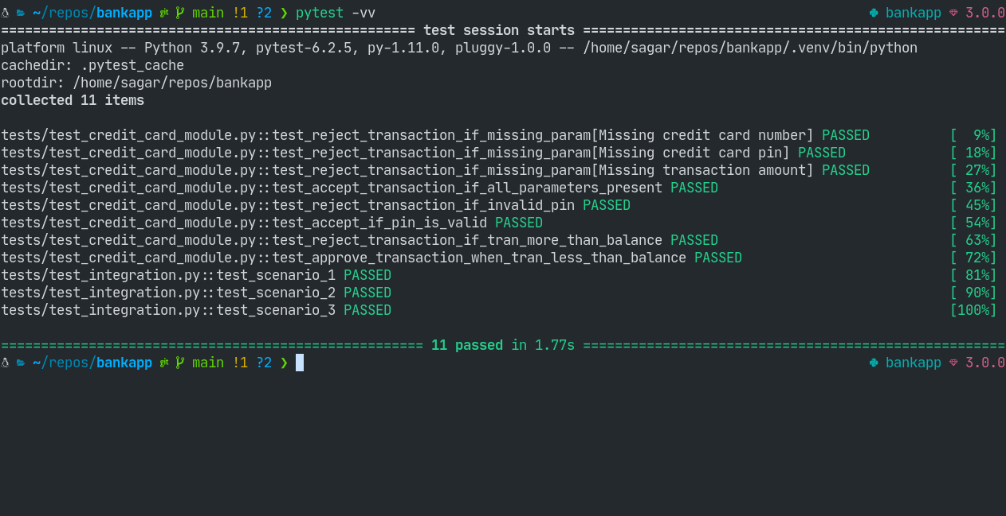

Slide 24
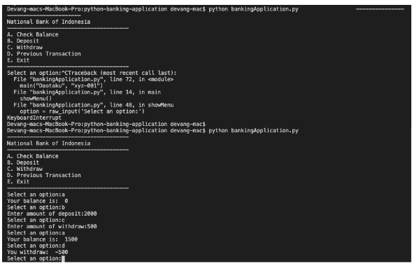
Screenshot and User Interaction

Slide 25
Link to the project repo
https://github.com/parekhdevang/Bank-app

Slide 26


