Slide 1
Tesla: Part Demand Case Study
By: Ronak Parekh
8/23/2017

Slide 2
Executive Summary
High level information and trends in the data given
Output of the forecast model
Takeaways from the forecast
Questions we’d like to ask
Improvements and scale

Slide 3
The Data Given
In this dataset we are looking at the ordering history of 26 different service parts
The date range is from mid-2015 to mid-2017
The data is aggregated at a weekly level

Slide 4
Trends in Parts Ordered Per Week
During the holidays, significantly fewer parts are ordered
General upward trend in total number of parts ordered
Week-over-week variance in parts ordered has increased over time

Slide 5
Parts trend differently
Some parts trend very differently from the overall numbers, thus we should make forecasts on an individual part level

Slide 6
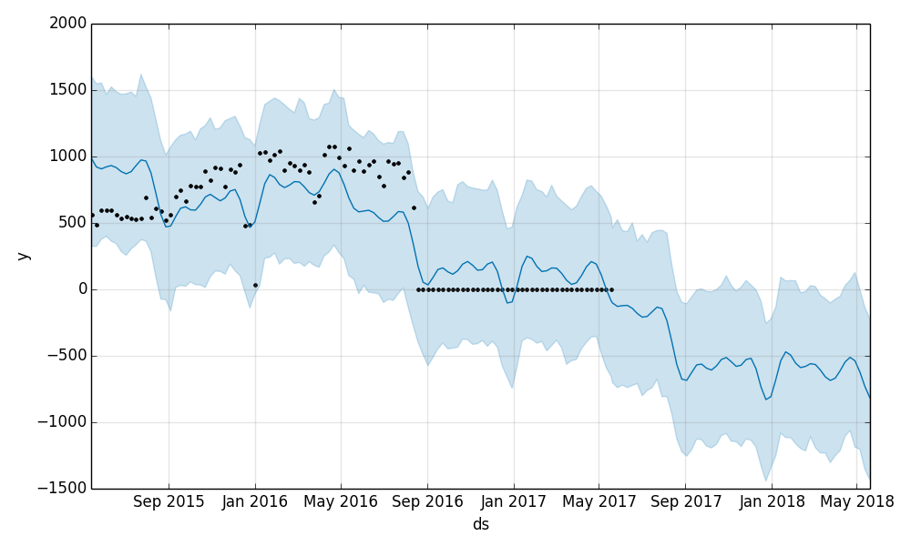
Model Adjustment
Part_4 Forecast visualization:
Black dots are historic data given
Blue line is forecast line & Error Range
In this example forecast, the number of parts we expect to order in the future is actually a negative number. From a business standpoint, this output doesn’t make sense. We will adjust the output such that whenever the model outputs a negative number, we will change it to 0.

Slide 7
Aggregate Part Order Forecast
History
Based on our forecast model, to the right is a graph that shows how the historical data given looks like compared to our 1 year forecasted output for the sum of all 26 parts
The general shape of the forecast continues to go up and relatively look like what we would expect
In the Forecast_parts.csv document, are the projections for how many parts will be ordered per week for each individual part.
Forecast

Slide 8
Questions to improve this model
Would it be possible to see which parts are only used for the Model S vs. the Model X vs. other Tesla products?
Would it be possible to see which parts may be deprecated ahead of time?
Would it be possible to see which vehicle_id each part was ordered for?
Would it be possible to get vehicle sales data, to help predict future part needs?

Slide 9
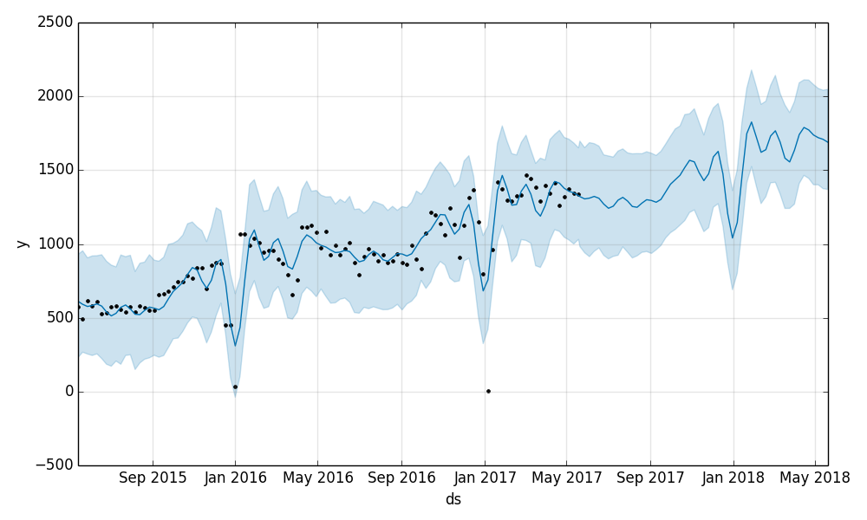
Further Improvements
Part_1 Forecast visualization:
Black dots are historic data given
Blue line is forecast line & Error Range
Greater emphasis on the holiday period, our forecast clearly isn’t low enough for those dates
Some parts don’t contain enough of an ordering history for us to make an accurate long-term forecast. We could possibly move to a moving average model for these parts instead
If it would be possible to get data on a daily level, we can preform a more robust Time Series Analysis

Slide 10
Formalize and Scale
Fortunately the model we are using to make forecasts take into a number of different techniques (linear regression, ASIMA, time series etc.) so from a technical/operational standpoint this should scale easily. However, we still need for formalize a few topics before applying this to thousands of parts and making important decisions off of:
Set up a system of A/B testing different forecast models to ensure we are always making the best predictions we can
Have a process for incorporating new data (ex. car sales data)
Create a system to monitor forecasts with actual ordering habits
Determine how the results of the forecast should be communicated and shared with stakeholders, and at what cadence
Understand how stakeholders will use this data, to ensure we have a product that meets their needs (should we move away from a pre-built modeling package?)

