Slide 1
Storage AI
An Intelligent, Explainable Storage Cleanup Assistant
Academic project — AI at the Application Level · storage_ai/

Slide 2
MOTIVATION
The problem this project solves
• Storage fills up silently: duplicate files, stale downloads, unbounded logs and caches.
• Manual triage is slow and risky — which files are truly unused? which app owns this data?
• Goal: an assistant that finds, explains, and safely acts on cleanup opportunities.
• Built as an academic project on “AI at the Application Level.”
Storage AI · Motivation

Slide 3
DESIGN PHILOSOPHY
Classical, explainable AI — not an LLM by default
• Every recommendation traces back to a concrete, inspectable reason.
• Content hashing, weakly-supervised classification, linear regression, K-means clustering.
• A local LLM appears exactly once, as a narrowly-scoped last resort (Section 8) — never the default path.
• No API keys, no GPU, no network calls at runtime — fully offline and reproducible.
Storage AI · Design philosophy

Slide 4
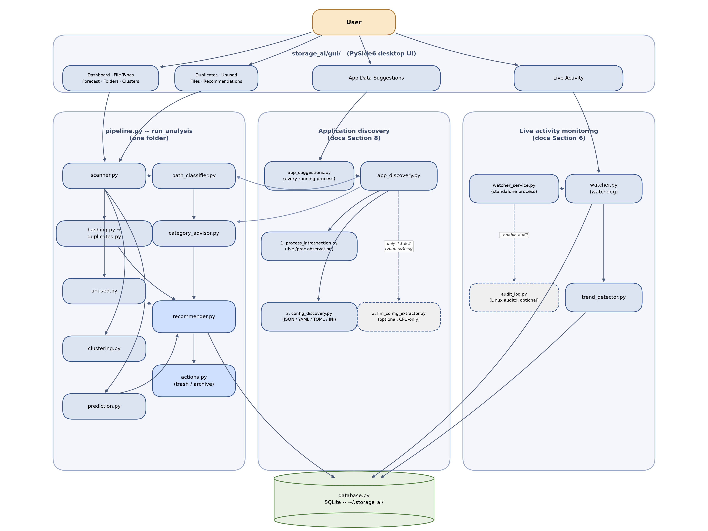
ARCHITECTURE
Two orchestrators, one shared store
Storage AI · Architecture · see docs/architecture.png

Slide 5
CORE ANALYSIS
Duplicate detection & unused-file scoring
• Duplicate detection: size → partial-hash → full-hash funnel — only real candidates get fully read.
• Unused-file scoring: a RandomForestClassifier trained on weakly-labeled access patterns.
• Falls back to a pure heuristic when there isn't enough data to train a real model.
• Produces a 0–1 “likely unused” score per file — informational only, never auto-deleted.
Storage AI · Core analysis

Slide 6
CORE ANALYSIS
Growth forecasting & file clustering
• Storage growth forecasting: linear regression over real scan history, or a file-timestamp pseudo-history on a first scan.
• K-means clustering groups files by size and staleness into archetypes like “Large & Stale.”
• An unsupervised cross-check, independent of the unused-file classifier — not a duplicate of it.
• “No growth trend detected” is a correct answer, not a bug, when there's no signal to extrapolate.
Storage AI · Core analysis

Slide 7
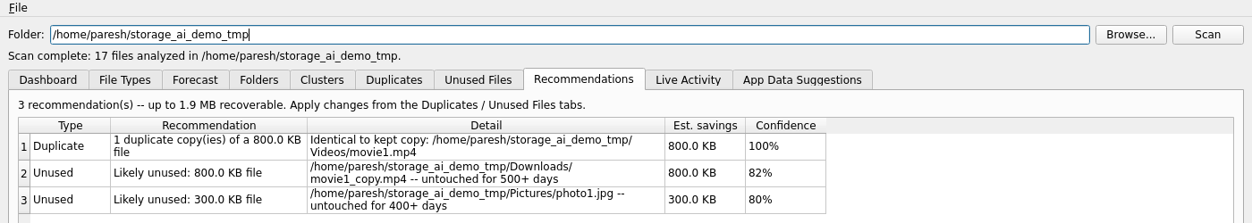
CORE ANALYSIS
Path classification & ranked recommendations
• Every file tagged: system · log · cache · application_data · user_data · trash · other.
• Known-service bonus label (e.g. /var/lib/postgresql → PostgreSQL) with tailored advice.
• Duplicates, unused files, storage warnings, and category advisories merge into one ranked list.
• Sorted by estimated space recovered, each row backed by a concrete reason.
Storage AI · Real screenshot: a genuine demo scan (duplicate + 2 unused files, 1.9 MB recoverable)

Slide 8
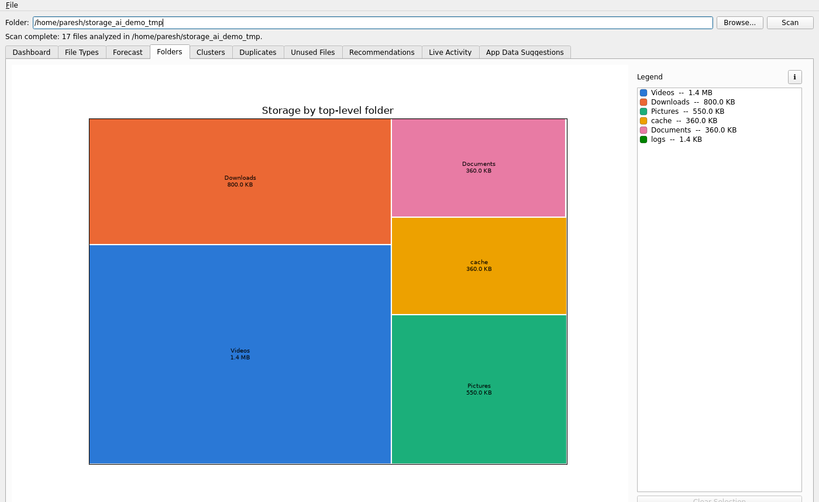
CORE ANALYSIS
Visualization — and provenance on demand
• Dashboard, File Types, 30-day Forecast, Folder treemap, and Cluster scatter — one story per chart.
• Every chart's ℹ button now shows the real directories behind a total, not just an opaque number.
• E.g. “User data: 1.3 GB” becomes an actual, inspectable list of folders on click.
• legend_detail.py: one small module, reused unchanged across four structurally different charts.
Storage AI · Real screenshot: top-level folder treemap from a genuine demo scan

Slide 9
SAFETY
Safe by default, reversible by design
• Cleanup actions send files to the OS trash or a local dated archive folder — never a hard delete.
• Files under a live service's data directory, or real OS system paths, are never offered as candidates.
• An advisory can only ever suggest — no advisory string can itself trigger a delete or archive.
• A storage tool that's occasionally wrong about “unused” must stay recoverable.
Storage AI · Safety

Slide 10
LIVE MONITORING
Real-time activity monitoring (Section 6)
• Cross-platform create/modify/delete watcher (watchdog) — runs from the GUI or as a standalone service.
• Rate-based trend alerts: large file added, rapid deletes by one user, activity bursts.
• Alerts fire on plain, explainable thresholds — not a learned model.
• Optional Linux auditd integration upgrades attribution from “who owns this file” to “who actually did this.”
Storage AI · Live activity monitoring

Slide 11
APPLICATION DISCOVERY
How does it find an app it's never been taught? (Section 8)
• The core question: config files live in different places per app — how to find storagePath generically?
• 1. Live process introspection (/proc) — real command-line flags and open files, not a claim.
• 2. Structured config-file parsing — JSON, YAML, TOML, INI, fuzzy-matched for path-like settings.
• 3. The curated known-service table — classification, not discovery (the opposite direction).
• 4. An optional local, CPU-only extractive-QA model — a last resort, only for the residual case.
Storage AI · Application discovery · docs/METHODOLOGY.md Section 8

Slide 12
APPLICATION DISCOVERY
Real bugs found — not hypothesized
• Question-phrasing brittleness: identical text, different question wording, wildly different extraction quality.
• Span imprecision: naive token decoding fragmented paths (“mongo - storage”) — fixed with offset-mapping.
- A verified hallucination: the model reported 0.47 confidence extracting an answer from text with NO path in it at all.
• Fix: a mandatory, deterministic path-shape check — independent of confidence — locked in as a regression test.
Storage AI · Application discovery · empirically calibrated, not just implemented

Slide 13
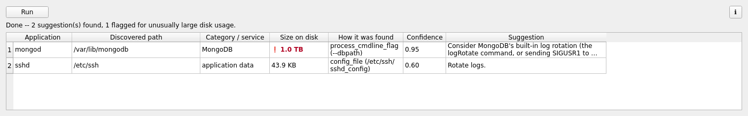
APPLICATION DISCOVERY
App Data Suggestions — batched across the whole machine
• app_suggestions.py reuses app_discovery.py unchanged, once per distinct running process.
• Only surfaces a finding if it maps to real advisory text — stays a short, actionable list.
• The discovered path's real on-disk usage is measured and flagged if unusually large.
• Independent Run / Rerun and Stop controls, cancellable mid-run — same pattern as the main scan.
Storage AI · App Data Suggestions tab · real classification/advice/severity logic

Slide 14
APPLICATION DISCOVERY
Worked example: a 1 TB MongoDB data directory
• mongod is found running with --dbpath /var/lib/mongodb (tier 1, live process introspection).
• Classified via the curated table as MongoDB → generic advice: "Consider MongoDB's built-in log rotation..."
• A real filesystem walk of that path measures its actual size — deferred until after every cheaper filter already passed, so it's not wasted on findings nobody will see.
• 1 TB crosses the 50 GB "critical" threshold → the row is flagged ❗, bold, colored, and sorted to the top, ahead of every other finding regardless of discovery confidence.
• Previously the same finding would show identical advice whether it used 10 MB or 10 TB — the size check is what turns a generic tip into an actual priority.
Storage AI · Worked example · LARGE_SIZE_BYTES = 5 GB, CRITICAL_SIZE_BYTES = 50 GB

Slide 15
NOVELTY
What's actually new here — for the record
• None of the individual algorithms are new — hashing, random forest, K-means, linear regression, extractive QA are all textbook.
• Reliability-ordered discovery, not LLM-first — cheapest/most certain signal tried first.
• A deterministic gate around every non-deterministic component — applied independently in 3 unrelated subsystems.
• A single-app lookup reused unchanged as a whole-system inventory (zero new discovery logic).
• On-demand provenance for every displayed total, not just ML outputs.
Storage AI · Novelty · docs/METHODOLOGY.md Section 9

Slide 16
HONESTY
Known limitations
• Duplicate detection is exact-match only — near-duplicates are out of scope.
• Known-service labels are default-location hints, not verified facts — a custom install won't match.
• Without --enable-audit, activity attribution is file-ownership based, not per-operation.
• The LLM tier's own confidence score is not trustworthy alone — verified, not assumed.
• No feedback loop yet records a user's accept/reject decision on a suggestion.
Storage AI · Known limitations · docs/METHODOLOGY.md

Slide 17
VERIFICATION
Tested for real, not just implemented
• 215 automated tests — non-GUI logic, plus GUI logic exercised via offscreen Qt.
• Real subprocesses tested for /proc-based discovery — not mocked.
• The LLM tier tested against the real model — its calibration bugs are permanent regression tests.
• Fully offline: no network calls at runtime, no GPU, no API keys, no external services.
Storage AI · Verification

Slide 18
WHAT'S NEXT
Future work
• Multi-folder & scheduled scanning; incremental scanning for large, slow-changing trees.
• Detect and prefer an already-running local LLM (e.g. Ollama) instead of always bundling one.
• A feedback-loop table recording accept/reject on every suggestion — the prerequisite for personalization.
• Multi-host aggregation — a fleet-wide storage inventory across several machines.
Storage AI · Future work · see future_plan.md

Slide 19
Thank you
Questions?
docs/METHODOLOGY.md · ReadMe.md · future_plan.md

