Slide 1

Welcome to my YouTube channel Learn Loom

Slide 2
Dax Aggregation Functions

Slide 3
Aggregation Functions
FUNCTIONS & SYNTAX:
COUNT(<column>)
COUNTA(<column>)
COUNTAX(<table>,<expression>)
COUNTX(<table>,<expression>)
COUNTROWS([<table>])
COUNTBLANK(<column>)
DISTINCTCOUNT(<column>)
DISTINCTCOUNTNOBLANK(<column>)

Slide 4
Aggregation Functions
Description:
COUNT: Counts the number of rows in the specified column, excluding blank values(Datatype supports: Number, String, Date)
COUNTA: Counts the number of rows in the specified column, excluding blank values(it supports Boolean value also)
COUNTAX: Counts the number of rows in a table that results from applying a given expression or calculation to numeric, string, and logical values as well.
COUNTX: Counts the number of rows in a table that results from applying a given expression or calculation to numeric, string, and dates only.

Slide 5
Aggregation Functions
COUNTROWS: The COUNTROWS function determines how many rows are in the given table or a table that is defined by an expression.
COUNTBLANKS: This function counts only blank cells from the columns
DISTINCTCOUNT: Counts the number of UNIQUE values in a column(INCLUDES BLANK VALUE)
DISTINCTCOUNTNOBLANK: Counts the number of UNIQUE values in a column(EXCLUDES BLANK VALUES)

Slide 6
Aggregation Functions
COUNT COUNT_SUBJECT = COUNT(CLASS[SUBJECT])
COUNTA COUNTA_PASS = COUNTA(CLASS[PASS])
COUNTAX COUNTAX_MARKS = COUNTAX(FILTER('CLASS',[MARKS]>=56),CLASS[SUBJECT])
COUNTX COUNTX_PASS = COUNTX(FILTER(CLASS, [PASS]=TRUE),CLASS[ID])
COUNTROWS COUNTROWS = COUNTROWS(FILTER(CLASS, CONTAINSSTRING([NAME],"*K")))
COUNTBLANK COUNTBLANK = COUNTBLANK(CLASS[SUBJECT])
DISTINCTCOUNT DISTINCTCOUNT = DISTINCTCOUNT(CLASS[SUBJECT])
DISTINCTCOUNTNOBLANK DISTINCTCOUNTNOBLANK = DISTINCTCOUNTNOBLANK(CLASS[SUBJECT])

Slide 7
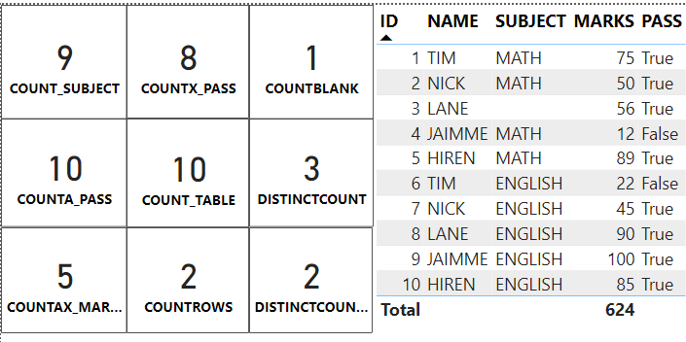
Aggregation Functions

Slide 8

References
https://learn.microsoft.com/en-us/dax
Thank you

