Slide 1

Dax Functions with Learn Loom

Slide 2
Aggregation functions
Function: MAX, MAXA, MAXX, MIN, MINA, MINX, PRODUCT, PRODUCTX, SUM, SUMX
Syntax:
MAX(<column>), MAX(<expression1>, <expression2>)
MAXA(<column>)
MAXX(<table>,<expression>,[<variant>])
MIN(<column>), MIN(<expression1>, <expression2>)
MINA(<column>)
MINX(<table>,<expression>,[<variant>])

Slide 3
Aggregation functions
PRODUCT(<column>)
PRODUCTX(<table>, <expression>)
SUM(<column>)
SUMX(<table>, <expression>)

Slide 4
Aggregation functions
MAX: The Max function returns the highest value in a column(does not support Boolean datatype)
MAXA: The Max function returns the highest value in a column(support Boolean datatype)
MAXX: This function returns the highest value in a table after evaluating the expression
MIN: The Max function returns the lowest value in a column(does not support Boolean datatype)
MINA: The Max function returns the lowest value in a column(support Boolean datatype)
MINX: This function returns the lowest value in a table after evaluating the expression

Slide 5
Aggregation functions
PRODUCT: This function returns the product of the numbers in a column.
PRODUCTX: This function gives back the result of an expression that is assessed for every table row.
SUM: This function returns the addition of all the numeric data from the column
SUMX: This function returns the addition of all the numeric data from the column after evaluating the expression

Slide 6
Aggregation functions
MAX: MAX_MARK = MAX(CLASS[MARKS])
MAXA: MAXA_DATE = MAXA(CLASS[DATE])
MAXX: MAXX_MARKS = MAXX(FILTER(CLASS, [MARKS] < 100), CLASS[MARKS])
MIN: MIN_MARK = MIN(CLASS[MARKS])
MINA: MINA_DATE = MINA(CLASS[DATE])
MINX: MINX_MARKS = MINX(FILTER(CLASS, [MARKS] > 56), CLASS[MARKS])
PRODUCT: PRODUCT_ID = PRODUCT(CLASS[ID])
PRODUCTX: PRODUCTX_MARKS = PRODUCTX(CLASS,[MARKS]*0.1)
SUM: SUM_MARKS = SUM(CLASS[MARKS])
SUMX: SUMX_MARKS = SUMX(CLASS, [MARKS]*2)

Slide 7
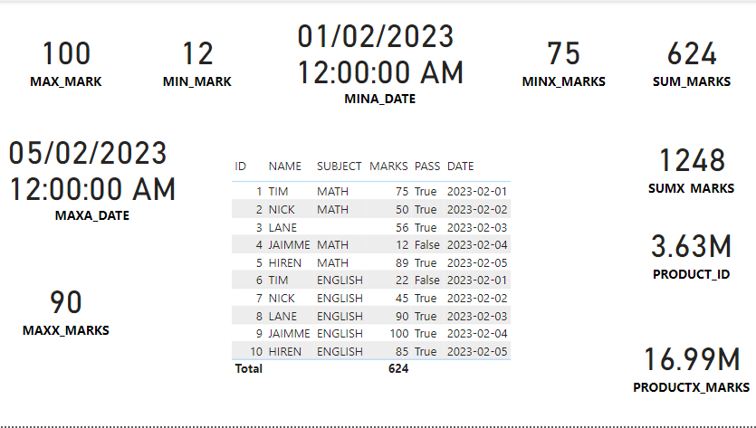
Aggregation functions

Slide 8

References
https://learn.microsoft.com/en-us/dax
Thank you

