Slide 1
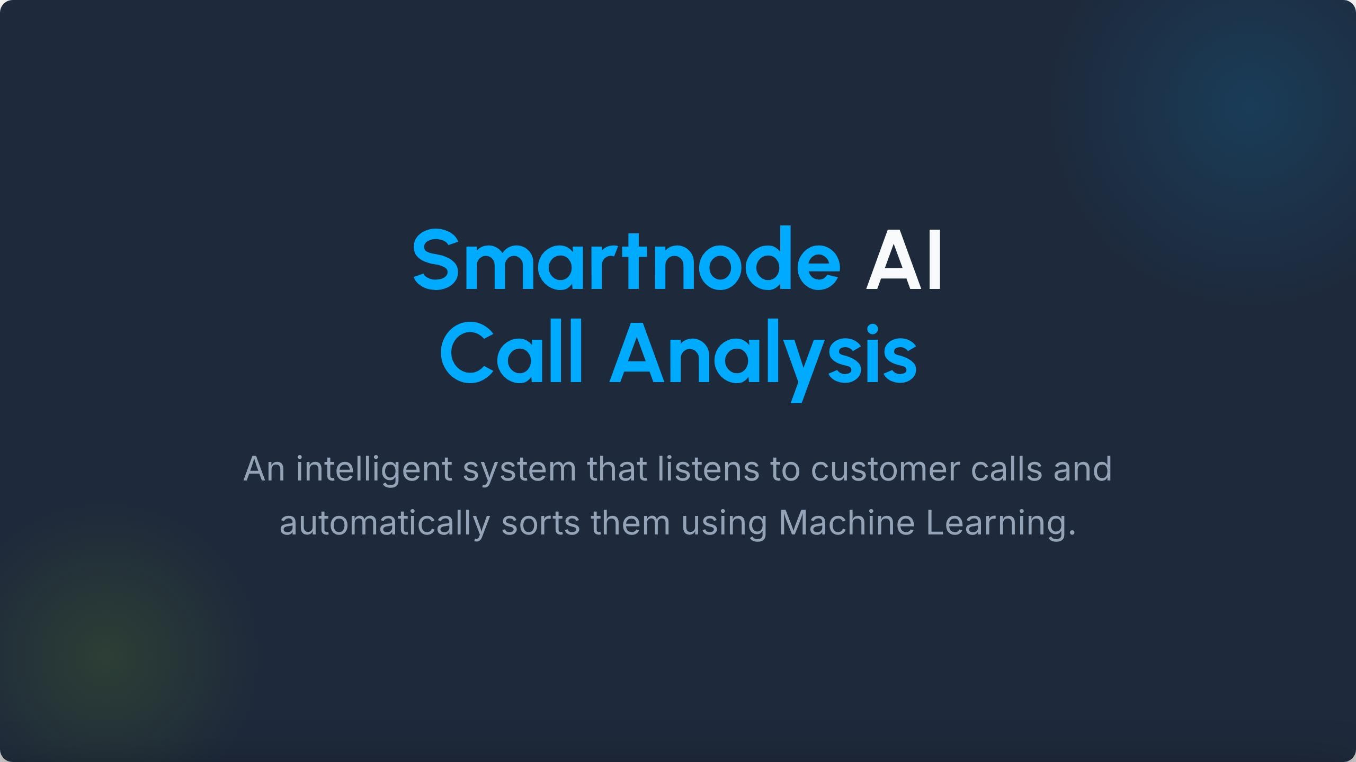

Slide 2
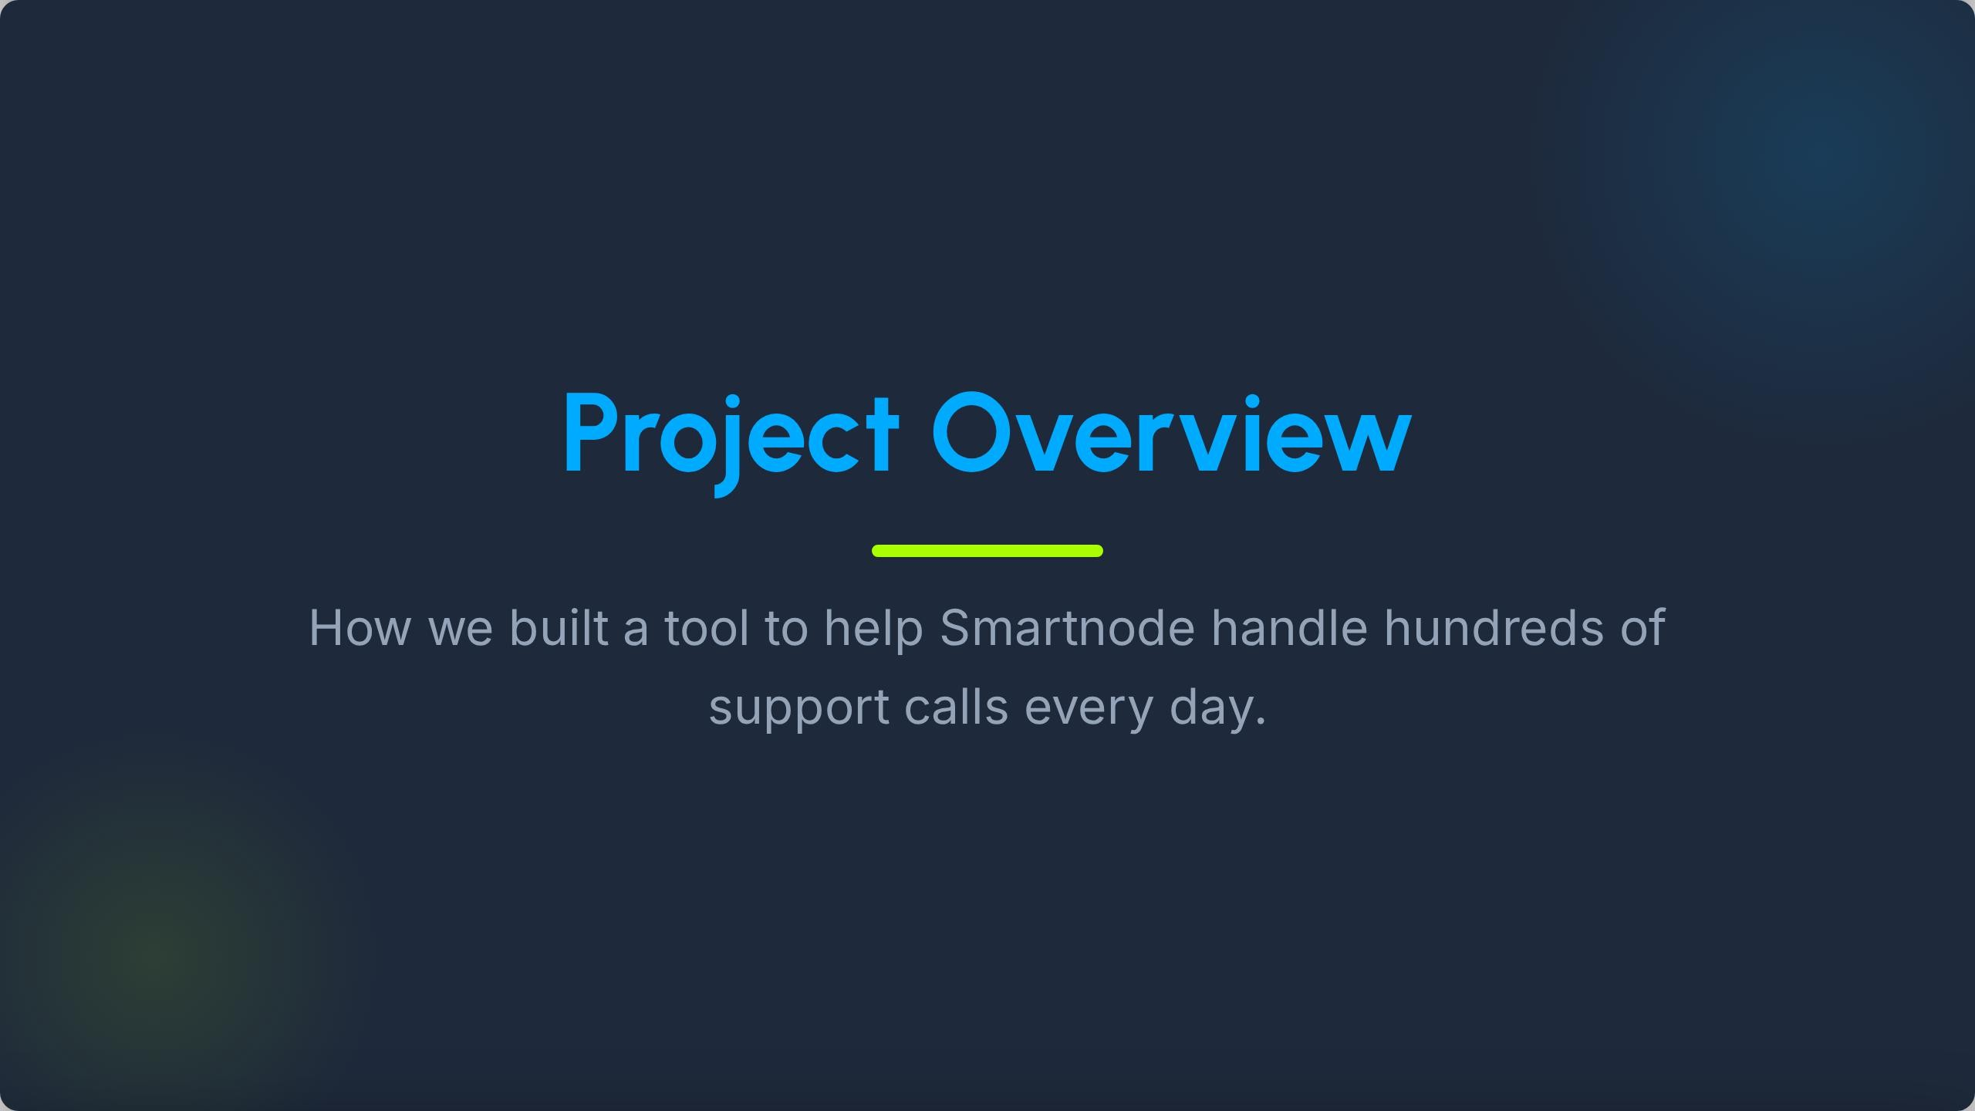

Slide 3
manually. It's slow and hard to stay
text and classifies them into helpful

Slide 4
Urgent
Open
Closed
emergencies, like broken
requests that need an
the customer is happy.

Slide 5
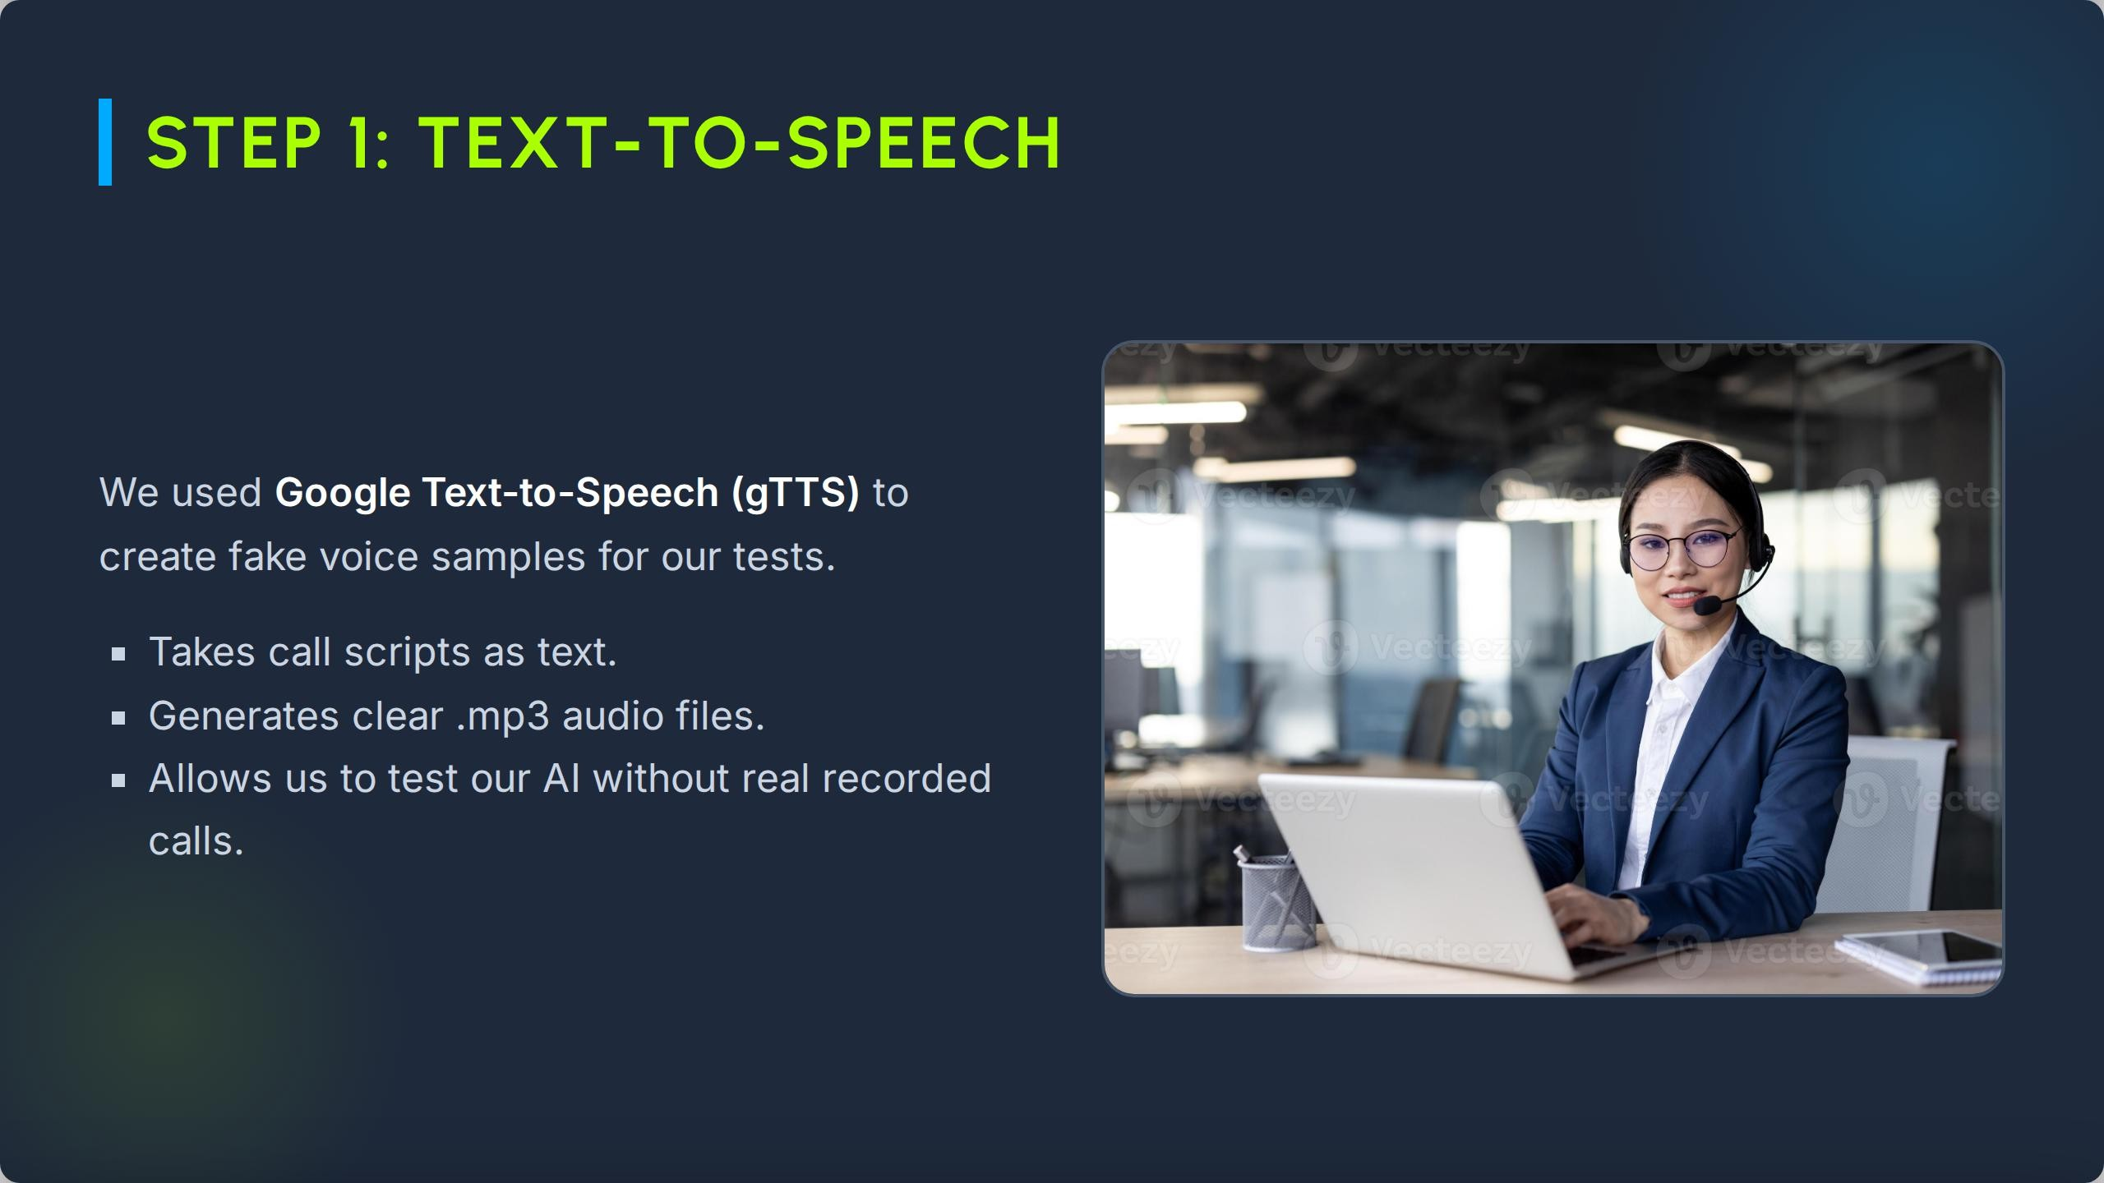

Slide 6
OpenAl Whisper
Whisper is a state-of-the-art Al model that converts speech into highly accurate written

Slide 7
Urgent Keywords:
Closed Keywords: Open Keywords:

Slide 8
STEP 4: SMART AI GUESSING
.‹ace
Advanced Thinking
Zero-Shot Classification

Slide 9
CLASSIFICATION ACCURACY
Rule-Based
Smart AI (Zero-Shot)
Rule -based was perfect for our test samples, while the AI proved it's highly capable of understanding general context.

Slide 10
CALL-001
Closed
Wi-Fi Module
Closed (Perfect)
CALL-003
Urgent
Door Lock Stuck
Urgent (Perfect)
CALL-005
Urgent
Hotel System Down
Urgent (Perfect)
CALL-006
Open
App Scene Bug
Open (Perfect)

Slide 11
Voice Input
Transcript
Sorting
Action

