Slide 1


Slide 2
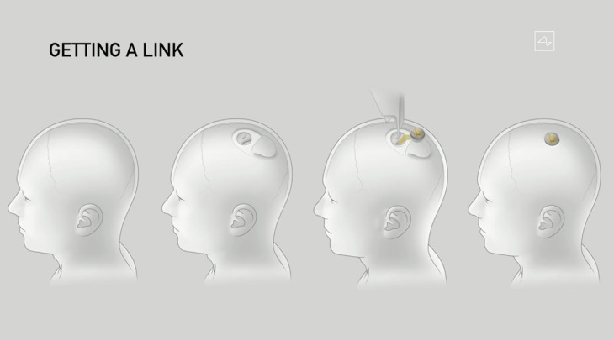

Slide 3


Slide 4
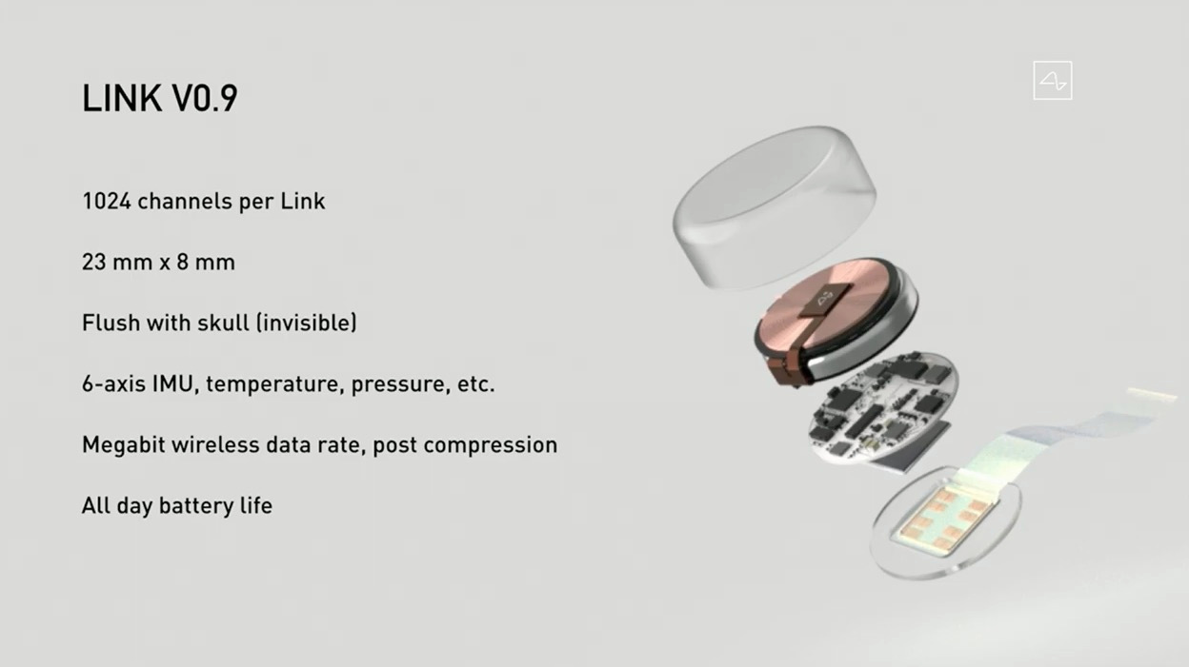

Slide 5
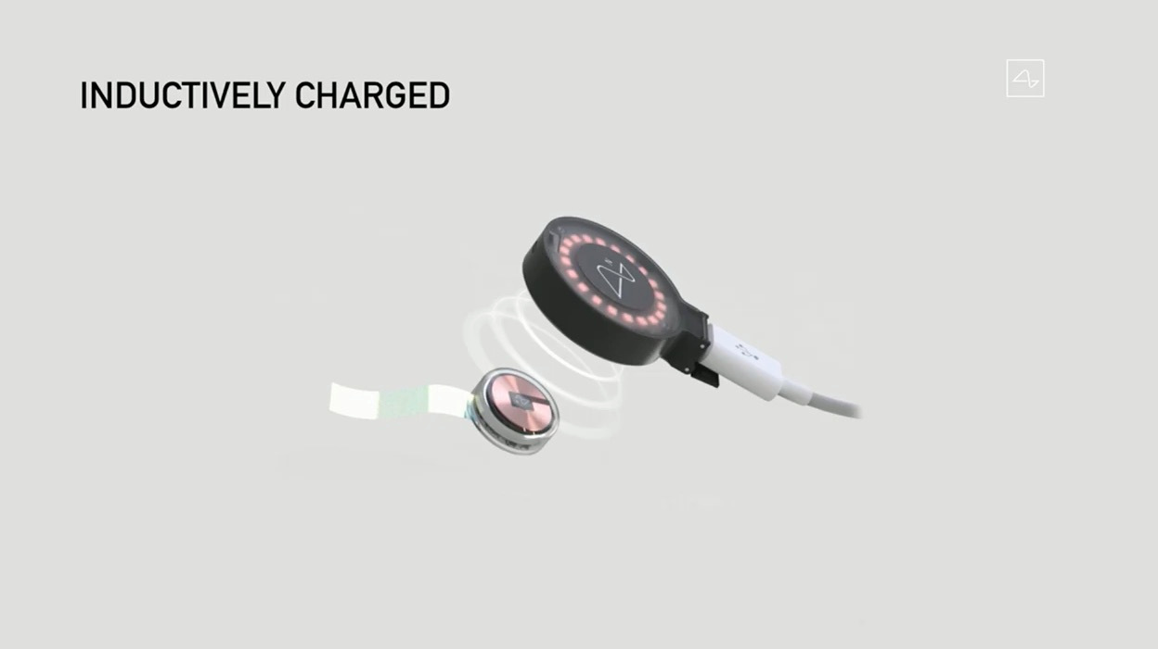

Slide 6


Slide 7
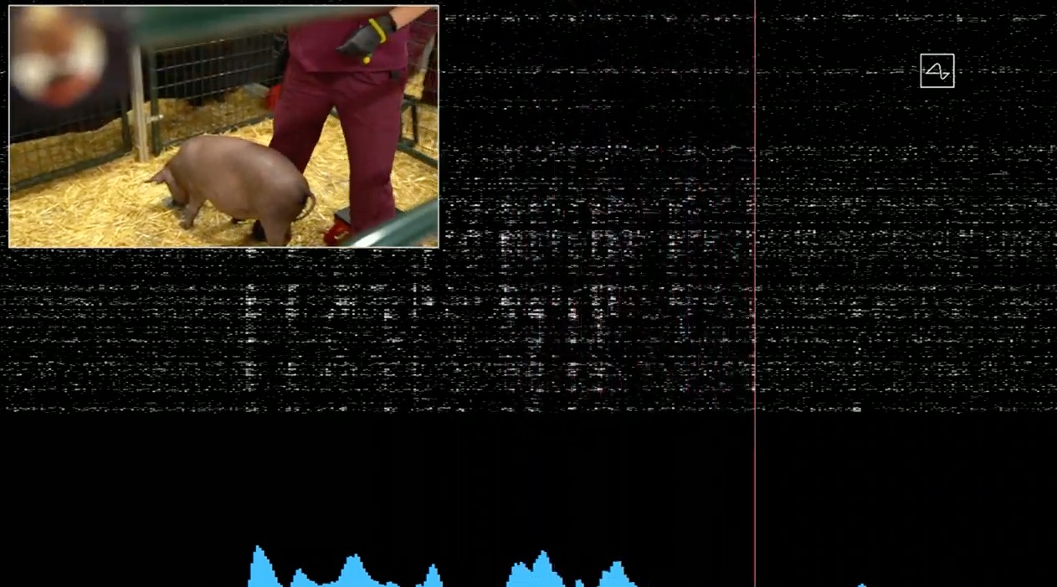

Slide 8
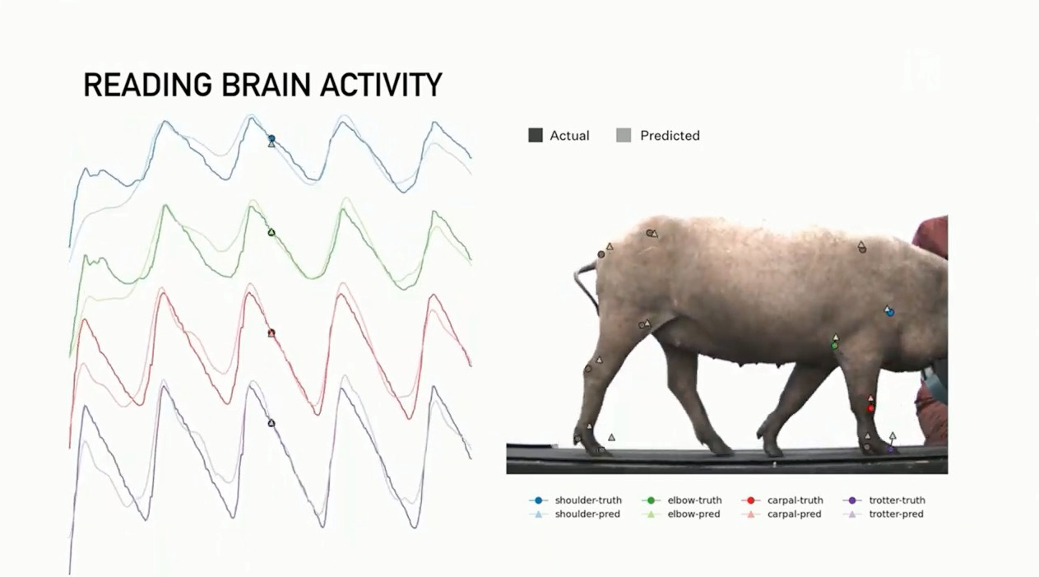

Slide 9
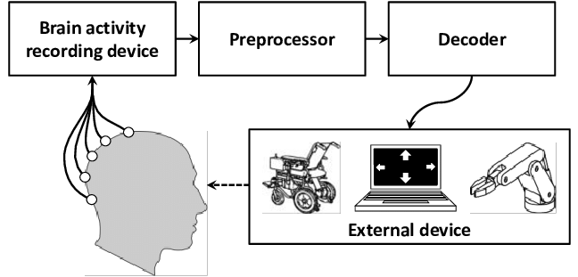
Brain Computer Interface (BCI) Invasive/ Non-Invasive

Slide 10
How Does a BCI Work?
Our brains are filled with cells called neurons. Every time we think, move, feel or remember something, our neurons are at work. That work is carried out by biochemical and electric signals. Scientists can detect those signals and interpret what they mean by using electroencephalography (EEG) technology. EEG can read signals from the human brain and send them to amplifiers. The amplified signals are then interpreted by a BCI computer program which uses the signals to control a device.

Slide 11
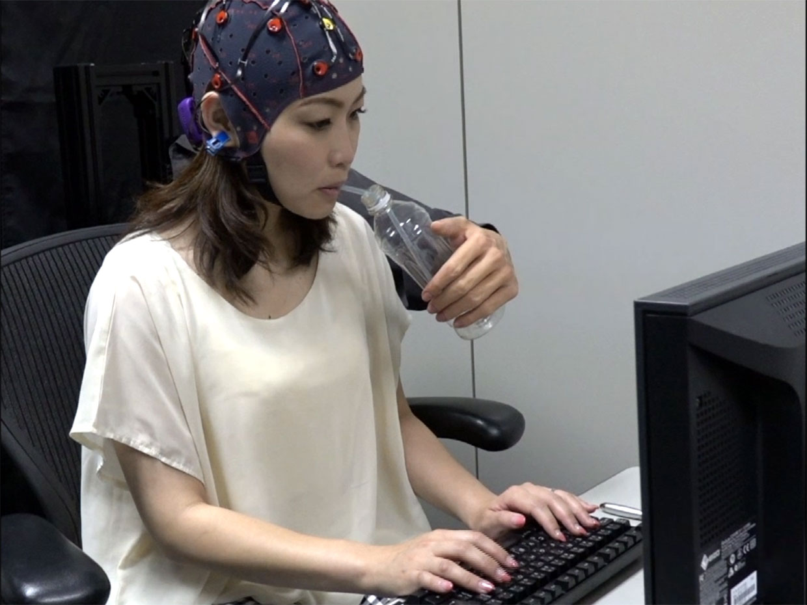
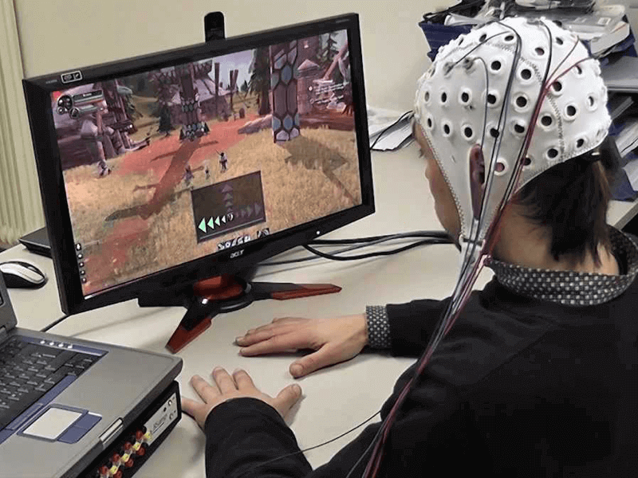

Slide 12



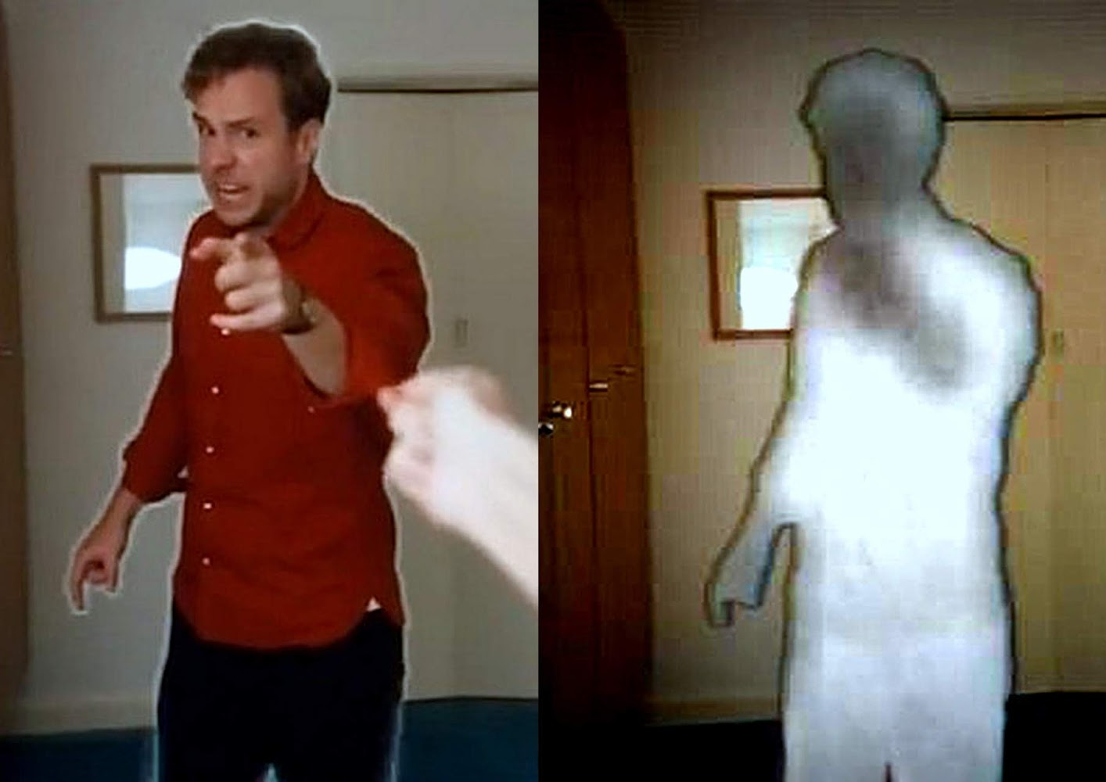

Slide 13
https://youtu.be/7t84lGE5TXA

