Slide 1
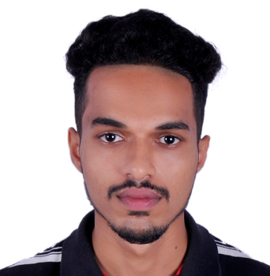
Paresh Mahesh Varik
Full-Stack IT Engineer
Education, Certificates & Recognitions
2015-2019 : BE in E&C from Canara Engineering Collage Mangalore, Karnataka
2019: OCA- Java SE 8 Programmer
2020: HTML, CSS, and JS for Web Developers- Coursera
Career Oct 2019- Present : Capgemini India
Technical Skills
Vue JS, Angular6, HTML5, CSS3, Bootstrap, Javascript
Java 8, Spring Boot, JPA, JUnit
Oracle, MySQL
Good team player
Hard working & keen to learn
Adaptable to change
I
Canacona, Goa
Indian
Konkani, English, Marathi & Hindi
paresh.varik@capgemini.com
Paresh is a college graduate and is close to one year experienced in IT industry. He is full stack IT Engineer, trained in multiple technologies such as Vue JS, Java, AWS. He has the ability to translate business requirement into technical solutions. He has ability to prioritize and multi-task while working in challenging environment. He is dedicated and commitment individual and confident working independently as well as in a team environment.
During his training period, he has learned both front end and back end. Trained on technologies like Angular 6, Java8, JPA with Hibernate, Spring Boot, HTML 5, CSS 3, Bootstrap, JavaScript. He has completed Oracle Certification for Java Associate.
He is looking forward to an opportunity that utilize his skills and helps him grow both personally as well as professionally.
He like to spend his free time playing cricket, badminton and browsing latest inventions.
08/2020 – Present Vue JS Training
Completed Vue JS training and developed a web application to apply learnings, including unit testing.
05/2020 – 05/2020 AWS Training
Went through AWS training provided by Capgemini, developed hands-on understanding on AWS basics such as S3, Dynamo DB, EC2, RDS.
02/2020 – 05/2020 Electric Charging Management System.
Worked in both front-end & back-end using Angular 6 and Spring Boot. Used Firebase and Heroku for hosting application.
07/2019 – 10/2019 Bus Booking System
Worked in both-front end and back-end using Angular 6 & Spring Boot, used MySQL for database.
07/2019 – 10/2019 Capgemini Training
Completed Java Full Stack training provided by Capgemini. Designed and developed e-commerce application using Angular 6, Java 8, Spring Boot, HTML 5, CSS 3, Bootstrap.

