Slide 1
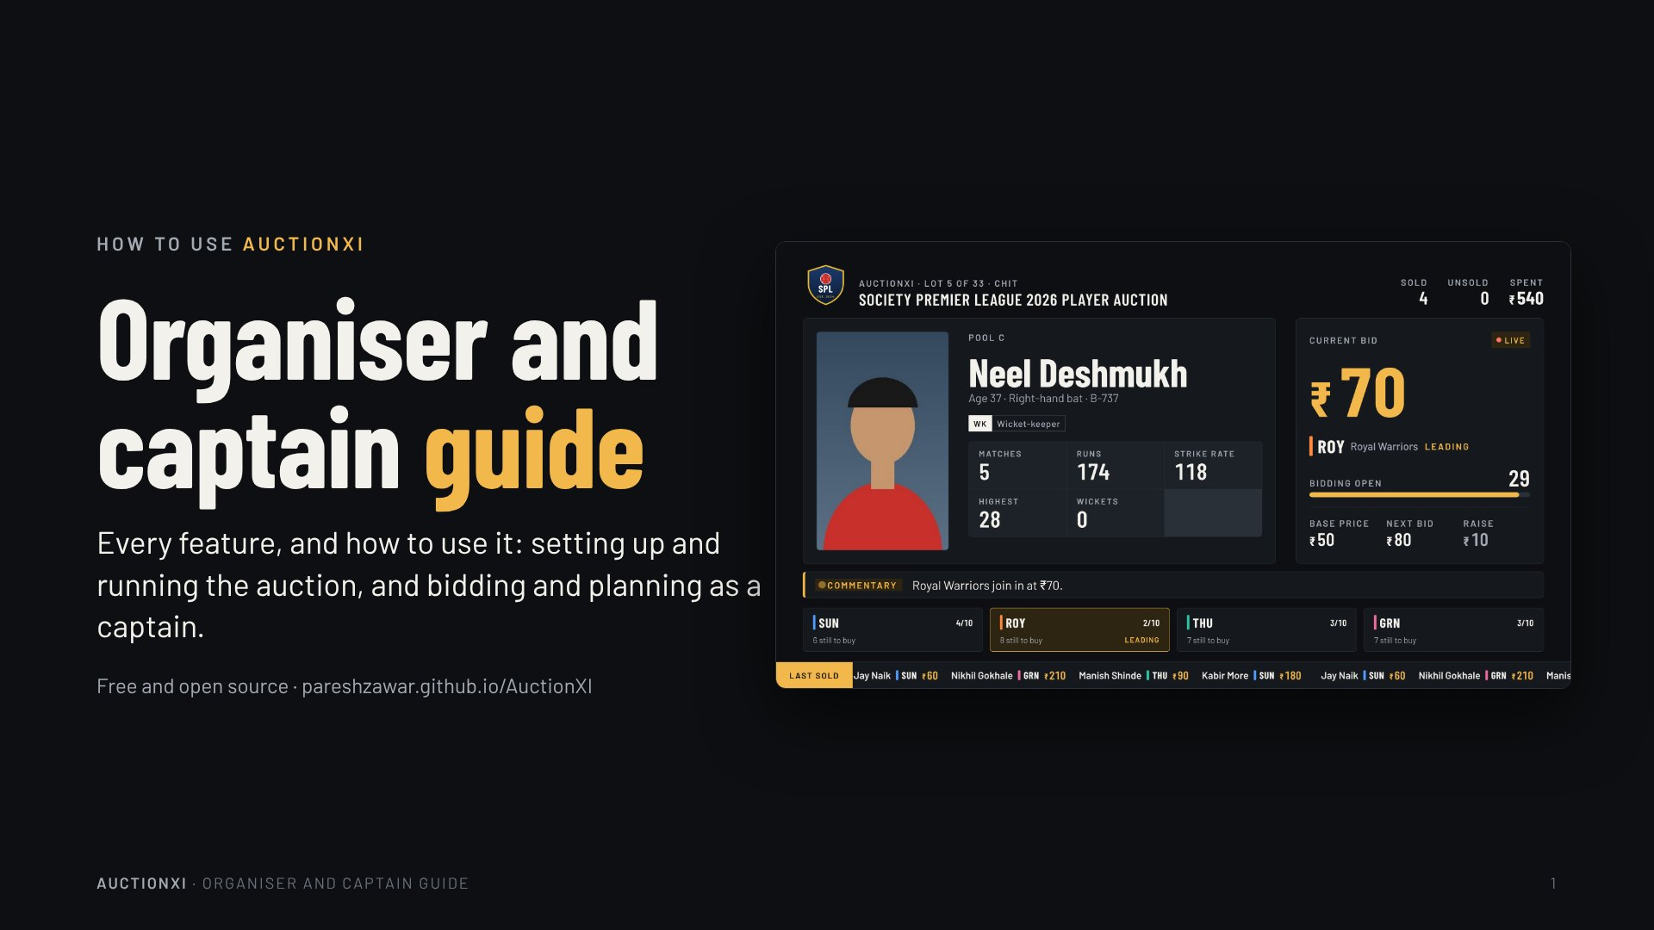
Notes:
How to use AuctionXI
Organiser and captain guide
Every feature, and how to use it: setting up and running the auction, and bidding and planning as a captain.
Free and open source · pareshzawar.github.io/AuctionXI

Slide 2
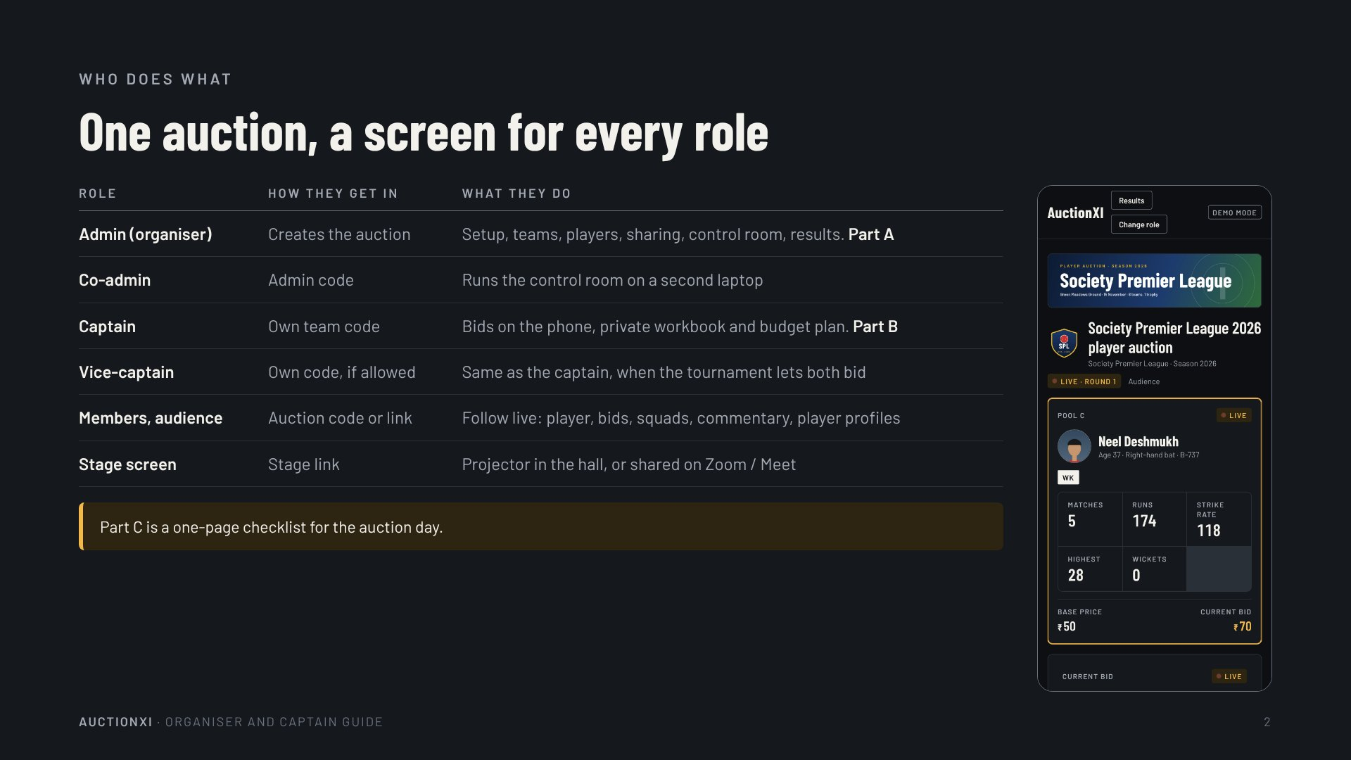
Notes:
Who does what
One auction, a screen for every role
Role · How they get in · What they do
Admin (organiser) · Creates the auction · Setup, teams, players, sharing, control room, results. Part A
Co-admin · Admin code · Runs the control room on a second laptop
Captain · Own team code · Bids on the phone, private workbook and budget plan. Part B
Vice-captain · Own code, if allowed · Same as the captain, when the tournament lets both bid
Members, audience · Auction code or link · Follow live: player, bids, squads, commentary, player profiles
Stage screen · Stage link · Projector in the hall, or shared on Zoom / Meet
Part C is a one-page checklist for the auction day.

Slide 3
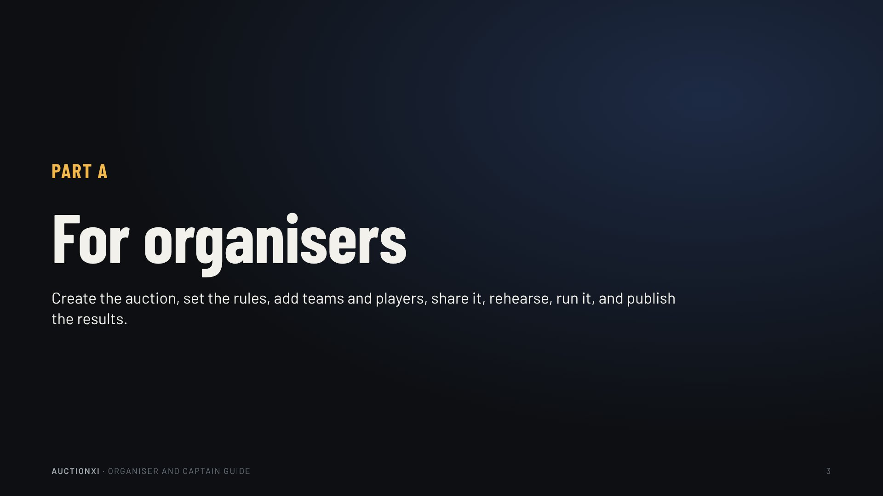
Notes:
Part A
For organisers
Create the auction, set the rules, add teams and players, share it, rehearse, run it, and publish the results.

Slide 4
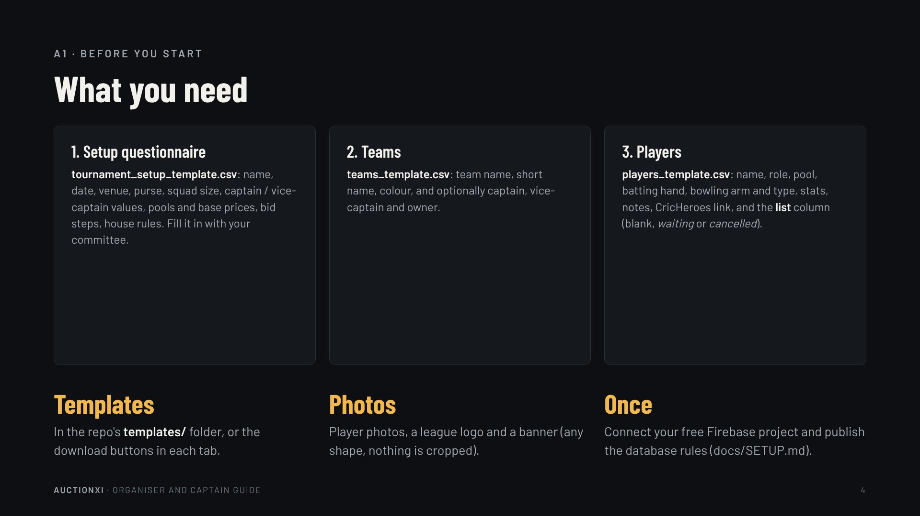
Notes:
A1 · Before you start
What you need
1. Setup questionnaire
tournament_setup_template.csv: name, date, venue, purse, squad size, captain / vice-captain values, pools and base prices, bid steps, house rules. Fill it in with your committee.
2. Teams
teams_template.csv: team name, short name, colour, and optionally captain, vice-captain and owner.
3. Players
players_template.csv: name, role, pool, batting hand, bowling arm and type, stats, notes, CricHeroes link, and the list column (blank, waiting or cancelled).
Templates
In the repo's templates/ folder, or the download buttons in each tab.
Photos
Player photos, a league logo and a banner (any shape, nothing is cropped).
Once
Connect your free Firebase project and publish the database rules (docs/SETUP.md).

Slide 5
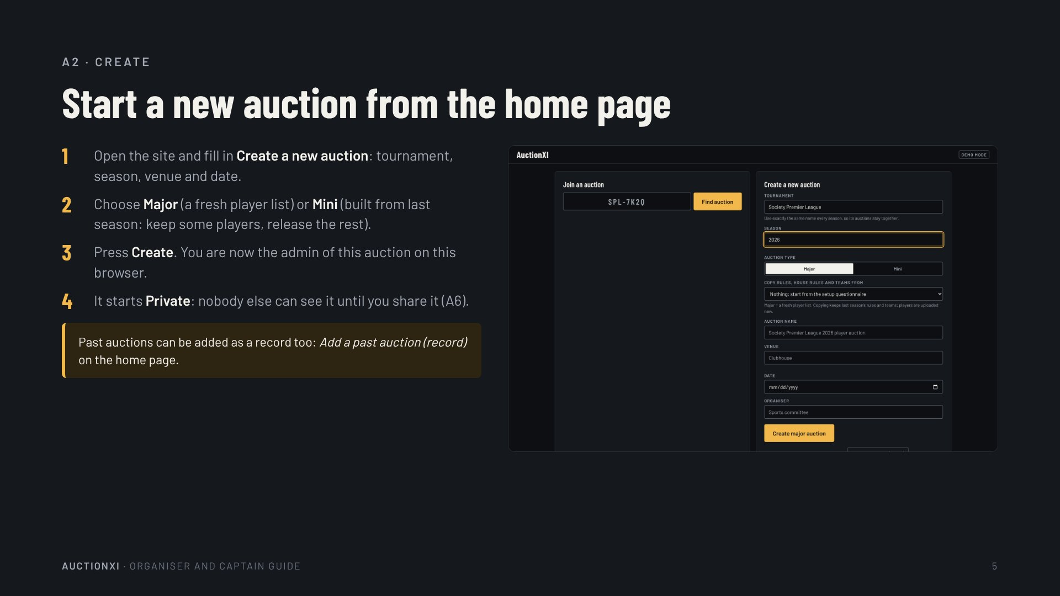
Notes:
A2 · Create
Start a new auction from the home page
Open the site and fill in Create a new auction: tournament, season, venue and date.
Choose Major (a fresh player list) or Mini (built from last season: keep some players, release the rest).
Press Create. You are now the admin of this auction on this browser.
It starts Private: nobody else can see it until you share it (A6).
Past auctions can be added as a record too: Add a past auction (record) on the home page.

Slide 6
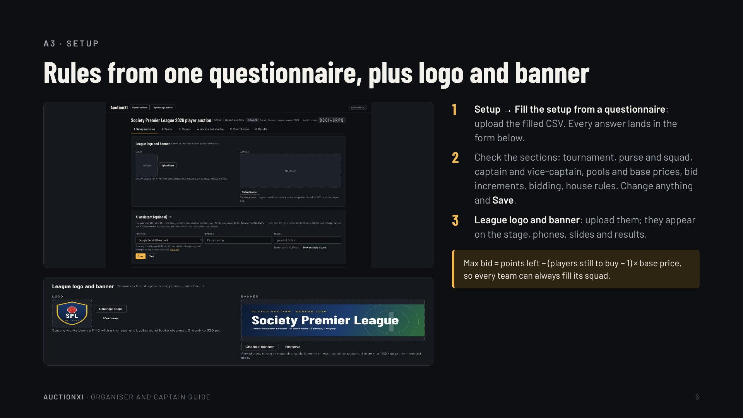
Notes:
A3 · Setup
Rules from one questionnaire, plus logo and banner
Setup → Fill the setup from a questionnaire: upload the filled CSV. Every answer lands in the form below.
Check the sections: tournament, purse and squad, captain and vice-captain, pools and base prices, bid increments, bidding, house rules. Change anything and Save.
League logo and banner: upload them; they appear on the stage, phones, slides and results.
Max bid = points left − (players still to buy − 1) × base price, so every team can always fill its squad.

Slide 7
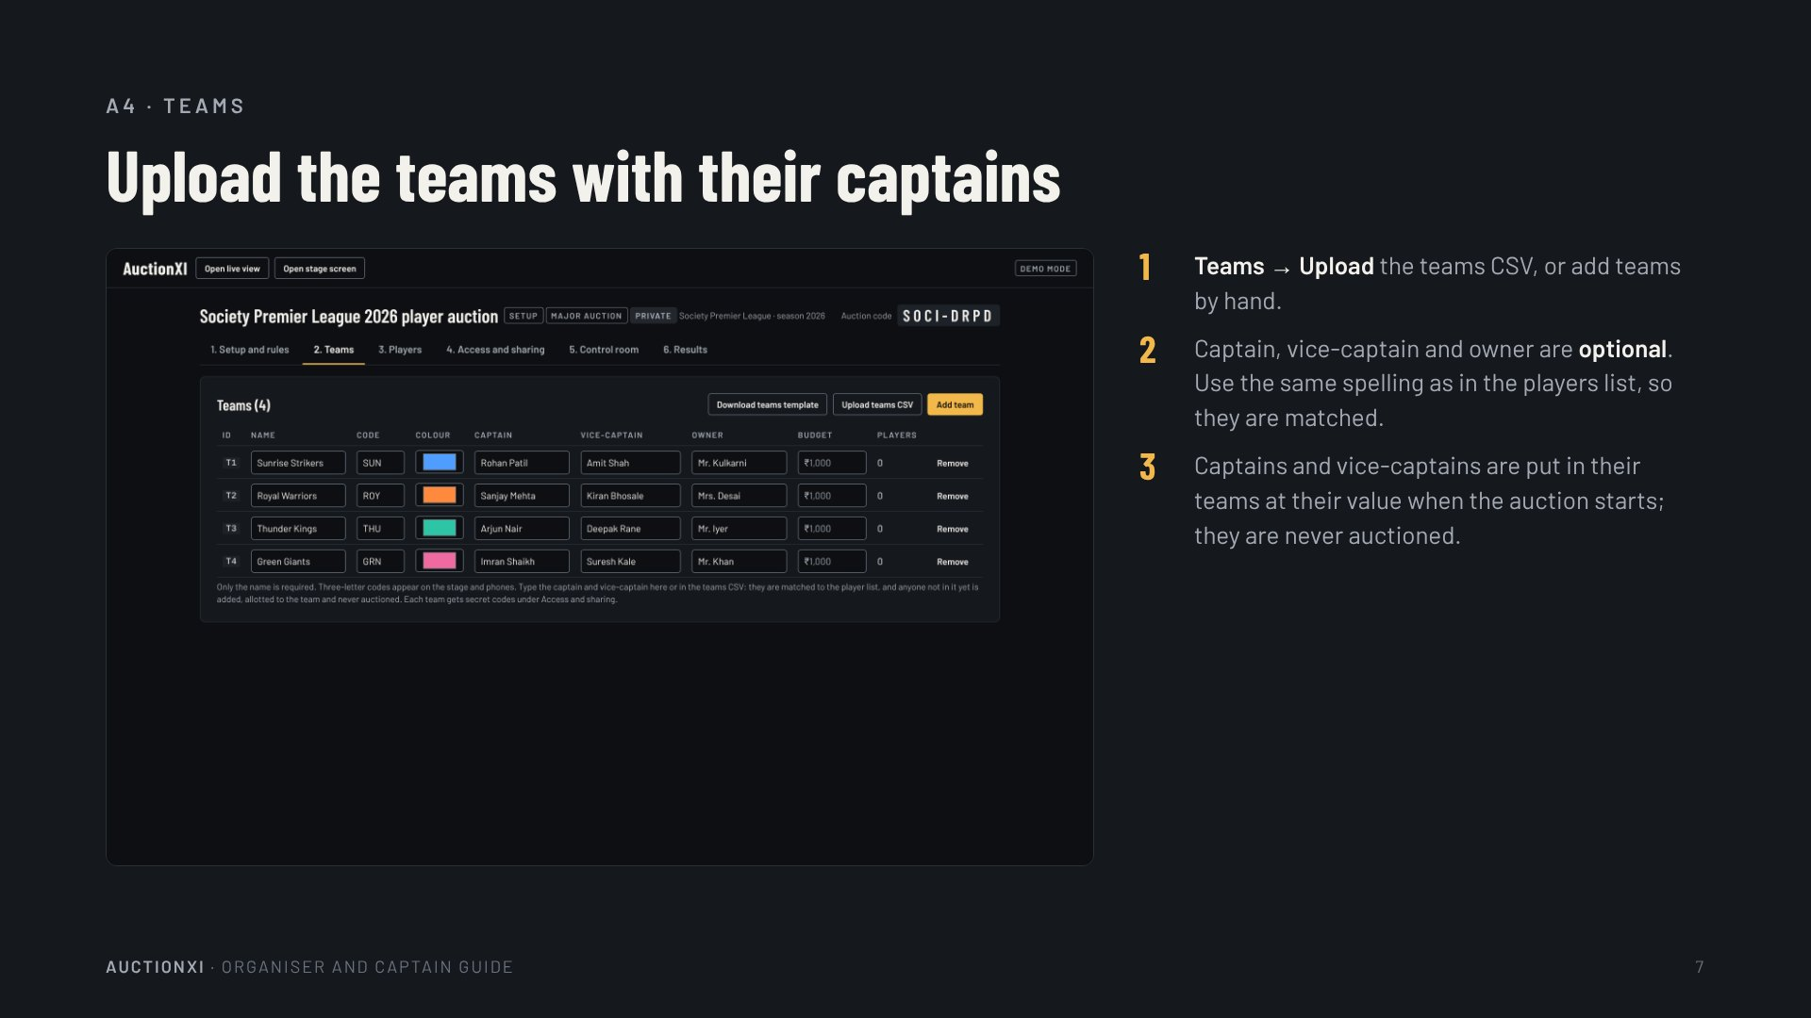
Notes:
A4 · Teams
Upload the teams with their captains
Teams → Upload the teams CSV, or add teams by hand.
Captain, vice-captain and owner are optional. Use the same spelling as in the players list, so they are matched.
Captains and vice-captains are put in their teams at their value when the auction starts; they are never auctioned.

Slide 8
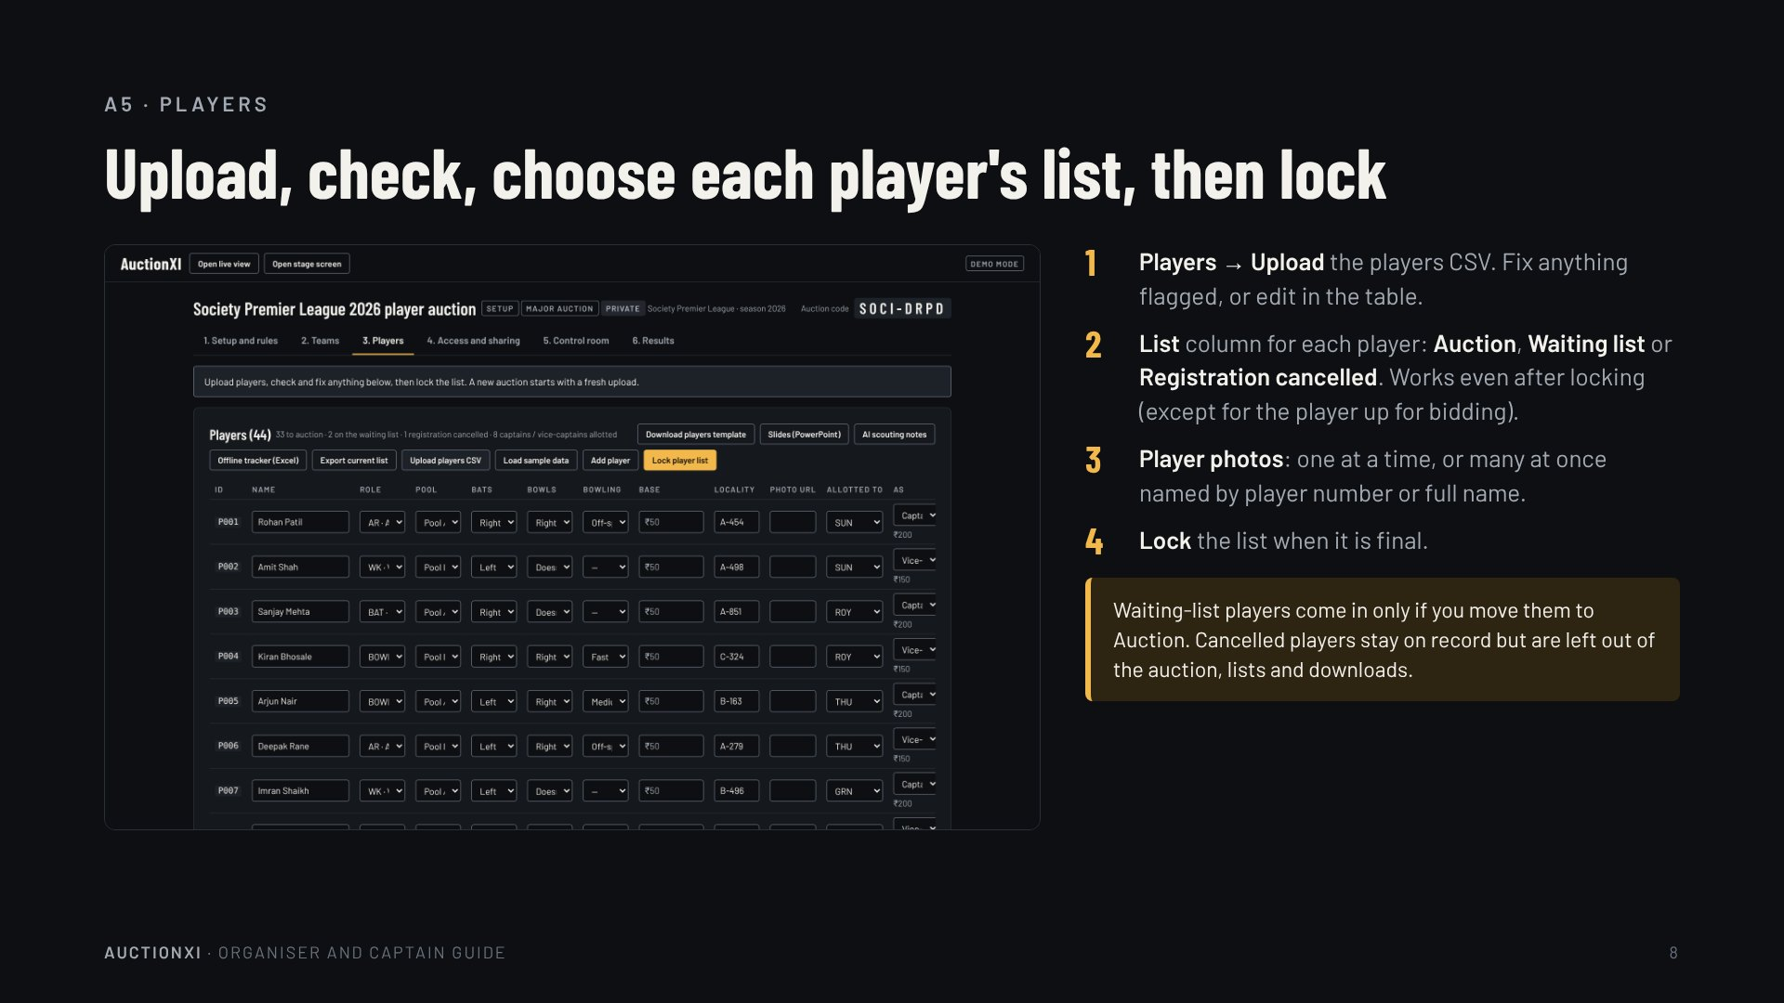
Notes:
A5 · Players
Upload, check, choose each player's list, then lock
Players → Upload the players CSV. Fix anything flagged, or edit in the table.
List column for each player: Auction, Waiting list or Registration cancelled. Works even after locking (except for the player up for bidding).
Player photos: one at a time, or many at once named by player number or full name.
Lock the list when it is final.
Waiting-list players come in only if you move them to Auction. Cancelled players stay on record but are left out of the auction, lists and downloads.

Slide 9
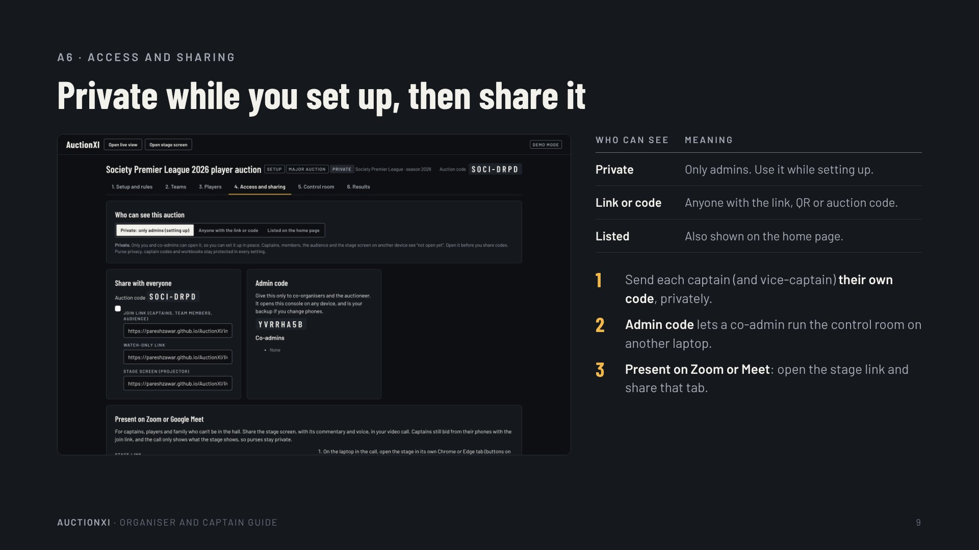
Notes:
A6 · Access and sharing
Private while you set up, then share it
Who can see · Meaning
Private · Only admins. Use it while setting up.
Link or code · Anyone with the link, QR or auction code.
Listed · Also shown on the home page.
Send each captain (and vice-captain) their own code, privately.
Admin code lets a co-admin run the control room on another laptop.
Present on Zoom or Meet: open the stage link and share that tab.

Slide 10
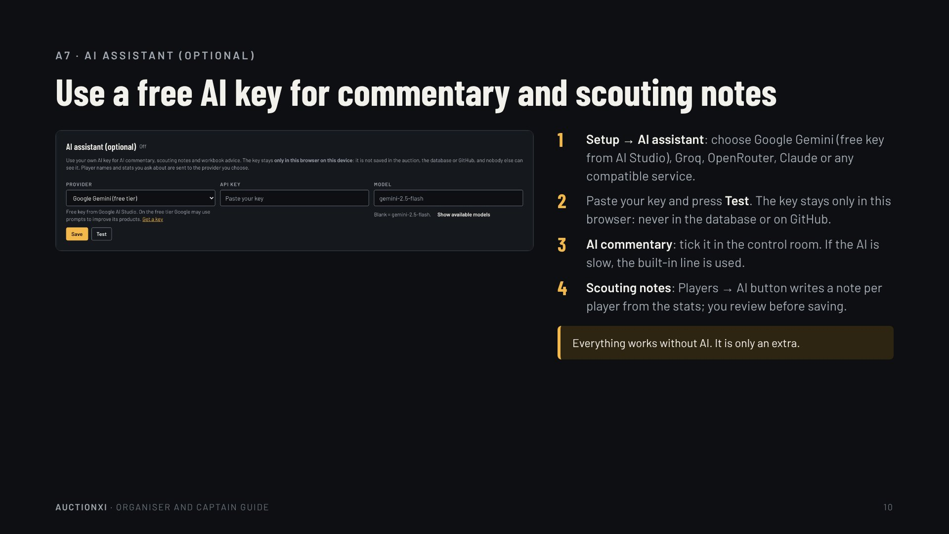
Notes:
A7 · AI assistant (optional)
Use a free AI key for commentary and scouting notes
Setup → AI assistant: choose Google Gemini (free key from AI Studio), Groq, OpenRouter, Claude or any compatible service.
Paste your key and press Test. The key stays only in this browser: never in the database or on GitHub.
AI commentary: tick it in the control room. If the AI is slow, the built-in line is used.
Scouting notes: Players → AI button writes a note per player from the stats; you review before saving.
Everything works without AI. It is only an extra.

Slide 11
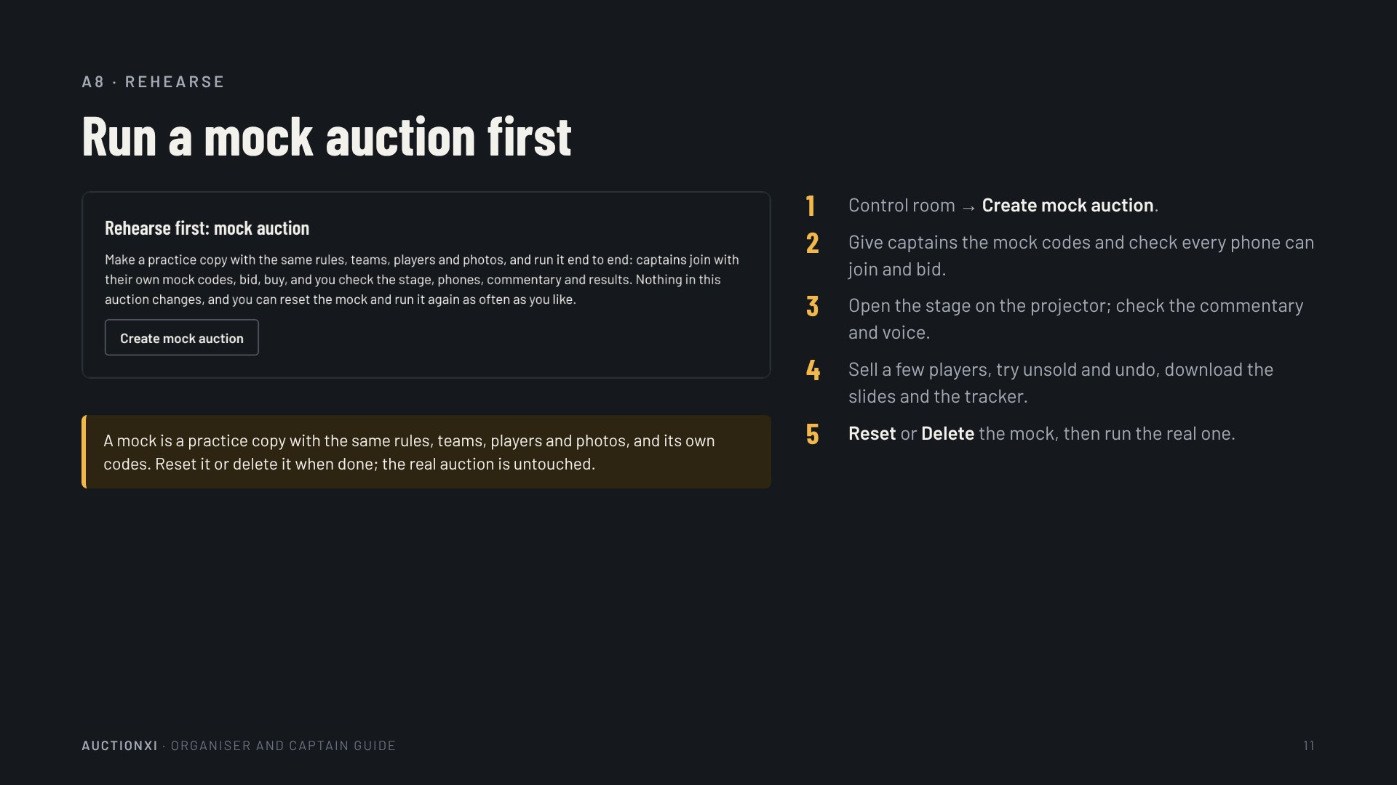
Notes:
A8 · Rehearse
Run a mock auction first
A mock is a practice copy with the same rules, teams, players and photos, and its own codes. Reset it or delete it when done; the real auction is untouched.
Control room → Create mock auction.
Give captains the mock codes and check every phone can join and bid.
Open the stage on the projector; check the commentary and voice.
Sell a few players, try unsold and undo, download the slides and the tracker.
Reset or Delete the mock, then run the real one.

Slide 12
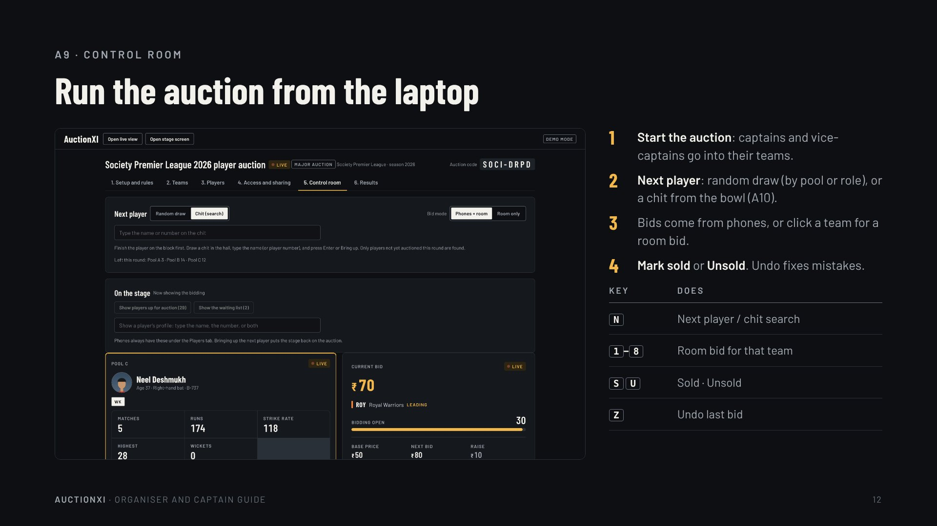
Notes:
A9 · Control room
Run the auction from the laptop
Start the auction: captains and vice-captains go into their teams.
Next player: random draw (by pool or role), or a chit from the bowl (A10).
Bids come from phones, or click a team for a room bid.
Mark sold or Unsold. Undo fixes mistakes.
Key · Does
N · Next player / chit search
1–8 · Room bid for that team
S U · Sold · Unsold
Z · Undo last bid

Slide 13
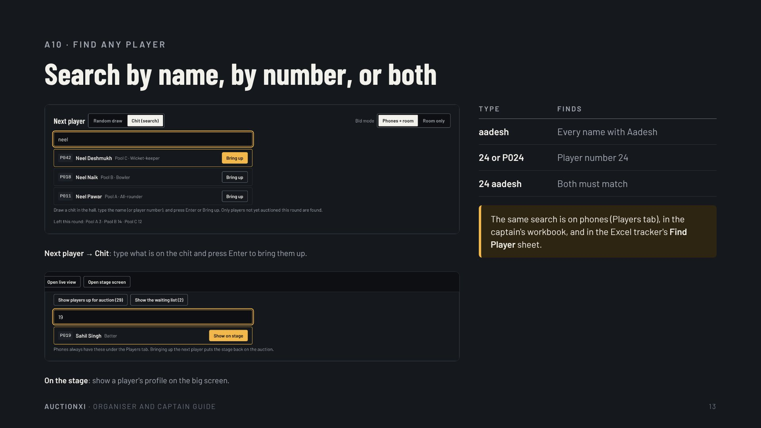
Notes:
A10 · Find any player
Search by name, by number, or both
Next player → Chit: type what is on the chit and press Enter to bring them up.
On the stage: show a player's profile on the big screen.
Type · Finds
aadesh · Every name with Aadesh
24 or P024 · Player number 24
24 aadesh · Both must match
The same search is on phones (Players tab), in the captain's workbook, and in the Excel tracker's Find Player sheet.

Slide 14
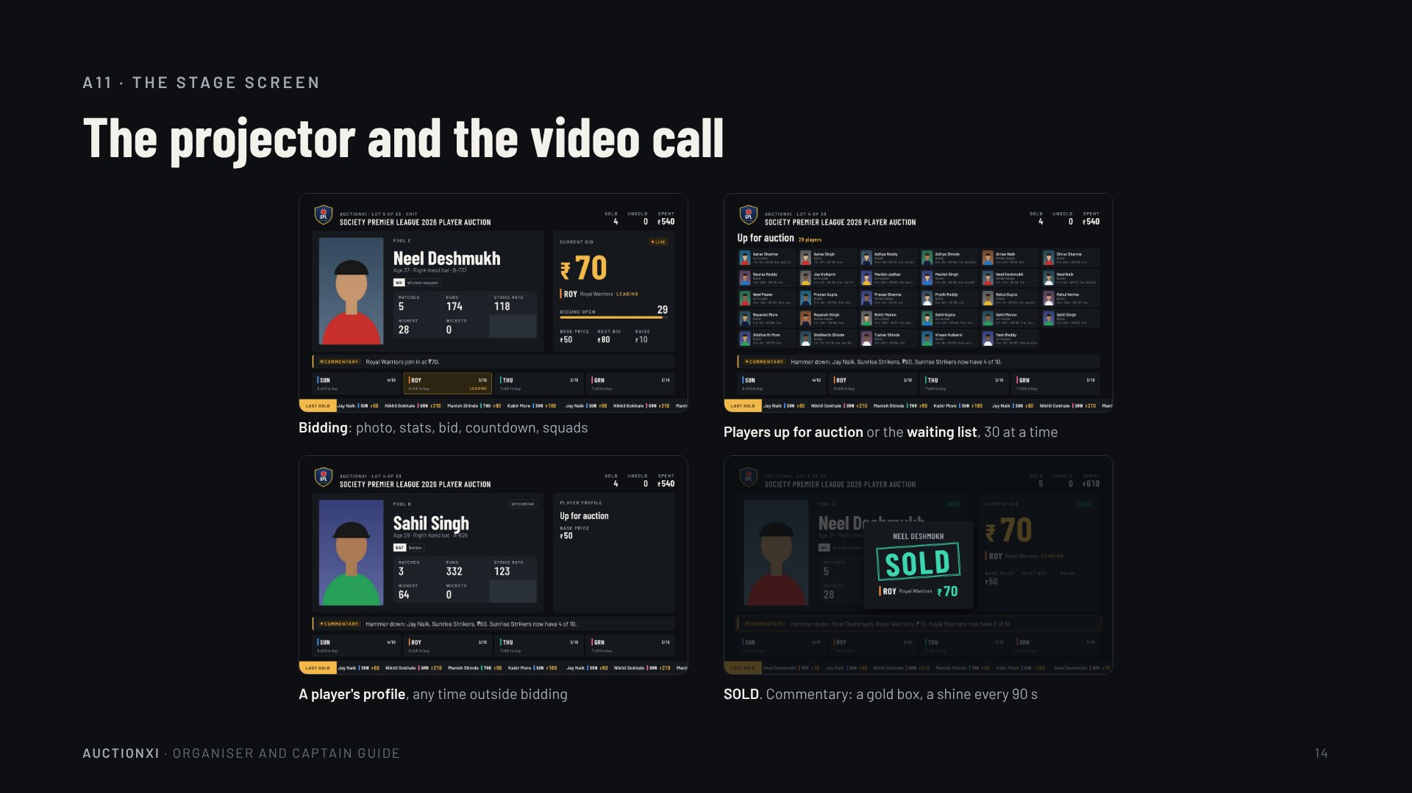
Notes:
A11 · The stage screen
The projector and the video call
Bidding: photo, stats, bid, countdown, squads
Players up for auction or the waiting list, 30 at a time
A player's profile, any time outside bidding
SOLD. Commentary: a gold box, a shine every 90 s

Slide 15
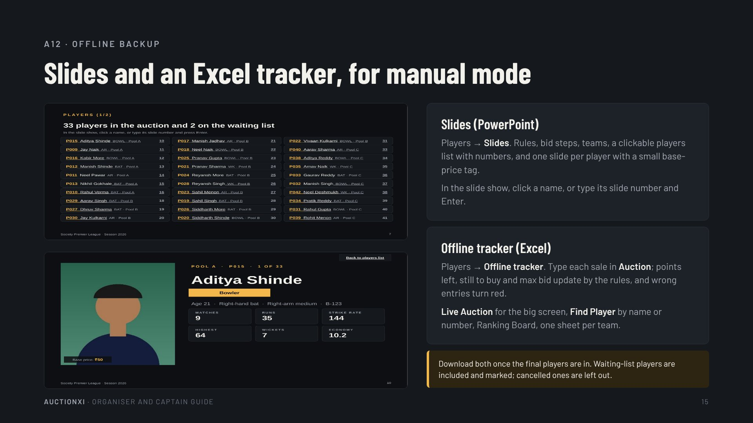
Notes:
A12 · Offline backup
Slides and an Excel tracker, for manual mode
Slides (PowerPoint)
Players → Slides. Rules, bid steps, teams, a clickable players list with numbers, and one slide per player with a small base-price tag.
In the slide show, click a name, or type its slide number and Enter.
Offline tracker (Excel)
Players → Offline tracker. Type each sale in Auction; points left, still to buy and max bid update by the rules, and wrong entries turn red.
Live Auction for the big screen, Find Player by name or number, Ranking Board, one sheet per team.
Download both once the final players are in. Waiting-list players are included and marked; cancelled ones are left out.

Slide 16
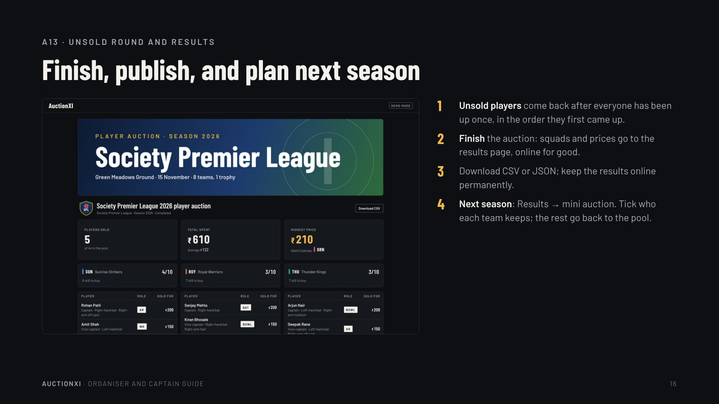
Notes:
A13 · Unsold round and results
Finish, publish, and plan next season
Unsold players come back after everyone has been up once, in the order they first came up.
Finish the auction: squads and prices go to the results page, online for good.
Download CSV or JSON; keep the results online permanently.
Next season: Results → mini auction. Tick who each team keeps; the rest go back to the pool.

Slide 17
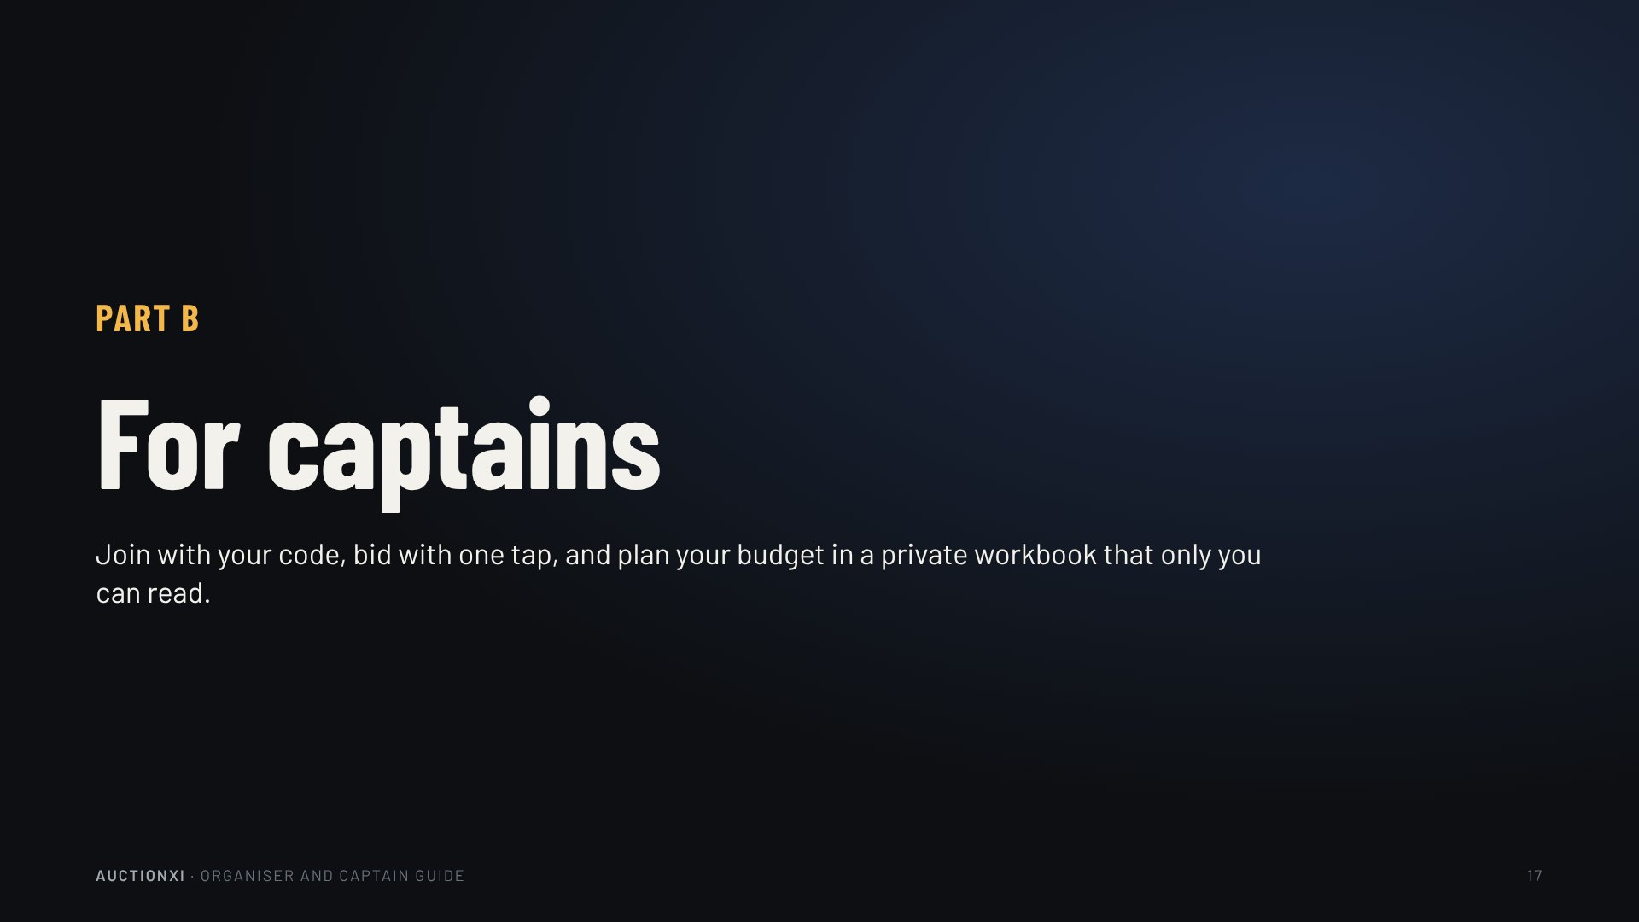
Notes:
Part B
For captains
Join with your code, bid with one tap, and plan your budget in a private workbook that only you can read.

Slide 18
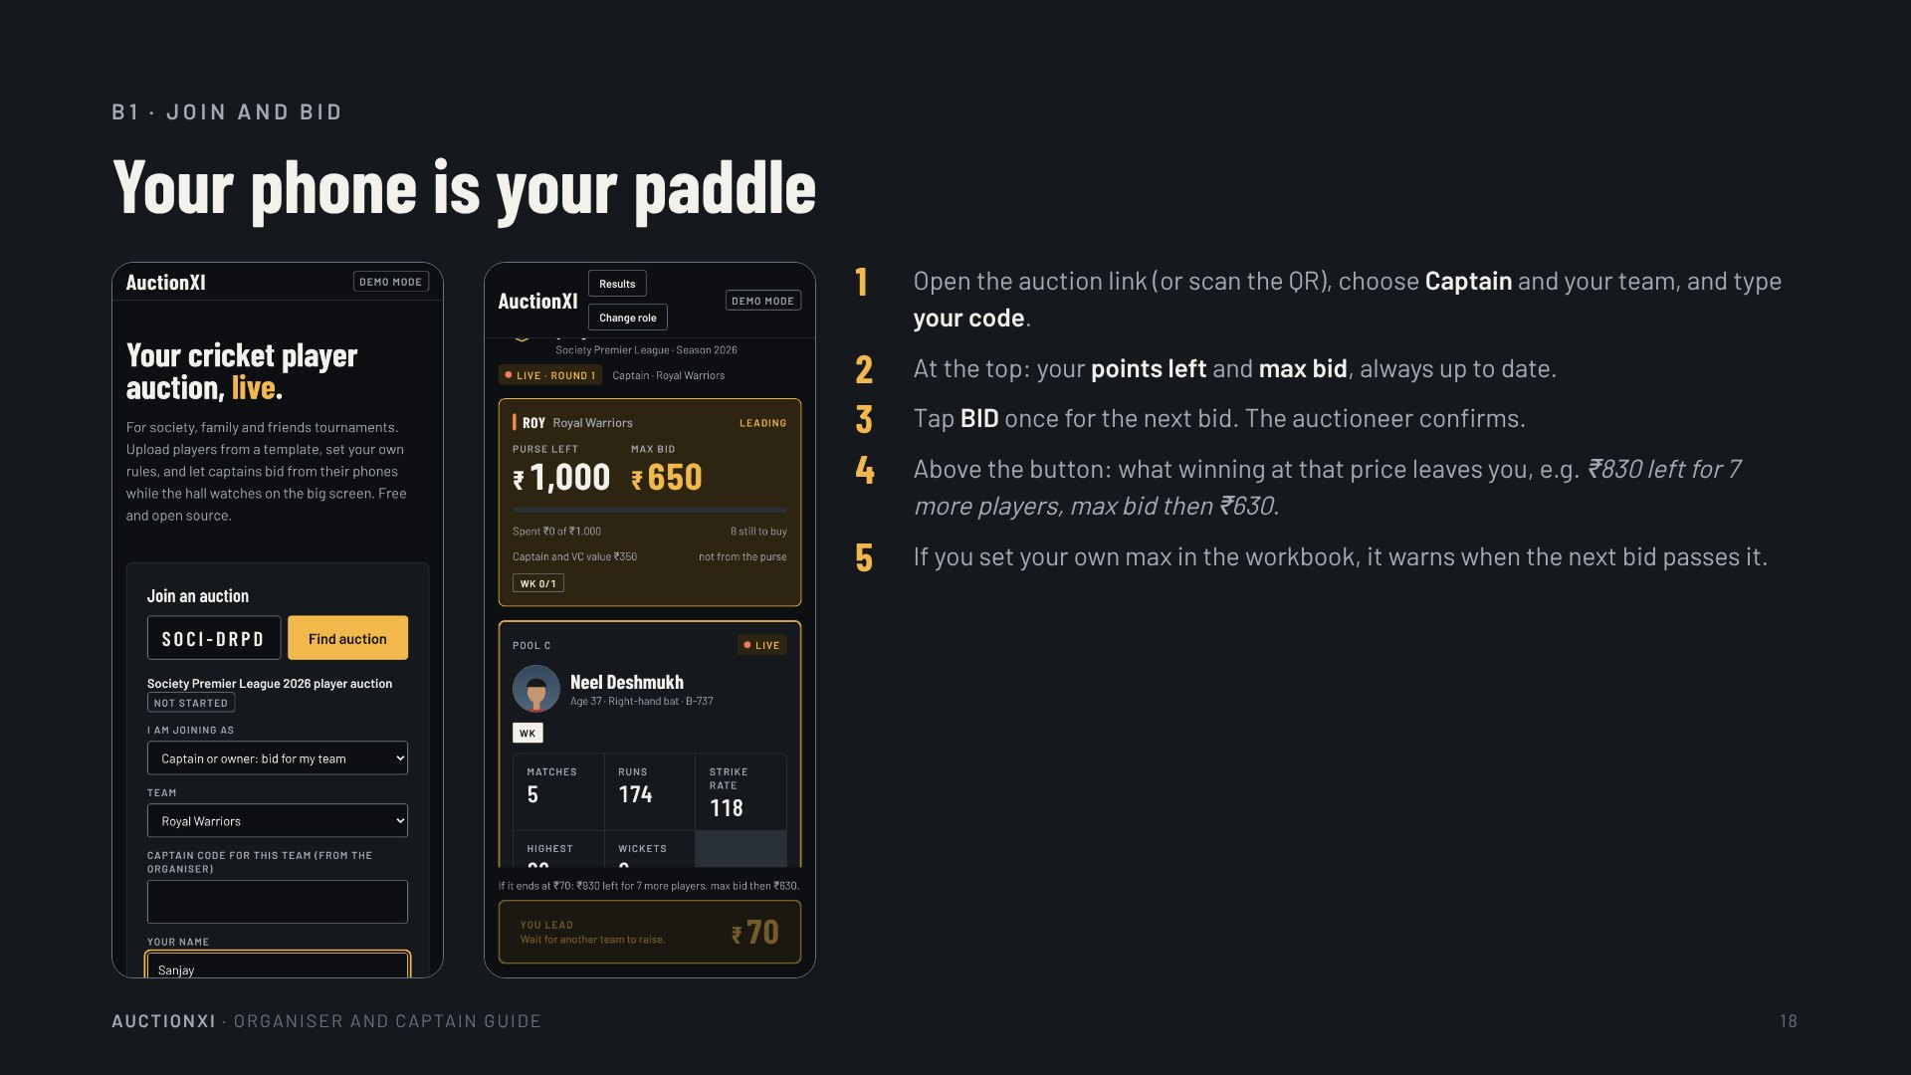
Notes:
B1 · Join and bid
Your phone is your paddle
Open the auction link (or scan the QR), choose Captain and your team, and type your code.
At the top: your points left and max bid, always up to date.
Tap BID once for the next bid. The auctioneer confirms.
Above the button: what winning at that price leaves you, e.g. ₹830 left for 7 more players, max bid then ₹630.
If you set your own max in the workbook, it warns when the next bid passes it.

Slide 19
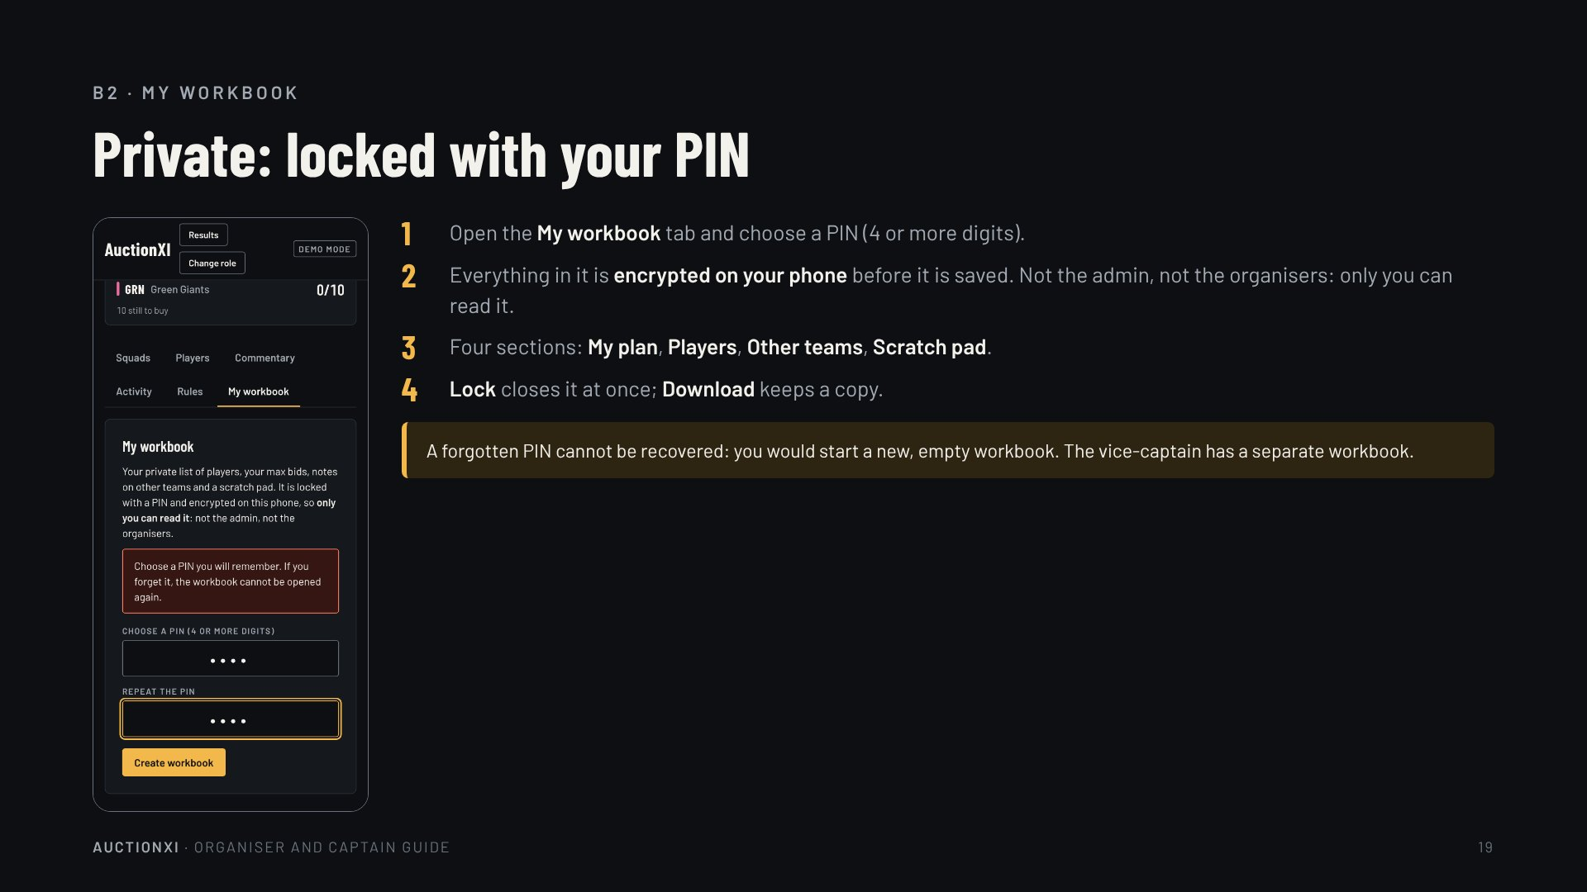
Notes:
B2 · My workbook
Private: locked with your PIN
Open the My workbook tab and choose a PIN (4 or more digits).
Everything in it is encrypted on your phone before it is saved. Not the admin, not the organisers: only you can read it.
Four sections: My plan, Players, Other teams, Scratch pad.
Lock closes it at once; Download keeps a copy.
A forgotten PIN cannot be recovered: you would start a new, empty workbook. The vice-captain has a separate workbook.

Slide 20
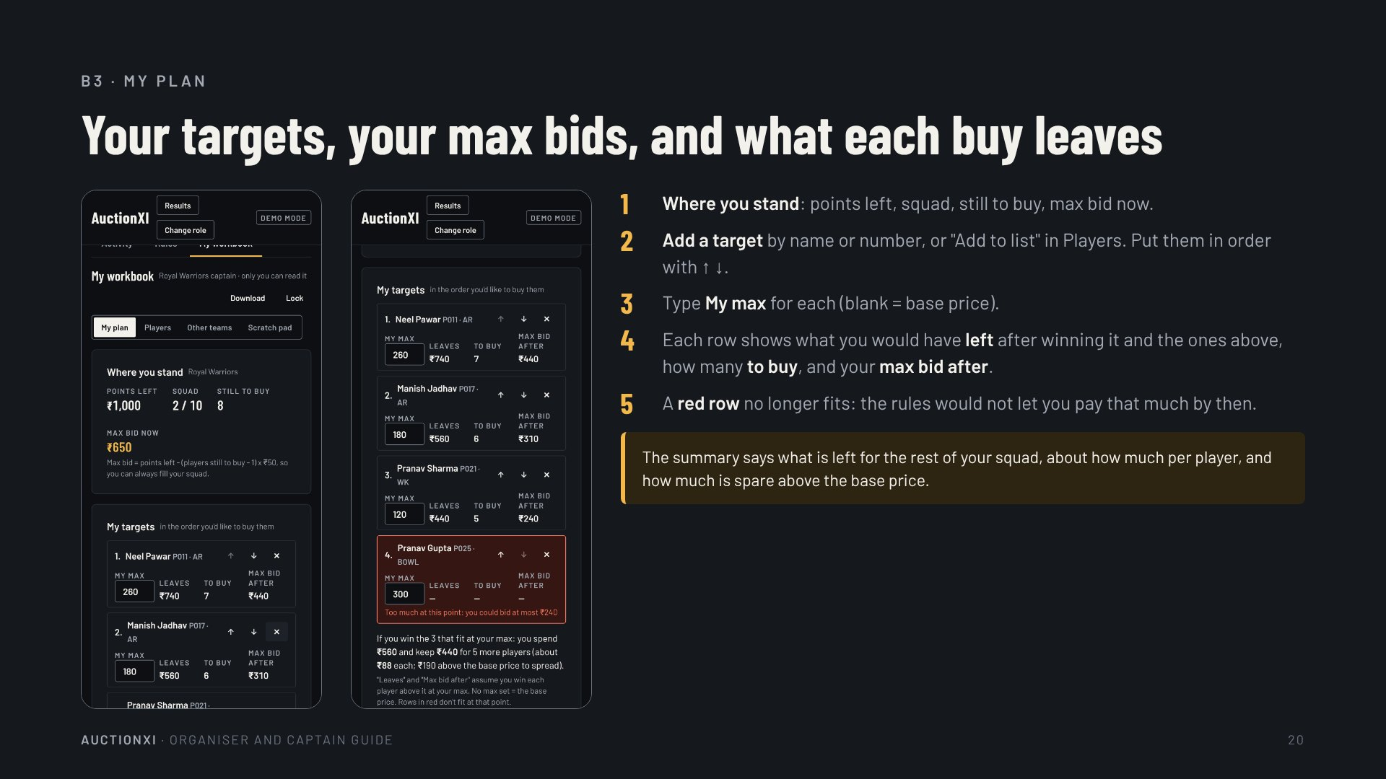
Notes:
B3 · My plan
Your targets, your max bids, and what each buy leaves
Where you stand: points left, squad, still to buy, max bid now.
Add a target by name or number, or "Add to list" in Players. Put them in order with ↑ ↓.
Type My max for each (blank = base price).
Each row shows what you would have left after winning it and the ones above, how many to buy, and your max bid after.
A red row no longer fits: the rules would not let you pay that much by then.
The summary says what is left for the rest of your squad, about how much per player, and how much is spare above the base price.

Slide 21
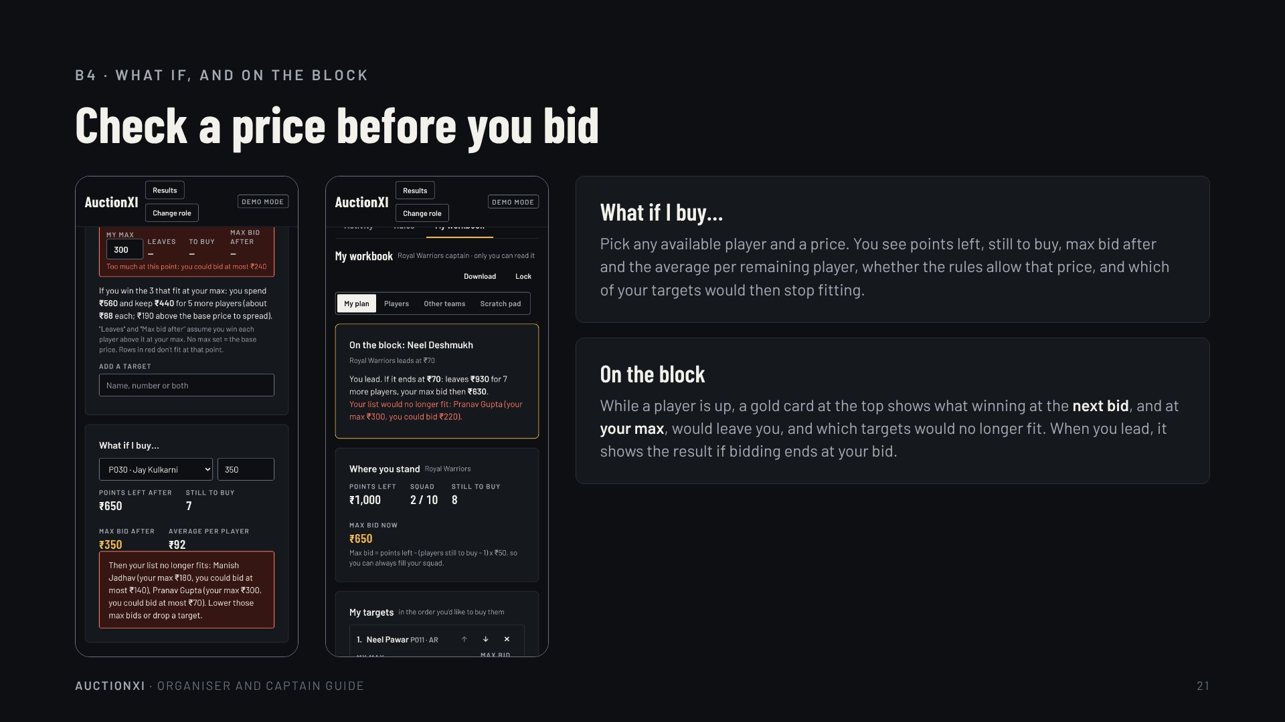
Notes:
B4 · What if, and on the block
Check a price before you bid
What if I buy…
Pick any available player and a price. You see points left, still to buy, max bid after and the average per remaining player, whether the rules allow that price, and which of your targets would then stop fitting.
On the block
While a player is up, a gold card at the top shows what winning at the next bid, and at your max, would leave you, and which targets would no longer fit. When you lead, it shows the result if bidding ends at your bid.

Slide 22
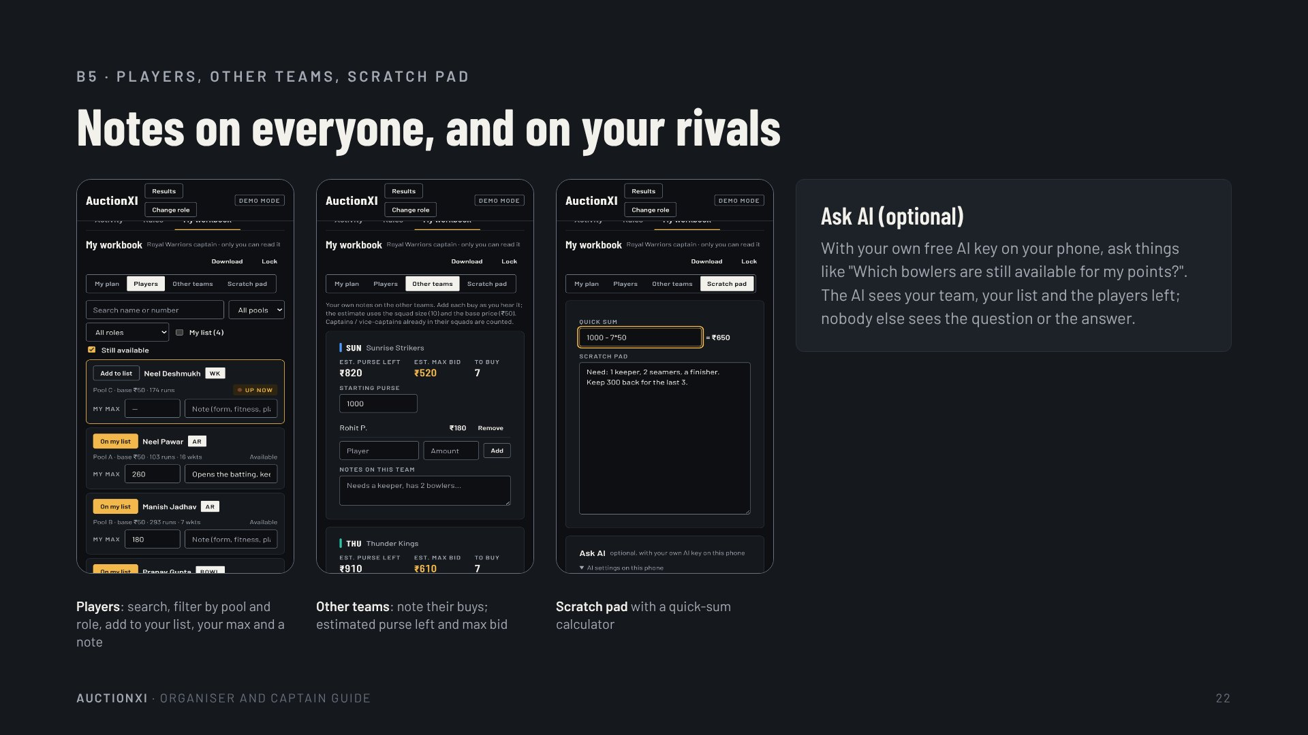
Notes:
B5 · Players, other teams, scratch pad
Notes on everyone, and on your rivals
Players: search, filter by pool and role, add to your list, your max and a note
Other teams: note their buys; estimated purse left and max bid
Scratch pad with a quick-sum calculator
Ask AI (optional)
With your own free AI key on your phone, ask things like "Which bowlers are still available for my points?". The AI sees your team, your list and the players left; nobody else sees the question or the answer.

Slide 23
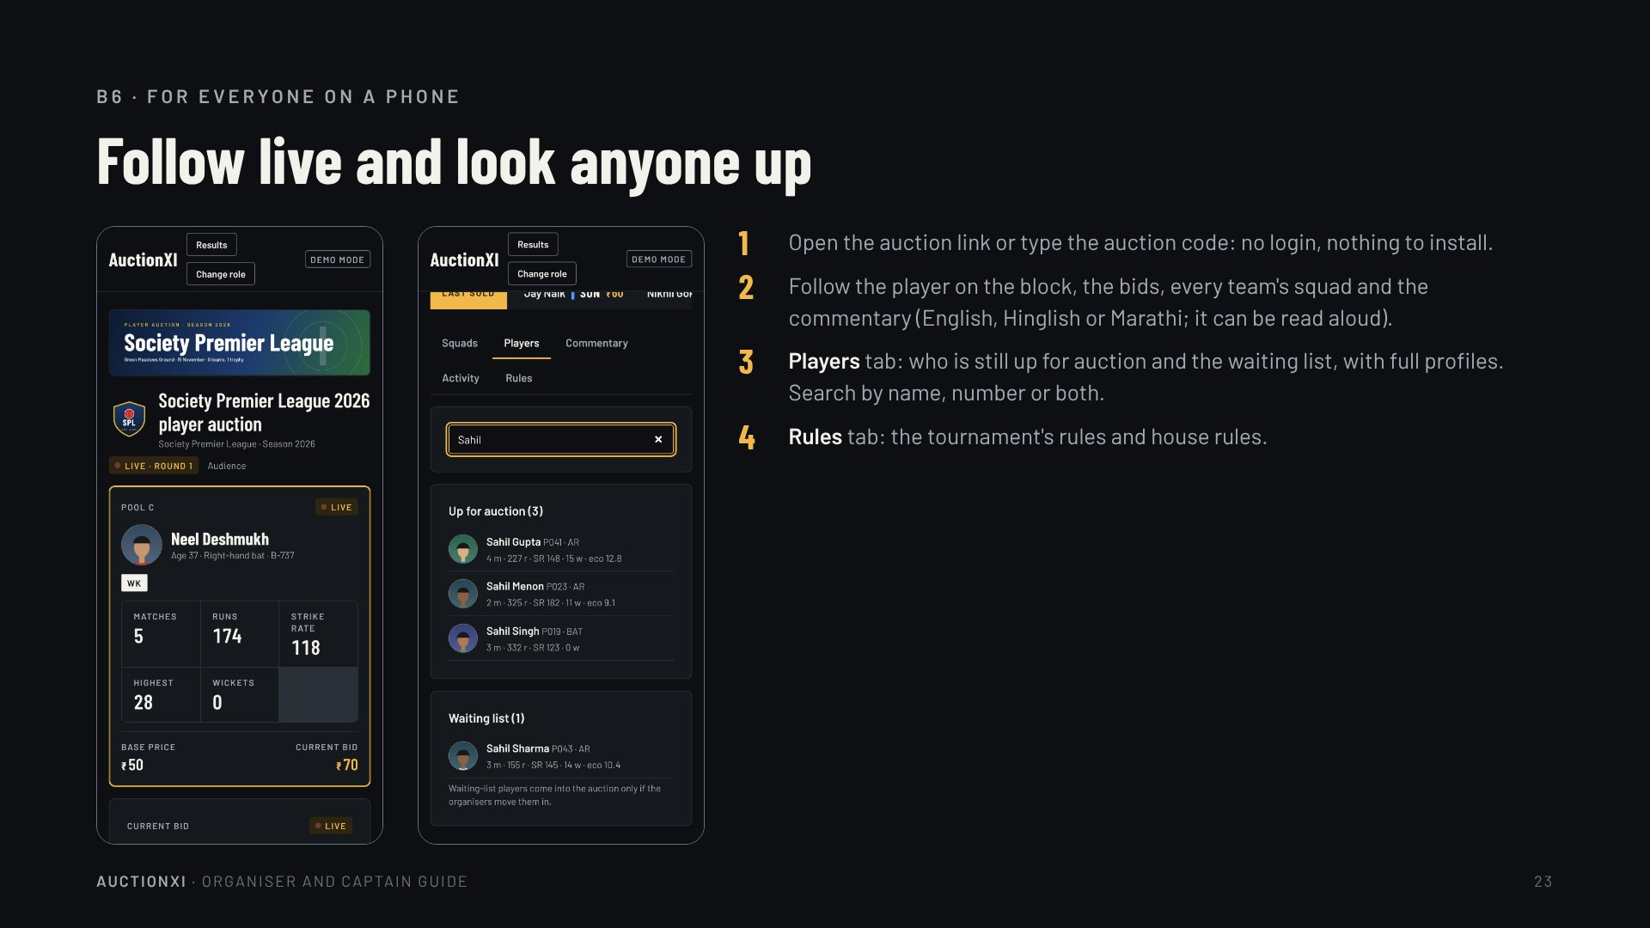
Notes:
B6 · For everyone on a phone
Follow live and look anyone up
Open the auction link or type the auction code: no login, nothing to install.
Follow the player on the block, the bids, every team's squad and the commentary (English, Hinglish or Marathi; it can be read aloud).
Players tab: who is still up for auction and the waiting list, with full profiles. Search by name, number or both.
Rules tab: the tournament's rules and house rules.

Slide 24
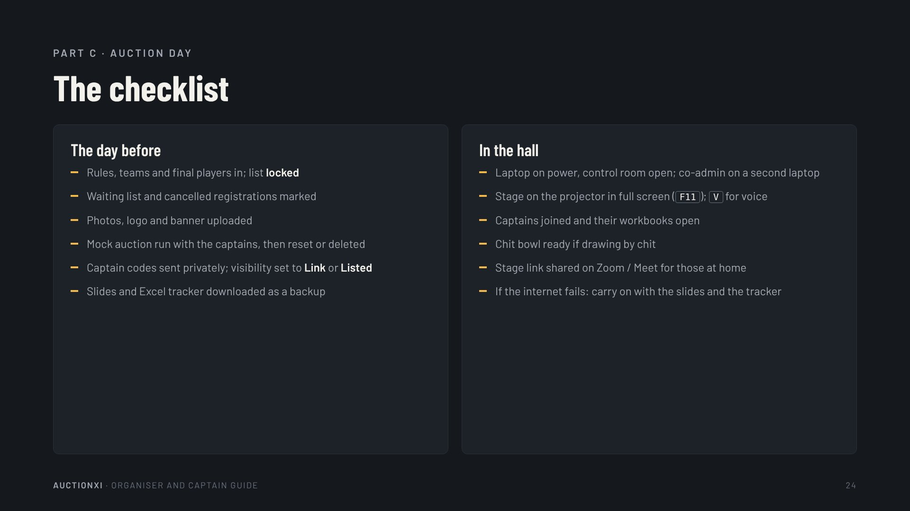
Notes:
Part C · Auction day
The checklist
The day before
Rules, teams and final players in; list locked
Waiting list and cancelled registrations marked
Photos, logo and banner uploaded
Mock auction run with the captains, then reset or deleted
Captain codes sent privately; visibility set to Link or Listed
Slides and Excel tracker downloaded as a backup
In the hall
Laptop on power, control room open; co-admin on a second laptop
Stage on the projector in full screen (F11); V for voice
Captains joined and their workbooks open
Chit bowl ready if drawing by chit
Stage link shared on Zoom / Meet for those at home
If the internet fails: carry on with the slides and the tracker

Slide 25
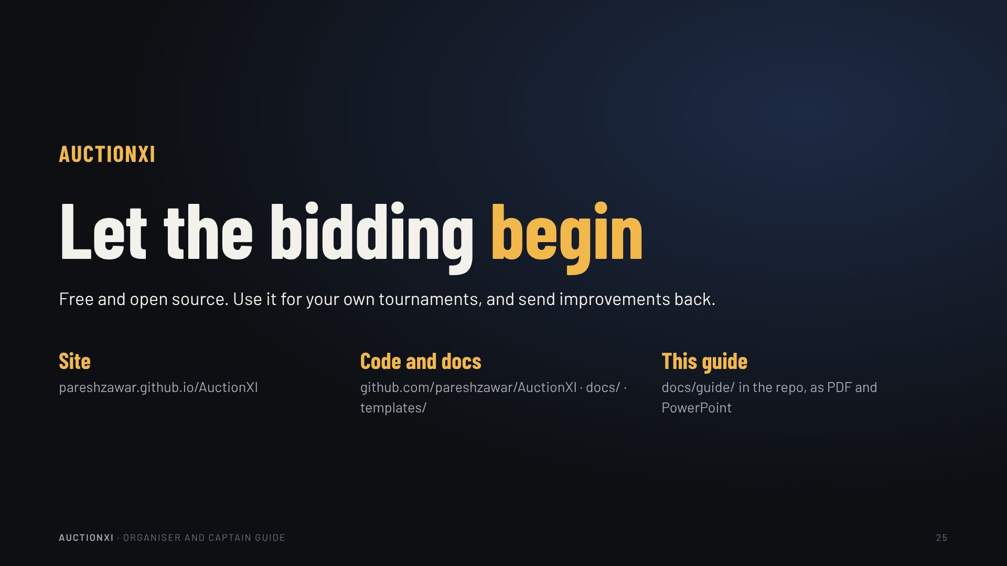
Notes:
AuctionXI
Let the bidding begin
Free and open source. Use it for your own tournaments, and send improvements back.
Site
pareshzawar.github.io/AuctionXI
Code and docs
github.com/pareshzawar/AuctionXI · docs/ · templates/
This guide
docs/guide/ in the repo, as PDF and PowerPoint

