Slide 1
Huntington-Hill
Like Webster but with Logs

Slide 2
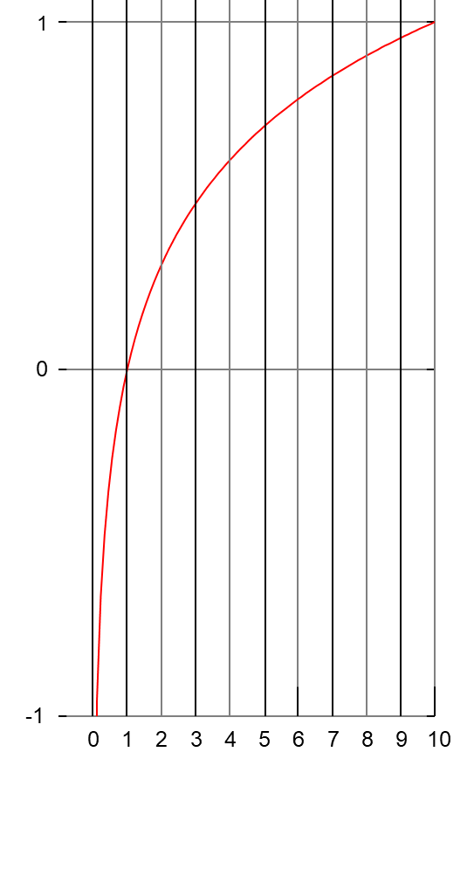
Log
Log base 10, to be exact.
Log(10) = 1
Log(1) = 0
Log (.1) = -1
10¹ = 10
10⁰ = 1
10⁻¹ = 0.1

Slide 3
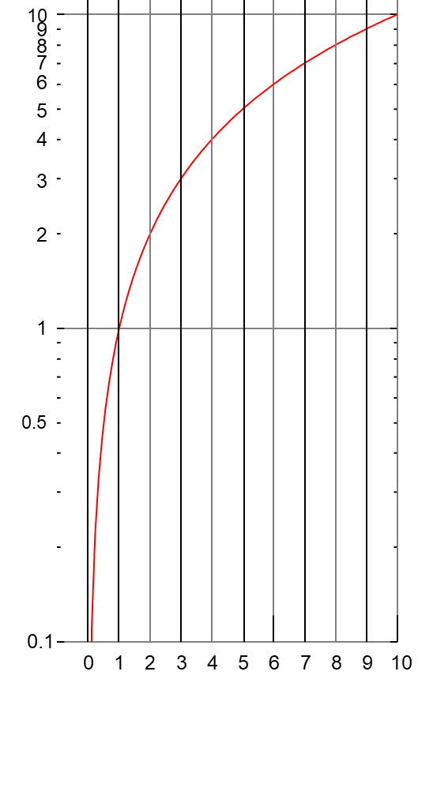
Semilog Paper
Different Labels
We still see the shape of the curve, but we label it using the input.

Slide 4
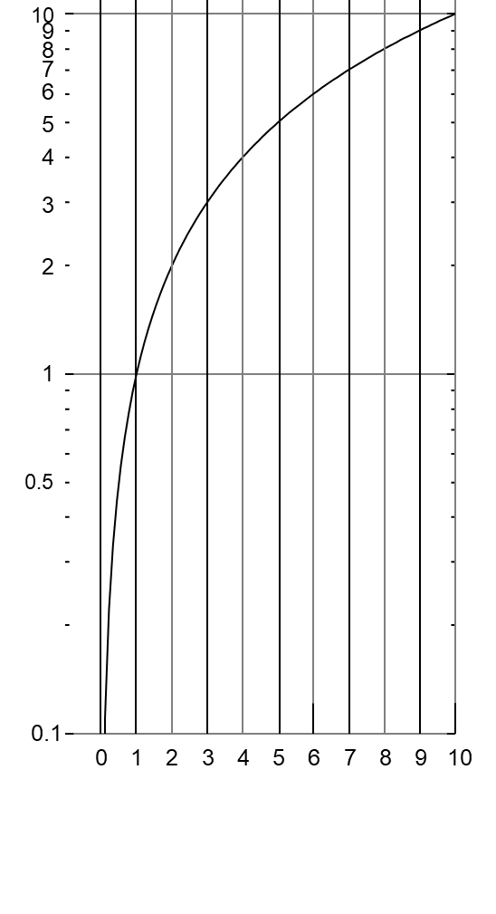
Two Parties
Same population

Slide 5
Two Parties
Second party has twice the population

Slide 6
Two Parties
Second party has twice the population
The interesting thing about logs is all you have to do to multiply or divide is to shift up or down. So, to account for the factor of two, all we have to do is line up the first seat for the less populous party with the second seat for the more populous party.

Slide 7
Algorithm
Fill from bottom

Slide 8
Algorithm
Fill from bottom

Slide 9
Algorithm
Fill from bottom
Use midpoint between top and bottom to determine seats/vote ratio.
-

Slide 10
Algorithm
-
-
-
-
-
-
-
-
-
-
Fill from bottom
Use midpoint between top and bottom to determine seats/vote ratio.
This ratio is raised until all the seats are filled.
Ratio
10:5
2
-
-
-
-
-
-
-
-

Slide 11
Algorithm
-
-
-
-
-
-
-
-
-
-
Fill from bottom
Use midpoint between top and bottom to determine seats/vote ratio.
This ratio is raised until all the seats are filled.
Ratio
10:5
2
-
-
-
-
-
-
-
-

Slide 12
End

Slide 14
Working slides

Slide 15
Algorithm
Fill from bottom
-

Slide 16
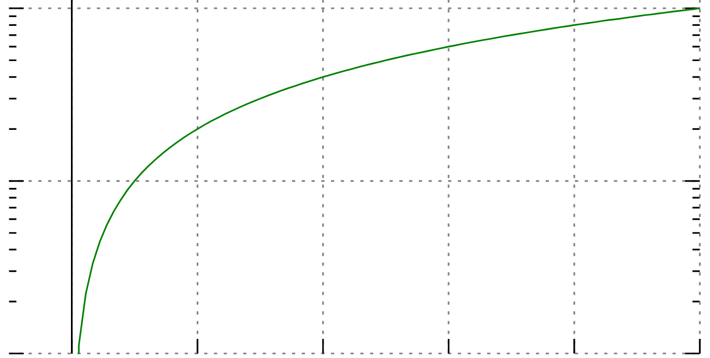

Slide 18
Log
This is log base 10.
Any log works.
Natural log works.
10
f(x) = x
1
0.1
0
2
4
6
8
10

Slide 19
Log
This is log base 10.
Any log works.
Natural log works.
10
f(x) = x
1
0.1
0
2
4
6
8
10

Slide 20
Log
This is log base 10.
Any log works.
Natural log works.
10
f(x) = x
1
0.1
0
1
2
3
4
5
6
7
8
9
10

Slide 21
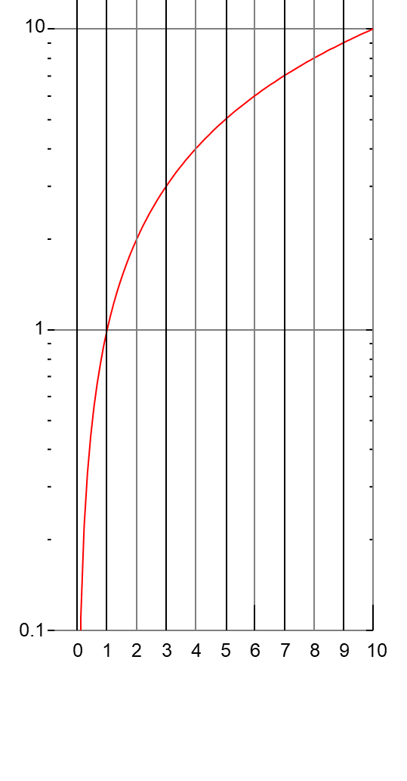
Log
10
1
0.1
0
1
2
3
4
5
6
7
8
9
10

Slide 22
Log
10
9
8
7
6
5
4
3
2
1
0.5
0.1
0
1
2
3
4
5
6
7
8
9
10

Slide 23
Log
1
0
-1
0
1
2
3
4
5
6
7
8
9
10

Slide 24
Log
10
9
8
7
6
5
4
3
2
1
0.5
0.1
0
1
2
3
4
5
6
7
8
9
10

Slide 25
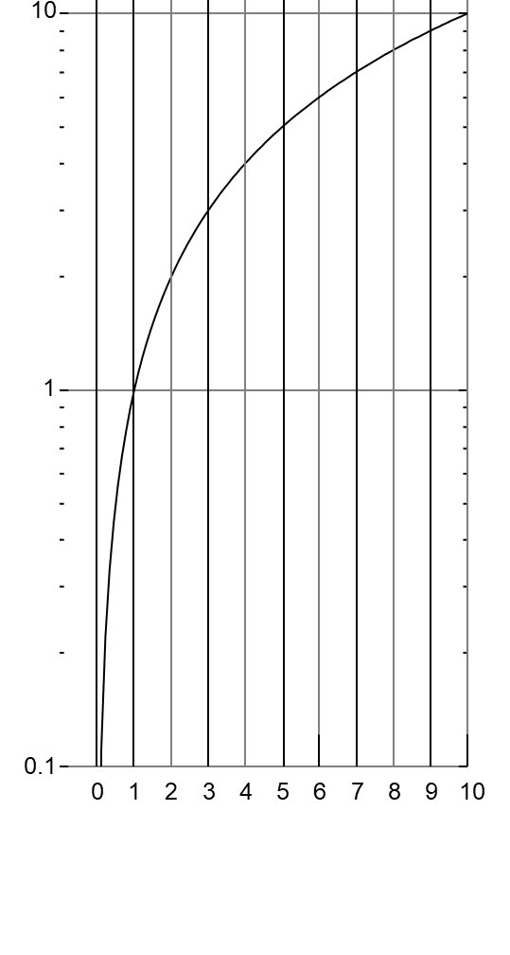
Log
10
1
0.1
0
1
2
3
4
5
6
7
8
9
10

Slide 27
Shift to Multiply
The interesting thing about logs is all you have to do to multiply or divide is to shift up or down. So, to account for the factor of two, all we have to do is line up the first seat for the less populous party with the second seat for the more populous party.

Slide 29
Log
1000
f(x) = 10_{x}
f(x) = x
f(x) = log¹⁰_{(x)}
This is log base 10.
Any log works.
Natural log works.
100
10
1
0.1
0
2
4
6
8
10

Slide 30
Log
Log Base 10

Slide 31
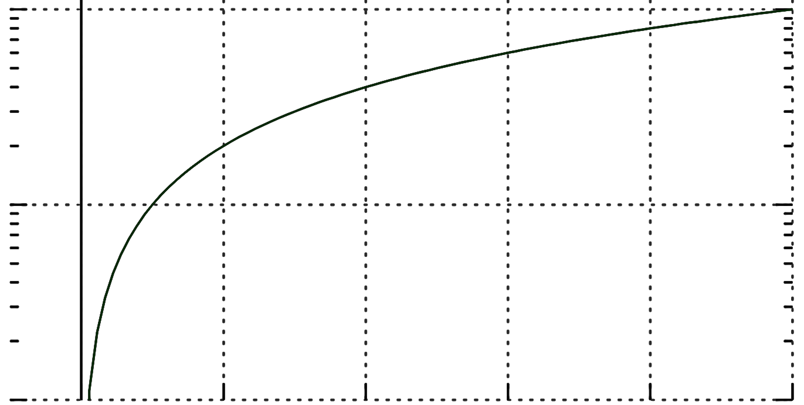
Log
Log Base 10

Slide 32
Log
Log Base 10

Slide 33
Shift Up

Slide 34
Shift Up
Then we can number

Slide 35
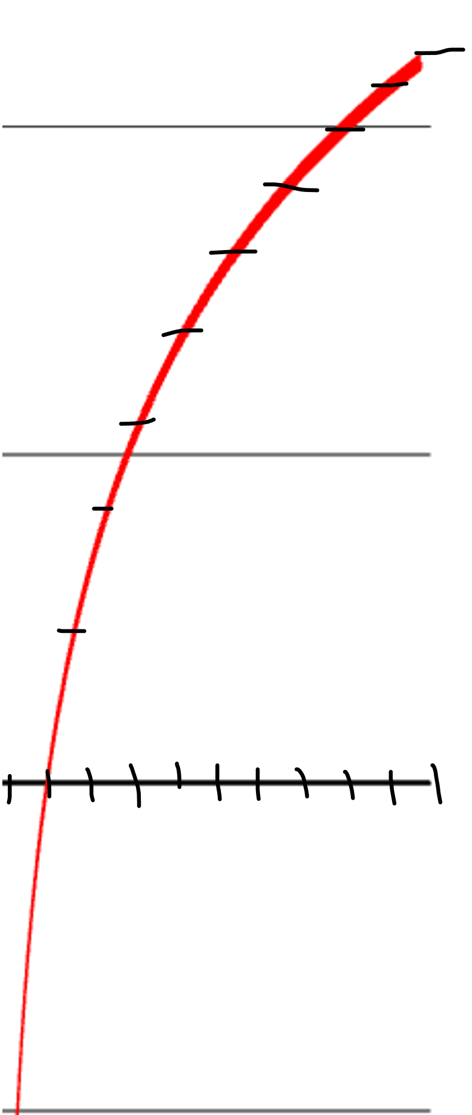
Natural Log

Slide 36
10
9
8
7
6
Natural Log
5
4
3
2
1

Slide 37
10
9
8
7
10
9
6
8
7
5
6
4
Natural Log
This is actually a straight line on a semilog graph.
5
3
4
2
3
2
1
1

Slide 38
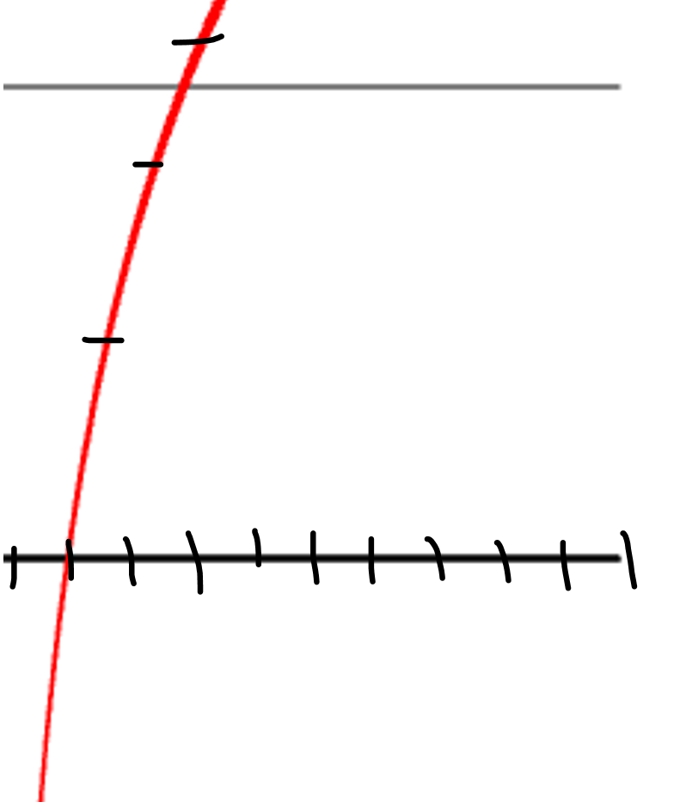
A
B
4
10
9
3
8
7
6
Two parties.
One has twice as many voters as the other.
5
2
4
3
2
1
1

Slide 39
Working Slides

Slide 40
