Slide 1
THE SMART SUPERMARKET MANAGEMENT SYSTEM
Student Name: IZABAYO Parfait
Student ID: 27144
Class Group: Monday
Lecturer: Eric Maniraguha
Course: INSY 8311 – Database Development with PL/SQL
Academic Year: 2024–2025
Notes:
Introduce yourself and your project title.

Slide 2
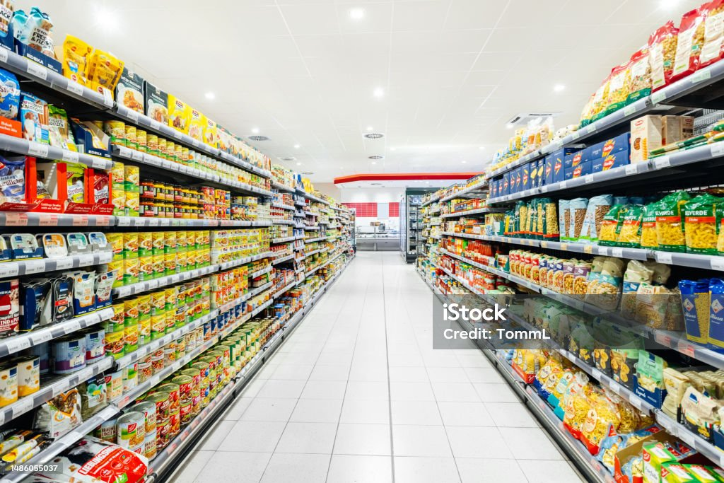
INTRODUCTION
This project presents a Smart Supermarket Management System developed using Oracle PL/SQL.
It automates inventory control, sales tracking, and supplier management to improve efficiency, accuracy, and transparency in retail operations.

Slide 3
Problem Statement
Inconsistent stock levels
Manual and error-prone order and invoice processing
Limited performance analytics
Lack of audit tracking for sensitive actions
Notes:
Describe the major problems faced by supermarkets.

Slide 4
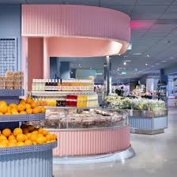
Project Objectives
Automate stock, sales, and orders
- Ensure data consistency with constraints and triggers
- Provide analytics using PL/SQL functions and cursors
- Enable secure and traceable database operations
- Support real-time inventory and financial insights

Slide 5
Target Users
- Cashiers
- Store Managers
- Inventory Controllers
- Suppliers
Notes:
Mention who will use this system.

Slide 6
Database Tables
CATEGORY, PRODUCT, CUSTOMER, SUPPLIER, EMPLOYEE,
INVOICE, INVOICE_DETAIL, ORDER_SUPERMARKET,
STOCK, AUDIT_LOG, HOLIDAY
Notes:
Briefly explain what tables store the data.

Slide 7
SQL & PL/SQL Components
Procedures: add_invoice_detail
Functions: get_invoice_total
Cursors: low_stock_cursor
Packages: Supermarket_Package
Triggers: prevent_dml_on_holidays, log_user_action
Notes:
Explain how PL/SQL automates operations.

Slide 8
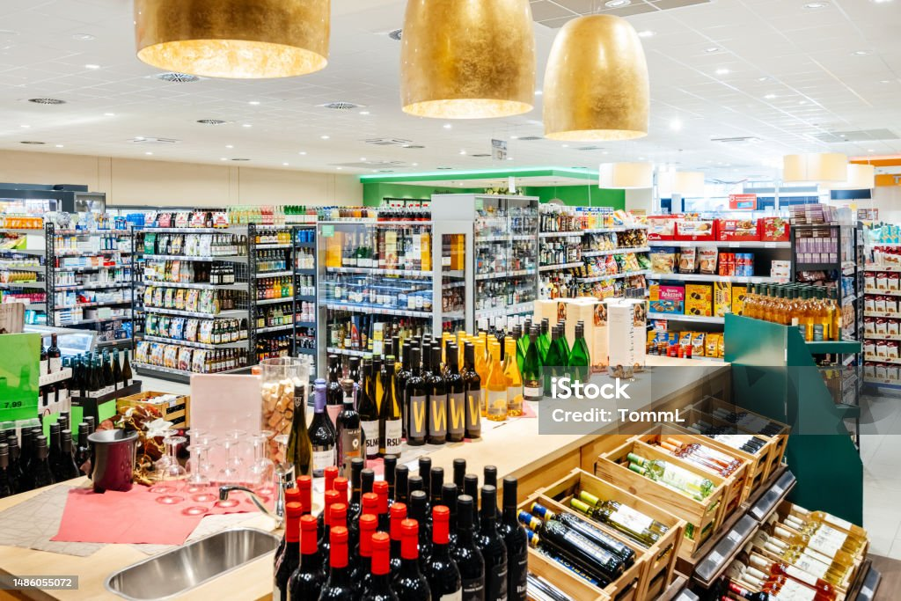
SQL & PL/SQL Components
Procedures: add_invoice_detail
Functions: get_invoice_total
Cursors: low_stock_cursor
Packages: Supermarket_Package
Triggers: prevent_dml_on_holidays, log_user_action

Slide 9
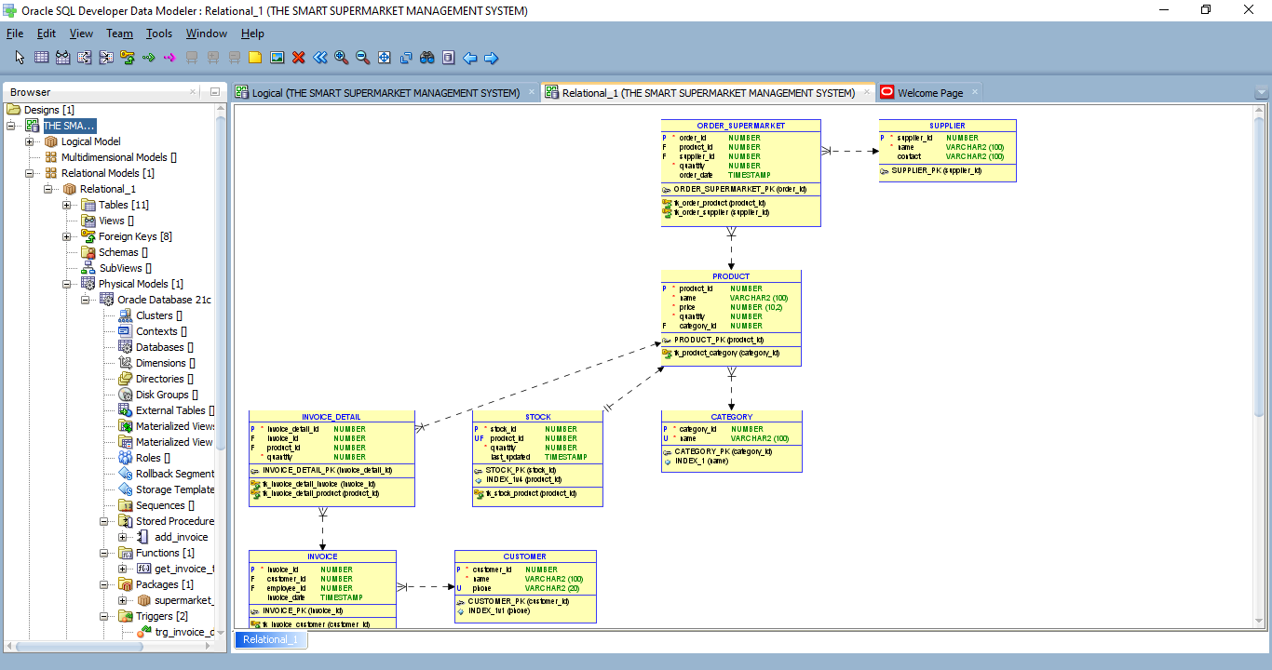
Entity Relationship Diagram (ERD)
This diagram shows relationships between products, customers, suppliers, employees, invoices, orders, and stock.
Notes:
Explain what the ERD shows.

Slide 10
Sample Data
Customers: Jean Bosco, Uwase Divine
Employees: Alice Mukamana, Eric Niyonzima
Suppliers: Niyonzima Suppliers Ltd, Kigali Wholesalers
Products: Rice, Sugar, Tea, Soap
Notes:
Talk about realistic test data.

Slide 11
Tools Used
Oracle Database 21c
Oracle SQL Developer
DBeaver
GitHub
Notes:
Mention the tools you used.

Slide 12
Auditing & Security
All updates and deletions are logged in the AUDIT_LOG table using triggers.
The HOLIDAY table prevents critical actions on public holidays.
Notes:
Explain how auditing improves security.

Slide 13
Future Enhancements
- Mobile app integration
- Real-time analytics dashboard
- Barcode scanning
- Supplier portal integration
Notes:
Discuss what can be improved in future.

Slide 14
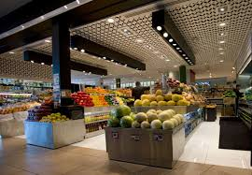
Conclusion
The Smart Supermarket Management System successfully automates supermarket operations using Oracle PL/SQL and provides a secure, reliable, and scalable solution.

Slide 15
Thank You
Presented by:
IZABAYO Parfait
Student ID: 27144

