Slide 1

G2M Case Study
Virtual Internship
21-November-2024

Slide 2
Agenda
Executive Summary
Problem Statement
Approach
EDA
EDA Summary
Recommendations

Slide 3
Background –G2M(cab industry) case study
Business Problem
XYZ Corporation seeks to determine the better investment opportunity between two U.S. cab companies, Pink Cab and Yellow Cab, by analyzing market trends, customer behavior, and financial performance.
Objectives
Assess usage patterns and customer preferences.
Analyze customer demographics and payment behaviors.
Compare revenue, profitability, and growth trends.
Evaluate market positioning and competitive advantages.
Recommend the better investment option.

Slide 4
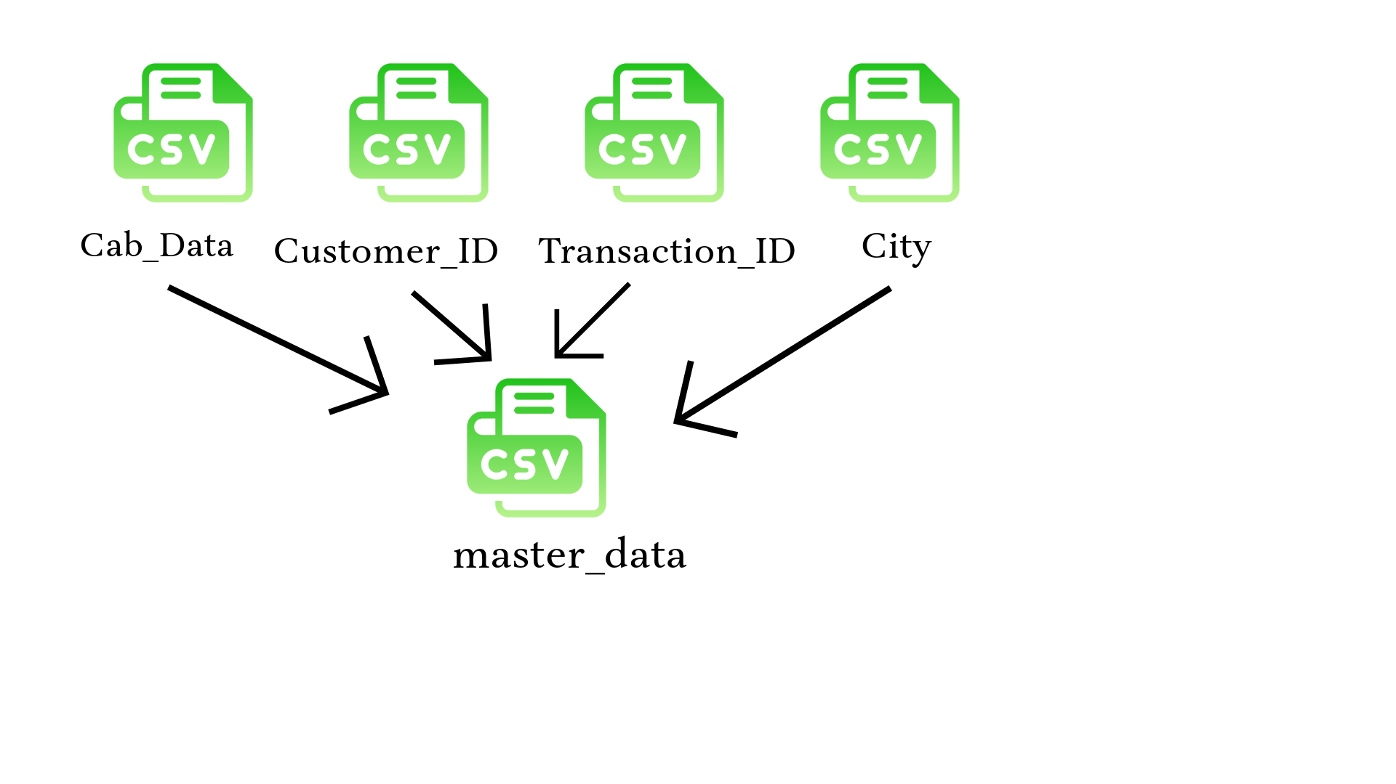
Data Intake and Understanding
16 Features
Timeframe of the data: 2016-01-31 to 2018-12-31
Total data points : 359392
Assumptions:
Outliers are present in Price_Charged feature. However,
this can be due to premium or luxury services
(e.g., high-end vehicles, personalized features) that cost more.
Therefore, we are not removing these outliers.

Slide 5
Profit Analysis
Hypothesis 1: Yellow Cab is more popular in terms of usage compared to Pink Cab.
Analysis 1: Number of Users by Company
Analysis 2: Total KM Traveled by Company
Analysis 3: Monthly Trip Volume Trends

Slide 6
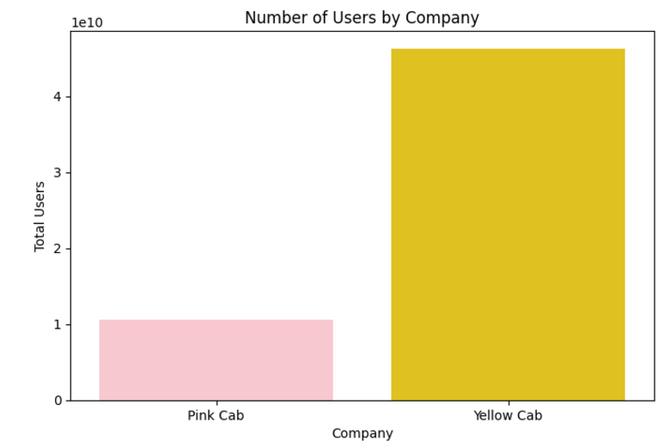
Number of Users by Company

Slide 7
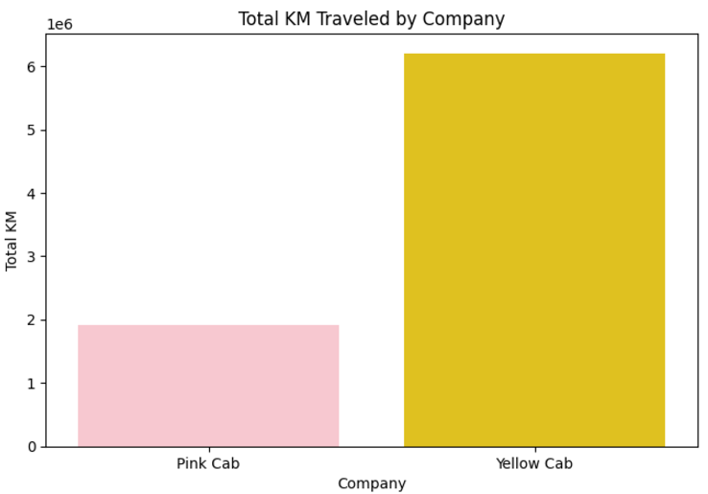
Total KM Traveled by Company

Slide 8
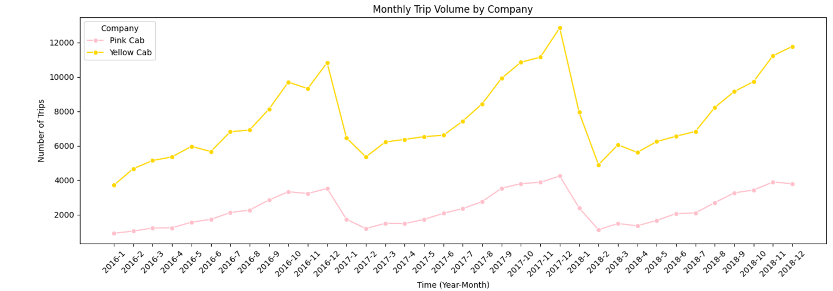
Monthly Trip Volume Trends

Slide 9
Profit Analysis
Hypothesis 2: Yellow Cab generates higher revenues per trip compared to Pink Cab.
Analysis 1: Price Charged per Trip
Analysis 2: Average Cost of Trip and Profitability
Analysis 3: Customer Income Comparison

Slide 10
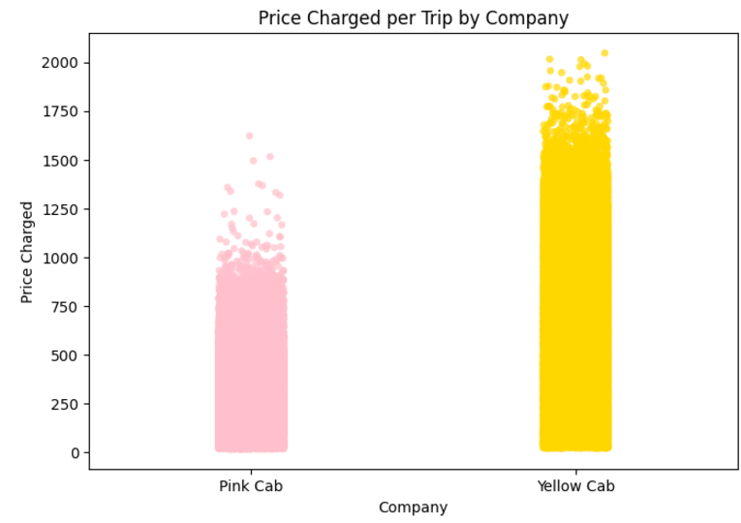
Price Charged per Trip

Slide 11
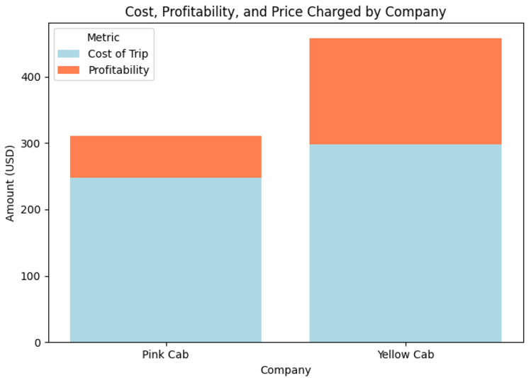
Average Cost of Trip and Profitability

Slide 12
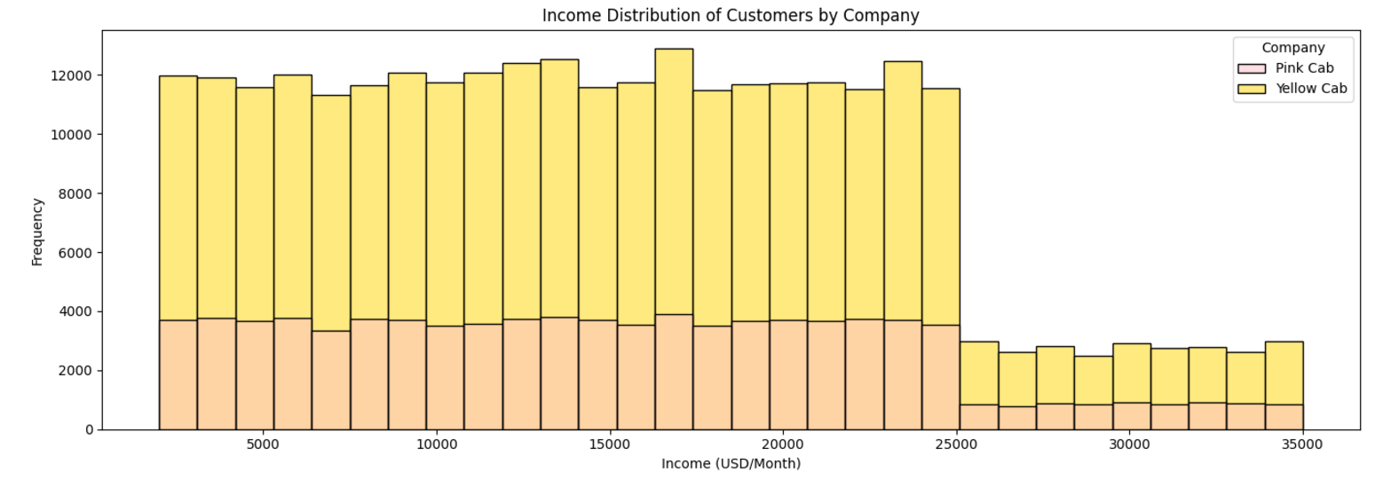
Customer Income Comparison

Slide 13
Profit Analysis
Hypothesis 3: Yellow Cab caters to a younger demographic than Pink Cab.
Analysis 1: Average Age of Users for Pink Cab and Yellow Cab
Analysis 2: Age Distribution and Company Choice
Analysis 3: Age Group vs. Distance Traveled (KM Travelled)

Slide 14
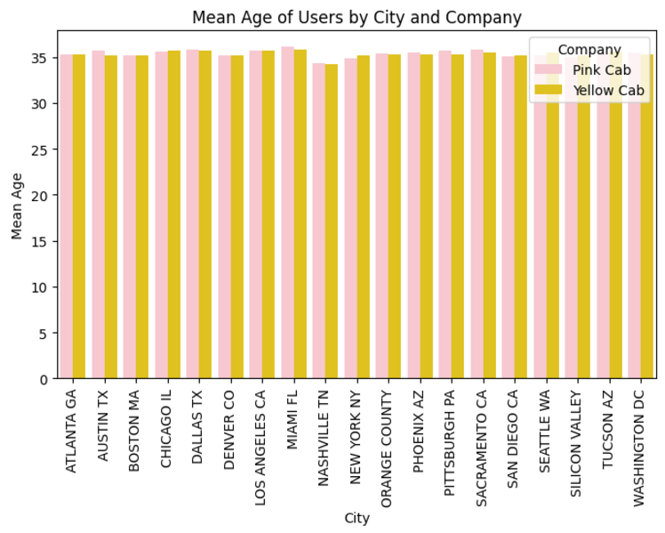
Average Age of Users for Pink Cab and Yellow Cab

Slide 15
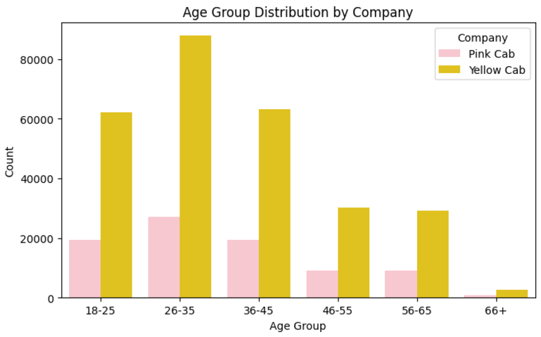
Age Distribution and Company Choice

Slide 16
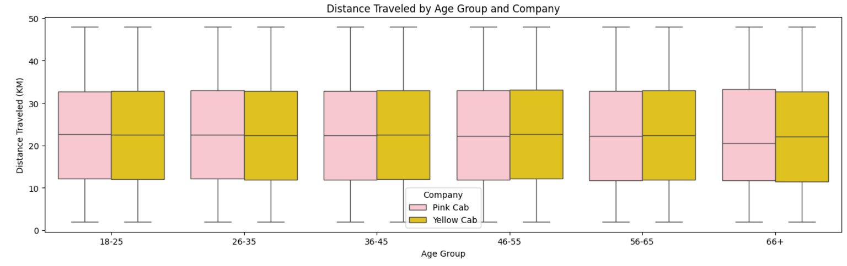
Age Group vs. Distance Traveled (KM Travelled)

Slide 17
Profit Analysis
Hypothesis 4: Customers in larger cities prefer Yellow Cab over Pink Cab.
Analysis 1: City Size vs. Company Preference
Analysis 2: Average Distance Traveled by City Size and Company
Analysis 3: Revenue Comparison by City Size and Company

Slide 18
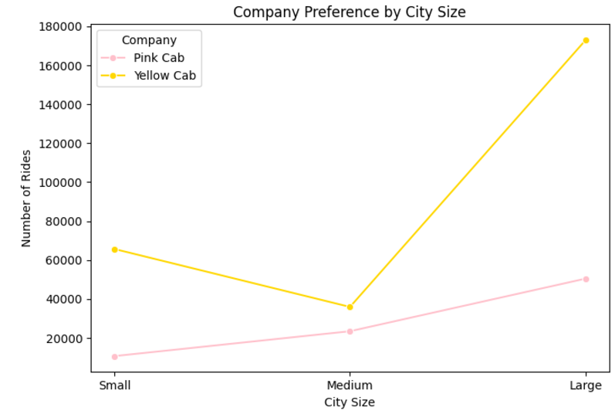
City Size vs. Company Preference

Slide 19
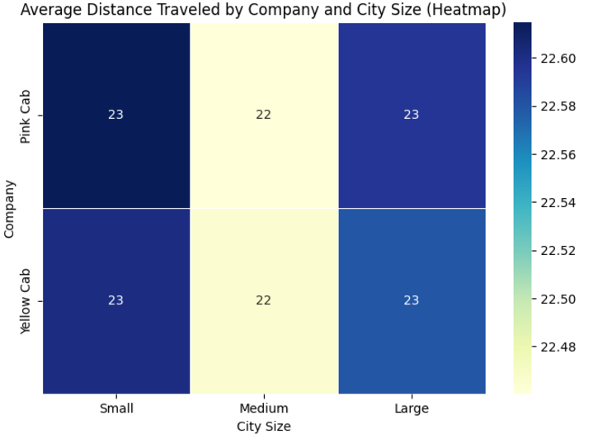
Average Distance Traveled by City Size and Company

Slide 20
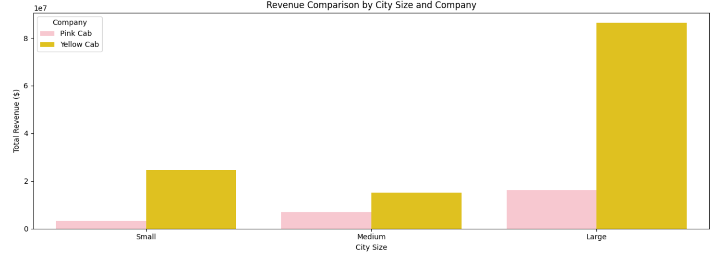
Revenue Comparison by City Size and Company

Slide 21
Profit Analysis
Hypothesis 5: Customers who use Pink Cab are more likely to choose cashless payment methods (like Card or App-based payments), while Yellow Cab customers tend to use more traditional payment methods (like cash).
Analysis 1: Payment Method Distribution by Company
Analysis 2: Payment Mode Distribution in Large Cities by Company
Analysis 3: Age vs. Payment Mode

Slide 22
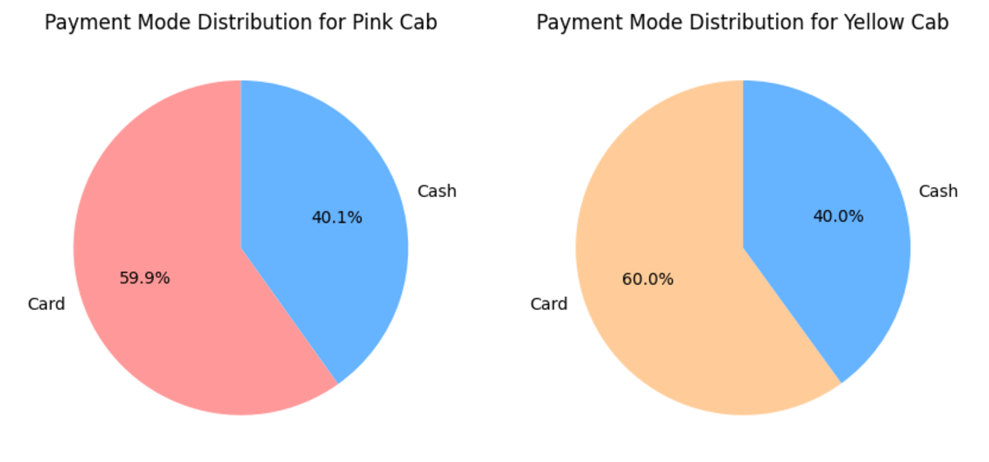
Payment Method Distribution by Company

Slide 23
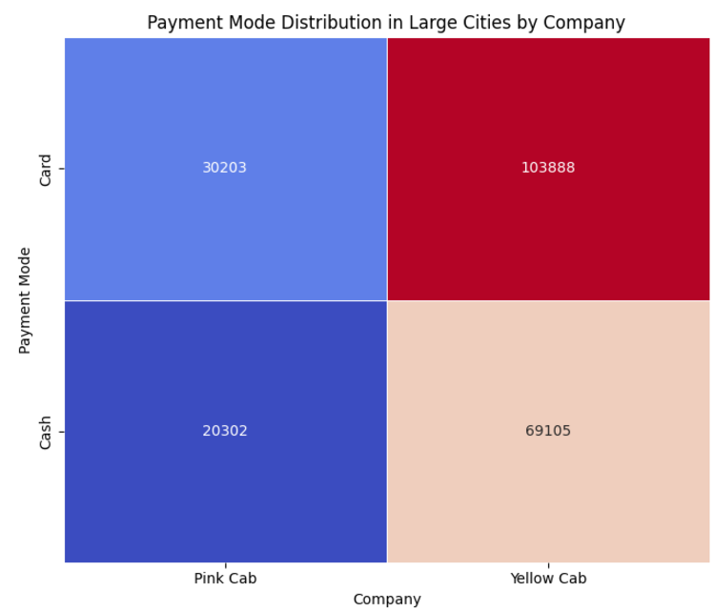
Payment Mode Distribution in Large Cities by Company

Slide 24
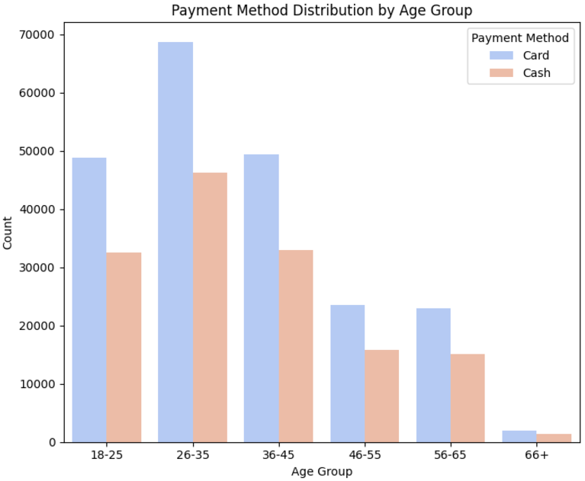
Age vs. Payment Mode

Slide 25
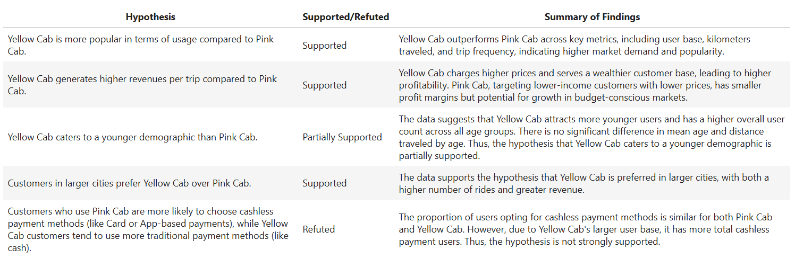
Key Findings and Hypotheses Summary

Slide 26
Recommendations
Invest in Yellow Cab
Reasons:
Market Dominance: Yellow Cab consistently outperforms Pink Cab in user base, trip frequency, and revenue across all city sizes, especially in large urban areas where profitability is highest.
Higher Revenue Potential: Yellow Cab generates significantly more revenue per trip, driven by higher pricing and a wealthier customer base, ensuring better financial returns.
Scalability: Its strong foothold in large cities makes Yellow Cab more scalable, with greater opportunities for growth in high-demand, high-income markets.
Diversified Appeal: Yellow Cab attracts a broad demographic, including younger users, ensuring steady demand across various customer segments.
Conclusion: Yellow Cab’s established market presence, revenue potential, and scalability make it a more profitable and secure investment for XYZ compared to Pink Cab.

Slide 27
Thank You

