Slide 1
DevOps Lifecycle

Slide 2
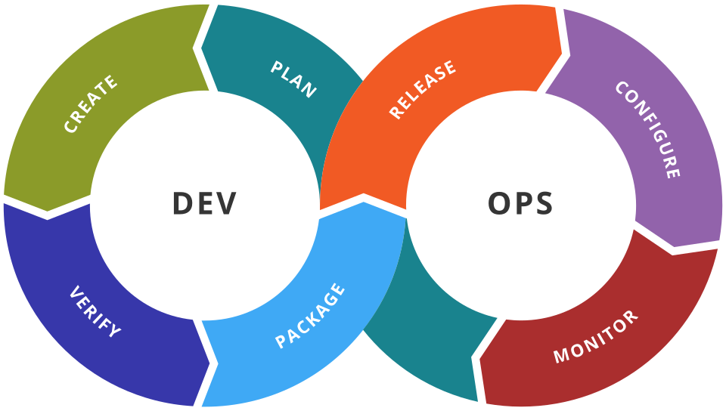
PLANNING
Planning is the first stage where project goals, requirements, and tasks are defined before development begins.

Slide 3
Requirement Gathering
01
Goal Setting
02
Task Assignment
03
Timeline Creation
04
Risk Identification
05
Resource Planning
06

Slide 4
Why Planning is Important?
Without Planning
With Planning
Confused team
Missed deadlines
Budget overruns
Poor communication
Clear roadmap
Better collaboration
On-time delivery
Higher productivity

Slide 5
TRELLO
AZURE BOARDS
JIRA
PLANNING TOOLS

Slide 6

JIRA
Jira is an Issue Tracking and Agile Project Management tool.
Developed by Atlassian in 2002.
Used to plan, organize, assign and track project work.
Supports Scrum and Kanban methodologies.
Widely used in software development teams.

Slide 7
FEATURES
Issue & bug tracking
Scrum and Kanban boards
Sprint & backlog management
Customizable workflows
Dashboards and reports
Integration with GitHub, Bitbucket, Jenkins, etc.

Slide 8
ADVANTAGES
DISADVANTAGES
Easy Collaboration
Customizable Workflow
Real-Time Tracking
Learning Curve
Paid Advanced Features

Slide 9
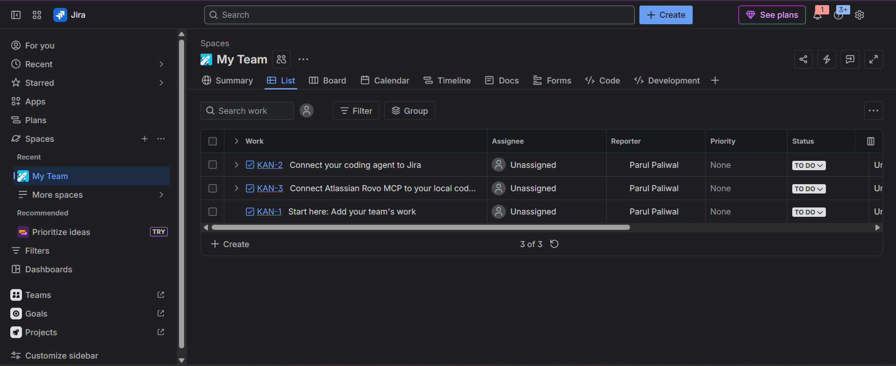
JIRA INTERFACE

Slide 10
What is an Issue in Jira ?
An Issue is a work item in Jira that represents a task, bug, feature request, or any piece of work that needs to be tracked and completed.
Type of Issues
Issue Type | Description
Epic | A large feature consisting of multiple stories or tasks.
Story | A user requirement or functionality.
Task | A general work item assigned to a team member.
Bug | An error or defect that needs to be fixed.

Slide 11
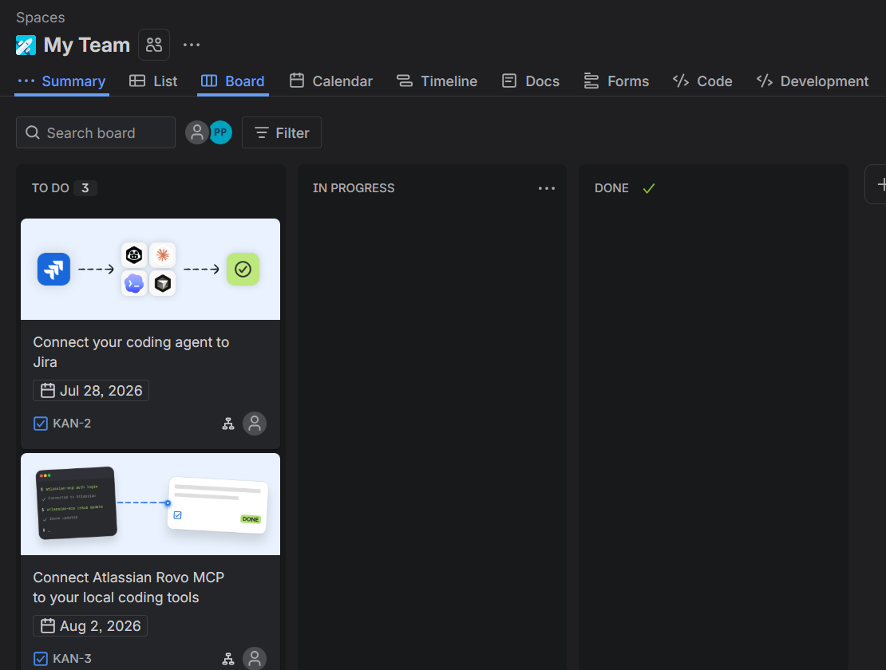
JIRA WORKFLOW
Kanban Board in Jira
Create Issue
↓
Add to Backlog
↓
Assign to Team Member
↓
Track Progress on Board
↓
To Do → In Progress → Done
↓
Task Completed

Slide 12
What is Trello?

Slide 13
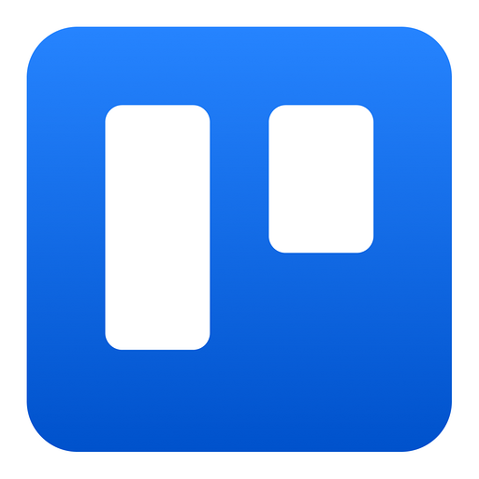
Trello
Trello is a free, web-based project management and productivity tool that helps individuals and teams organize tasks visually using boards, lists, and cards.

Slide 14



Trello Features
cards are the core units of work that sit inside lists on a board. Each card represents a single task, idea, or item that needs to be tracked. Cards can hold a title, description, due date, checklist, labels, attachments, and comments, making them highly customizable and detailed.
for example, from To
Boards
List
Cards
Boards are the highest-level organizational unit in Trello. Each board represents a single project or workflow, giving your team a centralized space to manage all related tasks and progress. Examples include boards for a Marketing Campaign, E-commerce .
In Trello, lists are the vertical columns on a board that represent stages, categories, or workflows. They act as containers for cards (tasks), helping you organize and track progress visually. For example, if you’re managing assignments, you might create lists like “To Do,” “In Progress,” and “Completed.”

Slide 15
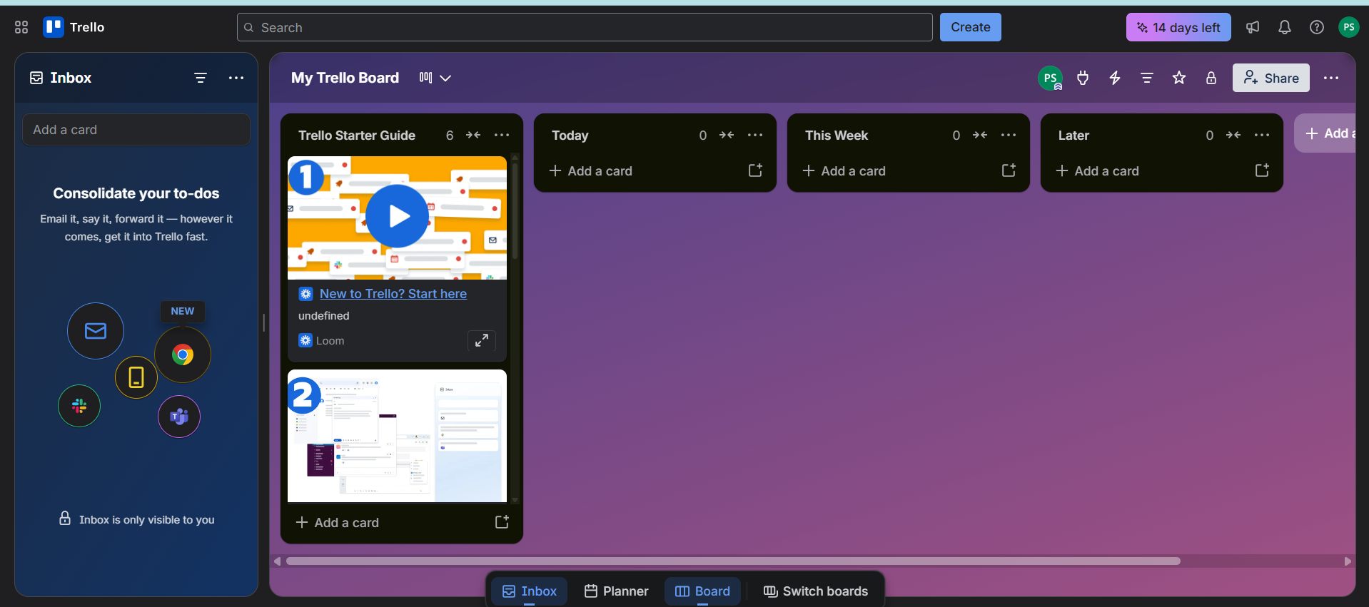
TRELLO

Slide 16
Labels in Trello
How Labels Work
Example for Students
Name
Tag
Filter
Category
Green Label: “Programming”
Yellow Label: “Theory”
Red Label: “Urgent”
Blue Label: “Group Project”

Slide 17
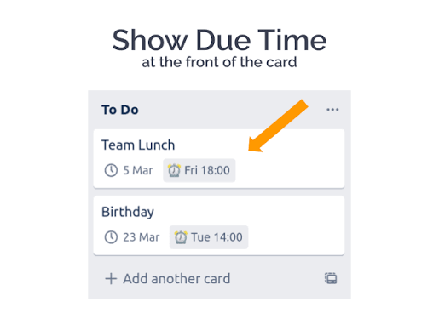
Due Date In Trello
In Trello, a due date is a deadline you attach to a card to track when a task needs to be completed. It’s a built‑in feature that helps you stay on schedule and avoid missing important tasks. Card: “Submit DBMS Project”
Due Date: July 25, 2026, 11:59 PM
Labels: Red (Urgent), Blue (Group Project) This way, you know both the priority and the exact deadline.

Slide 18
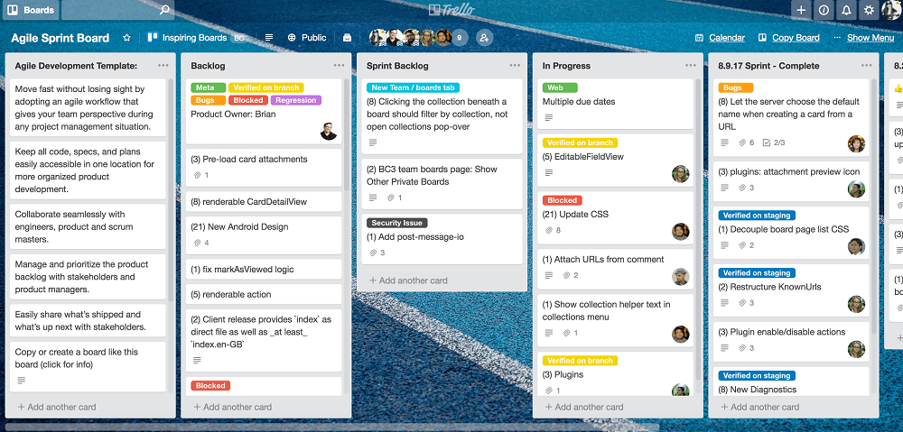
Uses In E-Commerce
In e‑commerce, Trello is used as a visual project management tool to streamline workflows and improve team collaboration. Businesses can create boards for different areas such as product launches, marketing campaigns, inventory management, or customer support. Within each board, lists can represent stages like Ideas, In Progress, Testing, and Live, while cards hold specific tasks such as upload product images, update pricing, or schedule social media posts. Labels help categorize tasks by urgency or department, and due dates ensure deadlines are met for promotions or seasonal sales.

Slide 19
What is Azure Boards?
A work tracking tool inside Azure DevOps for planning, organizing, and tracking software projects.
Notes:
Azure Boards is a work tracking tool inside Azure DevOps that helps teams plan, organize, and track their work. It supports Agile and Scrum, so it fits well with modern software teams.

Slide 20



Azure Boards
Introduction to Project Management Tools
A work tracking tool inside Azure DevOps
Used to plan and manage software projects end-to-end
Helps teams plan, organize, assign & track work
From high-level goals down to daily tasks
Supports Agile and Scrum methodologies
Fits naturally into modern software teams
Notes:
Azure Boards is a work tracking tool inside Azure DevOps that helps teams plan, organize, and track their work. It supports Agile and Scrum, so it fits well with modern software teams.

Slide 21
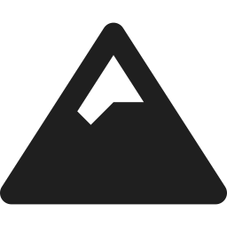
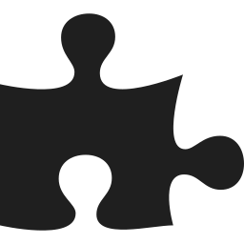

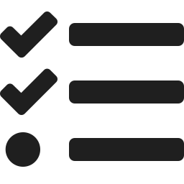
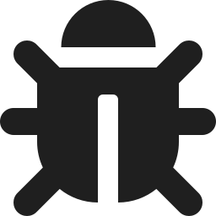
Key Components of Azure Boards
Work items are organized in a simple hierarchy, from big goals down to daily tasks
01
02
03
04
05
Epic
Feature
User Story
Task
Bug
Largest body of work
A deliverable piece of a project
A user need or requirement
A concrete unit of work
An issue to be fixed
Notes:
Azure Boards organizes work in a hierarchy, from big to small: Epics break down into Features, then into User Stories, and finally into Tasks. Bugs can be logged and linked at any level to track issues that need fixing.

Slide 22



Why Use Azure Boards?
Larger work is broken down step by step — an Epic contains Features, a Feature contains User Stories, and a User Story contains Tasks.
Plan project work
Assign tasks to
team members
Track progress
Manage bugs
Improve team
collaboration
Notes:
Azure Boards lets teams plan their work, assign tasks, track progress, manage bugs, and collaborate more effectively. That brings us to the end of the basics.

Slide 23
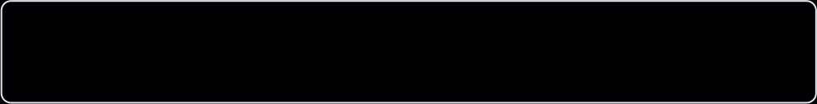

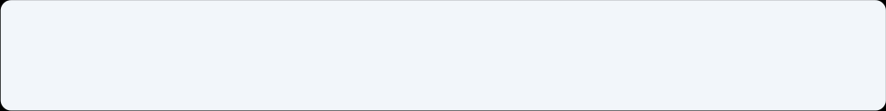

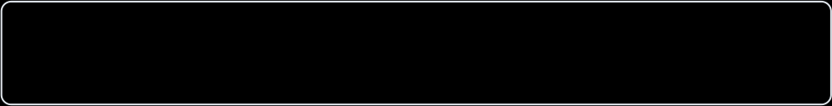
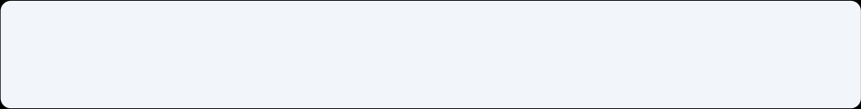

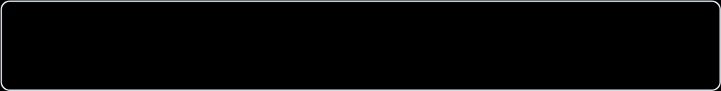
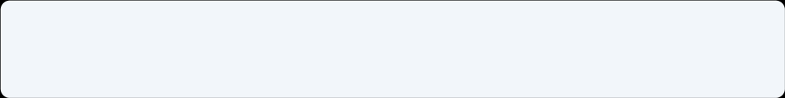

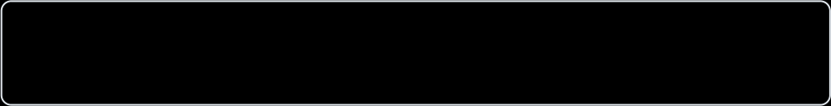
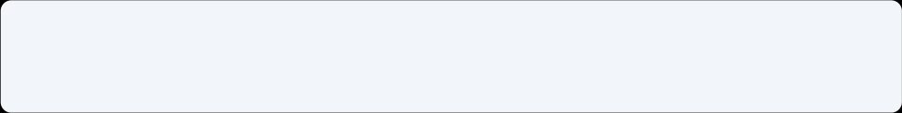

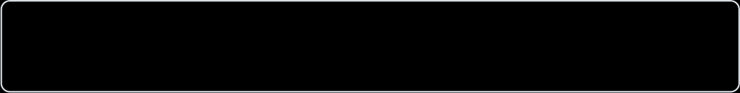
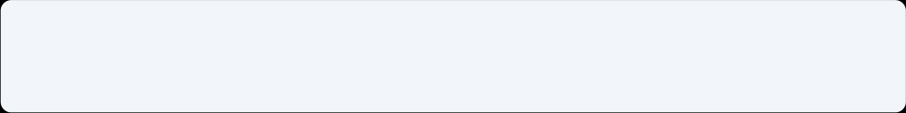

WHAT WE'LL COVER
Dashboard
Boards
Azure Boards
Backlog & Sprint
Interface & Demo
Work Items
Pipelines Connection
Demonstrated using the E-Commerce Website project

Slide 24
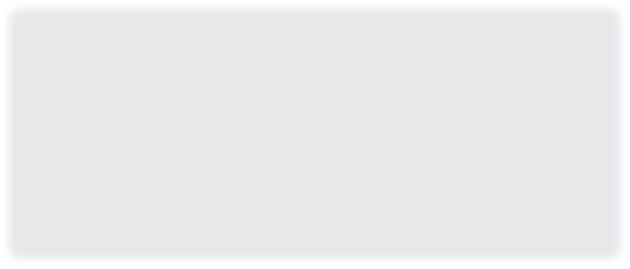
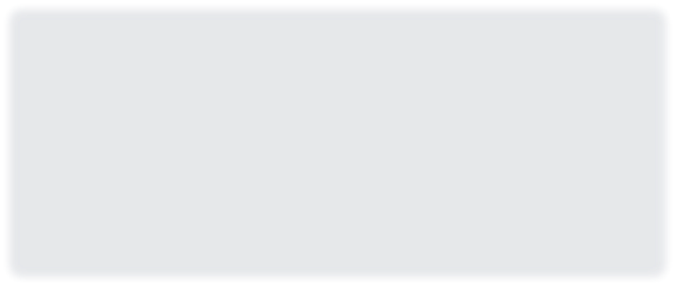












Azure Boards Interface
Four core areas teams use every day
Dashboard
Boards
At-a-glance widgets for project health: burndown, velocity,
Visual Kanban board where cards move across To Do, Doing,
and assigned work.
and Done.
Backlog
Sprint
Prioritized, ranked list of all user stories and features awaiting
A time-boxed iteration (1–4 weeks) where the team commits
work.
to a set of items.
Azure Boards Interface & Demo
2

Slide 25


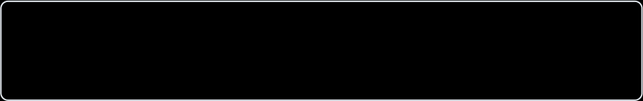
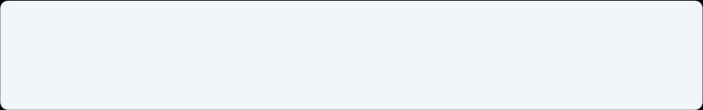

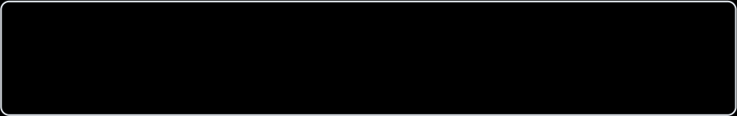








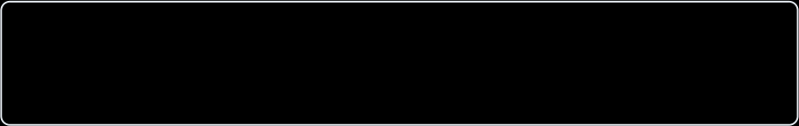
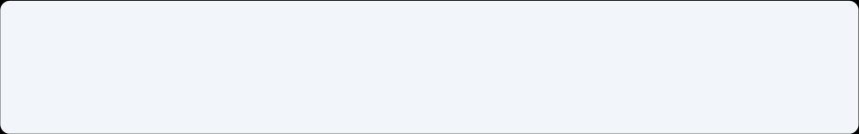


Work Items & the Pipelines Connection
How planned work gets tracked, and briefly, how it links to delivery
WORK ITEM TYPES
Pipelines Connection
Epic
A large body of work spanning multiple features
Azure Boards links directly to Azure Pipelines, so work
items connect to the code that resolves them.
Feature
A deliverable capability, e.g. "Checkout"
Work Item
▼
Commit / PR
User Story
A specific piece of functionality for a user
▼
Build Pipeline
▼
Bug
A defect found during development or testing
Release
3
Azure Boards Interface & Demo

Slide 26


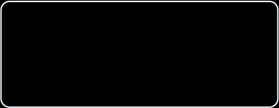
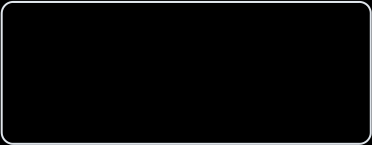
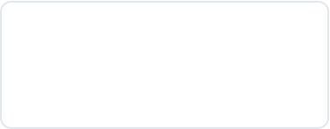
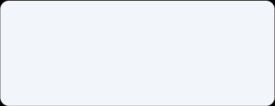
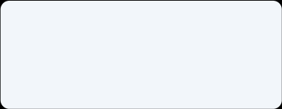
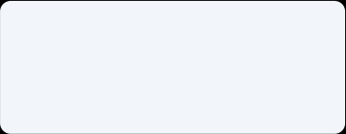




Azure Boards Structure
How a project's work is organized, top to bottom
Azure DevOps Project — E-Commerce Website
Team Backlog
Backlog
Boards (Kanban)
Sprints
Work Items: Epic →Feature →User Story →Task / Bug
4

Slide 27











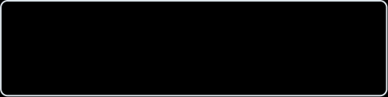
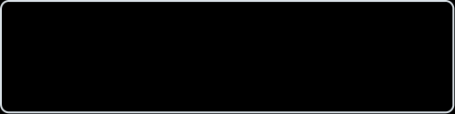






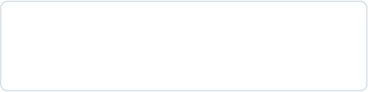
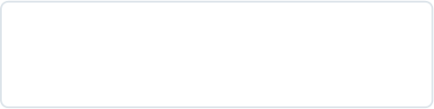
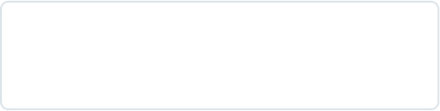



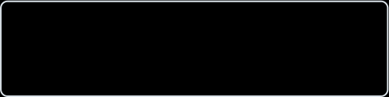

Demo: E-Commerce Website Project
A simplified Azure Boards Kanban view for the sample project
To Do
Doing
Done
User Registration
Shopping Cart Logic
Product Catalog UI
User Story
User Story
User Story
Product Search Filter
Payment Gateway API
Homepage Layout
User Story
User Story
User Story
Order History Page
User Story
5

Slide 28
Which Tool Should You Choose?
Trello
Jira
Azure Boards
BEST FOR
BEST FOR
BEST FOR
Students
Freelancers
Small startups
Software dev teams
Agile projects
Scrum teams
Large companies
Microsoft Azure users
Enterprise teams
WHY?
WHY?
WHY?
Easy to learn
Simple interface
Drag-and-drop boards
Free for basic projects
Sprint planning
Backlog management
Issue tracking
Advanced reporting
Work items
Sprint planning
Azure Pipelines integration
End-to-end DevOps

Slide 29
Comparison Table
Feature | Trello | Jira | Azure Boards
Ease of Use | Excellent | Very Good | Good
Best For | Students | Agile Teams | Enterprises
Learning Curve | Easy | Moderate | Moderate
Agile Support | Basic | Excellent | Excellent
Scrum Support | Limited | Excellent | Excellent
Kanban Boards | Yes | Yes | Yes
Integrations | Good | Excellent | Excellent
Scalability | Medium | High | High
Cost | Free tier available | Paid | Paid

Slide 30

Conclusion
Planning is the foundation of the DevOps lifecycle.
Tools like Jira, Trello, and Azure Boards help teams organize tasks,
collaborate effectively, and track project progress.
• Project Size
• Team Requirements
• Budget
• Workflow Complexity
Choose Trello
Choose Jira
Choose Azure Boards
Students, Freelancers, Small Teams
Agile & Scrum Software Development
Microsoft Azure & Enterprise Organizations

