Slide 1
Cpanel Xpress
Cpanelplus.net
info@cpanelplus.net
November 2003

Slide 2
What is Cpanel Xpress ?
CpanelXpress is a small utility to keep track of your CPanel accounts.
Once configured, you can open any CPanel login at a single click without having the need to re-enter their username and password.

Slide 3
Who can use Cpanel Xpress ?
Cpanel Hosting Providers
Resellers having moderate number of Clients
Individuals having multiple CPanel accounts

Slide 4
High Lights !
Manage any number of Cpanel accounts.
Manage Cpanel accounts on multiple servers
All the Data is stored in a secure encrypted file format
Password Protected Application
Free for Both Commercial and Personal Use.

Slide 5
Requirements
Windows 98 / Me / 2000 / XP
Internet Explorer 4.0 or higher

Slide 6
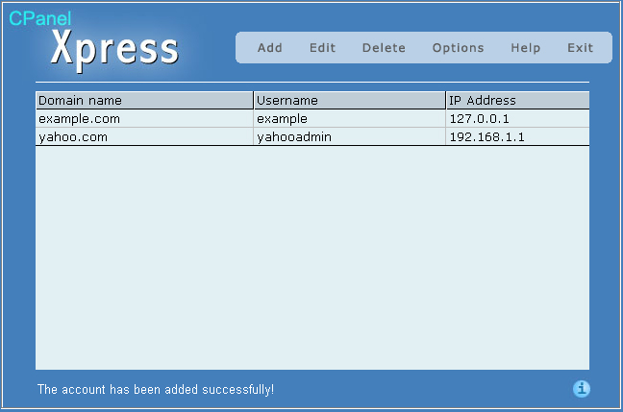
Cpanel Xpress - ScreenShot

Slide 7
Cpanel Xpress - Price !
$ 0.00 *
* Free for Commercial & Personal Use

Slide 8
Where to get Cpanel Xpress ?
You can download Cpanel Xpress at our website
CpanelPlus.net

Slide 9
About CpanelPlus.net
cPanel is the most widely used control panel used by thousands of hosting providers around the world. Over the years cPanel has evolved into the most secure, feature rich, user-friendly control panel for the unix platform.
Though the developers of cPanel have tried their best to give us a good
control panel, by virtue of it's complexity and the huge number of features there are a few areas where we thought there is a possibility of some improvements. The purpose of cPanelPlus.net is to cater these areas, and help the users to take complete advantage of the cPanel software.

