Slide 1
Nexion - Cpanel Skin
Cpanelplus.net
info@cpanelplus.net
October 2003

Slide 2
What is Nexion ?
Nexion is a cPanel skin with Windows Explorer styled User friendly interface, and having well categorized Menus and Sub-Menus for easy navigation.

Slide 3
High Lights !
The colors of the skin can be changed from a single configuration file.
Nexion has a well integrated 'Context Based Help' which will be very useful for the customers who are not aware of the advanced features.
Nexion also has in-built Java-Script Validations which checks all the user input variables and eliminates unwanted characters.

Slide 4
Nexion - Features
Windows Explorer style User Friendly Interface
Context Based Help where ever needed
Highly customizable
Change your color scheme whenever you want
Java Script Validations
Download in four exciting color schemes
Highly recommended for low bandwidth / DialUp users
Tested with popular versions of Interenet Explorer and Netscape Navigator
Free upgrades

Slide 5
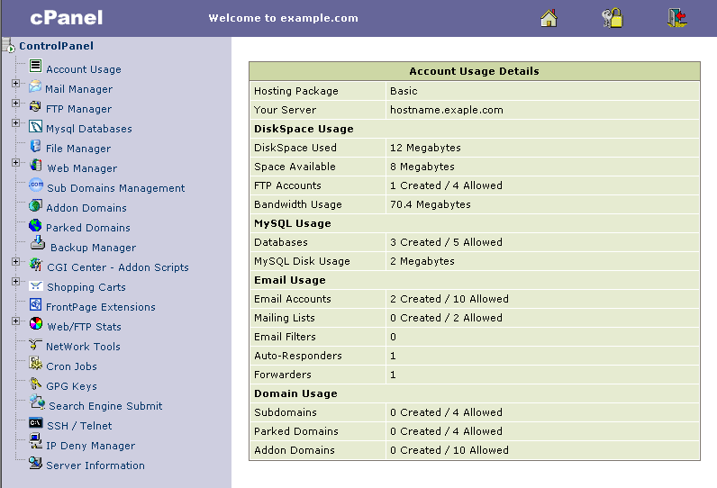
Nexion - ScreenShot

Slide 6
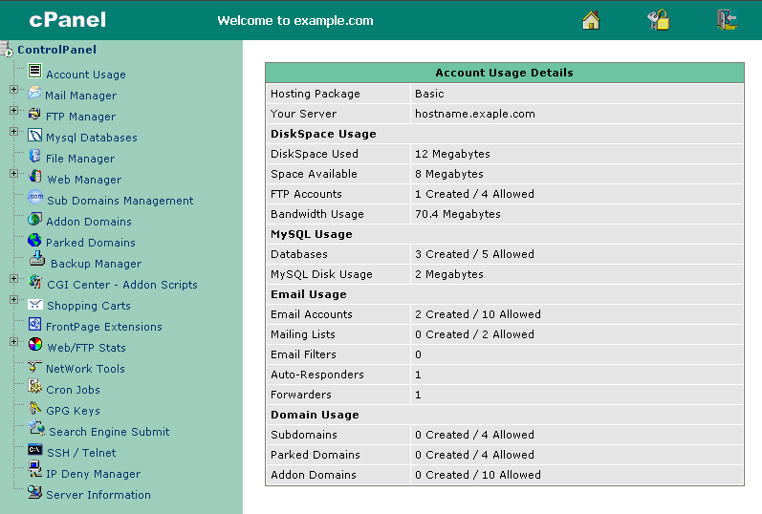
Nexion - ScreenShot

Slide 7
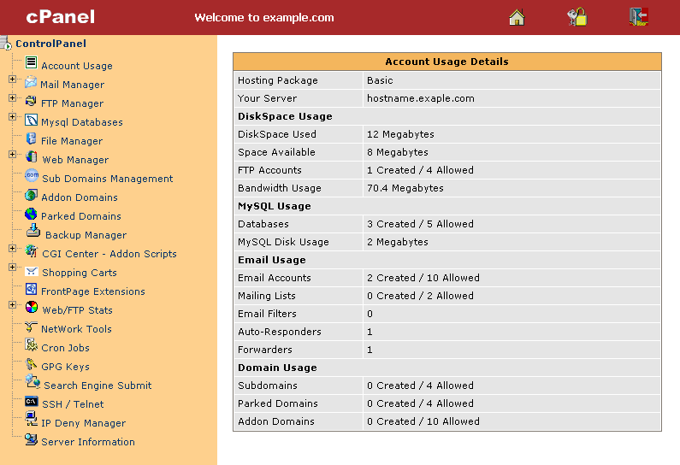
Nexion - ScreenShot

Slide 8
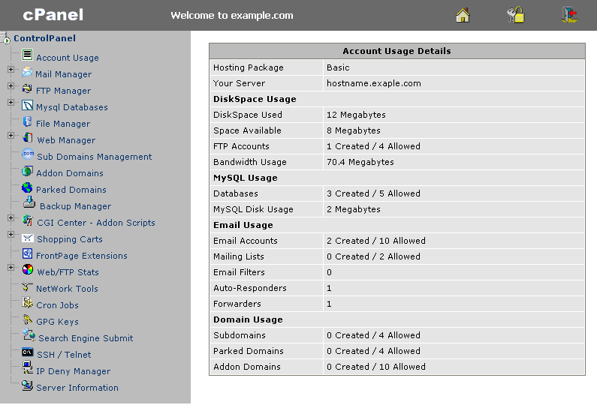
Nexion - ScreenShot

Slide 9
Nexion - Price
$ 40 / Server *
* One time fee

Slide 10
Nexion - How to buy
You can place an order at our website
CpanelPlus.net

Slide 11
Nexion - About CpanelPlus.net
cPanel is the most widely used control panel used by thousands of hosting providers around the world. Over the years cPanel has evolved into the most secure, feature rich, user-friendly control panel for the unix platform.
Though the developers of cPanel have tried their best to give us a good
control panel, by virtue of it's complexity and the huge number of features there are a few areas where we thought there is a possibility of some improvements. The purpose of cPanelPlus.net is to cater these areas, and help the users to take complete advantage of the cPanel software.

