Slide 1

Donation
Blood & Organ
By: Parinitha Pembarthi - 19H51A05E3
Savan Reddy - 19H51A05E4
Deepthi - 19H51A05E5
Project Guide: V. Narsimha

Slide 2
Table of Contents
Abstract
Introduction
Problem Statement
Aim of project
Literature review
Proposed methodology
Conceptual Design
Block Diagram
Requirement Analysis
Implementation
Result & Discussion
Conclusion
References

Slide 3
Abstract
Despite fast-evolving technology, we have hospitals struggling to provide blood and organs when the patient is in need of them. Because of this delay or scarce supply it is leading to death of the patient. Keeping these struggles and needs in mind we decided to create a Blood and Organ Donation website.This website will be a common domain for both the donor and the patient in need. The donor can just visit the website and share his details and the patient can in the same manner visit the website and find a donor of his choice.
We will be using Reactjs to create the front-end, Mongodb and Nodejs to create the backend of the Website.

Slide 4
Introduction
The person who gives the organs is called a donor, while a person who receives the organ is called a recipient.
Many patients and hospitals find for donors, but most of the time the donor isn’t available. This may lead to loss of life or complications in an operation due to the delay.
Sometimes the donor might be available but his health status won’t match the given requirements for the donation.
To bridge this gap of communication we decided to create a website that collects the data of a donor and encourages people to donate. And this website connects the patient to the donor as per his requirements.

Slide 5
Problem Statement
Despite fast-evolving technology, we have hospitals struggling to provide blood and organs when the patient is in need of them. Because of this delay or scarce supply it is leading to death of the patient.
Keeping these struggles and needs in mind we are trying to create a Blood and Organ Donation website. This website will be a common domain for both the donor and the patient in need.

Slide 6
Aim of the project
01
To create a Website that is user friendly and appealing to the eye.
02
To create a Website that encourages people to donate and guide them through the donation process.
03
To create a Website that stores the data of the donors and provides them to the patients as per their requirements
04
To create a Website that is serviced based and that uses minimal time to give or receive data.

Slide 7
Literature review
NHS Organ & Transplant
NHS Blood & Transplant
Ketto
This website is a UK based website, where one can register themselves and become a organ donor.
organdonations.nhs.uk
This website is a UK based website, where one can register themselves and become a Blood donor. They provide services like blood, transplantations, Diagnostics and research.
https://www.nhsbt.nhs.uk/
This is a Indian based website that enables donors to make charitable donations and donate money as well.
Kettodonation

Slide 8
Proposed methodology
3. Create Front-end
Make a flowchart
4. Create Back-end
2. Research
5. Host the website
Create the Front-end of the website by using Reactjs
Create a flowchart that maps the pages of the website and it’s connection to the backend
Create the Back-end of the website using Mongodb, Nodejs and Expressjs.
Research about organ and blood donation methodologies and their advantages.
The website will be taken public by hosting it on a cloud platform.

Slide 9
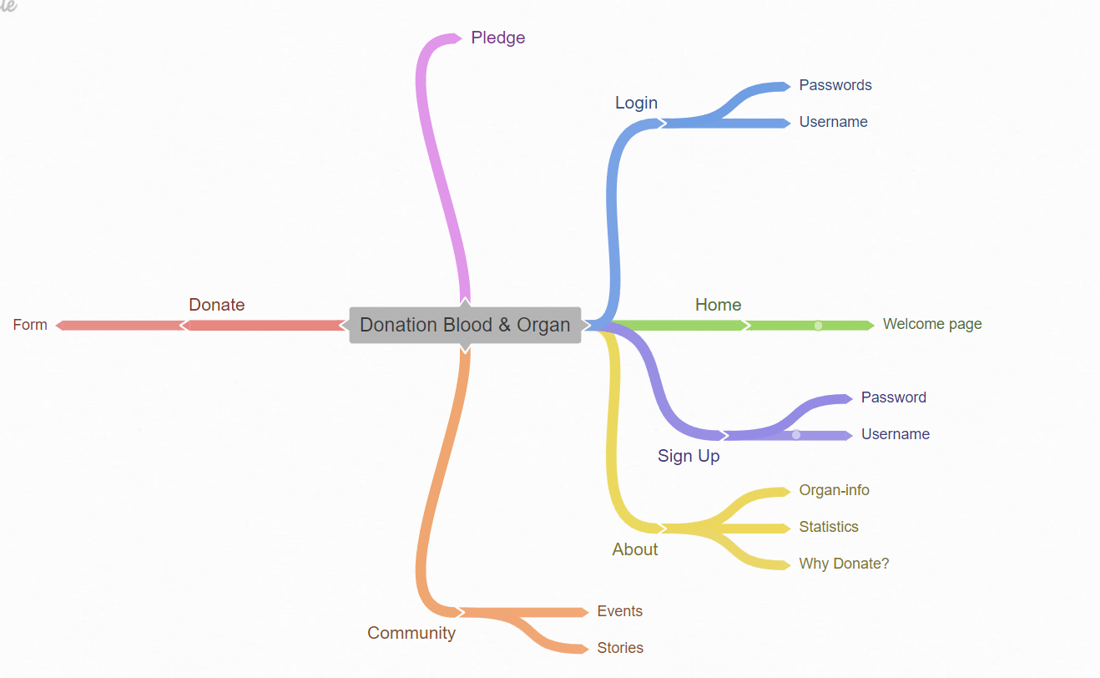
Conceptual Design

Slide 10
Block Diagram
Flowchart to make website
Front-end
Reactjs
Back-end
NodeJS
ExpressJs
MongoDb
Host the website

Slide 11
Requirement Analysis
Requirements to make the website are:
Database
Hosting of the website
Website with proper UI/UX
Languages to be used in the website:
MongoDb
ExpressJs
NodeJs
ReactJs

Slide 12
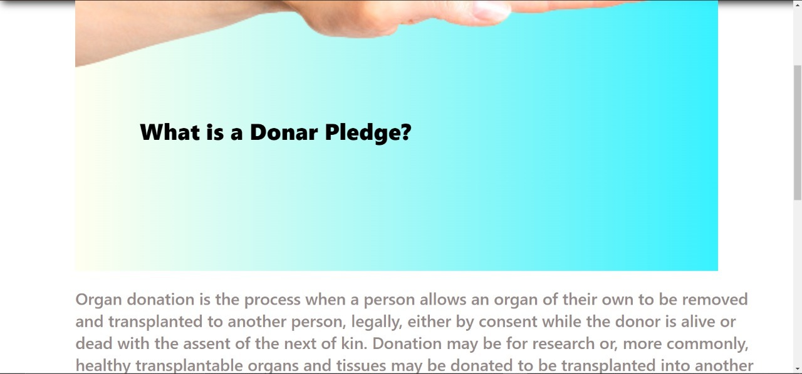
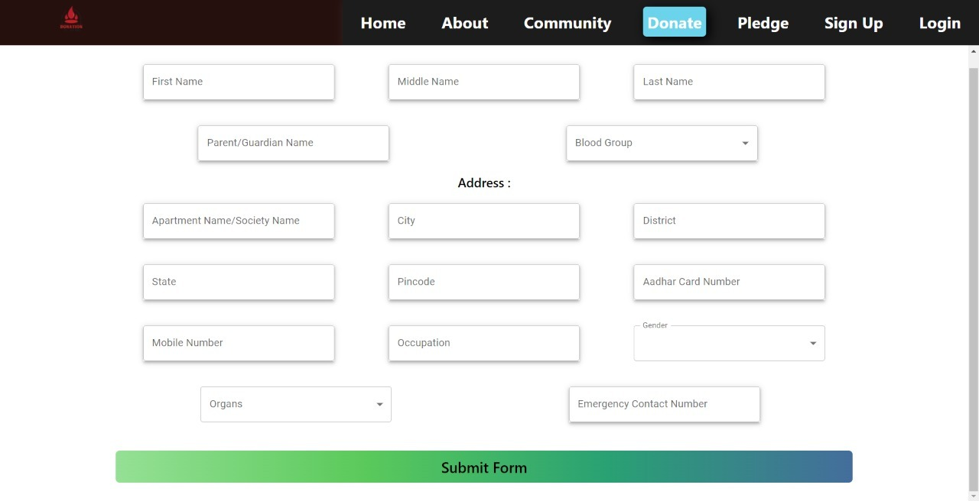
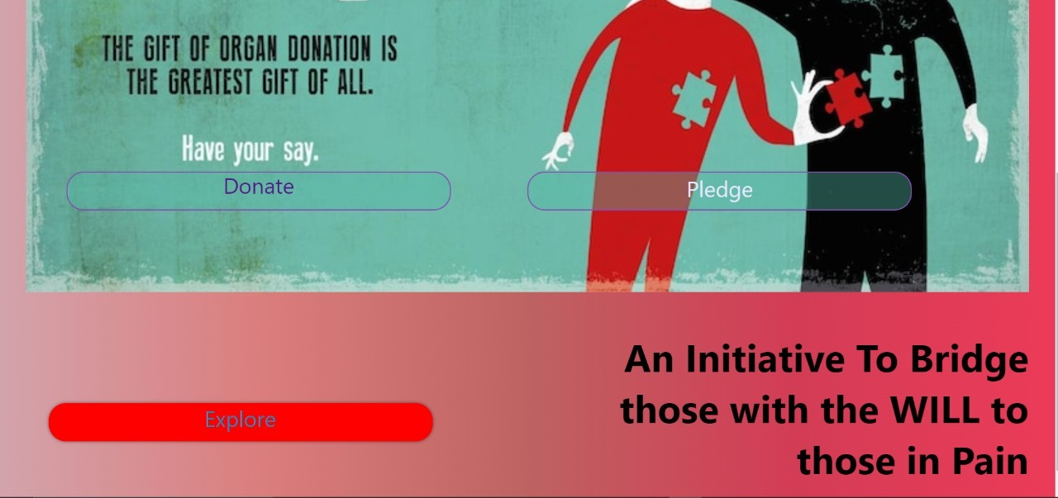
Implementation
We have created a website which can be used by a Donor to register himself and a patient contact our administration for his requirements

Slide 13
Result & Discussion
Understanding our problem statement we have come up with a user friendly website that can be accessible by all. We created a website in which a Donor can upload his information and register himself as a Donor. This information will be stored in our database. When there is a requirement, they can contact our administration for the same. When our administration gets a request we sort the data as per the requirements and provide the stakeholder with the details of the donor.

Slide 14
Conclusion
The old-fashioned way of approaching our blood-related relatives and family members for organs and blood works in a few cases but mostly fails. With our solution one can survive and receive the required organs and blood in a short span of time.
By uploading your information and registering yourself on our website one can save a person’s life. One can even share their donation and survival stories on our website and inspire others to register themselves.
We have also provided information about why should one donate and the procedure of each organ donation. Finally the donor information is stored in our database and is secure. This information is accessible by the administration as per the requirements.

Slide 15
References
https://www.organdonation.nhs.uk/
https://www.nhsbt.nhs.uk/
KettoDonation
MongoDb
https://nodejs.org/en/
https://expressjs.com/
https://reactjs.org/

Slide 16
Thanks!

