Slide 1
PREDICTION ON PIMA INDIANS DIABETES DATASET USING MACHINE LEARNING APPROACH
STUDENT DETAILS

Slide 2
Contents
Introduction
Methodology
Programming Environment
Dataset
Modelling
ML Algorithms
Performance Metrics
Experimental Results
Conclusion

Slide 3
Introduction
Diabetes Mellitus describes a metabolic disorder and the most dangerous chronic disease that could lead to other severe complicated conditions[1].
The complicated conditions are heart attack and sudden stock and Some of the risk factors for getting diabetes include being overweight and obese.
Diabetes symptoms are caused due to the raise of blood sugar.
Diabetes prevalence seems to be higher in states with greater per-capita income.
Diabetes is caused when the pancreas in the body is unable to generate insulin in enough quantity or when the cells and tissues in the body fail to utilize the insulin produced.

Slide 4
Methodology
Machine learning algorithms use computational methods to “learn” information directly from data without relying on a predetermined equation as a model. The algorithms adaptively improve their performance as the number of samples available for learning increases.
The proposed methodology focuses on the diagnosis of diabetes mellitus to make a decision support system. To diagnose the diabetes Pima dataset has trained by using machine learning algorithms for providing accuracy for diagnosis.[2]
Our proposed research works with the algorithms KNN, Random forest, decision tree, SVR and naïve bayes observed the experimental results from the parameter indices, i.e., Accuracy, Sensitivity and specificity, Precision, F1-Score.

Slide 5
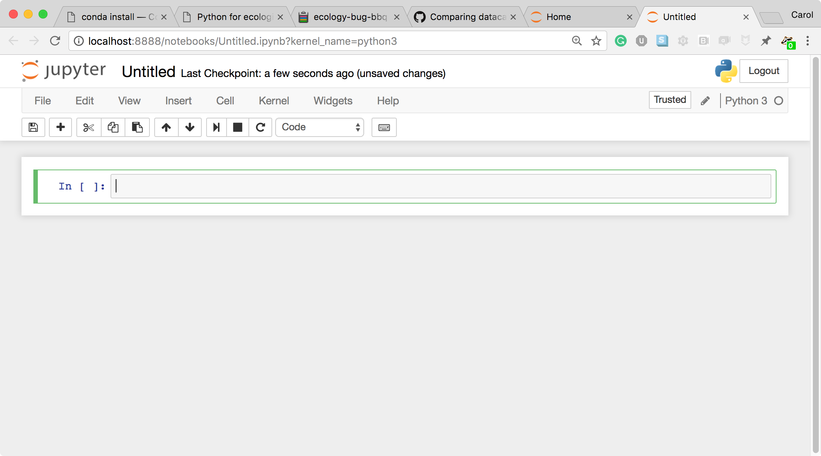
Programming Environment
Jupyter notebook is an integrated development environment (IDE) (IDE). It is open source and supports different programming languages. You may use the Jupyter notebook to produce and distribute reports that include live code, circumstances, and impressions. This might be used to clean, convert, model, and display data.[3]
The programming was performed on Jupyter Notebook.

Slide 6
Dataset Identification
Dataset :Pima Indians diabetes dataset (PIDD)
Attributes: 8
Total Instances: 768
For the sake of this investigation, the repository at the University of California, Irvine was collected, and the data was posted in the Kaggle repository [4] .
Table 1. Dataset Attribute Description
No. | Attribute Name | Attribute Description
1 | Pregnancies | Number of times a woman got pregnant
2 | Glucose (mg/dl) | Glucose concentration in oral glucose tolerance test for 120 min
3 | Blood Pressure (mm/Hg) | Diastolic Blood Pressure
4 | Skin Thickness (mm) | Fold Thickness of Skin
5 | Insulin (mu U/mL) | Serum Insulin for 2 h
6 | BMI (kg/m2) | Body Mass Index (weight/(height)^2)
7 | Diabetes Pedigree Function | Diabetes pedigree Function
8 | Age | Age (years)
9 | Outcome | Target class (1: positive, 0:Negative)

Slide 7
Research work approach
There are three main phases of this research approach
Data Analysis & Pre-process
Feature Importance
Machine learning Modeling
Feature Importance
Analysis
Train Test Split
70% train & 30 % split
ML based learning
KNN, Random Forest, decision tree and naïve bayes
Person Correlation

Slide 8
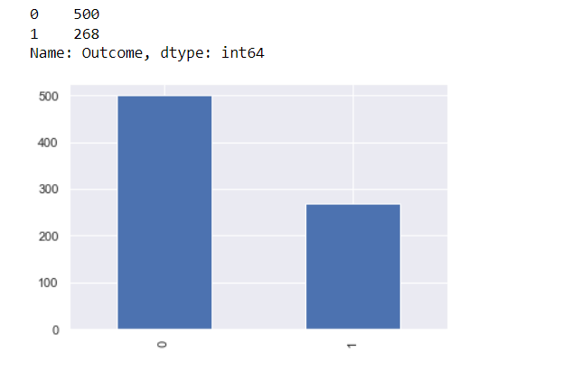
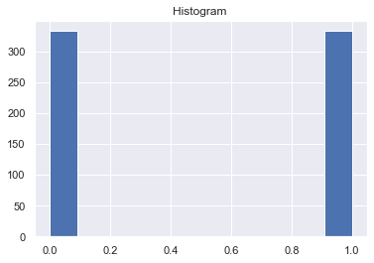
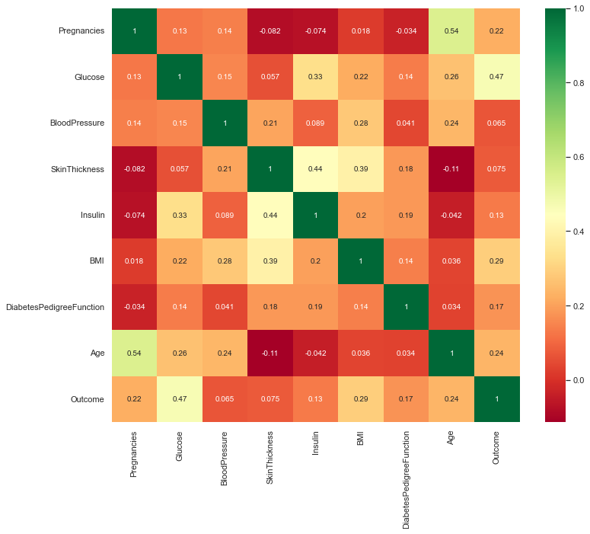
Feature Selection
SMOTE
Using SMOTE, the data was increased 768 to 922 traditionally.
In this research work, feature scaling is performed with the MIN-Max Scaler Normalization and later the feature selection is calculated within the filter method (correlation : Pearson's correlation)
How much data present?
Check Impurities and Outliners - Perform Min Max Scalar
Perform Feature Selection – Pearson’s correlation
According to the correlation mapped with the dataset target; Glucose, BMI, Age, Pregnancies are the features to be selected.

Slide 9
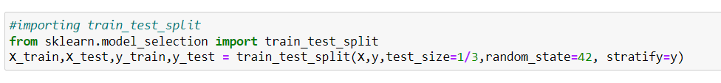
Modelling
To learn a machine, the original data is split into train and test sets.
70% of the data is dedicated to the training and the rest is for testing.
To improve the accuracy , Validation set is prepared in the training.
The cross validation & hyper tuning parameters can also be performed with validation set. (random) is a custom function used to adopt the data randomly into validation set.
These are learned with the algorithms to observe the performance.

Slide 10
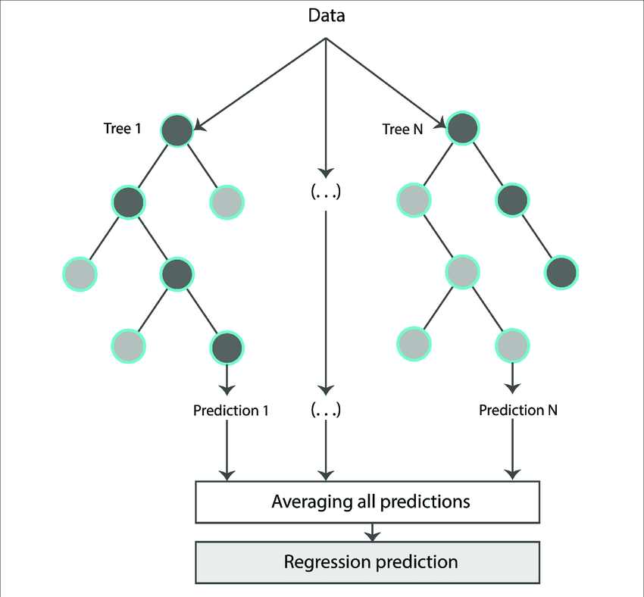
Random forest
Random forest is a meta estimator that fits a number of decision tree classifiers on various sub-samples of the dataset and uses averaging to improve the predictive accuracy and control over-fitting.[5]
In an algorithm, the machine searches continuously for a characteristic that allows observations in a set to be partitioned into groups that are as dissimilar from one another as feasible, while guaranteeing that the people in each subgroup are as similar as possible.
Random forests rely on chance, whereas decision trees are based on specified traits and often overfit. Random forest trees use bootstrap aggregating to randomly choose training data pieces (bagging).
After applying the model to restricted data sets, the predictions are weighted and averaged. Replacement sampling allows for several instances of the same data to be used again, which results in decision-making trees that not only trained on different data sets, but also make use of different characteristics.

Slide 11
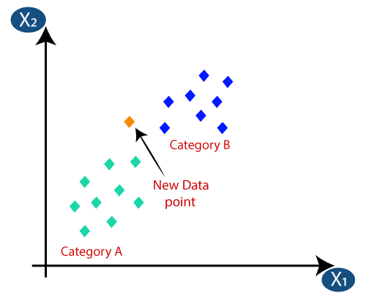
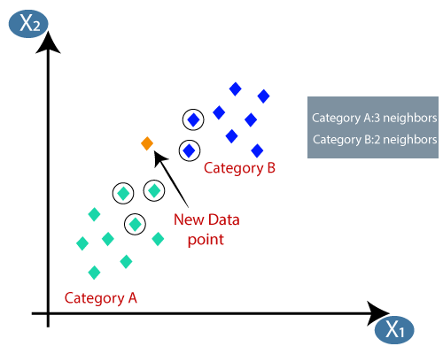
K-Nearest Neighbors
KNN is one of the simplest machine learning algorithms based on supervised learning
It is also used as regression. Based on Euclidean distance, when the new data is added; the highest similarity that is closest to the “k” point is considered to the category of A or B.

Slide 12
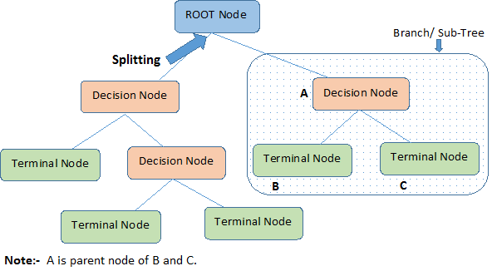
Decision tree
Decision tree is a type of supervised learning algorithm (having a predefined target variable) that is mostly used in classification problems.
Categorical Variable Decision Tree: Decision Tree which has categorical target variable then it called as categorical variable decision tree
Continuous Variable Decision Tree: Decision Tree has continuous target variable then it is called as Continuous Variable Decision Tree.

Slide 13
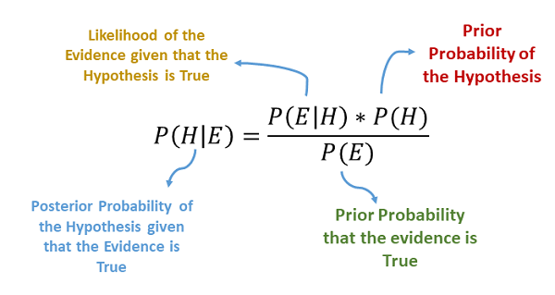
Naïve Bayes
Naive Bayes demonstrates how the simplest responses are often the most powerful. Machine learning has advanced in recent years, but it's still simple, fast, accurate, and reliable[7].
The Bayes theorem gives us a formula to determine the likelihood of a hypothesis given our knowledge. The Naive Bayes algorithm classifies binary (two-class) or multi-class data. Reading about the procedure is easiest while using binary and categorical input values. naïve Bayes, often called stupid Bayes, simplifies the probability calculation for each hypothesis. Named for its simplicity.

Slide 14
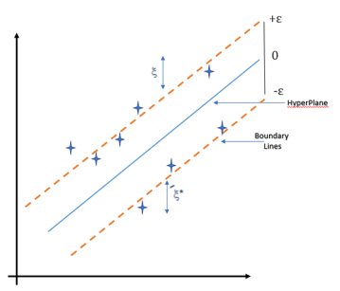
SVR
Support Vector Machines, often known as SVMs, are frequently and extensively utilised in the machine learning community for solving classification problems.
The objective of regression would be to locate a function that, just on basis of the a training examples, can provide an approximation of a map from such an input space to real numbers. When we move forward with SVR, our goal is to essentially consider the points are within the choice boundary line. This will allow us to make a more informed judgement.
The hyperplane that contains the most points is the one that provides the best fit for our data.

Slide 15
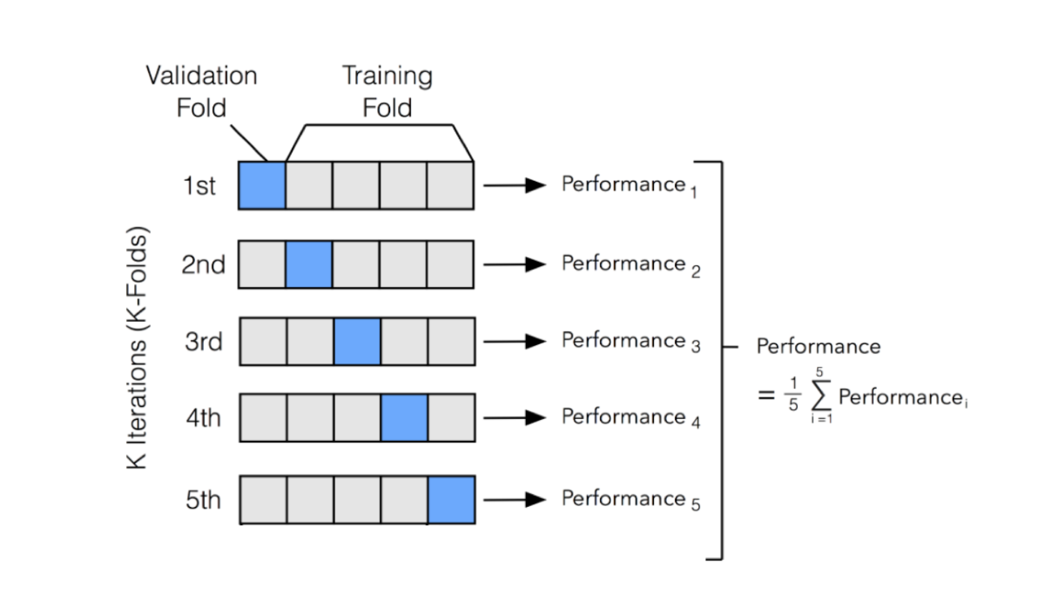
Cross Validation
Cross Validation is a technique which involves reserving a particular sample of a dataset on which you do not train the model. Later, you test your model on this sample before finalizing it.
k-fold cross validation is widely used to check whether a model is an overfit or not. If the performance metrics at each of the k times modelling are close to each other and the mean of metric is highest

Slide 16
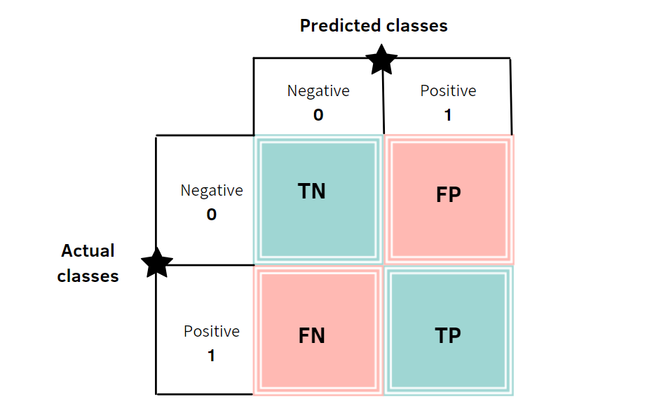
Performance Indices

Slide 17

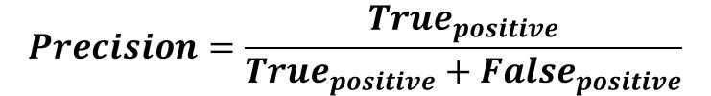
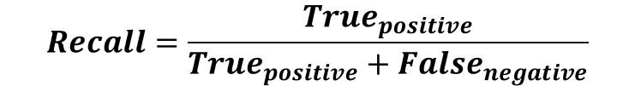
Performance Indices
Accuracy: Accuracy is a metric that generally describes how the model performs across all classes. It is useful when all classes are of equal importance. It is calculated as the ratio between the number of correct predictions to the total number of predictions.
Precision: Precision is calculated as the ratio between the number of Positive samples correctly classified to the total number of samples classified as Positive (either correctly or incorrectly). The precision measures the model's accuracy in classifying a sample as positive.
Recall:The recall is calculated as the ratio between the number of Positive samples correctly classified as Positive to the total number of Positive samples. The recall measures the model's ability to detect Positive samples. The higher the recall, the more positive samples detected.

Slide 18
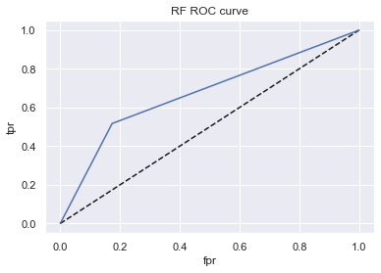
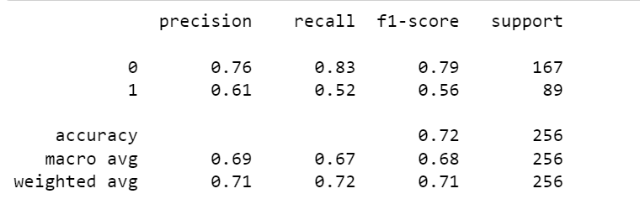
Experimental Results - RF
the accuracy of random forest is scored around with the 75% and the ROC score was 0.82

Slide 19
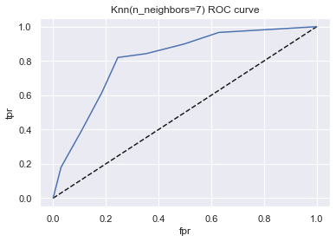
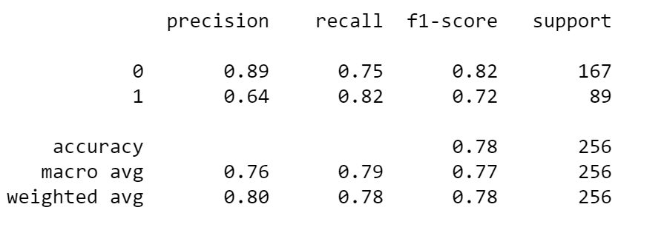
Experimental Results - KNN
For 7 neighbors, the accuracy score is 77.73% and the ROC score was 0.81

Slide 20

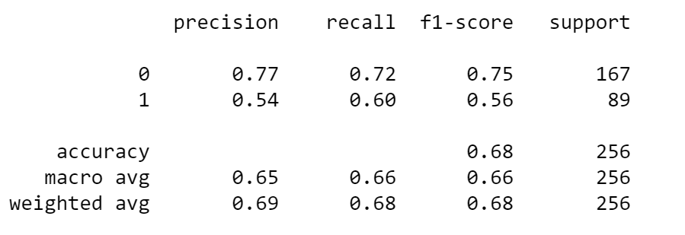
Experimental Results - DT
The accuracy of decision tree was 67.96% and the ROC was 0.66

Slide 21
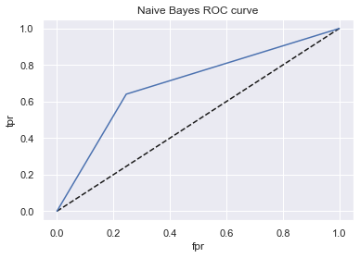
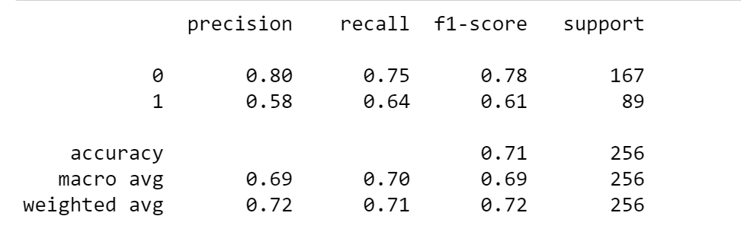
Experimental Results - NB
The accuracy of Naïve Bayes was 71.48% and the ROC Score is 0.79

Slide 22
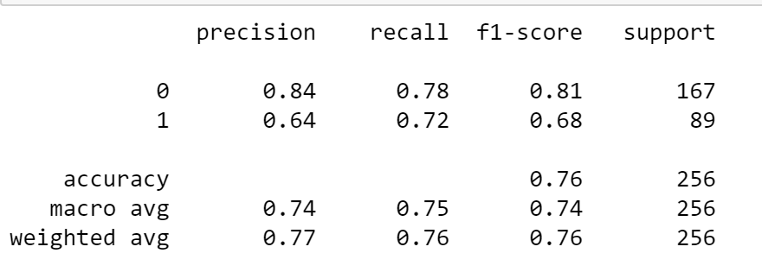
Experimental Results - SVR
The accuracy of SVR 76.17%. Since due to the hyper plane , the predict probability was not available in ROC therefore, the roc score or curve was not available

Slide 23
Conclusion
Model | Accuracy | ROC-AUC Score
Random Forest | 75% | 0.82
KNN | 77.73% | 0.81
Decision Tree | 67.96% | 0.66
Naïve Bayes | 71.48% | 0.79
SVR | 76.17% | -
The objective of the research is to create a model that is capable of more precise classification of the instances contained in the dataset. The overall potential of the dataset has been improved thanks to the application of methods such as feature selection and data cleaning, which have contributed to the development.
With KNN, the Classifiers were able to achieve an accuracy of 77.73%. The Support vector regression (SVR) scored 76.17% accuracy which is second best. The Random Forest classifier which achieved an accuracy of 75% on the list at third, while the naïve bayes and Decision Tree classifier were at last , which places it in last place on the list among the classifiers.
Following a comparison of the available models, we have arrived at the conclusion that the KNN is the one that is most suited for the dataset that contains both diabetic and non-diabetic individuals.

Slide 24
References:
[1] https://www.who.int/health-topics/diabetes#tab=tab_1
[2] https://www.who.int/india/events/world-diabetes-day
[3] Neha Prerna Tigga , & Shruti Garg(2019).Prediction of Type 2 Diabetes using Machine Learning Classification Methods. International Conference on Computational Intelligence and Data Science (ICCIDS 2019). DOI:10.1016/j.procs.2020.03.336
[4] https://www.kaggle.com/datasets/uciml/pima-indians-diabetes-database
[5] Han Wu , Shengqi Yang1, Zhangqin Huang , & Jian Heand Xiaoyi Wang.(2017). Type 2diabetes mellitus prediction model based on data mining. Informatics in medicine unlocked. 10,(PP. 100-107). DOI:10.1016/j.imu.2017.12.006
[6] P. Cıhan and H. Coşkun, "Performance Comparison of Machine Learning Models for Diabetes Prediction," 2021 29th Signal Processing and Communications Applications Conference (SIU), 2021, pp. 1-4, doi: 10.1109/SIU53274.2021.9477824.
[7] F. -J. Yang, "An Implementation of Naive Bayes Classifier," 2018 International Conference on Computational Science and Computational Intelligence (CSCI), 2018, pp. 301-306, doi: 10.1109/CSCI46756.2018.00065.

Slide 25
THANK YOU

