Slide 1
Predicting Flood Risk
Paria Rezaeinia
Data Incubator Final Interview
August 2019

Slide 2
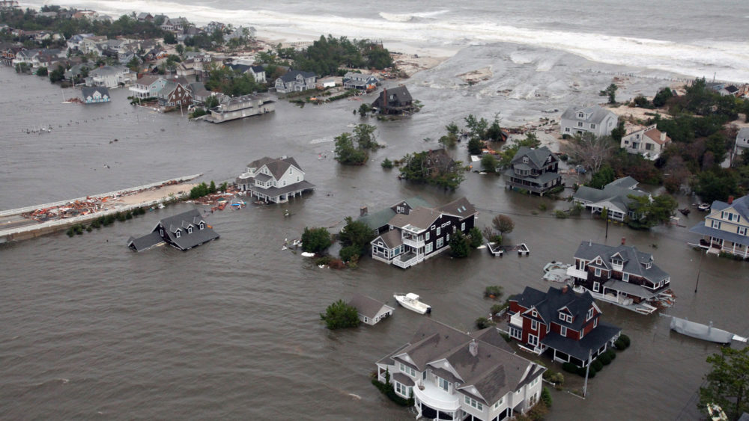
Nearly 400,000 U.S. Homes Will Experience Flooding by 2050

Slide 3
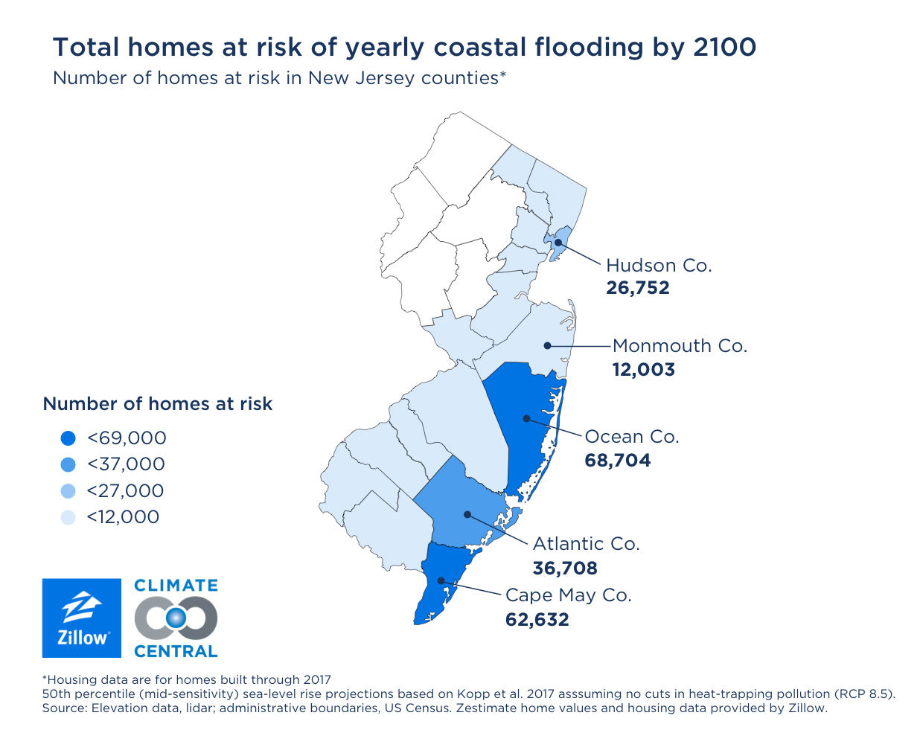

Slide 4
National Flood Insurance Program (NFIP)
Reduce future flood losses
Provide insurance protection
More than 2,000,000 claims since 1970
Updates every 45-60 days
600 MB

Slide 5
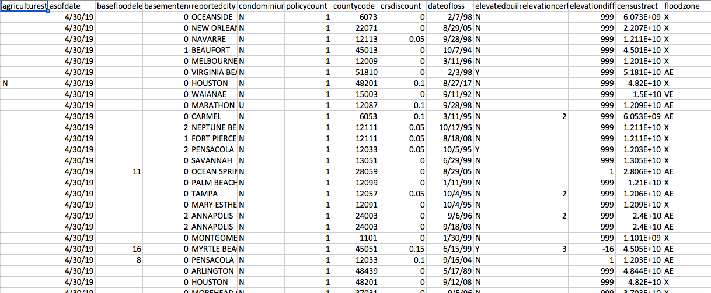

Slide 6
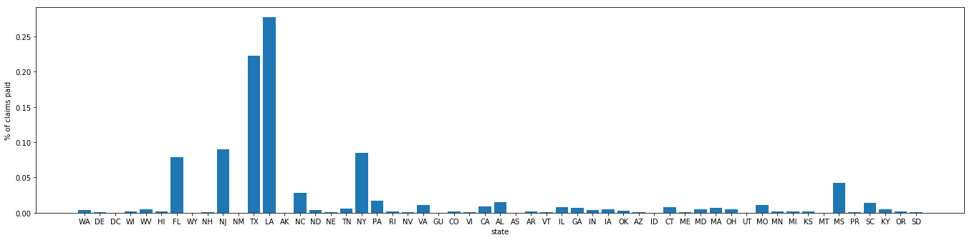
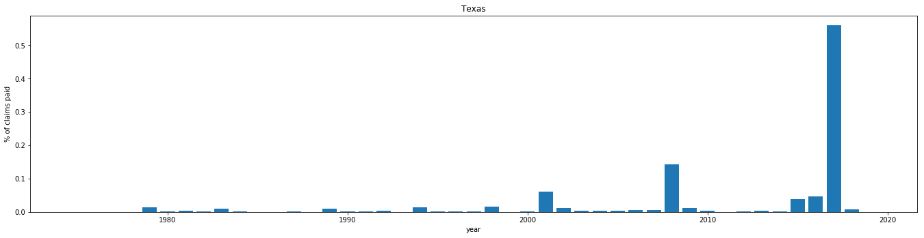

Slide 7
How to Use the Data?
Consumer targeting
Risk assessment and pricing
Claim management
Fraud detection
Automatic underwriting

Slide 8
