Slide 1
Project Proposal Lightning Talk
Title: Drift-Aware Forecasts of NYC 311 Demand
CSCE 676 DATA MINING AND ANALYSIS
Himanshu Parida
Master of Computer Science

Slide 2
Motivation: Reliable Forecasts as NYC Changes
NYC 311 receives thousands of non-emergency requests daily (noise, heat, trash, potholes).
Agencies must staff crews and call centers ahead of demand.
Too few staff means backlogs; too many means wasted money.
City behavior shifts over time (COVID, seasons, policies, festivals), so a model trained once goes stale.
Take-home message: A forecasting model is only useful if it keeps working as the data changes, so we build a streaming system that detects drift and retrains automatically.
Notes:
Every day, New Yorkers file thousands of 311 requests, like noise complaints, no heat, or missed trash pickup. City agencies need to know in advance how many requests are coming so they can schedule the right number of workers. The problem is that the city keeps changing. Weather, policies, and big events like COVID change what people complain about. So a model that works well today can quietly get worse next month. The main message of my project is this: building a forecast is not enough. We need a system that notices when the data changes and fixes the model automatically.

Slide 3
Problem formulation: Data, Constraints, Prediction
Goal: forecast the number of 311 requests for the next hours or days, by complaint category and area.
Dataset: NYC Open Data, 311 Service Requests from 2020 to Present, with timestamps, complaint type, agency, and location.
Constraints:
- Source updates daily, so the stream is simulated by replaying historical events in time order.
- Evaluation must respect time.
- Data distribution shifts over time.
Objectives:
- accurate forecasts to avoid understaffing/overstaffing
- detect drift (covariate/label/concept)
- retrain automatically

Slide 4
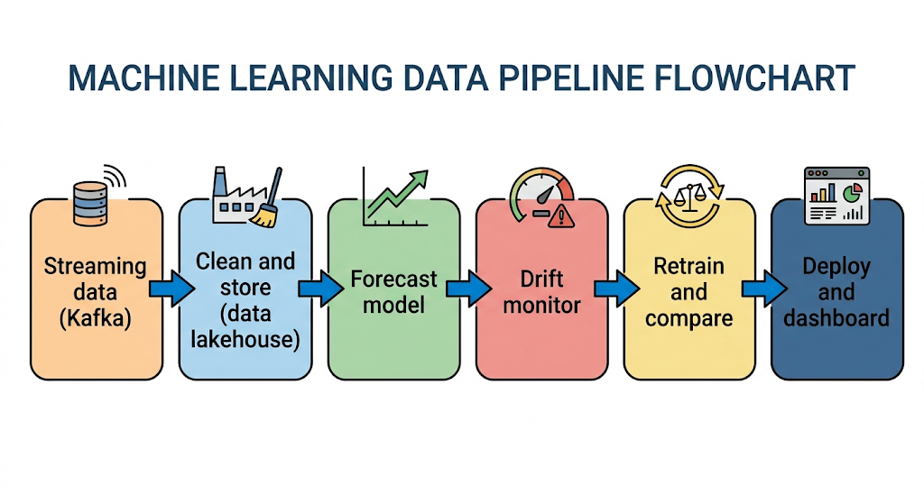
Method flow and evaluation
Method flow:
Retraining strategies compared: never retrain, scheduled retraining, drift-triggered retraining.
Metrics:
- Forecast quality: error vs. a simple baseline(ETS or similar classical models), quantile loss for the uncertainty range
- Drift handling: detection delay, false-alarm rate, how fast accuracy recovers after a shock
- System: retraining cost and forecast latency

Slide 5
Thank you for your time.
Thank you for your time.
Questions?

