Slide 1

INSTAGRAM CLONE ANALYSIS
INSTAGRAM CLONE ANALYSIS

Slide 2
OBJECTIVES
MySQL project which is a cloned mimic version of Instagram database. It is used to perform data analysis for real world business related questions and scenarios such as
find out the rewarding system for the loyal users
launching campaign to target the weekdays with the most user registrations
encouraging inactive users to log in back to the system
etc.

Slide 3
Ig_clone database
The SQL script provided creates an Instagram clone database with the following tables and their relationships:
Users
Photos
Comments
Likes
Follows
Tags
Photo_Tags (junction table for photos and tags)
Here’s a brief overview of the table structures and their relationships:
Users: Stores user information.
id: Primary key
username: Username of the user
created_at: Timestamp of creation
Photos: Stores photos uploaded by users.
id: Primary key
image_url: URL of the image
user_id: Foreign key referencing users(id)
created_at: Timestamp of creation

Slide 4
Comments: Stores comments made on photos.
id: Primary key
comment_text: Text of the comment
user_id: Foreign key referencing users(id)
photo_id: Foreign key referencing photos(id)
created_at: Timestamp of creation
Likes: Stores likes on photos.
user_id: Foreign key referencing users(id)
photo_id: Foreign key referencing photos(id)
created_at: Timestamp of creation
Primary key is a combination of user_id and photo_id
Follows: Stores follow relationships between users.
follower_id: Foreign key referencing users(id)
followee_id: Foreign key referencing users(id)
created_at: Timestamp of creation
Primary key is a combination of follower_id and followee_id
Tags: Stores tags for categorizing photos.
id: Primary key
tag_name: Unique name of the tag
created_at: Timestamp of creation
Photo_Tags: Junction table for many-to-many relationship between photos and tags.
photo_id: Foreign key referencing photos(id)
tag_id: Foreign key referencing tags(id)
Primary key is a combination of photo_id and tag_id

Slide 5
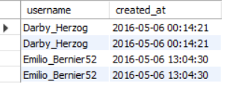
/*Reward users who have been around the longest. */
INPUT:-
select * from users;
select username , created_at from users order by created_atlimit 4;
OUTPUT:-

Slide 6
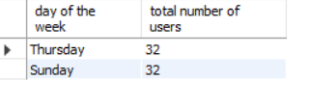
/*What day of the week do most users register on?*/
INPUT:-
select date_format(created_at,'%W') as 'day of the week',count(*) as 'total number of users' from usersgroup by 1 order by 2 desc limit 2;
OUTPUT:-

Slide 7
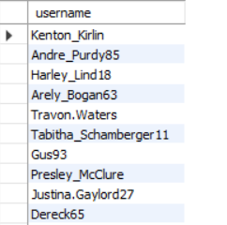
/*We want to target our inactive users with an email campaign.*/
INPUT:-
select username from users
left join photos on users.id = photos.user_idwhere photos.user_id is not null group by users.username;
OUTPUT:-

Slide 8
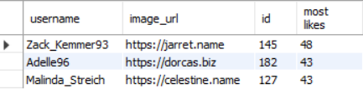
/*We're running a new contest to see who can get the most likes on a single photo WHO WON??*/
INPUT:-
select users.username ,photos.image_url, photos.id,count(*) as 'most likes' from photosinner join likes on photos.id = likes.photo_idinner join users on photos.user_id = users.idgroup by 3order by 4 desclimit 3;
OUTPUT:-

Slide 9

/*Our Investors want to know...How many times does the average user post?*//*total number of photos/total number of users*/
INPUT:-
SELECT ROUND((SELECT COUNT(*)FROM photos)/(SELECT COUNT(*) FROM users),2);
OUTPUT:-

Slide 10
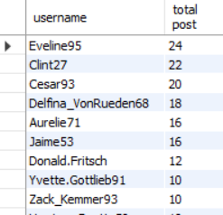
/*user ranking by postings higher to lower*/
INPUT:-
select users.username ,count(*) as 'total post' from photosinner
join users on photos.user_id = users.id group by 1order by 2 desc;
OUTPUT:-

Slide 11

/*Total Posts by users */
INPUT:-
select sum(total.total_post)from
(select users.username ,count(*) as total_post from photosinner join users on photos.user_id = users.id group by 1) as total;
OUTPUT:-
/*0r */select count(users.id) as posts from users inner join photos on users.id = photos.user_id;

Slide 12
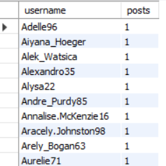
/*total numbers of users who have posted at least one time */
INPUT:-
select username,count(distinct(users.id)) as posts from users inner join photos on users.id = photos.user_idgroup by 1;
OUTPUT:-

Slide 13
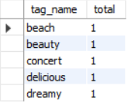
/*A brand wants to know which hashtags to use in a post What are the top 5 most commonly used hashtags?*/
INPUT:-
SELECT t.tag_name, COUNT(*) AS total FROM tags t
LEFT JOIN photo_tags pt ON t.id = pt.tag_id GROUP BY t.tag_name
ORDER BY total DESC
LIMIT 5;
OUTPUT:-

Slide 14
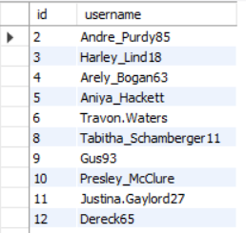
/*We have a small problem with bots on our site...Find users who have liked every single photo on the site*/
INPUT:-
select distinct id, username from users
where users.id in (select user_id from likes);
OUTPUT:-

Slide 15
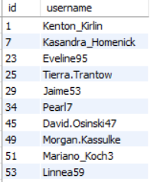
/*We also have a problem with celebrities --Find users who have never commented on a photo*/
Output:-
INPUT:-
select distinct(id) ,username from users where users.id not in (select user_id from comments);

Slide 16
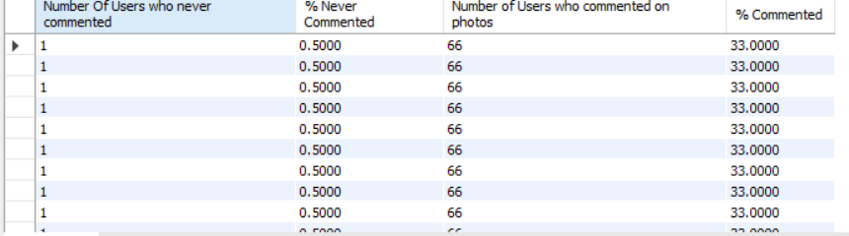
/*Are we overrun with bots and celebrity accounts?Find the percentage of our users who have either never commented on a photo or have commented on photos before*/
INPUT:-
SELECT
tableA.total_A AS 'Number Of Users who never commented', (tableA.total_A / (SELECT COUNT(*) FROM users)) * 100 AS '% Never Commented',
tableB.total_B AS 'Number of Users who commented on photos', (tableB.total_B / (SELECT COUNT(*) FROM users)) * 100 AS '% Commented’
FROM
(SELECT COUNT(*) AS total_A FROM users
LEFT JOIN comments ON users.id = comments.user_id
GROUP BY users.id
HAVING COUNT(comments.id) = 0) AS tableAJOIN (SELECT COUNT(*) AS total_B FROM users
LEFT JOIN comments ON users.id = comments.user_id GROUP BY users.id HAVING COUNT(comments.id) > 0) AS tableB;
OUTPUT:-

