Slide 1


MYNTRA ANALYSIS
SUBMITTED BY- PARIDHI BHARDWAJ

Slide 2
CONTETNT :
DATA CLEANING AND PREPRATION
DATA ANALYSIS
DATA RETRIEVAL AND LOOKUP

Slide 3

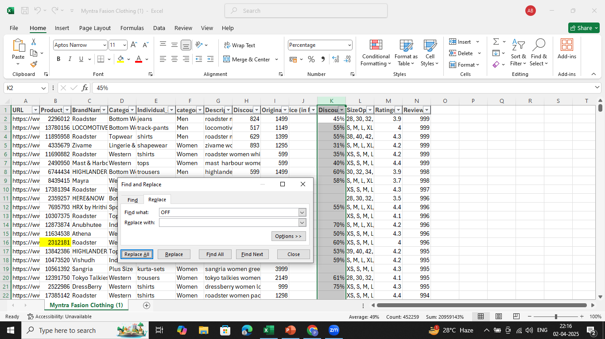
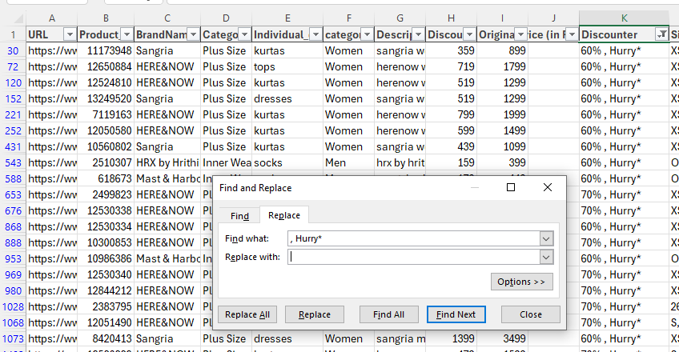
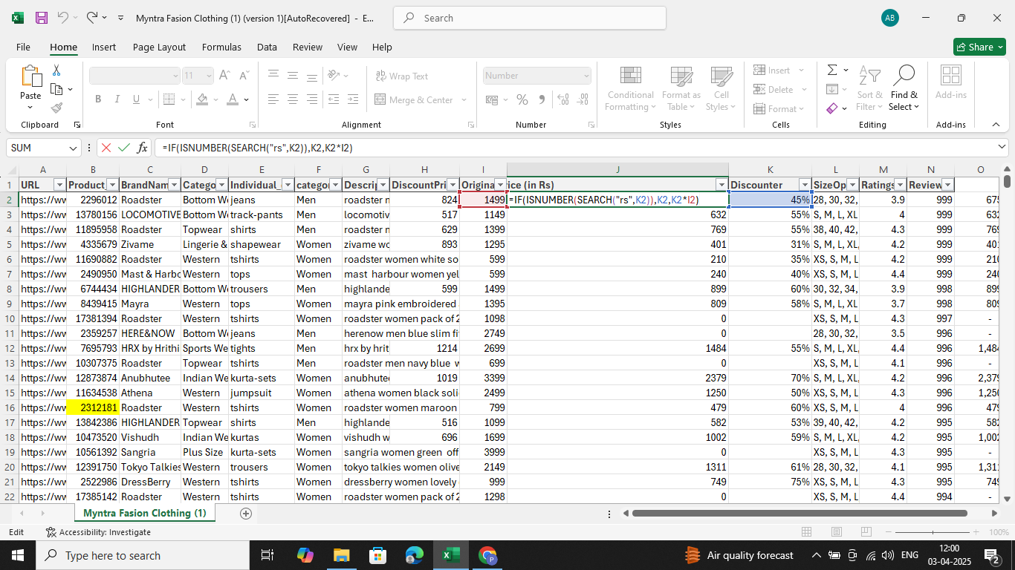
A. Data Cleaning & Prepration 1. Standardize the "DiscountOffer" column to a single format, ensuring all values are uniform.
Step 1 -: Replace “hurry*” & “off” with nothing.
Step 2 -: standerdize the discount offer column by using combination of functions “if” “isnumber” and “search”.

Slide 4
SEARCH("rs", K2)
SEARCH("rs", K2) looks for the text "rs" inside the value of cell K2.
If "rs" is found, it returns the position of "rs" within the text.
If "rs" is not found, it returns an error.
ISNUMBER(SEARCH("rs", K2))
ISNUMBER(...) checks if the result of SEARCH("rs", K2) is a number.
If "rs" is found, SEARCH(...) returns a number → ISNUMBER(...) returns TRUE.
If "rs" is not found, SEARCH(...) returns an error → ISNUMBER(...) returns FALSE
IF(ISNUMBER(SEARCH("rs", K2)), K2, K2*I2)
If "rs" exists in K2 → the formula returns K2 (unchanged).
If "rs" does not exist in K2 → the formula multiplies
K2 * I2.

Slide 5
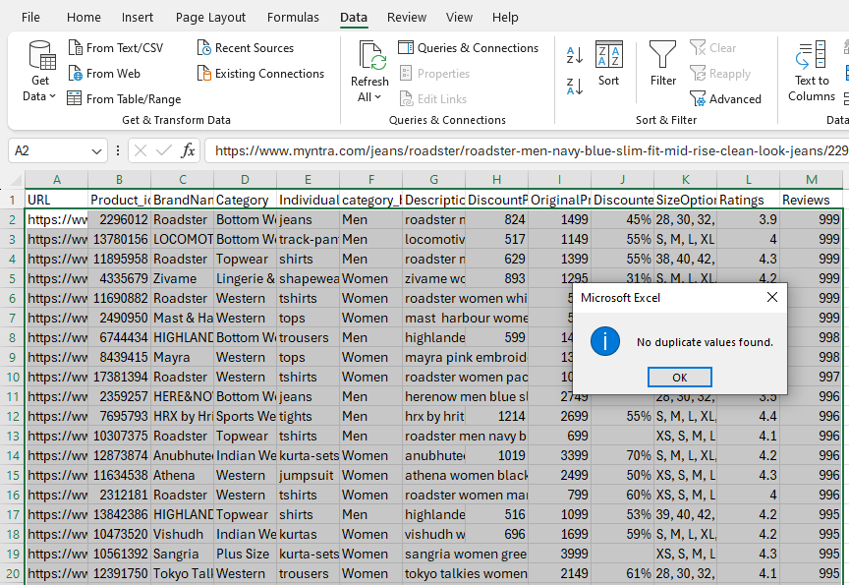
2. Check for duplicate values in your dataset and remove them.
Click OK & Remove Duplicates
Click OK to remove duplicates.
Excel will show a message: "X duplicate values found and removed, Y unique values remain.“
Alternative: Identify Duplicates Without Removing
If you just want to highlight duplicates before deleting, use Conditional Formatting:
Select the column (e.g., Product ID).
Go to Home → Conditional Formatting → Highlight Cells Rules → Duplicate Values.
Choose a color to highlight duplicates.
Select the Entire Dataset
Click anywhere inside your dataset.
Press Ctrl + A to select all data.
Open the Remove Duplicates Tool
Go to Data → Remove Duplicates in the ribbon.

Slide 6
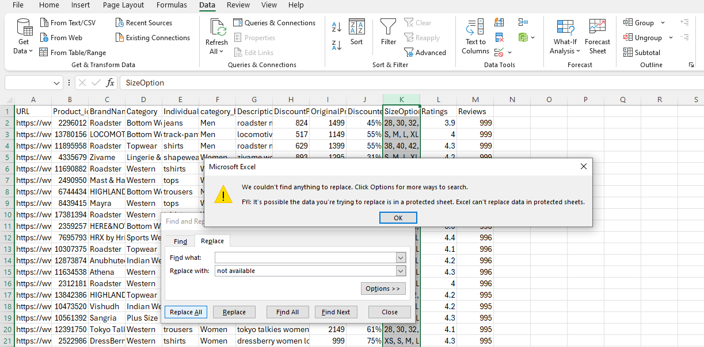
3. Replace all null values in the "SizeOption" column with the text "Not Available.
Using Find & Replace (Manual Method)
Select the SizeOption column.
Press Ctrl + H to open Find & Replace.
In Find what: leave it blank.
In Replace with: type "Not Available".
Click Replace All.
THERE IS NO NULL VALUE FOUND IN “SIZE OPTION” COLUMN

Slide 7

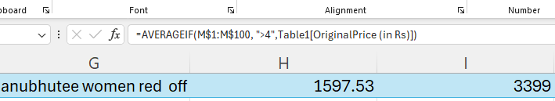
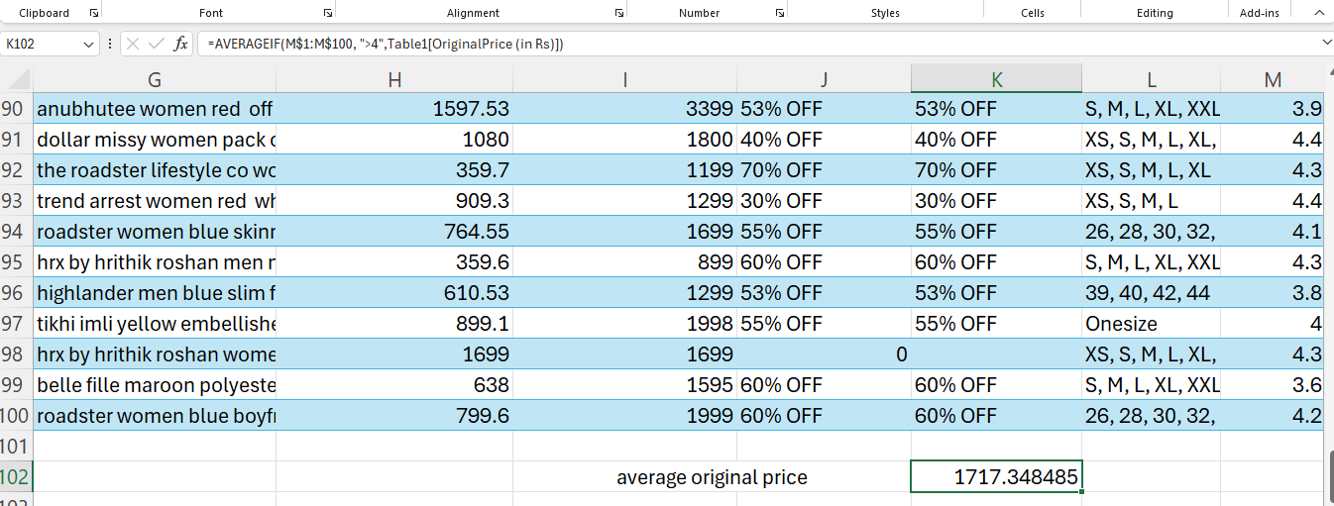
B. DATA ANALYSIS 1. Calculate the overall average original price for products with ratings greater than 4
Function used-: Averageif (rating column,”>4”,original price)

Slide 8
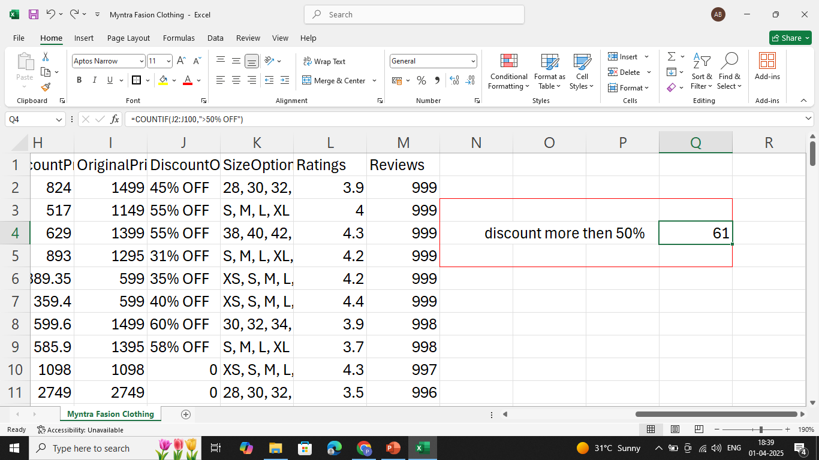
2.Count the number of products with a discount offer greater than 50% OFF.
Function used-: countif (discount offer column,”>50%OFF”)

Slide 9
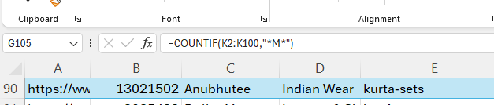
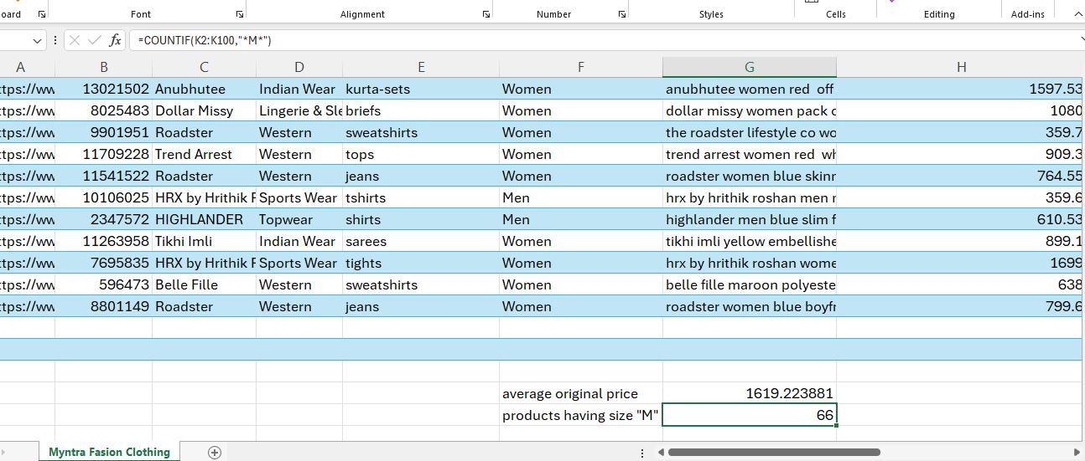
3. Count the number of products available in size "M.
Function used-: countif (size column , “*M*”)
“*M*” – “*” allow excel to count any cell containing “M” anywhere in the text’ including “S,M,L,or XL”.

Slide 10
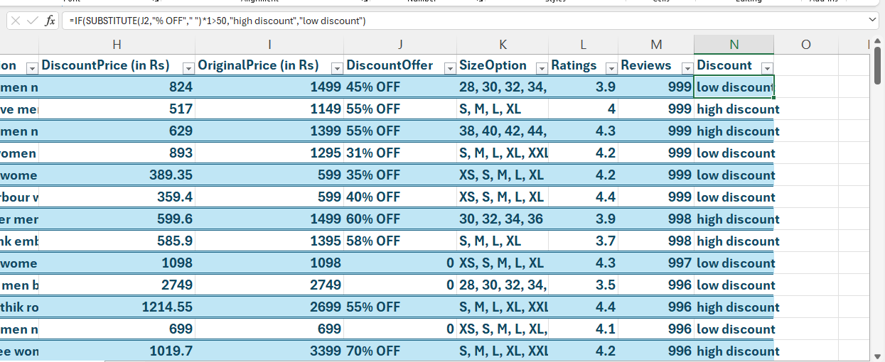
4. Create a new column to label the products as "High Discount" if the discount offer is greater than 50% OFF, otherwise label them as "Low Discount."
Function used-: IF(substitute(discount offer cell,“% OFF”,“ ”)*1>50,“hig discount”
, “low discount”)
substitute(discount offer cell,“% OFF”,“ ” -: Removes “%OFF” from discount offer.
*1 -: converts the extracted text into number.
>50 -: checks if the discount is greater than 50%.

Slide 11

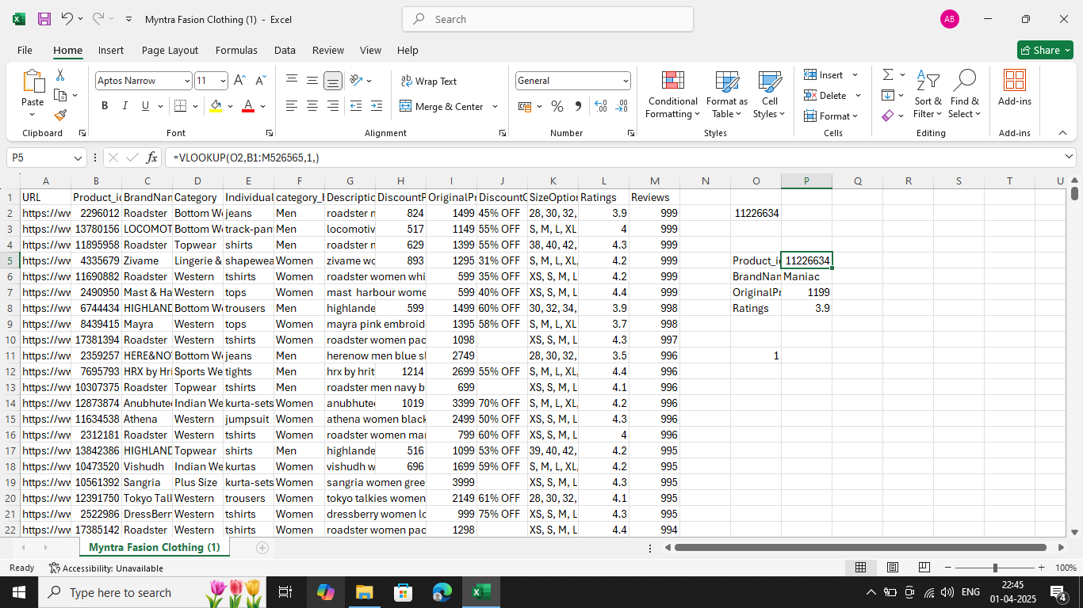
c. Data Retrieval and Lookup 1. Use VLOOKUP/XLOOKUP to find the product brand, price, and rating of the product with Product id "11226634".
Function used-: vlookup(=VLOOKUP(11226634, DataRange, ColumnNumber, FALSE)
PRODUCT ID

Slide 12
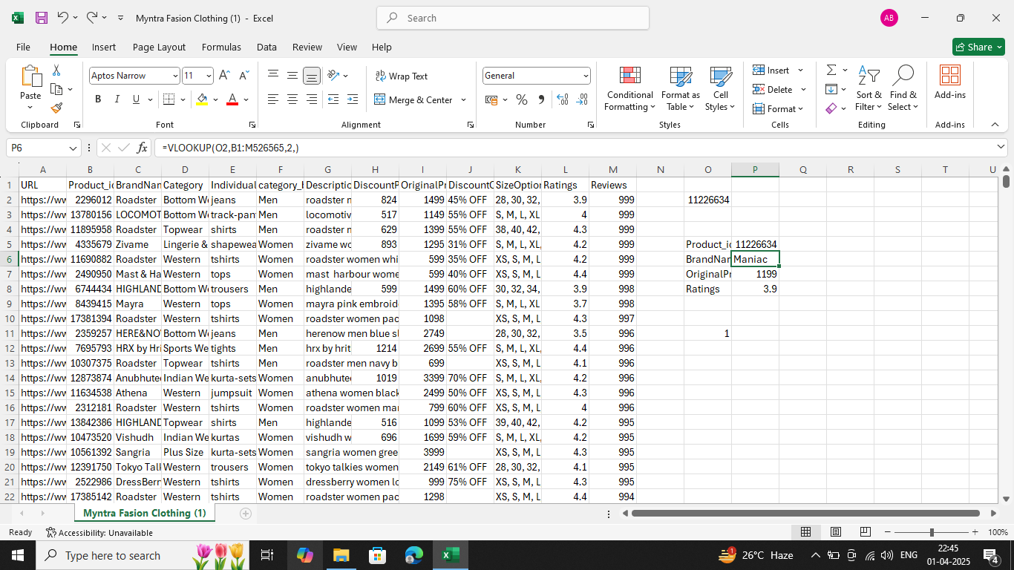
Use VLOOKUP/XLOOKUP to find the product brand, price, and rating of the product with Product id "11226634".
Function used-: vlookup(=VLOOKUP(11226634, DataRange, ColumnNumber, FALSE)
2. BRAND NAME

Slide 13
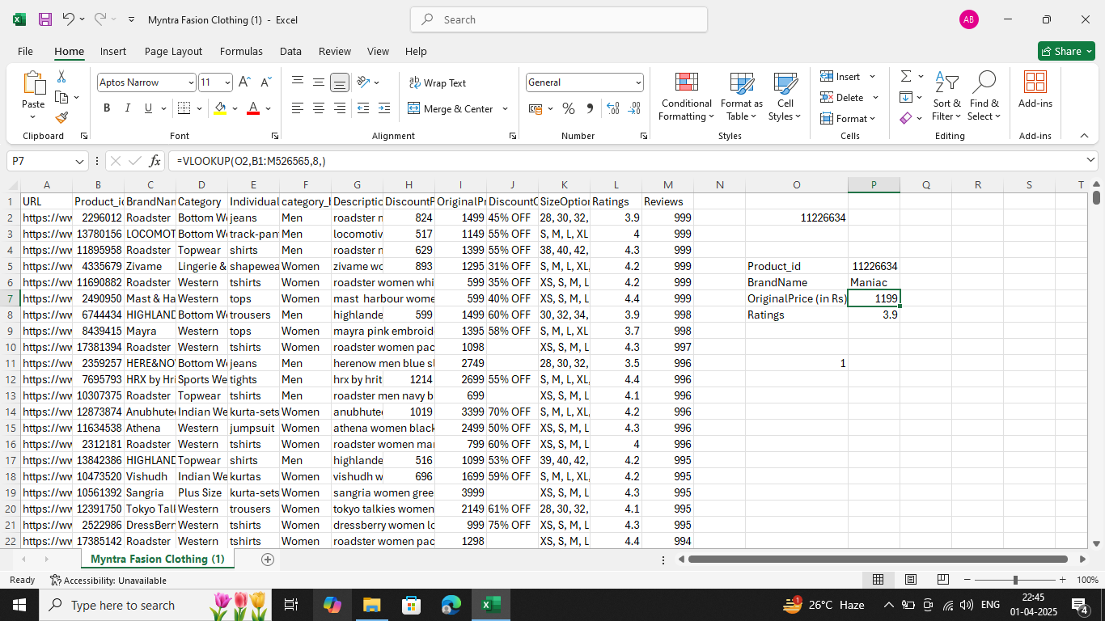
Use VLOOKUP/XLOOKUP to find the product brand, price, and rating of the product with Product id "11226634".
Function used-: vlookup(=VLOOKUP(11226634, DataRange, ColumnNumber, FALSE)
3.PRICE

Slide 14

Use VLOOKUP/XLOOKUP to find the product brand, price, and rating of the product with Product id "11226634".
Function used-: vlookup(=VLOOKUP(11226634, DataRange, ColumnNumber, FALSE)
4. RATINGS

Slide 15
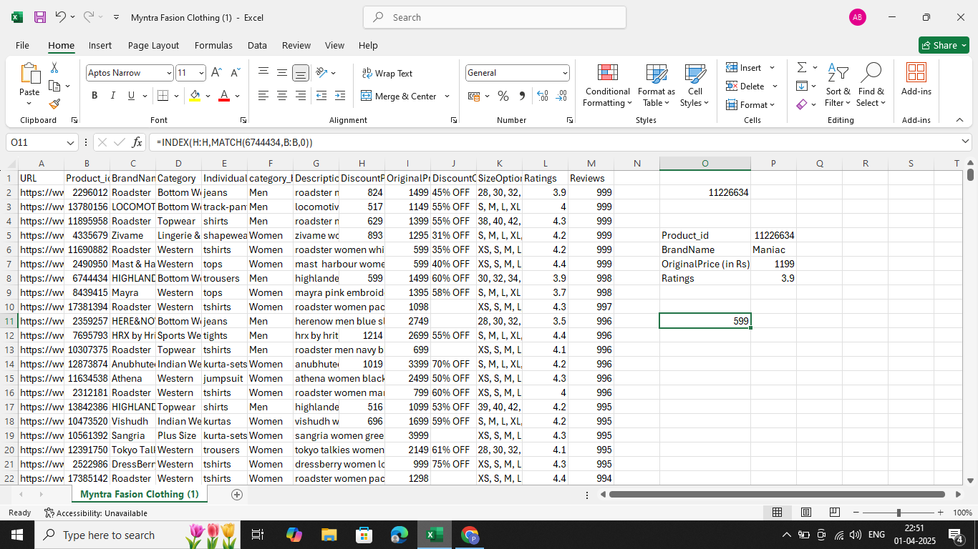
2.Find the "Discount Price" for the product with the Product ID "6744434" using the INDEX and MATCH functions.
Function used-: =INDEX(H:H, MATCH(6744434, B:B, 0))
MATCH(6744434, B:B, 0):
Looks for 6744434 in Column B (Product ID).
0 ensures an exact match.
INDEX(H:H, …):
Retrieves the value from Column H (DiscountPrice) at the
row where the Product ID is found.

Slide 16
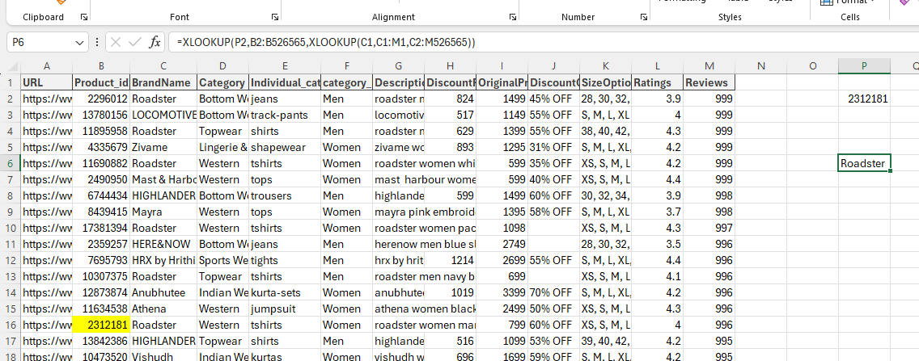
3. Utilize nested xlookup to find any column’s detail of a product with it’s product id.
Function used-: =XLOOKUP(ProductID, ProductID_Column, XLOOKUP(ColumnName, HEADER_Row, Data_Range))
Inner XLOOKUP:
XLOOKUP((C1,C1:M1,C2:M526565) finds the column data based on the column name.
Outer XLOOKUP:
XLOOKUP(P2,B2:B526565, ...) searches for the Product ID in column A and returns the corresponding value from the found column.

Slide 17
THANKYOU

