Slide 1

Hosts are unaided by Airbnb to price their properties, while similar properties in an area increase competition for hosts to set a competitive price to attract guests.
Notes:
Airbnb offers complete independence to its hosts to price their properties, with only minimal pointers that allow hosts to compare similar listings in their neighborhood to come up with a competitive price. Our primary motivation is assist new hosts on the platform to price their properties competitively

Slide 2
Dataset Characteristics
Geography – Single city – San Francisco, CA
Size – Original dataset – 3GB
– Cleaned dataset – 1 GB
Details – Listings Characteristics, Reviews and Price
Source – Open Source for 50+ cities around the globe

Slide 3
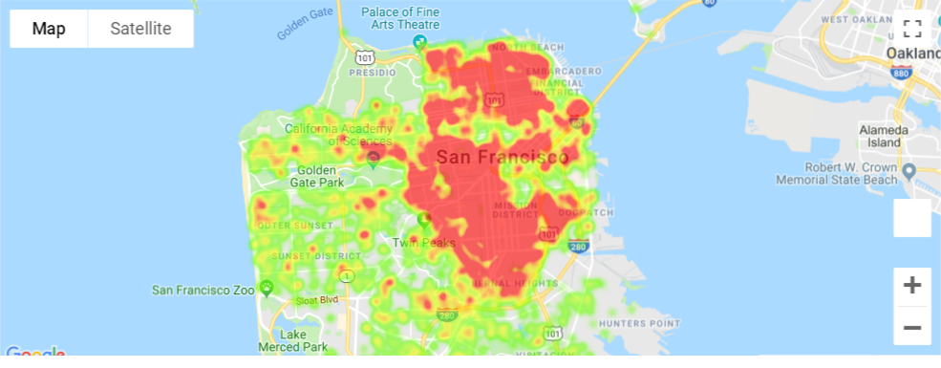
San Francisco Dataset
29% of listings underpriced

Slide 4
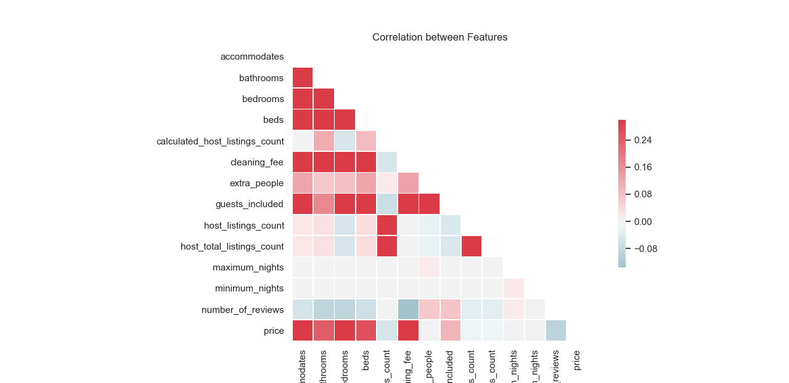
Predictors Correlation Matrix

Slide 5
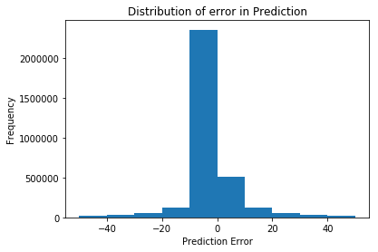
Prediction Error
Price Predictive Model Development:
Balanced the dataset
Fit a Random Forest Regressor
Performed Cross-validation

Slide 6
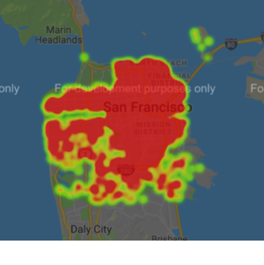
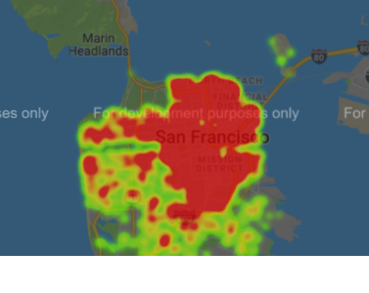
Training vs Testing HeatMap
Training Dataset
Testing Dataset

