Slide 1

DriveSafe AI
Real-Time, Privacy-Preserving Driver Monitoring at the Edge
TEAM MEMBERS :
Paridhi Prasanna
Matham Amolika
Yarlagadda Mahathi
C.R.Rao Advanced Institute of Mathematics, Statistics and Computer Science (AIMSCS)
Department of Computer Science & Engineering
DRIVESAFE AI
01

Slide 2

Our Motivation
Every year, thousands of lives are lost to drowsy and distracted driving — a risk that is almost entirely preventable. We wanted to build a solution that works in real time, runs on affordable edge hardware, and protects driver privacy by processing everything on-device, without ever streaming footage to the cloud.
Why This Project?
Driver fatigue and distraction are among the leading causes of preventable road accidents worldwide.
Most advanced Driver Monitoring Systems (DMS) are integrated only into premium vehicles, making them inaccessible for many drivers.
Existing cloud-based solutions may raise privacy concerns and require continuous internet connectivity.
There is a growing need for an affordable, real-time, and privacy-preserving driver safety solution that can run directly on edge devices.
Vision
To make intelligent driver safety technology affordable, accessible, and privacy-focused for every vehicle through real-time Edge AI.
ABOUT THE TEAM
02

Slide 3

THE PROBLEM
Driver Fatigue Is a Silent Killer on Our Roads
1.35M
20%
40%
Road deaths worldwide every year (WHO)
Of accidents linked to driver fatigue or drowsiness
Highway crashes tied to lapses in driver attention
Why Edge AI, and Why Now
Cloud-based monitoring introduces latency that is unacceptable for split-second safety alerts.
Streaming driver video to servers raises serious privacy concerns for everyday users.
Modern edge hardware (Jetson, Raspberry Pi) now makes on-device computer vision affordable and fast.
PROBLEM STATEMENT
03

Slide 4


MARKET OPPORTUNITY
A Fast-Growing ADAS Market, Ready for Edge AI
Global ADAS Market Growth (Illustrative)
Industry Relevance
Automakers & Tier-1 suppliers are mandating driver-monitoring systems (DMS) to meet upcoming safety regulations (Euro NCAP, etc.).
Why Now
Falling cost of edge compute + mature open-source CV libraries make a production-grade DMS achievable for a student team, not just OEMs.
MARKET OPPORTUNITY
04

Slide 5



OUR GOALS
Objectives
Real-Time Driver Monitoring
Continuously track eye state, head pose, and attention using a standard camera feed at real-time frame rates.
Reduce Accidents
Detect drowsiness, distraction, and fatigue early enough to issue alerts before a critical lapse occurs.
Privacy-Preserving Edge AI
Process all video entirely on-device — no footage ever leaves the vehicle or is stored in the cloud.
OBJECTIVES
05

Slide 6





OUR APPROACH
Solution Overview
A simple, five-stage real-time pipeline turns a camera feed into a spoken safety alert.
01
02
03
04
05
Camera
AI Analysis
Risk Score
Dashboard
Alarm
Onboard camera captures a continuous live feed of the driver's face. • OpenCV & MediaPipe extract facial landmarks, eye and mouth state, head pose. • A weighted model converts signals into a single, continuously-updated risk score. • Streamlit dashboard visualizes live status, trends, and alert history. • An audio alarm triggers instantly when risk crosses a safe threshold.
SOLUTION OVERVIEW
06

Slide 7
HOW IT'S BUILT
System Architecture
Input Layer
Camera Feed
Processing Layer
OpenCV + MediaPipe
(Face & Landmark Detection)
Scoring Layer
Risk Scoring Engine
Output Layer
Streamlit Dashboard + SQLite Log + Audio Alarm
SYSTEM ARCHITECTURE
07

Slide 8




TECH STACK
Technical Implementation
OpenCV
MediaPipe
Streamlit
Real-time video capture & image processing
Facial landmark & head-pose detection
Interactive live monitoring dashboard
SQLite
Plotly
Python
Lightweight local storage for alert history
Interactive analytics & trend visualizations
Core language tying the full pipeline together
TECHNICAL IMPLEMENTATION
08

Slide 9




CAPABILITIES
Key Features
Eye Closure Detection
Yawning Detection
Head Pose Estimation
Tracks eye-aspect-ratio (EAR) to flag prolonged closure.
Monitors mouth-aspect-ratio to catch signs of fatigue.
Detects head tilt/drop indicating drowsiness or nodding off.
Distraction Detection
Risk Scoring
Audio Alerts
Flags prolonged gaze away from the road ahead.
Combines all signals into one live, continuous risk score.
Instant audible alarm when risk crosses a safe threshold.
KEY FEATURES
09

Slide 10
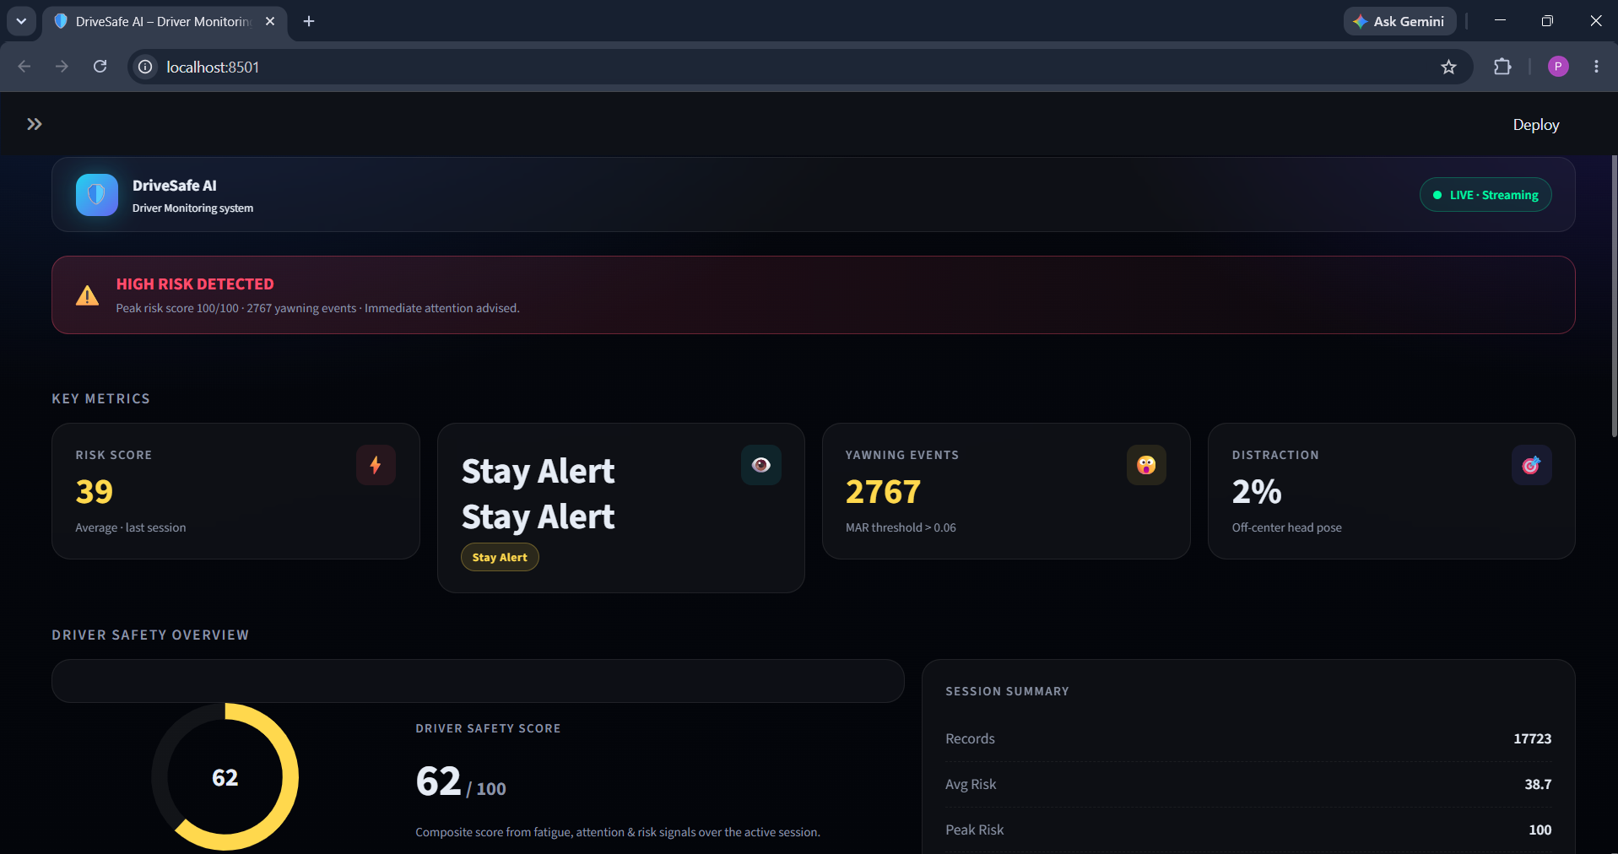
THE INTERFACE
Dashboard
DASHBOARD
10

Slide 11
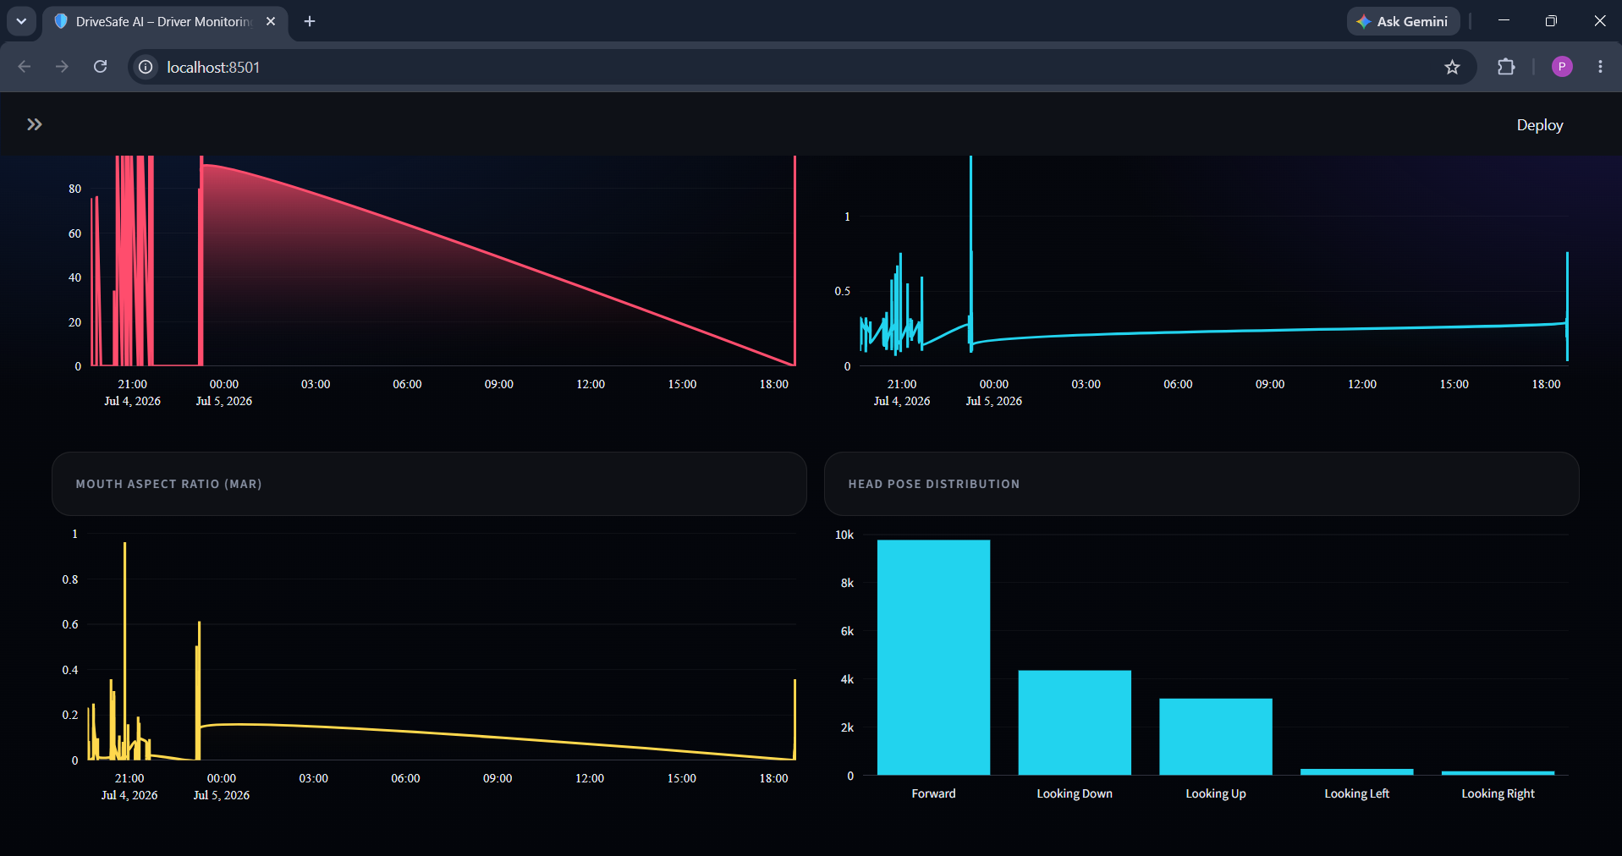
VALIDATION
Results
What the Numbers Show
RESULTS
11

Slide 12
COMPETITIVE LANDSCAPE
Comparison with Existing Solutions
Solution | Edge Processing | Open & Customizable | Cost | Privacy-First
Tesla Cabin Camera | Partial | No | Bundled / High | Limited
Mobileye | Yes | No | High (OEM) | Limited
Seeing Machines | Yes | No | High (Enterprise) | Moderate
Smart Eye | Yes | No | High (Enterprise) | Moderate
DriveSafe AI (Ours) | Yes | Yes | Low / Open-Source | Full
COMPARISON
12

Slide 13
WHAT WE OVERCAME
Challenges & Solutions
EAR Calibration
→
Per-user baseline calibration in the first few seconds of a session.
False Positives
→
Smoothing risk scores over a rolling window instead of single-frame triggers.
Dashboard UI
→
Iterated on Streamlit layout with real user feedback for clarity at a glance.
Alarm Triggering
→
Tuned threshold + debounce logic to alert promptly without being intrusive.
Performance Optimization
→
Reduced frame resolution & optimized landmark pipeline for real-time FPS.
CHALLENGES & SOLUTIONS
13

Slide 14



WHAT'S NEXT
Future Scope
Raspberry Pi / NVIDIA Jetson Deployment
Mobile Application
Cloud Analytics
Port the full pipeline to run natively on low-power embedded hardware in-vehicle.
Companion app for trip summaries, alerts history, and driver wellness scores.
Optional, opt-in aggregated fleet analytics for logistics & fleet operators.
Driver Identification
ADAS Integration
Personalize thresholds and history per recognized driver profile.
Feed risk signals into broader ADAS systems for coordinated safety response.
FUTURE SCOPE
14

Slide 15


Conclusion & Demo
Key Achievements
End-to-end real-time driver monitoring pipeline, built and tested
95% detection accuracy with sub-200ms alert latency
Fully on-device processing — zero cloud dependency
GOOGLE DRIVE LINK
Benefits
Prevents accidents through early, actionable warnings
Affordable and deployable on low-cost edge hardware
Respects driver privacy by design
https://drive.google.com/drive/folders/13ZByF93JR8-ciSYir-rQRwH7qe9-PqPb?usp=sharing
Thank You
CONCLUSION & DEMO
15

