Slide 1
Predictive Analysis of Credit Card Defaulters
- Paridhi Sharma

Slide 2
Table of Contents
Introduction
EDA
Remove Outliers
Method 1
Method 2
Method 3
Conclusion

Slide 3
Introduction
Credit card default is the term used to describe what happens when a credit card user makes purchases by charging them to their credit card and then they do not pay their bill.
The failure to promptly pay interest or principal when due.
Default occurs when a debtor is unable to meet the legal obligation of debt repayment.
Borrowers may default when they are unable to make the required payment or are unwilling to honor the debt.

Slide 4
Variable Explanation
Variable | Description
Limit_Bal | Amount of the given credit
Sex | Gender (1 = Male 2=Female)
Education | Education (1 = graduate school; 2 = university; 3 = high school; 4 = others)
Marriage | Marital status (1 = married; 2 = single; 3 = others)
Age | Age (year)
Pay_0 - Pay_6 | History of past payment (April to September 2005)
Bill_Amt1 – Bill_Amt6 | Amount of bill statement (April to September 2005)
Pay_Amt1 – Pay_Amt6 | Amount of previous payment (April to September 2005)
Default_payment_next_month | Default payment (Yes = 1, No = 0)

Slide 5
Exploratory Data Analysis
Remove Outliers:
Outlier is any data point more than 1.5 interquartile ranges (IQRs) below the first quartile or above the third quartile
That is, if a data point is below Q₁ – 1.5×IQR or above Q₃ + 1.5×IQR, it is viewed as being too far from the central values to be reasonable.

Slide 6
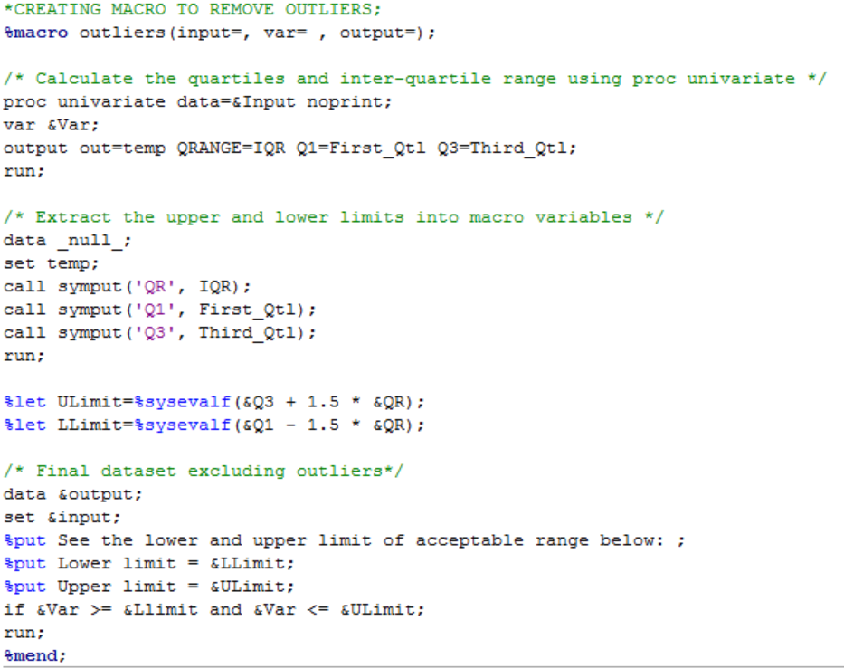
Macro creation to remove outliers

Slide 7
Linear Regression
In statistics, linear regression is an approach for modeling the relationship between a scalar dependent variable y and one or more explanatory variables (or independent variables) denoted X.
The case of one explanatory variable is called simple linear regression.

Slide 8
Principal Component Analysis
Principal component analysis (PCA) is a statistical procedure that uses an orthogonal transformation to convert a set of observations of possibly correlated variables into a set of values of linearly uncorrelated variables called principal components.
The number of principal components is less than or equal to the number of original variables

Slide 9
Logistic Regression
Logistic regression is a statistical method for analyzing a dataset in which there are one or more independent variables that determine an outcome. The outcome is measured with a dichotomous variable (in which there are only two possible outcomes).
The output variable is categorical in case of Logistic Regression.

Slide 10
Discriminant Analysis
Discriminant function analysis is a statistical analysis to predict a categorical dependent variable (called a grouping variable) by one or more continuous or binary independent variables (called predictor variables).
Discriminant function analysis is useful in determining whether a set of variables is effective in predicting category membership

Slide 11
Method 1
Used original Dataset after removing outliers.
All the variables were taken into model for multiple regression.
Only significant variables which we got from regression output, were considered into logistic regression model.
Principal component analysis was performed on all variables from Dataset.
Discriminant Analysis is done on set of variables which we got from STEPDISC procedure.

Slide 12
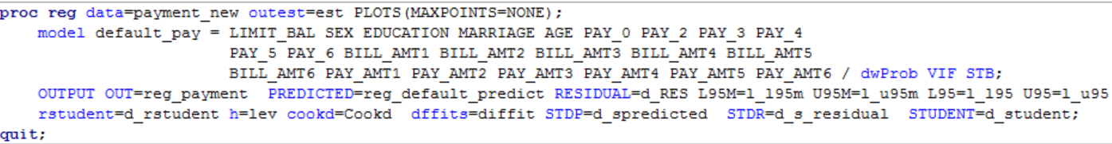
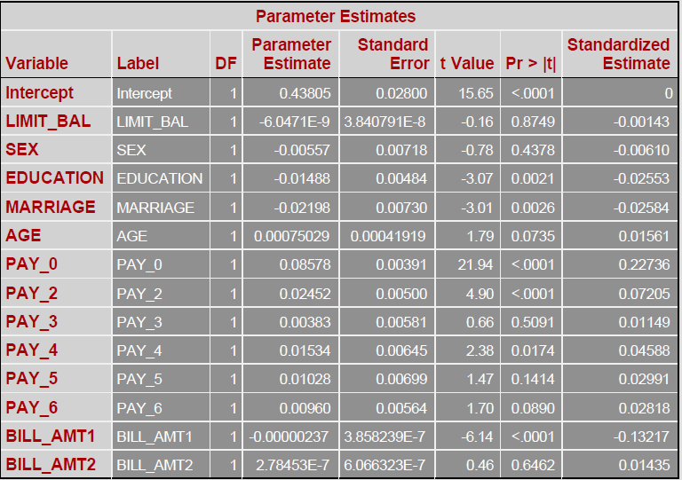
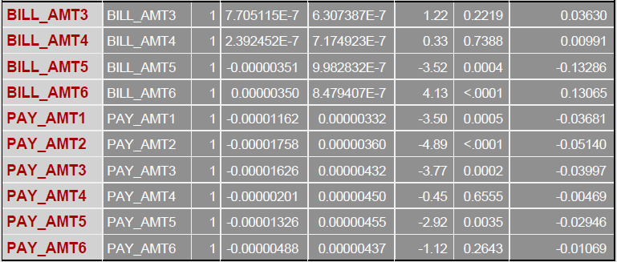
Multiple regression
As we can see from the output, most of the variables in this dataset do not provide a significant contribution to the target variable.
We have taken all the significant variables based on P value.

Slide 13
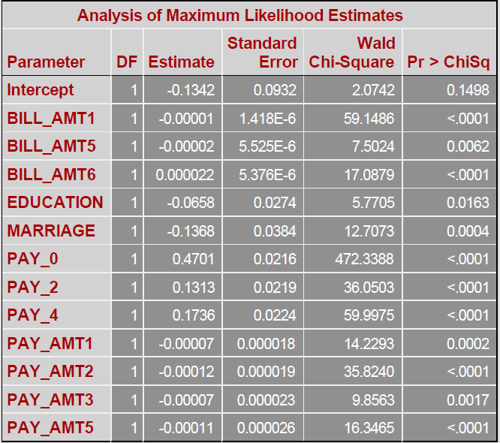
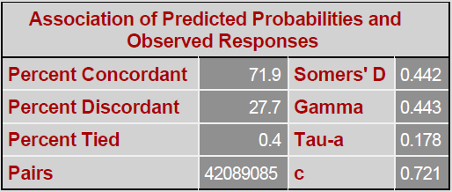
Logistic Regression
All the variables selected after regression are significant as seen from the output
The c- statistics indicates that the area under curve is 72.1% which is greater than 50% and hence is a good model.

Slide 14
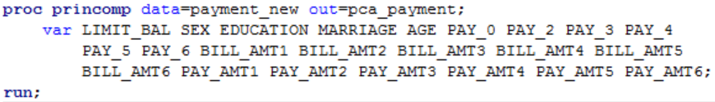
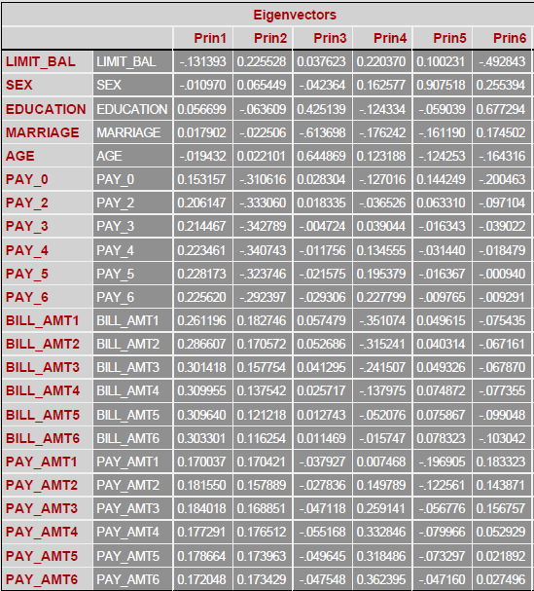
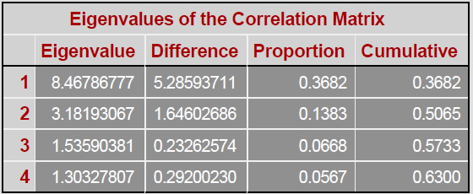

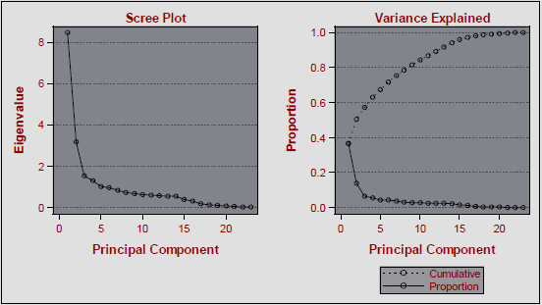
Principal Component Analysis

Slide 15
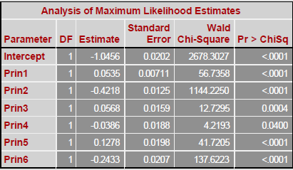
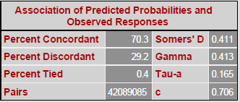
Logistic Regression
All the Principal Components are significant as seen from the output.
However the c-statistics values is 70.6% which is lower than that obtained by applying just the logistic regression.

Slide 16
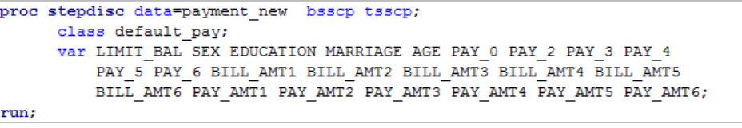
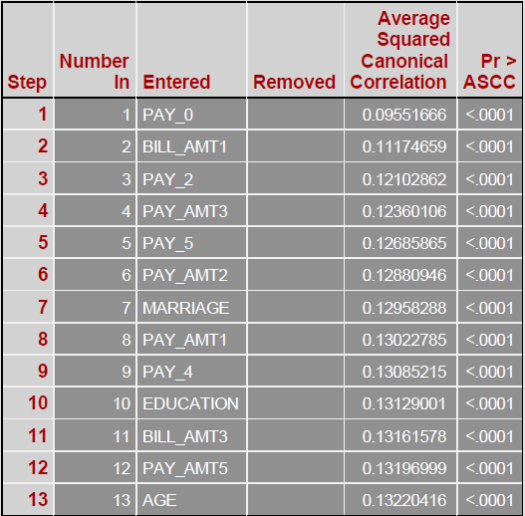
Discriminant Analysis-STEPDISC Procedure

Slide 17
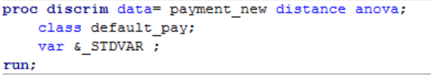
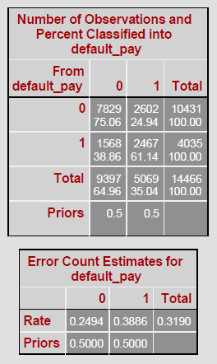
Discriminant Analysis
As seen from the output we conclude that the error rate is 31.90% which means that our model predicts the outcome with almost 69% accuracy.

Slide 18
Method 2
Used Dataset after removing outliers and standardizing the results.
All the variables were taken into model for multiple regression.
Only significant variables which we got from regression output, were considered into logistic regression model.
Principal component analysis was performed on all variables from Dataset.
Discriminant Analysis is done on set of variables which we got from STEPDISC procedure.

Slide 19
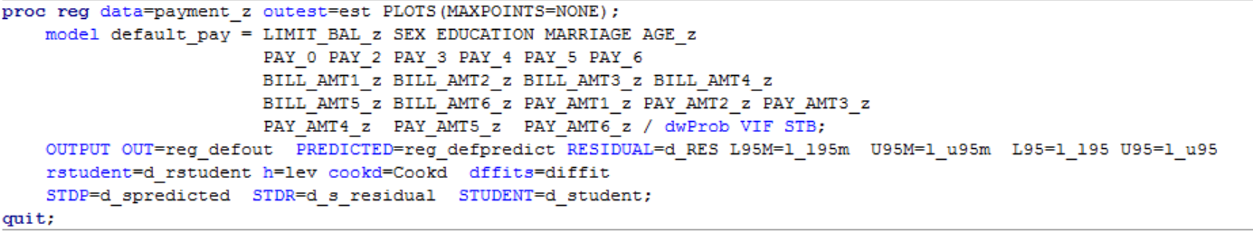
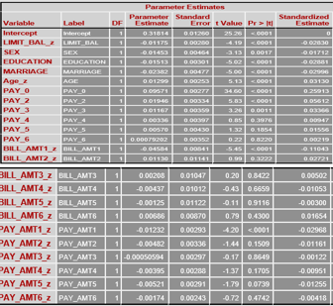
Multiple Regression
As we can see from the output, most of the variables in this dataset do not provide a significant contribution to the target variable.

Slide 20
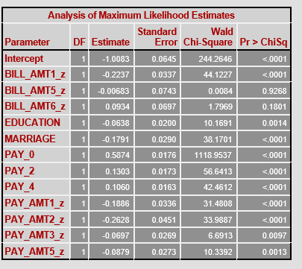
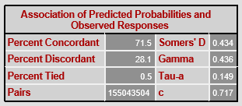
Logistic Regression
All the variables selected after regression are significant as seen from the output
The c- statistics indicates that the area under curve is 71.7% which is greater than 50% and hence is a good model.

Slide 21
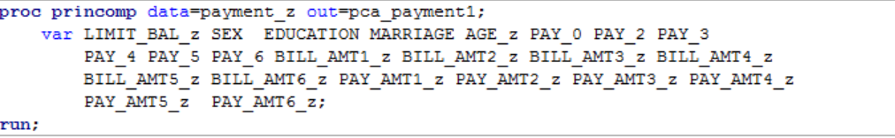
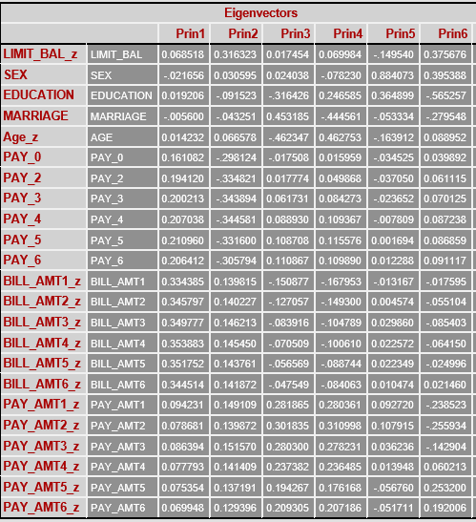
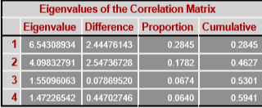

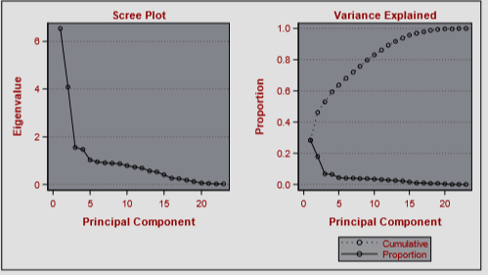
Principal Component Analysis

Slide 22
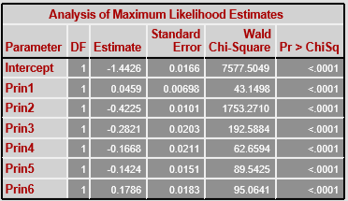
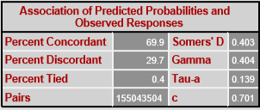
Logistic Regression
All the Principal Components are significant as seen from the output.
However the c-statistics values is 70.1% which is lower than that obtained by applying just the logistic regression.

Slide 23
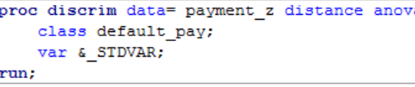
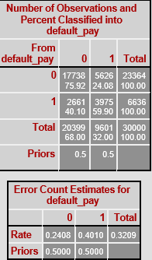
Discriminant Analysis
As seen from the output we conclude that the error rate is 32.09% which means that our model predicts the outcome with almost 68% accuracy.

Slide 24
Method 3
Used Dataset after removing outliers, standardizing results, power and log transformations
All the variables were taken into model for multiple regression.
Only significant variables which we got from regression output, were considered into logistic regression model.
Principal component analysis was performed on all variables from Dataset.
Discriminant Analysis is done on set of variables which we got from STEPDISC procedure.

Slide 25
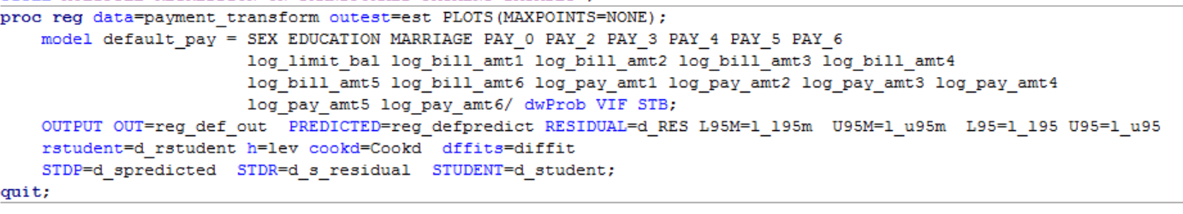
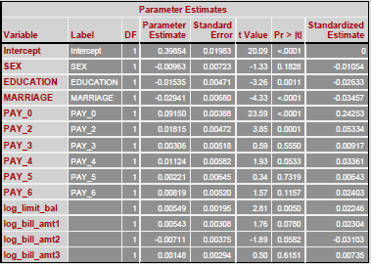
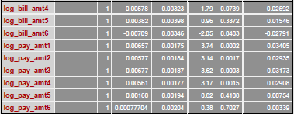
Multiple Regression
As we can see from the output, most of the variables in this dataset do not provide a significant contribution to the target variable.

Slide 26
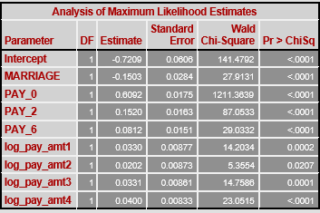
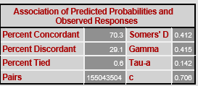
Logistic Regression
All the variables selected after regression are significant as seen from the output
The c- statistics indicates that the area under curve is 70.6% which is greater than 50% and hence is a good model.

Slide 27
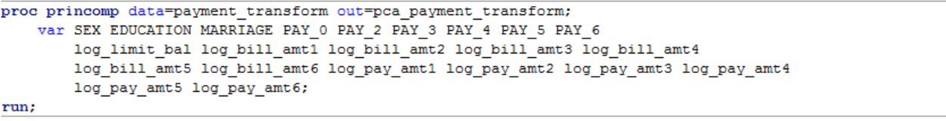
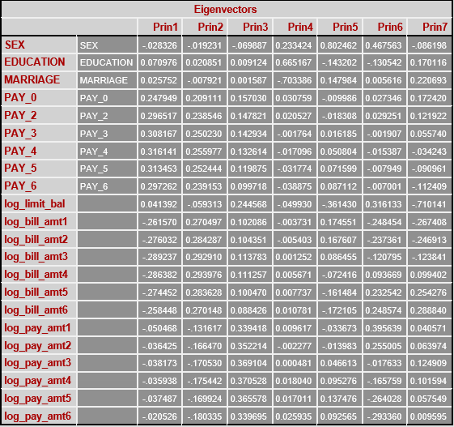
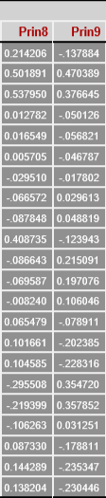
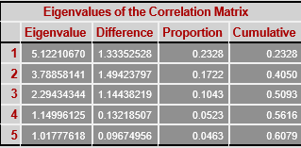

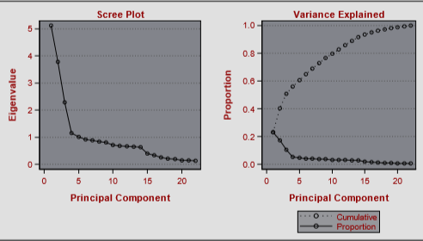
Principal Component Analysis

Slide 28
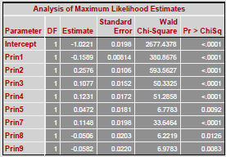
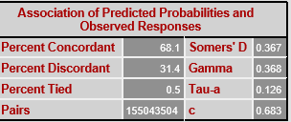
Logistic Regression
All the Principal Components are significant as seen from the output.
However the c-statistics values is 68.3% which is lower than that obtained by applying just the logistic regression.

Slide 29
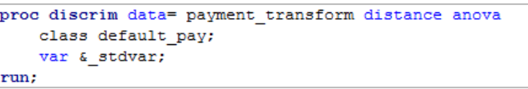
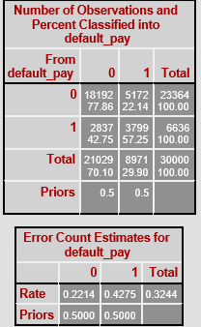
Discriminant Analysis
As seen from the output we conclude that the error rate is 32.44% which means that our model predicts the outcome with almost 67.5% accuracy.

Slide 30
Conclusion
We conclude that the solution obtained from method 1 is the model with the closest prediction to actual values
The error rate of 31.90 is the lowest of all the three methods and hence is the recommended method for this dataset.

