Slide 1



Predictive Modeling for Sports Performance Analysis
-Paridhi Talwar

Slide 2

Purpose
Dataset
Team Performance Analysis
Topics Covered
Tampa Bay and Key Players
Simulation
Models Used
Conclusion

Slide 3
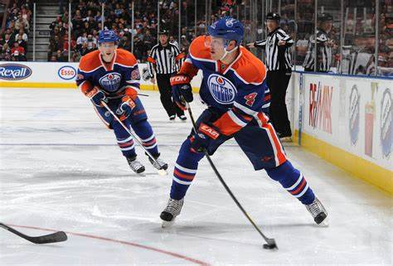
Purpose
In the world of sports, understanding the factors that contribute to team success is paramount. However, identifying these factors and their impact on performance can be a challenging task. In this presentation, we tackle this problem by conducting a comprehensive analysis of team performance in sports. Through exploratory data analysis (EDA) and what-if scenarios, we aim to uncover insights into the key drivers of success for teams. By addressing this problem, we hope to provide valuable insights that can assist teams in optimizing their strategies and decision-making processes to enhance their performance on the field.

Slide 4


Dataset
Our dataset includes game statistics from a variety of matches, offering information on team statistics as well as individual player performances. The collection captures important elements of gameplay and player contributions with columns like game_id, player_id, team_id, goals, shots, hits, powerPlayGoals, penaltyMinutes, and more. These characteristics allow us to perform in-depth analyses of player effectiveness, team dynamics, and overall game results. Our goal in using this dataset is to find patterns, trends, and relationships that can improve performance optimization strategies in the sports industry and guide strategic decision-making.

Slide 5

Team Performance Analysis
Exploratory data analysis (EDA) entailed carefully reviewing and analyzing the dataset in order to obtain understanding of different facets of player contributions and team performance. We started by looking at descriptive statistics for important performance metrics like goals, shots, hits, and power play goals, such as mean, median, and standard deviation. Additionally, to find patterns, distributions, and possible outliers in the data, we used visualizations like scatter plots, box plots, and histograms. We were able to comprehend the underlying patterns and relationships in the dataset better through the EDA process, which laid the groundwork for more in-depth analyses and modeling methods.

Slide 6
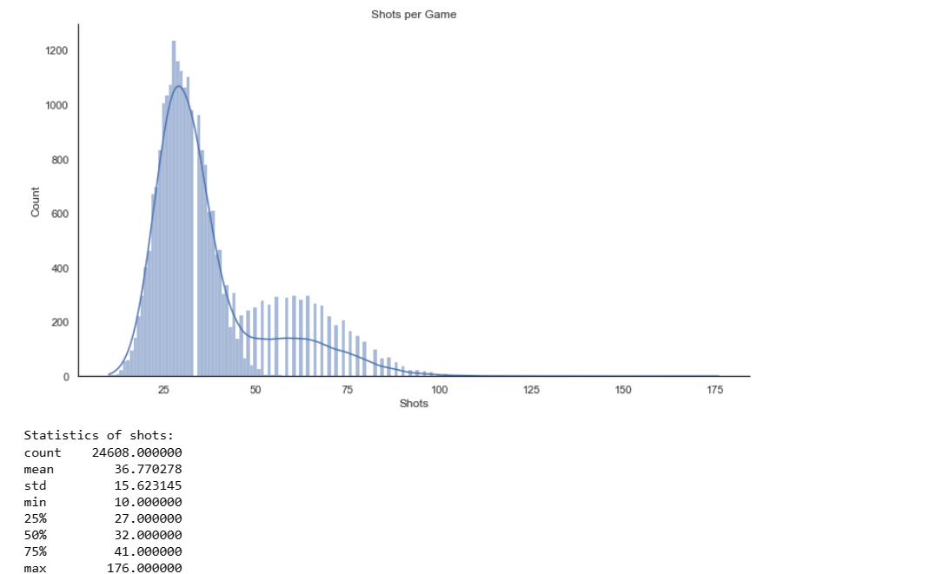
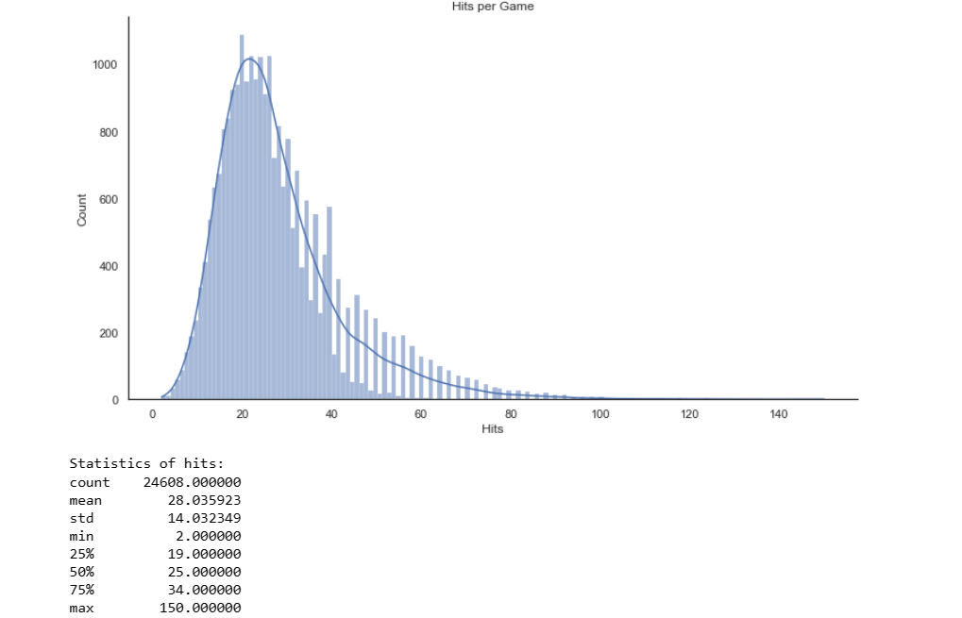

Slide 7
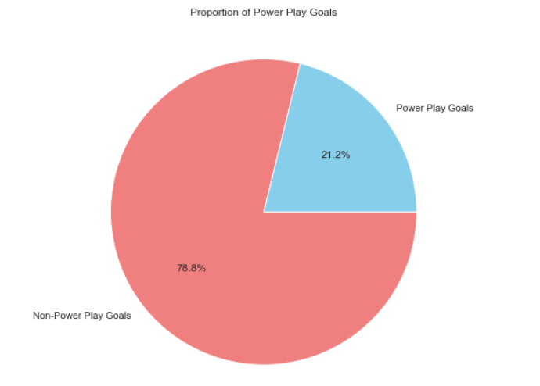
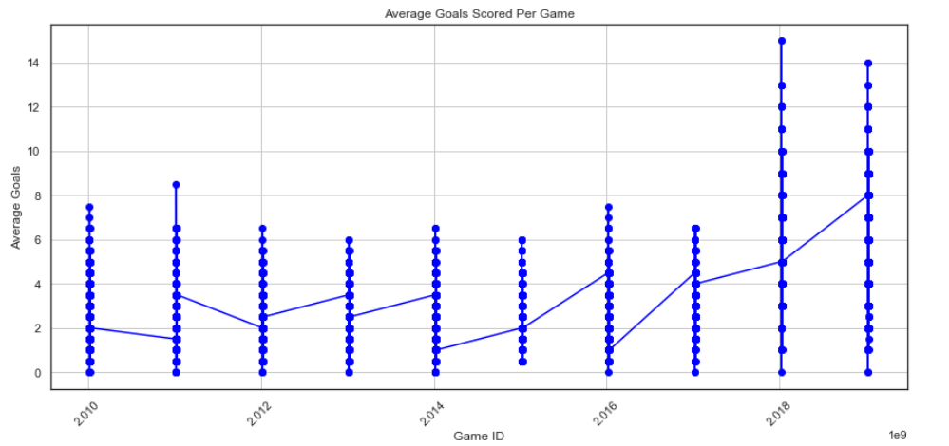

Slide 8
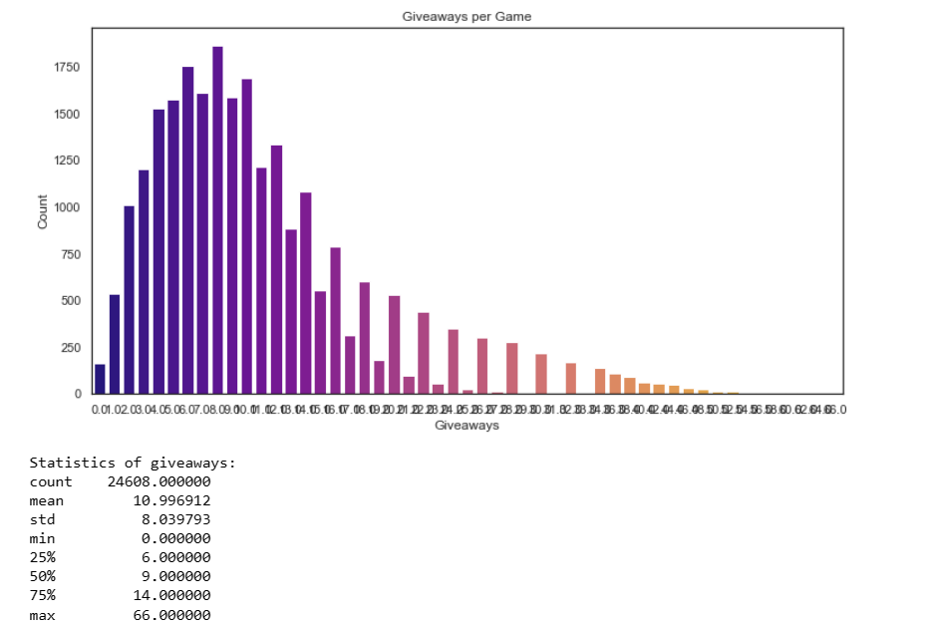
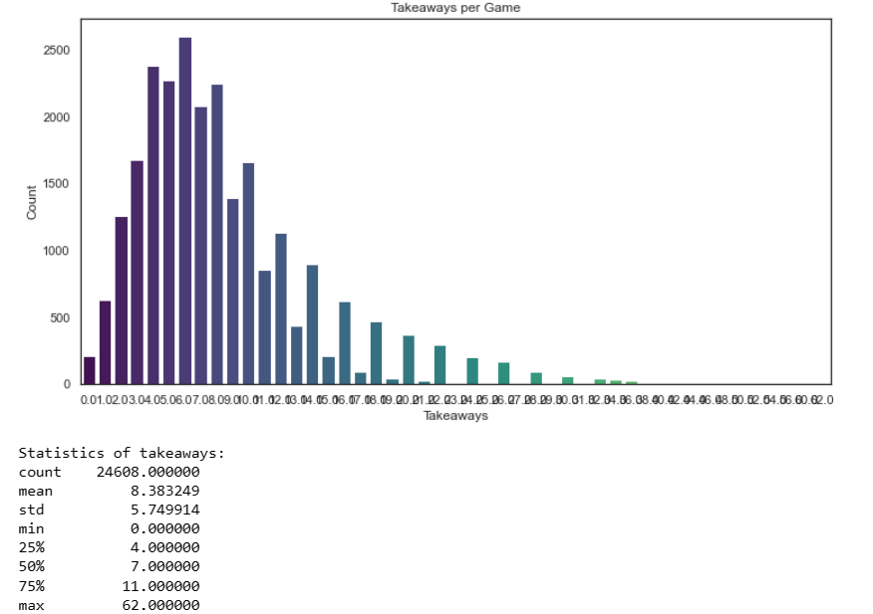

Slide 9

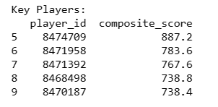
Tampa Bay and Key Players
The goal of our team performance analysis was to analyze Tampa Bay's play and identify the elements that contributed to their success. We compiled and examined game data, such as goals, hits, shots, power play goals, and more, in order to evaluate Tampa Bay's overall performance in a number of games. We were able to identify important figures who made a substantial contribution to Tampa Bay's success through this analysis. These important players were chosen using a variety of criteria, including time spent on the ice, assists received, goals scored, and defensive plays like hits and blocked shots. We were able to identify the standout players whose contributions were essential to Tampa Bay's victories and season-long success by utilizing cutting-edge data analytics techniques.

Slide 10

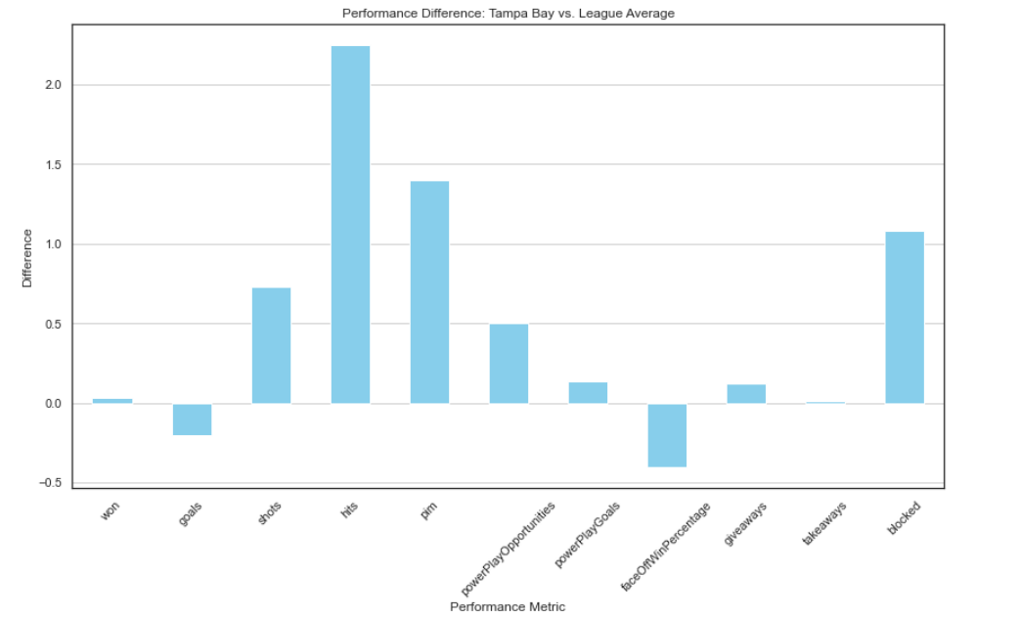

Slide 11
Injury to Key Player
We simulated injuries to important players identified by our analysis in order to conduct a simulation study and evaluate the possible effect of injuries on team performance. We created scenarios where important players were unable to play in games by specifically targeting them based on their contributions to the team's success. This gave us the opportunity to assess how different performance metrics, like goals scored, shots taken, and overall team success, might be impacted by the absence of these key players. Our objectives with this simulation were to inform strategic decision-making processes for team management and to obtain important insights into the adaptability and resilience of teams in the face of unanticipated events, such as player injuries.
Simulation

Slide 12

Models Used
Logistic Regression
Support Vector Machine
Random Forest
The logistic regression model achieved a respectable accuracy score of 0.791, indicating its ability to effectively predict team performance outcomes. Despite its simplicity, logistic regression provided valuable insights into the relationship between input features and the likelihood of team success.
With an accuracy score of 0.796, the SVM model demonstrated strong predictive performance in forecasting team performance based on input variables. SVM's ability to handle non-linear relationships and high-dimensional data contributed to its effectiveness in capturing complex patterns within the dataset.
The random forest model outperformed the other models with an accuracy score of 0.818, showcasing its robustness and versatility in predicting team outcomes. By aggregating predictions from multiple decision trees, random forest effectively mitigated overfitting and provided reliable predictions for the impact of player injuries on team performance.

Slide 13
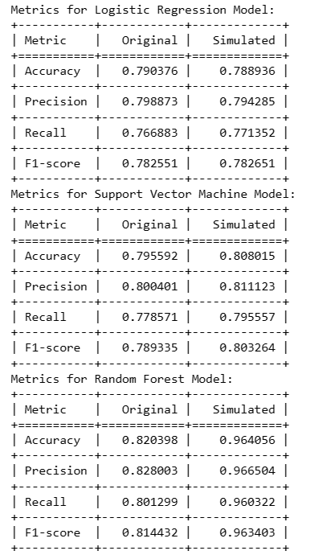
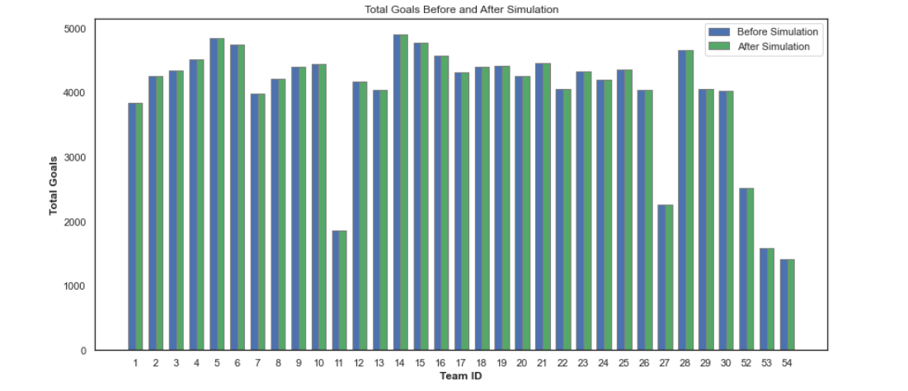

Slide 14
Conclusion
Our goal in running our simulation study was to evaluate how important players' injuries affected the overall performance of the team. Our analysis showed that the number of goals scored by the other team increased only slightly in spite of the absence of these key players. This implies that even though defensive players are essential in preventing opponents from scoring, teams have the flexibility and depth to lessen the impact of player absences. Our findings highlight the ability of teams to overcome obstacles and sustain competitive performance levels through resiliency and strategic acumen. In the future, this knowledge can guide team management's strategic decision-making procedures by highlighting the significance of a well-rounded roster and productive teamwork in attaining long-term success on the field.

Slide 15
Thank you!

