Slide 1

Predicting Customer Trip Type
ISM 6136 – Data Mining
Paridhi Varma| Prateek Jindal| Pulkit Pareek| Saharsh Kislaya

Slide 2
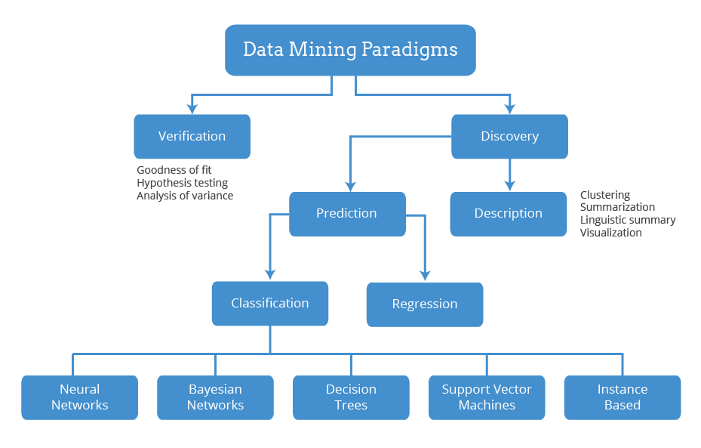

Slide 3
Contents
Introduction
Data Set Evaluation
Data Field Description
Data Preprocessing
Analysis Using J48
Analysis using Naïve Bayes
Analysis using Nearest Neighbor
Summary

Slide 4

Introduction
In this project we are trying to predict the customer trip type by using which Walmart can improve the customer shopping experiences by segmenting the trip types of different customers.
By classifying the customer trip types Walmart can use this information to give best shopping experience for customer.
Here we are using only historical transactional dataset of items purchased.
Walmart has categorized the trips contained in this data into 38 distinct types using a proprietary method applied to an extended set of data.

Slide 5
Data Set Evaluation
The training set (Wallmart.csv) contains a large number of customer visits with the TripType included.
Including the attributes : VisitNumber, Weekday, Upc, ScanCount, DepartmentDescription, FinelineNumber and Triptype.
This is the explanation provided for the data set –
TripType
VisitNumber
Weekday
Upc
ScanCount
DepartmentDescription
FinelineNumber

Slide 6
Data Field Description
TripType - a categorical id representing the type of shopping trip the customer made. This is the ground truth that you are predicting. TripType_999 is an "other" category
VisitNumber - an id corresponding to a single trip by a single customer
Weekday - the weekday of the trip
Upc - the UPC number of the product purchased
ScanCount - the number of the given item that was purchased. A negative value indicates a product return.
DepartmentDescription - a high-level description of the item's department
FinelineNumber - a more refined category for each of the products, created by Walmart

Slide 7
Data Set Evaluation
The representation of every weekday has been taken in to the dataset.
Each visit may only have one TripType.
UPC and FinelineNumber have NULL values.
VisitNumber clusters all the items of a single customer of a single trip.
The field VisitNumber helps to clusters the trip type – determining the trip based on the items purchased.
For example, for a Visit Number ‘5’ – if only one row is present, which implies that only one product is purchased, and Weekday value is ‘Friday’, this implies one kind of trip. Hence, the trips can also be classified on the basis of the number of rows (number of products) been bought.

Slide 8
Data Preprocessing
Before creating predictive models on the data, it needs to be randomized and sampled.
This would prevent the input from being skewed. Data can be randomized by applying filter in Weka.
The ‘randomize’ function under the instance folder within the unsupervised filter enables us to do so.
Also, the missing values need to be replaced to ensure that the model works properly.
This can be done using the ‘ReplaceMissingValues’ function under the attribute folder within the unsupervised filter. For our use case, we have considered 20,212 records.
Since the target variable, predicts the type or class of the trip made by the customer to Walmart, another filter needs to be applied to the data which tells Weka that the target values are nominal and not numeric. This can be done by applying the ‘NumericToNominal’ function under the attribute folder within the unsupervised filter.

Slide 9
Data Preprocessing
The data needs to randomized before creating models on the data.
It would prevent the input from being skewed.
The ‘randomize’ function under the instance folder within the unsupervised filter randomizes the data.
The missing values also need to be replaced for the model to be more accurate.
This can be done using the ‘ReplaceMissingValues’ function under the attribute folder within the unsupervised filter.
Since the target variable, predicts the type or class of the trip made by the customer to Walmart, another filter needs to be applied to the data which tells Weka that the target values are nominal and not numeric.
This can be done by applying the ‘NumericToNominal’ function under the attribute folder within the unsupervised filter.
For our use case, we have considered 20,212 records

Slide 10
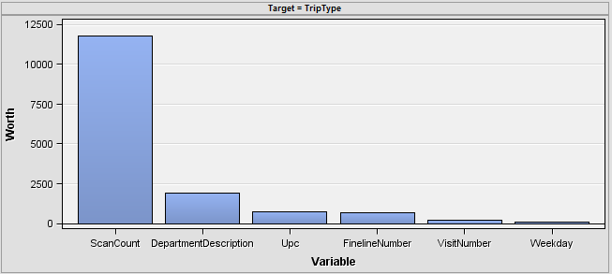
Logworth of each variable
We can clearly see in this graph that Scancount has highest Logworth in predicting the Triptype attribute

Slide 11
Summary Statistic of Dataset
High number of missing values in UPC and Filenumber attributes
High Skewness of UPC

Slide 12
Analysis using ZeroR
ZeroR is used to establish the baseline accuracy on the data. The following are the results of ZeroR.
=== Evaluation on test split ===
=== Summary ===
Correctly Classified Instances 1643 23.9086 %
Incorrectly Classified Instances 5229 76.0914 %
Kappa statistic 0
Mean absolute error 0.0502
Root mean squared error 0.1586
Relative absolute error 100 %
Root relative squared error 100 %
Total Number of Instances 6872

Slide 13
Analysis using J48
We have used J48 decision tree classifier to classify the Triptype target variable.
The results on the test data set are as follows :
Number of Leaves : 3692
Size of the tree : 3693
Time taken to build model: 0.95 seconds
=== Evaluation on test split ===
=== Summary ===
Correctly Classified Instances 6320 91.9674 %
Incorrectly Classified Instances 552 8.0326 %
Kappa statistic 0.9096
Mean absolute error 0.0043
Root mean squared error 0.0478
Relative absolute error 8.5678 %
Root relative squared error 30.1744 %
Total Number of Instances 6872

Slide 14
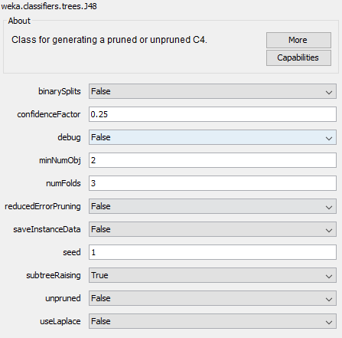
Analysis using J48
The following are the parameters used to run the J48 algorithm :

Slide 15
Analysis using Naive Bayes
The second prediction model created on the dataset is done using the Naïve Bayes algorithm . The results of the Naïve Bayes algorithm are as follows :
=== Evaluation on test split ===
=== Summary ===
Correctly Classified Instances 4720 68.6845 %
Incorrectly Classified Instances 2152 31.3155 %
Kappa statistic 0.6471
Mean absolute error 0.0261
Root mean squared error 0.11
Relative absolute error 52.0005 %
Root relative squared error 69.3592 %
Total Number of Instances 6872

Slide 16
Analysis using Nearest Neighbor
The third prediction model created on the dataset is done using the Nearest Neighbor algorithm . The results of the Nearest Neighbor algorithm are as follows :
=== Evaluation on test split ===
=== Summary ===
Correctly Classified Instances 4173 60.7247 %
Incorrectly Classified Instances 2699 39.2753 %
Kappa statistic 0.5618
Mean absolute error 0.0249
Root mean squared error 0.1286
Relative absolute error 49.5224 %
Root relative squared error 81.0946 %
Total Number of Instances 6872

Slide 17
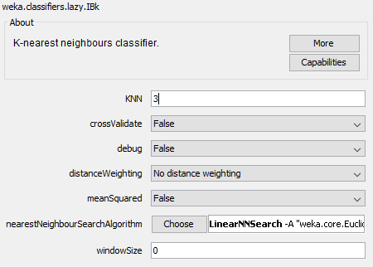
Analysis using Nearest Neighbor
The following are the parameters used to run the IBK algorithm :

Slide 18
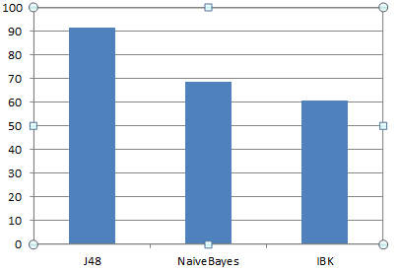
Summary
The J48 decision tree performs the best on the data set with an accuracy of 91.97%
The Naïve Bayes algorithm gives an accuracy of 68.6845 %
The Nearest Neighbor Algorithm predicts with the least accuracy of 60.73 %

