Slide 1
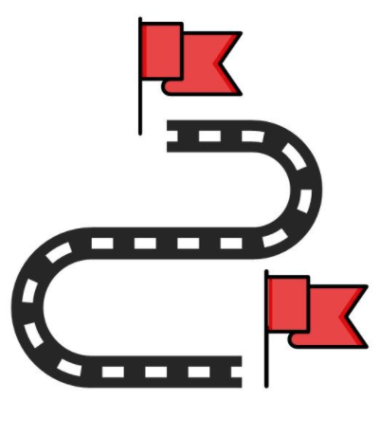
APJC DevNet Innovator 2021 Stage2
5 milestones
Planning Template
F
S
Team Name : Genpact Defenders
Submission Date : 14th May 2021

Slide 2
Cisco APJC DevNet Innovators –Hackathon Plan Submission
1st Milestone
2nd Milestone
3rd Milestone
Submission
Team Introduction
HLD of project
Submission
Essay of Project
it should also describe the methods and laying outflows and features.
Submission
1st Outcome of Plan
4th Milestone
5th Milestone
Mock-Up
Demo
Submission
2nd Outcome of Plan
Submission
3rd Outcome of Plan

Slide 3

1st Milestone
Team Introduction
Team Name | Genpact Defenders | Team Logo
Team Member
Name | Nick Name | Role
Avinash Singh | Avinash | Members
Krapanshu Sinha | Krapanshu | Members
Muhammed Rafeeq Sahib | Rafeeq | Members
Shiv Chandra | Shiv | Members

Slide 4
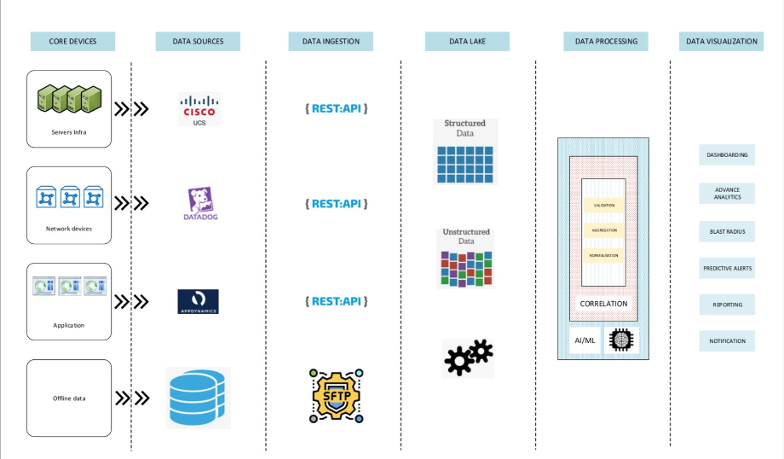
1st Milestone
High Level Design
Use Case Description ( in 3 lines )
One-stop desk – Single window/dashboard for the service desk to discover workplace needs and issues in real-time. The platform should be able to intake data from other solution, normalize and process with the common data
HLD Diagram

Slide 5
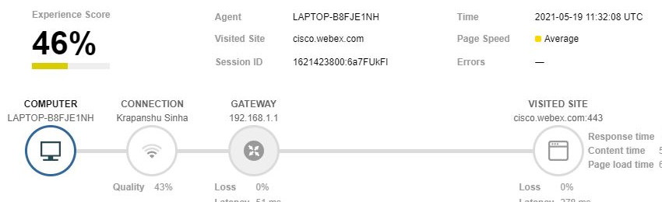
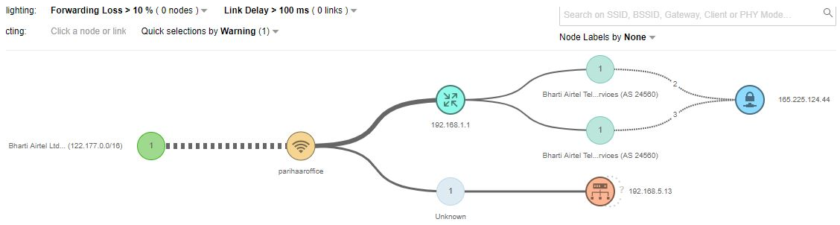
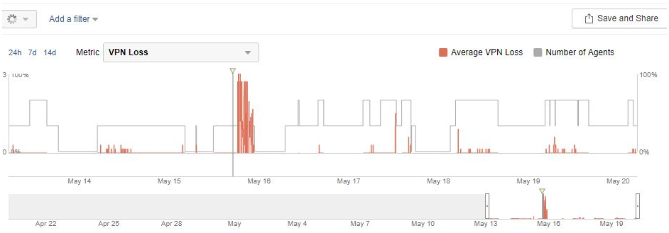
2nd Milestone
Milestone Plan
2nd Milestone Task | Thousand Eyes setup
Task Detail | Capture the telemetry information from remote users' machine and continuously monitor performance of VPN gateways and other critical services
Logic Flow Diagram
Overall workspace experience and connectivity view
Network path analytics
VPN loss in timeframe

Slide 6
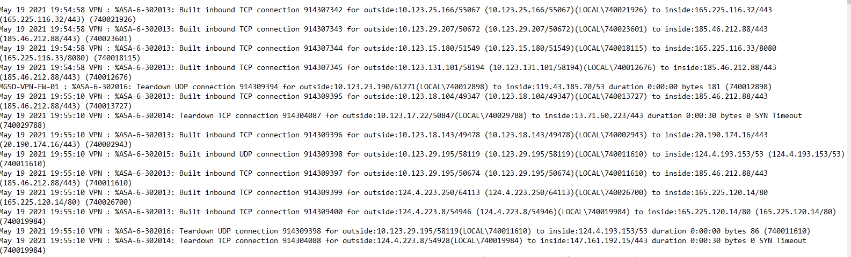
3rd Milestone
Milestone Plan
3rd Milestone Task | VPN setup on ASA firewall
Task Detail | Build a VPN concentrator on ASA and enable logging level to information to capture transaction of AnyConnect client and ASA concentrator
Logic Flow Diagram

Slide 7
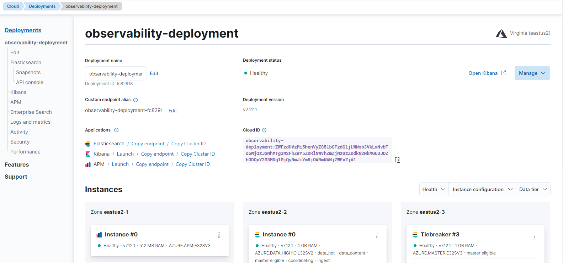
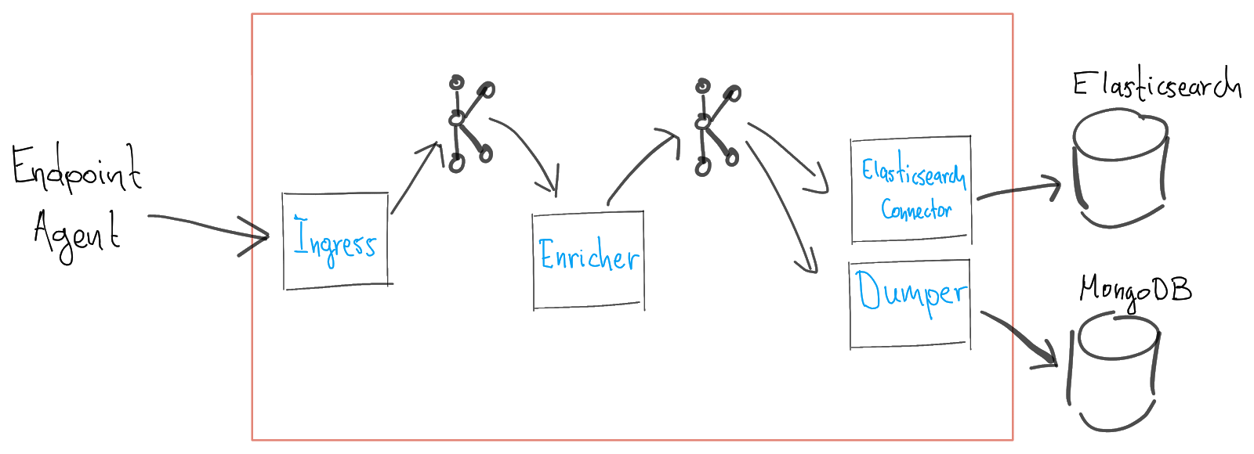
4th Milestone
Milestone Plan
4th Milestone Task | Elasticsearch
Task Detail | Migrate data from thousand eyes (Received from endpoint) and ASA syslogs to Elastic Search
Logic Flow Diagram

Slide 8
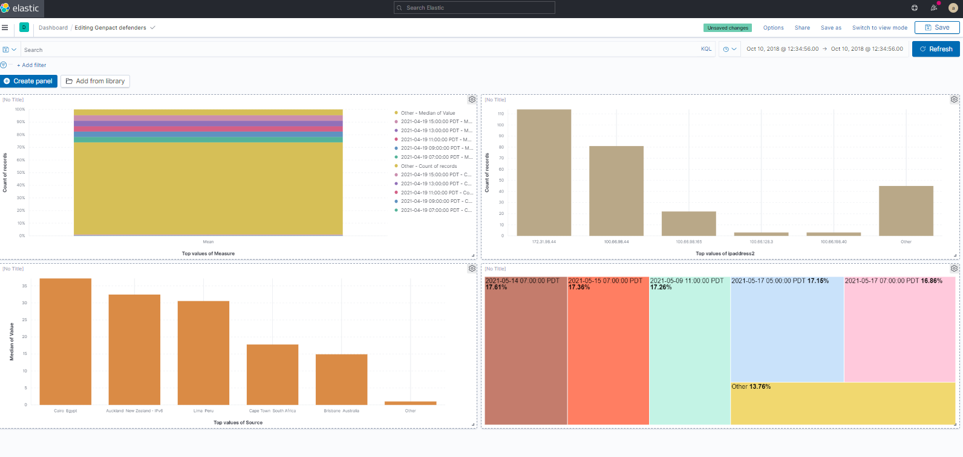
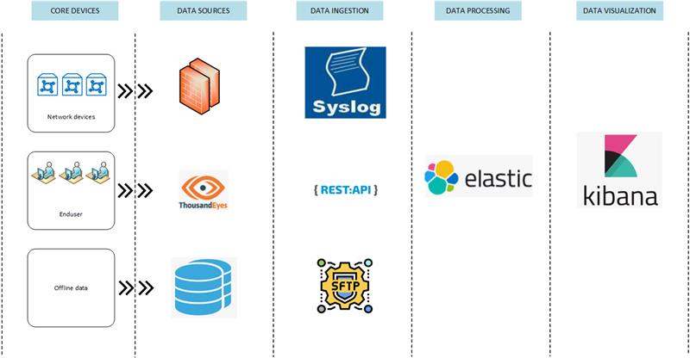
5th Milestone
Milestone Plan
5th Milestone Task | Kibana
Task Detail | Visualize all data dumped into elastic search in Kibana
Logic Flow Diagram

Slide 9




We Make It

