Slide 1
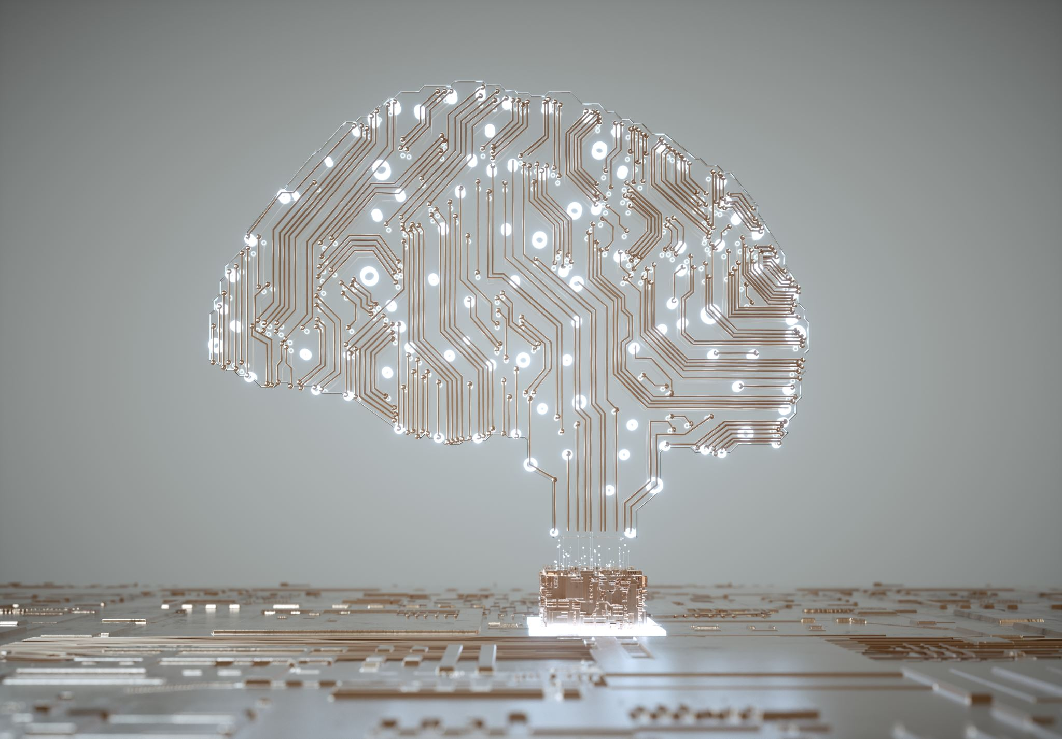
Introduction to Artificial Intelligence
Jaykishan Parikh
28th June 2024
Notes:
Introduce yourself and mention your role.
Briefly explain the purpose of the presentation: to provide an overview of AI and demonstrate a simple AI application.

Slide 2

What is Artificial Intelligence
What is AI?
Brief History of AI
Importance of AI in modern applications
Notes:
Define Artificial Intelligence (AI): the simulation of human intelligence in machines. Brief History of AI:1950s: Alan Turing's "Computing Machinery and Intelligence" paper.
1956: John McCarthy coined the term "Artificial Intelligence" at the Dartmouth Conference.
1980s-1990s: AI Winter due to reduced funding and interest.
2000s-Present: Revival of AI with advancements in computing power, data availability, and algorithms.

Slide 3
Types of AI
Narrow AI
General AI
Notes:
Narrow AI: AI systems designed for specific tasks (e.g., virtual assistants, recommendation systems).
General AI: Hypothetical AI that possesses the ability to perform any intellectual task that a human can.
Narrow AI, also known as Weak AI, refers to artificial intelligence systems that are designed and trained to perform a specific task or a set of closely related tasks. Unlike general AI, which would possess the ability to understand, learn, and apply intelligence across a broad range of tasks (akin to human intelligence), narrow AI is specialized and focused. It operates under a limited set of constraints and is not capable of generalizing knowledge beyond its domain of expertise.

Slide 4
What is Narrow AI
Definition:
AI systems designed to perform a specific task or a set of closely related tasks.
Characteristics:
Task-Specific: Excels at a single or narrow range of tasks.
Pre-Programmed Knowledge: Operates based on training data and instructions.
High Efficiency: Outperforms humans in its specialized domain.
Dependence on Data: Requires large, high-quality data sets.
Lack of Generalization: Cannot transfer knowledge to new, unrelated tasks.
Examples of Narrow AI:
Virtual Assistants: Siri, Alexa, Google Assistant
Recommendation Systems: Netflix, Spotify, Amazon
Image Recognition: Facial recognition, medical imaging
Speech Recognition: Voice-to-text transcription services
Game AI: DeepMind's AlphaGo
Chatbots: Customer service bots

Slide 5
Advantage & Limitation of Narrow AI
Advantages of Narrow AI:
High Performance:
Achieves superhuman accuracy and efficiency in specific tasks.
Cost-Effective:
Automates repetitive tasks, reducing human intervention and operational costs.
Scalability:
Easily scaled to handle large volumes of data and tasks.
Availability:
Operates 24/7 without fatigue.
Limitations of Narrow AI:
Lack of Flexibility:
Cannot adapt to new or unforeseen tasks outside its training scope.
Dependency on Data Quality:
Performance is tied to the quality and quantity of training data.
No Common Sense:
Lacks understanding of context or common sense reasoning.
Ethical and Bias Issues:
May perpetuate biases present in the training data, raising ethical concerns

Slide 6
What is Generic AI
Definition:General AI (Artificial General Intelligence or AGI) refers to AI systems with the ability to understand, learn, and apply intelligence across a wide range of tasks, similar to human intelligence.
Characteristics:Versatility: Capable of performing any intellectual task that a human can do.
Learning and Adaptation: Continuously learns from experience and adapts to new situations.
Reasoning and Problem-Solving: Understands and reasons about the world in a human-like manner.
Generalization: Applies knowledge learned in one context to different, unrelated contexts.

Slide 7
Potential Examples and Implications of General AI
Potential Examples of General AI:
Human-Like Assistants:
AI systems that can perform a variety of tasks, from complex problem-solving to creative endeavors, akin to a highly skilled human assistant.
Autonomous Learning Systems:
Machines that can independently acquire new skills and knowledge across diverse fields without explicit programming.
Adaptive Robots:
Robots capable of performing various tasks in dynamic environments, such as household chores, caregiving, or disaster response.
Implications of General AI:
Economic Impact:
Potential to revolutionize industries by automating complex tasks, leading to significant economic shifts.
Ethical Considerations:
Raises questions about AI rights, ethical use, and potential misuse.
Societal Changes:
Could transform education, healthcare, and daily life by providing advanced, personalized assistance.
Existential Risks:
Concerns about the control and safety of AGI systems, ensuring they align with human values and goals.

Slide 8
AI Techniques
Machine Learning
Deep Learning
Natural Language Processing
Notes:
Machine Learning (ML): Algorithms that allow computers to learn from data and improve over time without being explicitly programmed.
Deep Learning (DL): A subset of ML using neural networks with many layers to analyze various factors of data.
Natural Language Processing (NLP): The ability of computers to understand, interpret, and generate human language.

Slide 9
Machine Learning (ML)
Definition:
Subset of AI that enables systems to learn and improve from experience without being explicitly programmed.
Key Techniques:
Supervised learning, unsupervised learning, reinforcement learning.
Applications:
Predictive analytics, recommendation systems, fraud detection.

Slide 10
Deep Learning (DL)
Definition:
Subset of ML focused on algorithms inspired by the structure and function of the brain's neural networks.
Key Techniques:
Neural networks, convolutional neural networks (CNNs), recurrent neural networks (RNNs).
Applications:
Image and speech recognition, natural language processing (NLP), autonomous vehicles.

Slide 11
Natural Language Processing (NLP)
Definition:
Branch of AI focused on enabling computers to understand, interpret, and generate human language.
Key Techniques:
Tokenization, named entity recognition (NER), sentiment analysis, machine translation.
Applications:
Chatbots, language translation, text analysis, voice assistants.

Slide 12
Real-World Applications
Healthcare
Finance
Virtual Assistants

Slide 13
Live Demo
Meeting Assistance
Notes:
Sure, here's a detailed explanation of the project development, build, test process, and how AI is used:
## Project Development, Build, Test, and AI Explanation
### Project Development
#### Backend (Flask)
1. **Setup Flask Application**:
- Initialize a Flask application to serve as the backend.
- Install necessary packages including Flask, Flask-CORS, joblib, and scikit-learn.
- Create an endpoint `/predict_meeting_duration` that accepts POST requests with a start date/time and returns the predicted meeting duration.
2. **Machine Learning Model**:
- Train a decision tree regressor model using historical data on meeting durations.
- The features used for training include the day of the week and hour of the day.
- Save the trained model as `decision_tree_model.pkl` using joblib.
3. **Prediction Endpoint**:
- Load the pre-trained model in the Flask application.
- Extract features from the input start date/time (e.g., day of the week, hour of the day).
- Use the model to predict the meeting duration and return it in the response.
#### Frontend (React)
1. **Setup React Application**:
- Initialize a React application using `create-react-app`.
- Install necessary packages including axios for making HTTP requests and react-datepicker for selecting date and time.
2. **User Interface**:
- Create a simple user interface to select a start date and time for the meeting.
- Display the predicted meeting duration and suggested end date/time based on the model's prediction.
3. **API Integration**:
- When the user selects a start date and time, make a POST request to the backend `/predict_meeting_duration` endpoint.
- Update the UI with the predicted meeting duration and suggested end date/time.
### Build
#### Backend
1. **Install Dependencies**:
- Create a virtual environment and install the required Python packages listed in `requirements.txt`.
2. **Run Flask Application**:
- Start the Flask server using `python app.py`.
#### Frontend
1. **Install Dependencies**:
- Navigate to the `frontend/` directory and install Node.js dependencies using `npm install`.
2. **Run React Application**:
- Start the React development server using `npm start`.
### Test
1. **Backend Testing**:
- Use tools like Postman to send POST requests to the `/predict_meeting_duration` endpoint.
- Verify that the backend returns the correct predicted meeting duration.
2. **Frontend Testing**:
- Open the React application in a web browser.
- Select a start date and time and ensure the application displays the predicted meeting duration and suggested end date/time.
### How AI is Used
1. **Data Collection**:
- Historical data on meeting start times and durations is collected. This data includes features such as the day of the week and the hour of the day when the meeting started.
2. **Model Training**:
- A decision tree regressor model is trained using this historical data.
- The model learns to predict the meeting duration based on patterns in the data, such as which days and times are associated with longer or shorter meetings.
3. **Prediction**:
- When a user selects a start date and time for a meeting, the frontend sends this information to the backend.
- The backend extracts relevant features from the start date/time and uses the pre-trained decision tree model to predict the meeting duration.
- The predicted duration is then used to suggest an optimal end time for the meeting.
4. **Integration**:
- The prediction functionality is integrated into the meeting scheduler application, providing users with AI-powered suggestions for meeting times that optimize for availability and historical patterns.
By following this development, build, and test process, you can ensure that the application is correctly set up, integrates AI for meeting time predictions, and provides a seamless user experience.

Slide 14
Thank You
Contact Information

