Slide 1
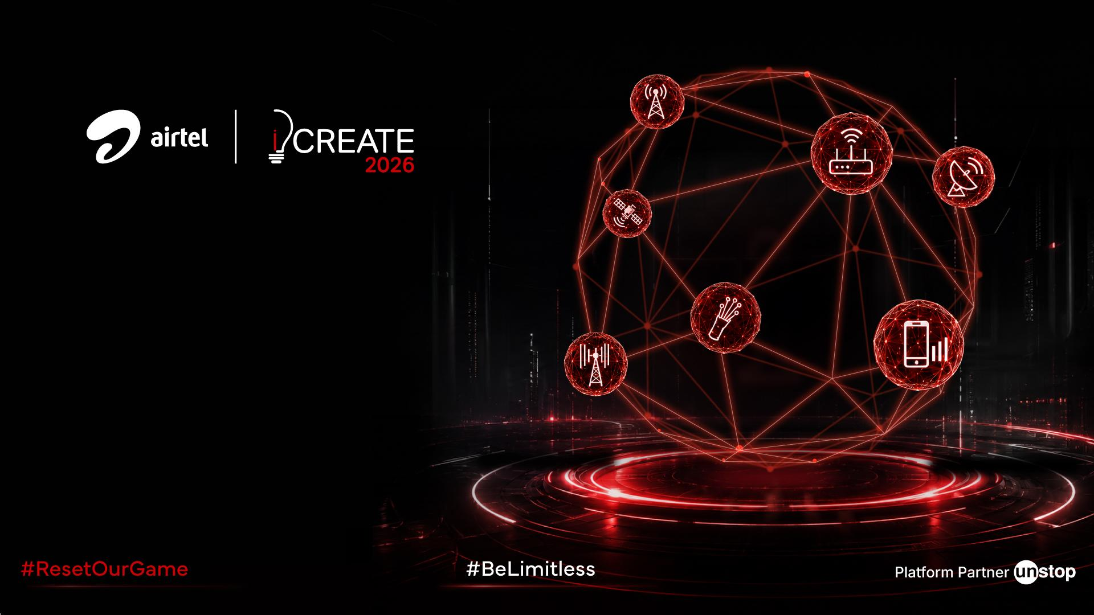
ALTURA COMMUNICATIONS
Connected Household Convergence Strategy
Maximizing Share of Wallet through Inbound Digital Platforms, Habit-Forming Bundle Pricing, Google One Storage, Autopay Incentives, and AI/ML Targeting.
Case Competition Submission | 2026 Strategy

Slide 2

Diagnosing the Convergence Gap
Market, product portfolio, consumer psychology and competitive position - why Altura's households aren't consolidating, and what defends the business meanwhile.
MARKET SNAPSHOT
👥 100 Mn+
High-value connected households in India
📈 ₹2.83 Lakh
Per-capita disposable income in India
📱 430 Mn
5G subscribers; ~1B data users
🪙 ₹194.57
Industry mobility ARPU
🎯 India is growing fast. Altura is built strong. But households still don't converge.
1
Market Landscape & Wallet Opportunity
2
Product Portfolio Today
3
Competitive Landscape & Altura's Moat
Where category growth and captured wallet share diverge
Five live product lines, sold and run in isolation
Where Altura already wins, and what defends it
• India: ₹2.83L per-capita disposable income, 430M 5G subscribers, ~1B data users; industry mobility ARPU ₹194.57
• Altura already leads the industry on ARPU (+₹40 vs. nearest rival) - but prepaid mobility growth is flat and pricing is capped
• Computed CAGR, FY24–27: Broadband +22%, Surveillance +36%, DTH -2% - fastest-growing lines are where Altura's wallet share is lowest
📞
📶
📺
🛡️
🏦
 | Altura | Jio | VI
ARPU (₹) | 257 | 214 | 190
Subscribers (Mn) | 373 | 524 | 198
Monthly churn | ~2% | 1.7% | ~4%
Mobility (prepaid + postpaid)
Broadband / WiFi
OTT + TV
Home Security (Xsafe)
Payments Bank
• Each runs as an independent silo: separate sales teams, separate onboarding, separate billing
• Channels: DTC (high-value, postpaid, ₹449 entry) · Distributor (mass-market, prepaid, ₹349) · Payments Bank (₹99) - each sells one product, rarely cross-sells
• Only a fraction of Altura's ~100M high-value households hold more than one product today
The Moat: not price - it's highest ARPU + a live multi-service footprint (mobility, broadband, DTH, security, banking) + an existing field-force relationship in millions of homes. Convergence turns that footprint into switching cost.
Connectivity
35%
🛡️
Entertainment
12%
Home Security
2%
Emerging Digital
0%
Src: Case intro; Exhibits 2 & 3, CAGR computed FY24–27
Src: Case Appendix 2, channel structure
Src: Competitive Benchmark, Q4 FY26 disclosures
4
Core Problems I: Structural Barriers
5
Core Problems II: Psychological Barriers
6
Personas & Behavioural Triggers
From secondary research - what the case data shows is broken
From primary research - why households resist consolidating
Three households, three different reasons to say no
📉 ① Saturated prepaid mobility - Flat subscriber growth, pricing power constrained
👥 ② Independent product silos - Disjointed onboarding, missed cross-sell
🔄 ③ Single-product churn drain - 22% annual churn vs. 5% for 3+ bundled services
📺 ④ DTH revenue contracting - ₹2,520 Cr (FY20) → ₹2,350 Cr (FY24) as OTT grows
🔧 ⑤ Field force under-used - Lowest decay (12–25%) of any channel, no cross-sell mandate
⚠️ SPOF anxiety: 60%+ fear one outage kills fibre + mobile + TV together
📶 Migration dread: Porting SIMs, installing router/TV-box/cameras, coordinating setup dates
🪙 Utility-arbitrage bias: Belief that separate "cheap" services beat a bundle - ignoring hidden fees (₹2,006 standalone vs. ₹999 bundle promo)
📷 Security-camera trust gap: Only 2% wallet share - no confidence in unbranded CCTV cloud backup or apps
R
REVA · 34 · Metro · High-Value · DTC channel
"I'll pay for one relationship if it won't go dark."
👥
S
SURESH · 41 · Semi-Urban · Distributor channel
"Show me the saving in rupees, not a percentage."
🏪
A
ANIKA · 24 · Metro · Digital-first, prepaid
"I compare four apps before I commit to one."
📱
Src: Case pp.2–3; Exhibits 1, 2, 4 & 5
Src: Primary consumer survey
Src: synthesised from Appendix 2 + primary survey

Slide 3
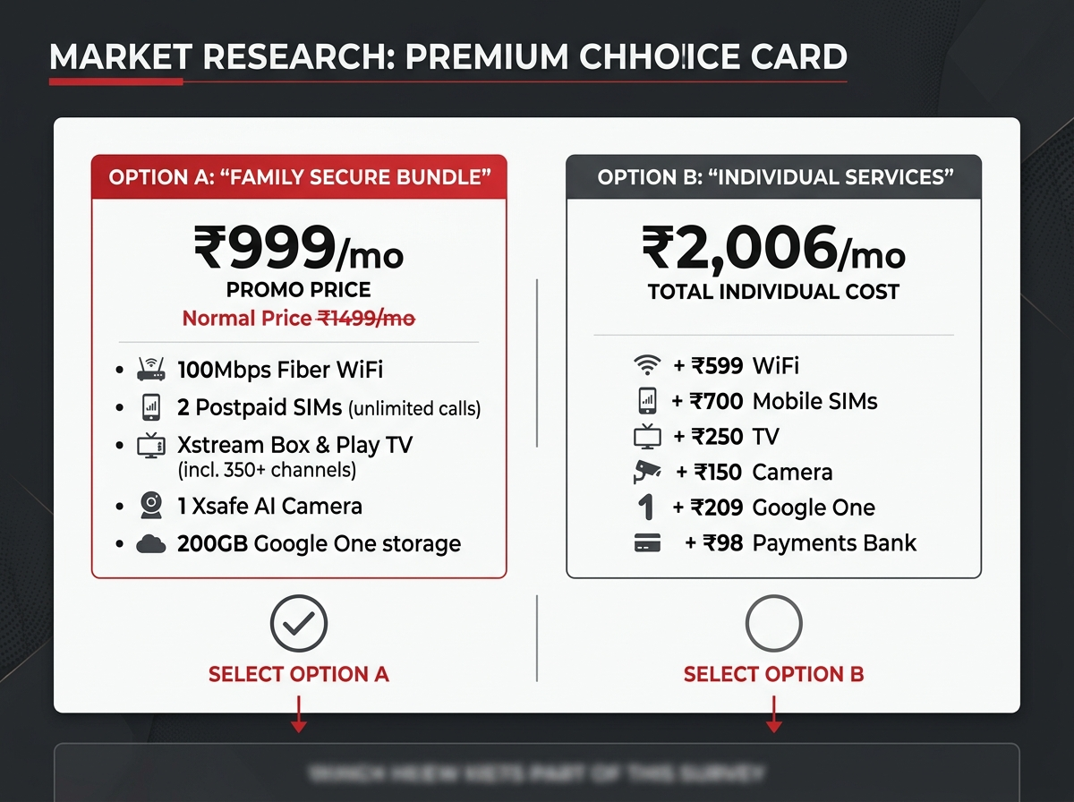
Annexure 1: Primary Research & Conjoint Choice Cards
Research Methodology & Conjoint Analysis
• Conjoint Setup: We deployed 4 binary choice questions directly comparing individual utilities vs. their bundled Altura Home counterparts (Choice Card Starter, Connect, Family Secure, and Infinite).
• Goal: This Discrete Choice Conjoint Experiment isolates exactly where price sensitivity breaks and maps household utility values.
• Quantifying SPOF: Our survey includes agree/disagree statements to map network reliability concerns and data privacy barriers.
• Uploading Cards: The generated card graphics (pictured right) help respondents visually compare price-to-benefit ratios.

Slide 4
Phased Rollout: Foundation to Ecosystem
Sequencing milestones across an 18-month horizon
Foundation
Launch savings calculator
₹0-balance bank accounts
Unified billing backend
Urban Launch
Family bundle configurator
"Live In Your Home" Ads
AI scam cover rollout
Rural GTM
Wall painting and DTH ads
Bundled SIM + bank access
Local partner programme
AI Personalization
Smart plan tool launch
Usage alerts & spend caps
Postpaid conversion push
Cross-sell Scale
Household bundle push
Auto-pay discount active
Device EMI financing
Banking Transition
Next Banking License
Micro-credit & rural loans
Super app as interface

