Slide 1

LLM Fine-Tuning

Slide 2
What is Fine-Tuning?
Adapting pre-trained LLMs to specific tasks, domains, or behaviours by continuing training on specialized datasets.
Full Fine-Tuning
Parameter-Efficient (PEFT)
Update all model parameters
Update small subset of parameters
High quality • Resource intensive • Risk of catastrophic forgetting
Memory efficient • Faster training • Easier deployment
Instruction Tuning
Alignment Methods
Train on instruction-response pairs
RLHF, DPO, and preference learning
Improves following instructions • Generalizes across tasks
Aligns with human values • Reduces harmful outputs

Slide 3
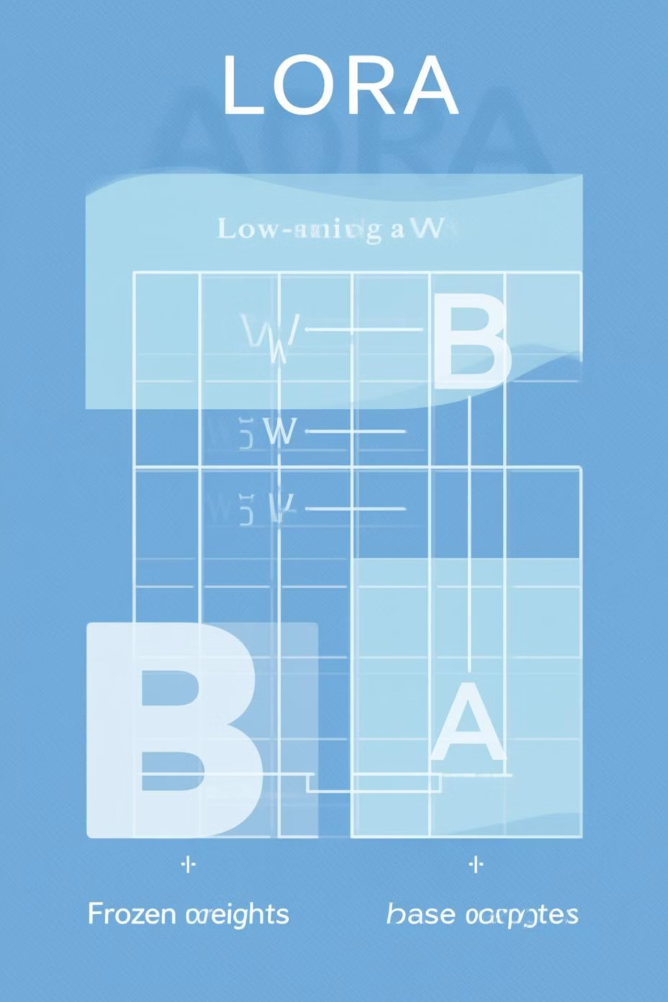
Parameter-Efficient Fine-Tuning (PEFT)
LoRA (Low-Rank Adaptation)
QLoRA (Quantized LoRA)
Injects trainable low-rank matrices into model layers. Instead of updating all weights, trains small decomposed matrices.
Combines LoRA with 4-bit quantization. Enables fine-tuning 65B+ models on consumer GPUs.
Memory: 75% less than LoRA
Parameters: 0.1-1% of original
Precision: 4-bit base model
Memory: ~1/3 of full FT
Use: Resource-constrained scenarios
Use: Most popular PEFT method
Prefix Tuning
Adapters
Prepends trainable continuous vectors to each layer. Keeps base model frozen.
Inserts small trainable modules between frozen transformer layers.

Slide 4

Instruction Tuning & Alignment Methods
Instruction Fine-Tuning
Train models on diverse (instruction, response) pairs to improve zero-shot task performance.
Key Datasets: FLAN, Alpaca, Dolly, ShareGPT
Benefits: Generalisation across tasks, better prompt following
Approach: Supervised fine-tuning (SFT) on curated instruction datasets
RLHF & Preference Learning
RLHF (Reinforcement Learning from Human Feedback)
DPO (Direct Preference Optimisation)
RLAIF (RL from AI Feedback)
Uses AI-generated preferences instead of human labels. More scalable.
Direct optimisation without reward model. Simpler than RLHF. Stable training, no RL complexity, competitive results.
Train reward model from human preferences → Optimise policy with PPO/TRPO. Complex but powerful. Used by ChatGPT, Claude.

Slide 5
Choosing the Right Technique
Decision Framework
1
2
Limited Resources? → QLoRA or LoRA
Need Maximum Performance? → Full Fine-Tuning
Fine-tune on single GPU, minimal memory requirements
When compute isn't constrained and you have domain-specific data
3
4
Want Better Instructions? → Instruction Tuning
Aligning with Preferences? → DPO or RLHF
Use SFT on instruction datasets, can combine with PEFT
DPO for simpler setup, RLHF for maximum control
Key Considerations
Data Quality
Evaluation
Hyperparameters
More important than technique choice
Test on held-out tasks and domains
Learning rate, rank (for LoRA), epochs

