Slide 1
SQL Query Generator using Fine-Tuned
AI-Powered Text-to-SQL Generation
Sakshi Parikh

Slide 2
📋 Overview & Tech Stack
🎯 PROJECT OVERVIEW:
• Transform natural language → SQL
• Fine-tune Mistral-7B with LoRA
• Dataset: 1000 synthetic queries
• Result: 86.82% accuracy
• Deployment: Gradio interface
🛠️ CORE TECHNOLOGIES:
• PyTorch & Transformers
• PEFT (LoRA fine-tuning)
• BitsAndBytes (4-bit quantization)
• Gradio (Web UI)
• Google Colab + T4 GPU
📊 KEY SPECIFICATIONS:
• Base Model: Mistral-7B-Instruct
• Model Size: ~4GB (quantized)
• Training: 1 epoch, 800 samples
• Training Time: ~20 minutes
• Memory: 8GB VRAM peak
✨ FEATURES:
• Real-time SQL generation
• Multi-domain support
• Query explanations
• Save history (JSON/CSV)
• 8 schema presets
• Copy-to-clipboard

Slide 3
🏗️ System Architecture & Logic Flow
1️⃣ DATA PREPARATION:
• Load gretelai/synthetic_text_to_sql dataset
• Shuffle & select 1000 samples (seed=2024)
• Format: Task → Schema → Question → Answer (SQL + Explanation)
• Split: 80% train (800), 20% test (200)
2️⃣ MODEL LOADING & QUANTIZATION:
• Load Mistral-7B-Instruct-v0.2
• Apply 4-bit NF4 quantization → Reduces 14GB to 4GB
• Configure tokenizer with EOS padding
3️⃣ LoRA FINE-TUNING:
• Add LoRA adapters: rank=8, alpha=16, dropout=0.1
• Target layers: q_proj, v_proj (attention mechanisms)
• Train with: batch_size=4, lr=3e-4, cosine scheduler
• Result: Loss 0.857 → 0.364 | Only ~4M params trained (99.9% frozen)

Slide 4
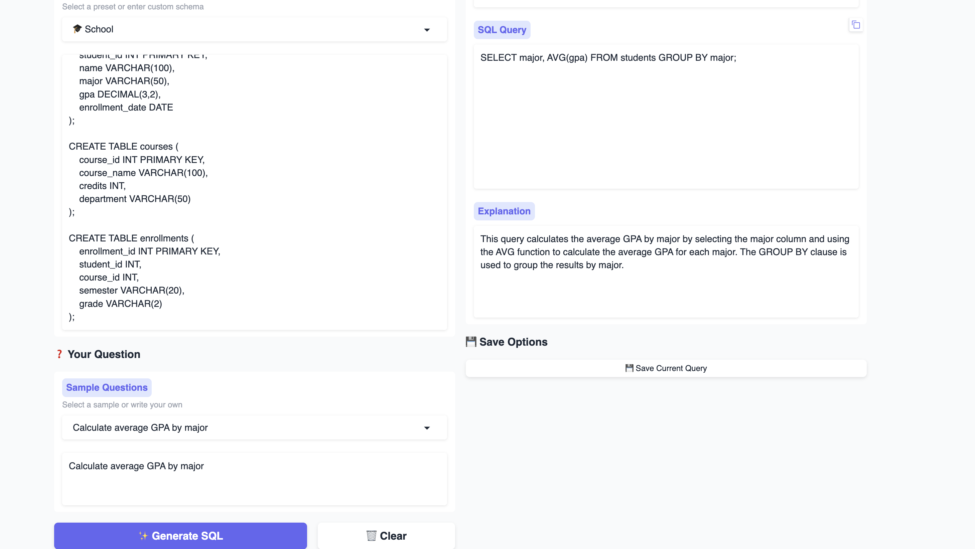
Outputs

Slide 5
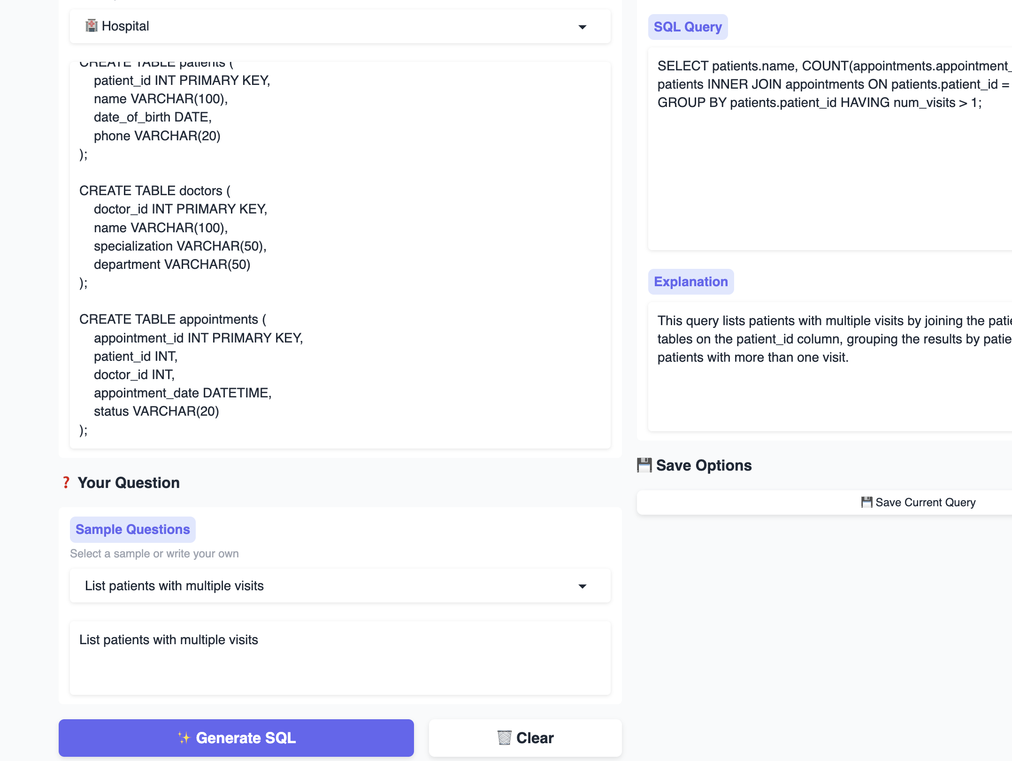
Outputs

