Slide 1



Final_Exam_Project
View in Power BI
Team Member:
Sujeeth Parikipandla
Last data refresh:
3/8/2025 4:14:34 AM UTC
Downloaded at:
3/8/2025 4:23:09 AM UTC

Slide 2
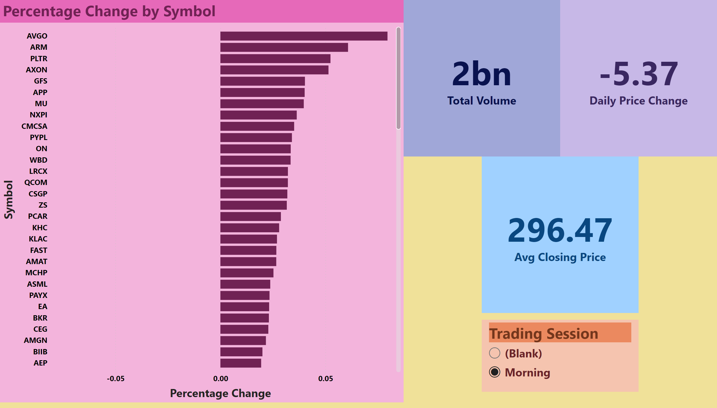
Summary Dashboard
Notes:
card
No alt text provided
card
No alt text provided
card
No alt text provided
clusteredBarChart
No alt text provided
slicer
No alt text provided

Slide 3
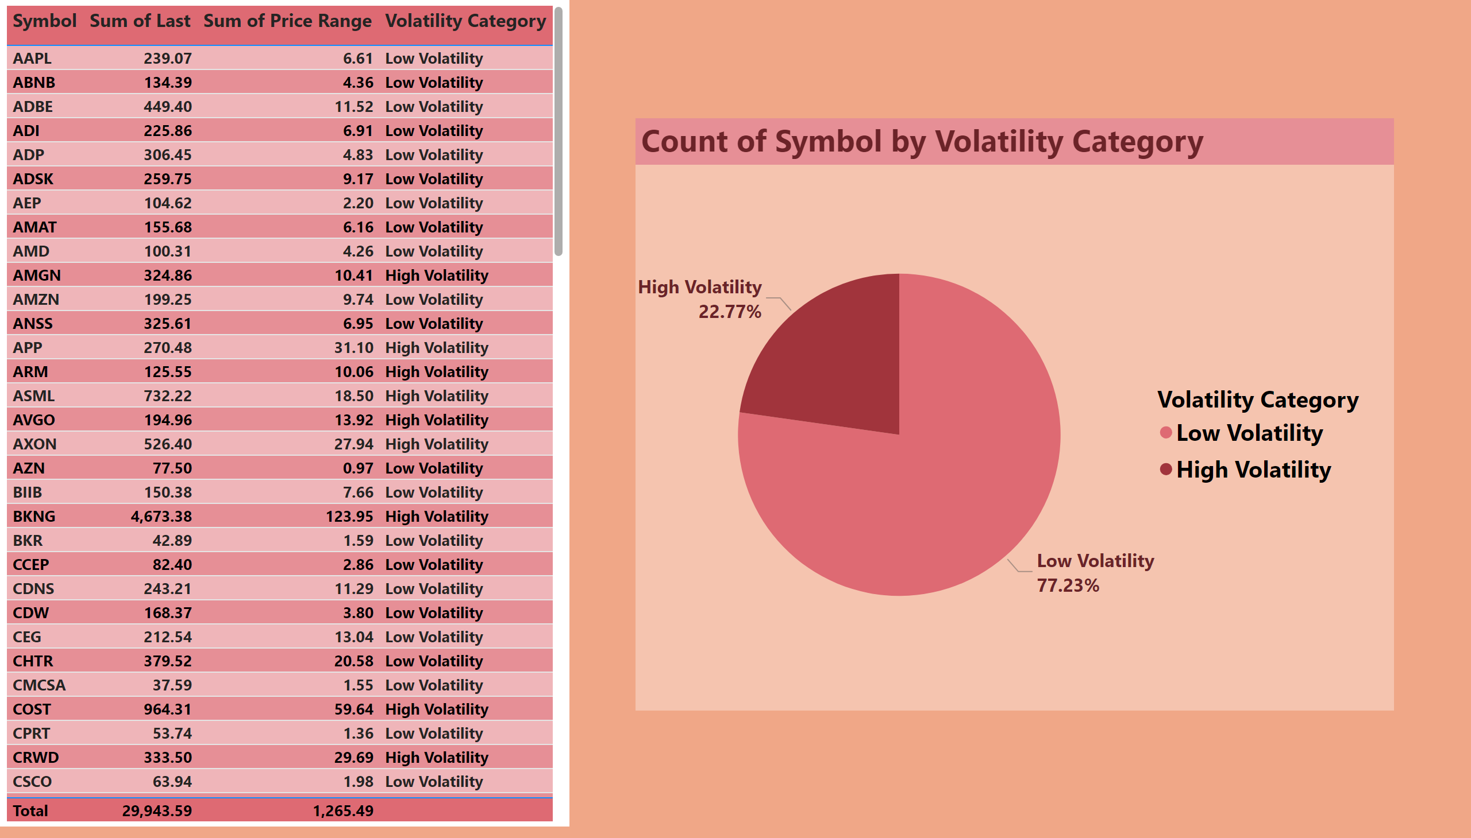
Stock Performance Analysis
Notes:
tableEx
No alt text provided
pieChart
No alt text provided

Slide 4
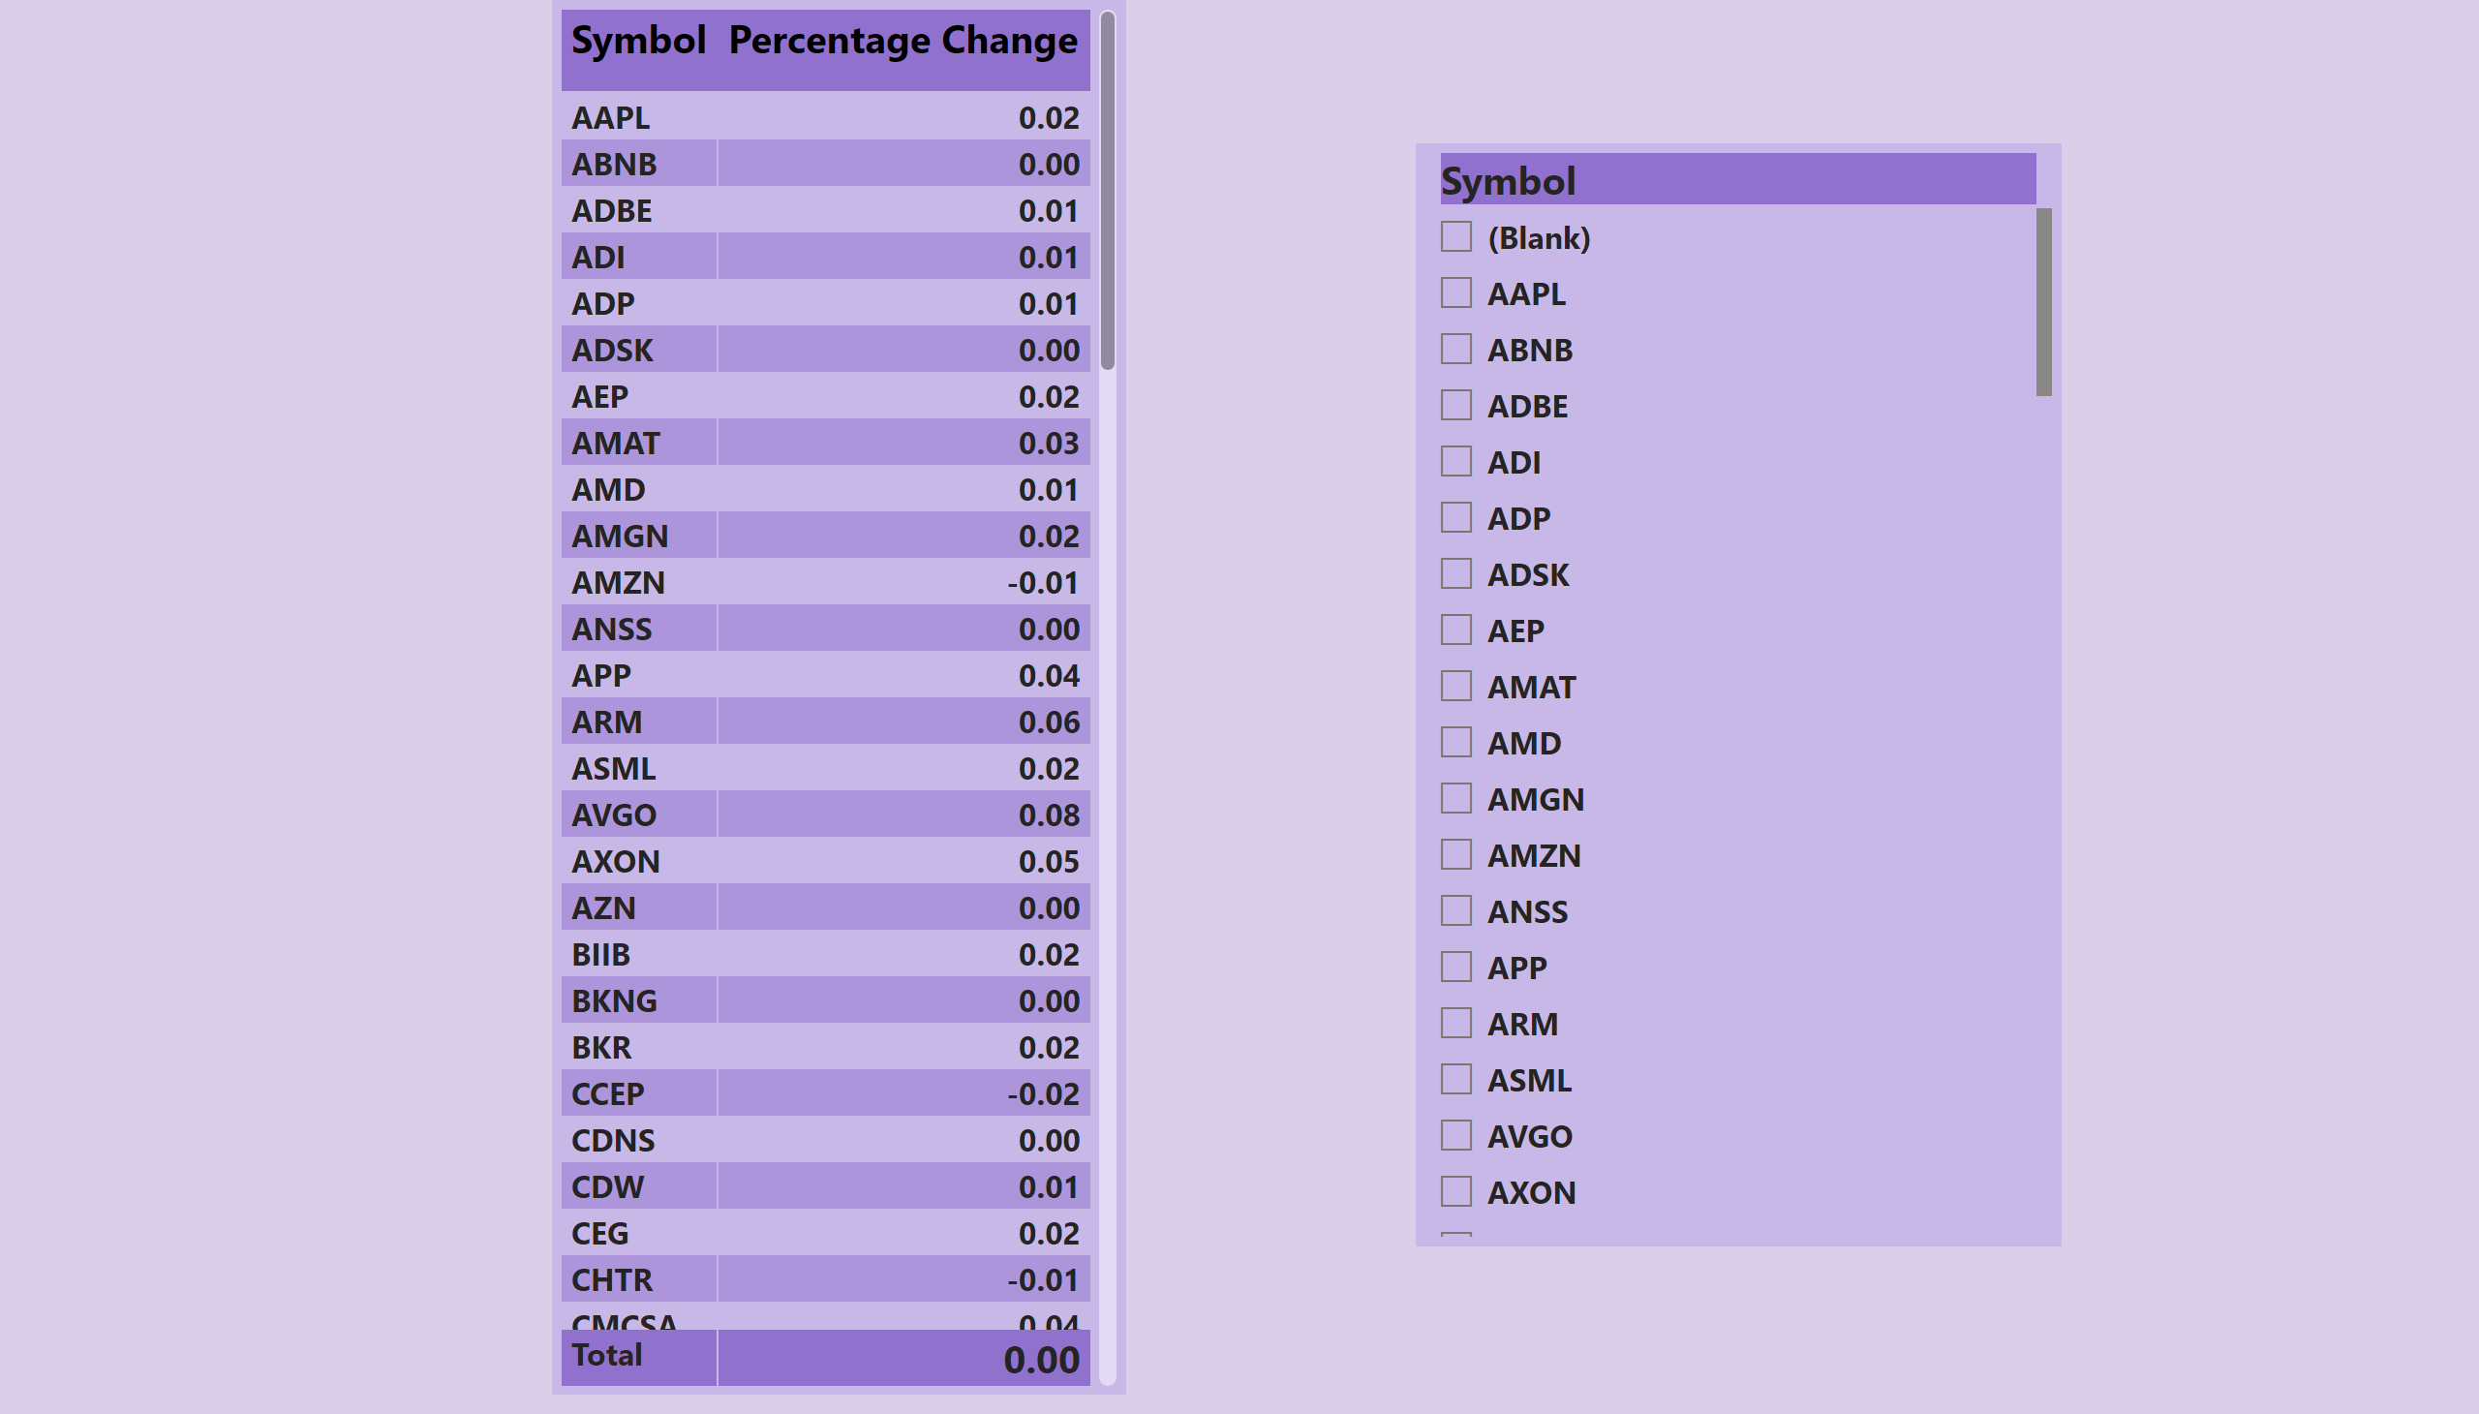
Market Insights & Advanced Analysis
Notes:
pivotTable
No alt text provided
slicer
No alt text provided

