Slide 1

Customer Shopping Behaviour Analysis
An end-to-end analysis of 3,900 customer transactions uncovering spending patterns, customer segments, and subscription behavior.
PYTHON · PANDAS
MYSQL
POWER BI

Slide 2
Dataset Summary
Key Features
3,900
18
Demographics: Age, Gender, Location, Subscription Status
Purchase Details: Item, Category, Amount, Season, Size, Color
Shopping Behavior: Discount, Promo Code, Previous Purchases, Frequency, Review Rating, Shipping Type
Transactions
Columns
37
Missing values (Review Rating)

Slide 3

Exploratory Data Analysis — Python
Explore
Clean
Run df.describe() and summary statistics
Impute Review Ratings with category median
Load Data
Engineer Features
Import pandas and inspect df.info()
Create age_group and purchase_frequency_days
Missing values in Review Rating were imputed using the median rating per product category. Columns were standardized to snake_case. Redundant promo_code_used was dropped after confirming overlap with discount_applied.

Slide 4

Cleaned Dataset
After EDA, the dataset was organized into a clean, analysis-ready structure with two engineered features: age_group (binned customer ages) and purchase_frequency_days (derived from purchase data). The cleaned DataFrame was loaded into MySQL for structured SQL analysis.

Slide 5
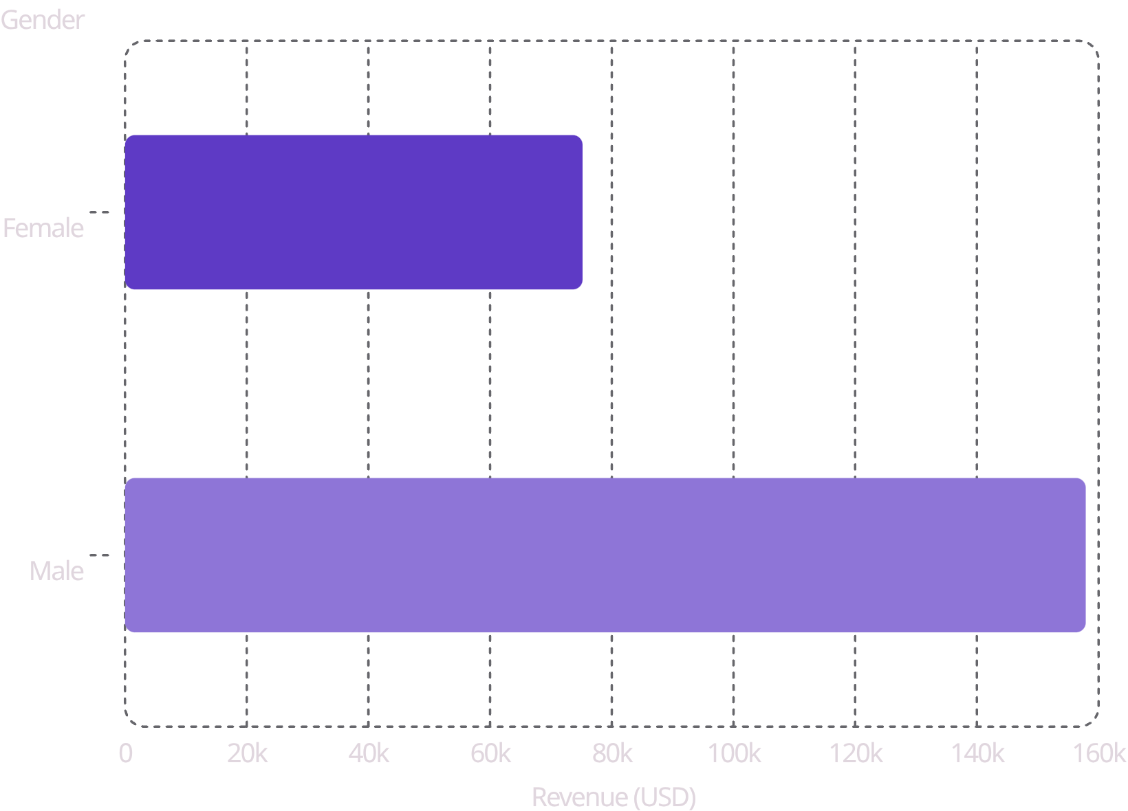
Revenue & Discount Insights
Revenue by Gender
Male customers generated $157,890 vs. $75,191 for female customers — more than double the revenue.
Discount-Dependent Products
Top 5 products by discount rate: Hat (50.00%), Sneakers (49.66%), Coat (49.07%), Sweater (48.17%), Pants (47.37%).

Slide 6
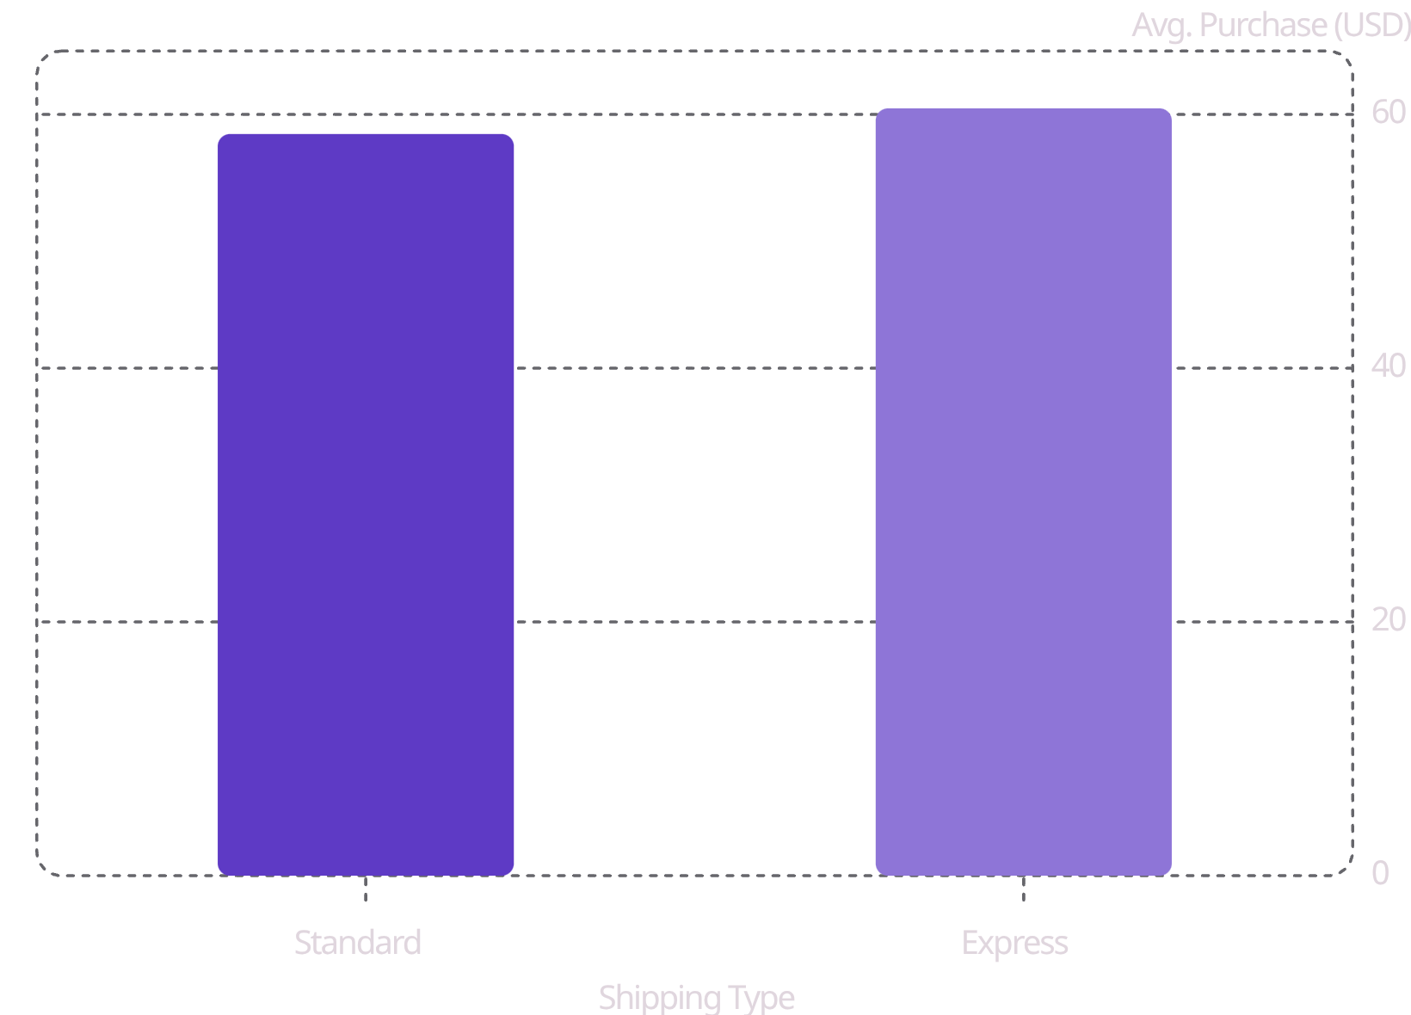
Shipping & Subscription Analysis
Shipping Type
Express shipping customers spend slightly more on average ($60.48 vs. $58.46).
Subscribers vs. Non-Subscribers
Non-subscribers dominate: 2,847 customers generating $170,436 total revenue vs. 1,053 subscribers at $62,645. Average spend is nearly identical (~$59.50).

Slide 7
Customer Segmentation
3,116
701
83
Loyal
Returning
New
80% of all customers
18% of all customers
2% of all customers
Among repeat buyers (>5 purchases): 2,518 are non-subscribers and 958 are subscribers — indicating subscription adoption is still an opportunity among frequent shoppers.

Slide 8
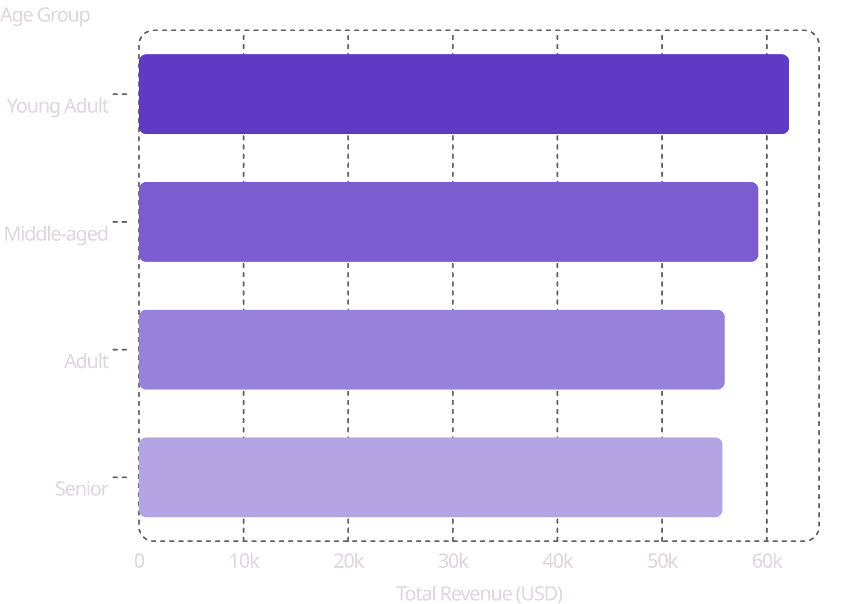
Top Products & Revenue by Age
Top 3 Products per Category
Category
Top Products
Accessories
Jewelry, Sunglasses, Belt
Clothing
Blouse, Pants, Shirt
Footwear
Sandals, Shoes, Sneakers
Outerwear
Jacket, Coat

Slide 9
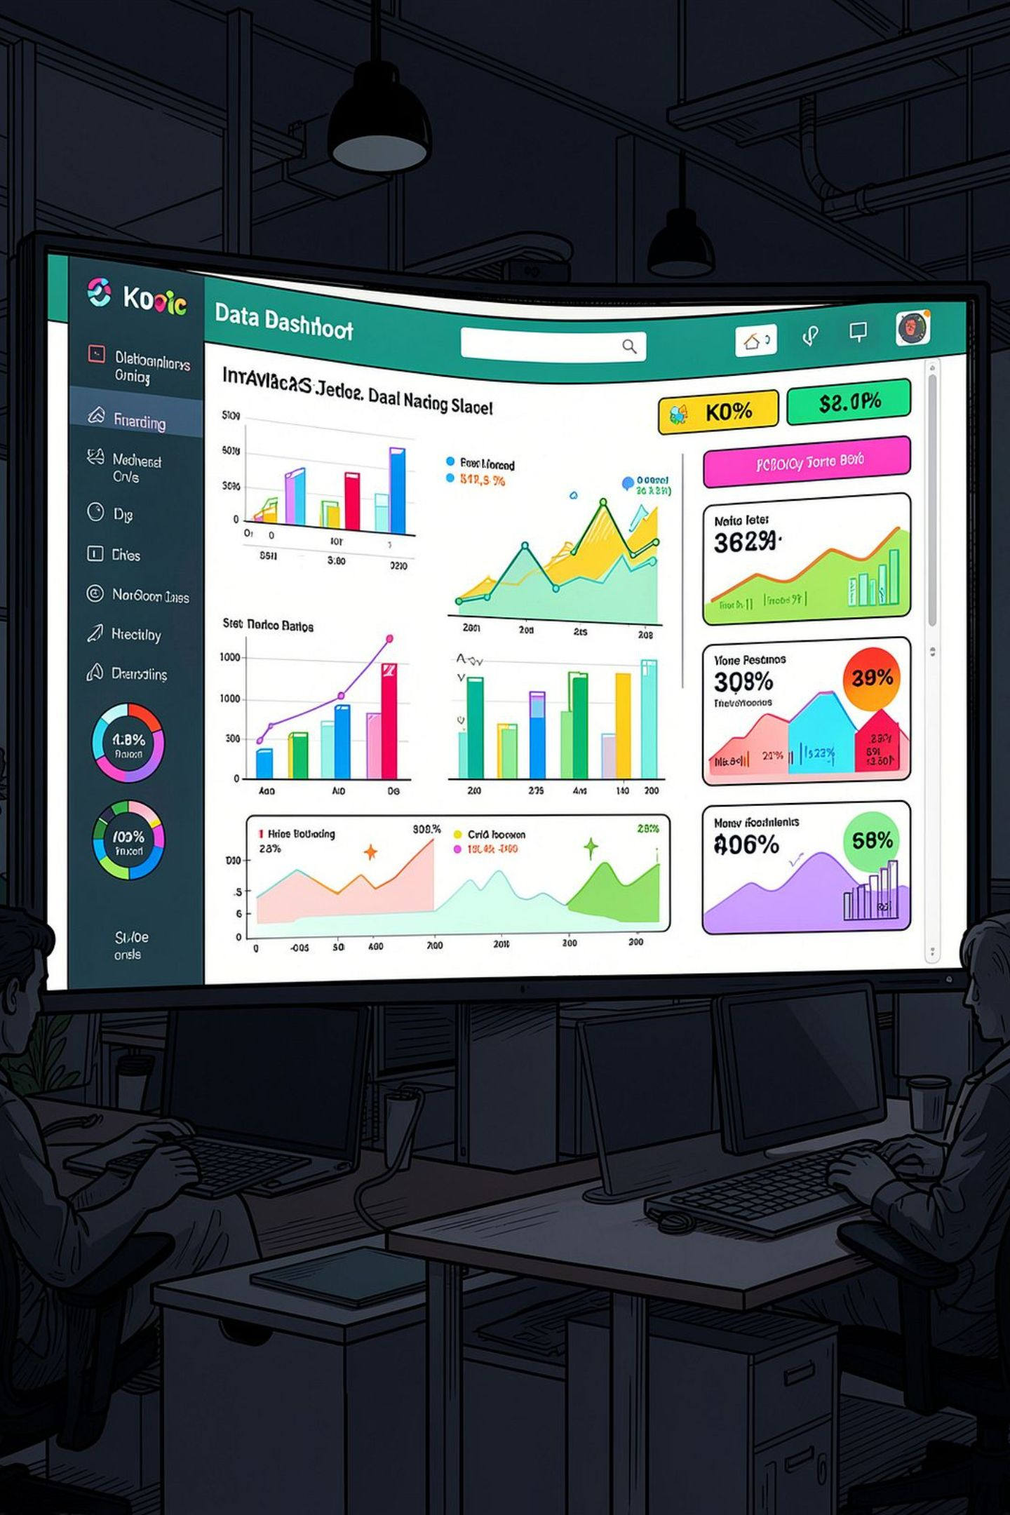
Power BI Dashboard
An interactive dashboard was built to present all insights visually, with filters for subscription status, gender, category, and shipping type — enabling stakeholders to explore the data dynamically.

Slide 10

Business Recommendations
Boost Subscriptions
Promote exclusive benefits to convert non-subscribers.
Customer Loyalty Programs
Reward repeat buyers to move them into the "Loyal" segment.
Review Discount Policy
Balance sales boosts with margin control on discount-dependent products.
Product Positioning
Highlight top-rated and best-selling products in campaigns.
Targeted Marketing
Focus efforts on high-revenue age groups and express-shipping users.

