Slide 1
Hotel data Analysis
By Parikshit Bangde
Python code used do analysis
IDE – Jupyter Notebook

Slide 2
Objective
1. Have you ever wondered when the best time of year to book a hotel room is?
2.the optimal length of stay in order to get the best daily rate?
3.What if you wanted to predict whether a hotel was likely to receive a disproportionately high number of special requests?

Slide 3
Approach for data Analysis
1. Checking data types of all columns
2. Understanding Numerical and Categorical variables
a. Check for Missing values
b. under standing the meaning of NULL and Zeros
c. Outliers cause detection and imputation
3. Date, month and year is extracted from reservation_status_date for analysing
3. Plotting different plots for uni-variate ,bi-variate and multivariate to understand the trend and gain insights
4. Creating model for prediction to predict whether a hotel was likely to receive a disproportionately high number of special requests

Slide 4
Exploratory data Analysis
Number of rows i.e records present 119390
number of columns i.e feature present 32
20 columns are numerical in Nature
12 are categorical
Inference from five point statistical summary
1.Agent column and company column contain NAN values
2.Adr column contain outliers for example '5400'
3.skewed distribution is likly present in most of the columns
4.children column also comtain some nan values and outliers
5.lead time columns also showes presence of outlier and long tail on right side
6. adr columns shows entries shows 'Zero' what its means need to be understand correctly
7. adr is showing negative values also , need to understand what negative adr means or its a miss typed error
NAN values present in agent column 16340 percentage of NAN values 13.686238378423654
NAN values present in company column 112593 percentage of NAN values 94.3068933746545

Slide 5
Exploratory data Analysis
summery of from categorical column
two different type of hotel data is present and city hotels frequency is 79330
5 different meal package is provided by hoteliers and bed and breakfast plan is opted 92310 by customers
out of 8 market segment online TA booking are 56477
TA/TO occurs 97870 times which is the most from 5 distribution channels
Room type A is booked most of the time and assigned A type most
Customer bookings are mostly without deposited
transient customers are most 89613
reservation status check-out only for 75166 customers out of 119390

Slide 6
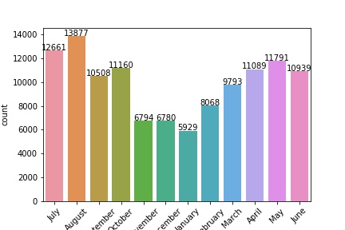
Categorical columns analysis
from the figure it can be seen that in the month of January number of customers in the hotel is less and that can be the best time to book the room as adr is also less

Slide 7
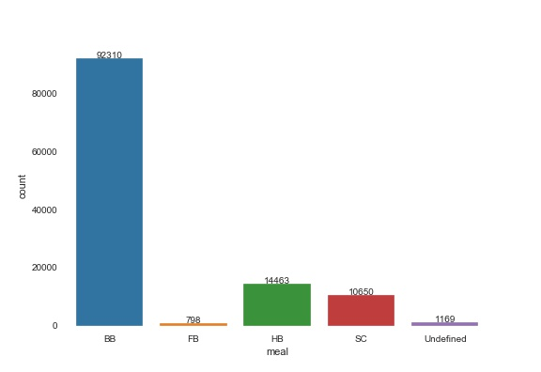
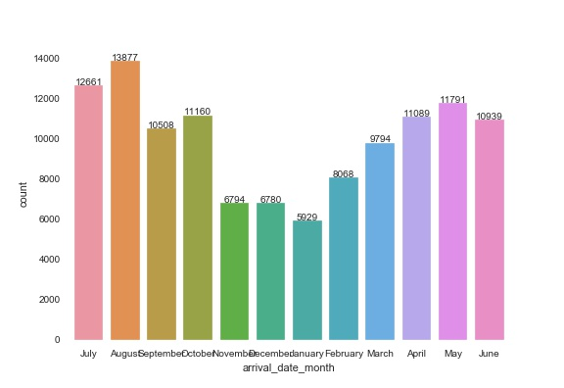
Categorical columns analysis
Graphs for arrival month and type of meal opted

Slide 8
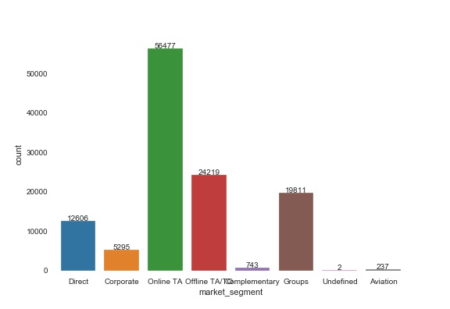
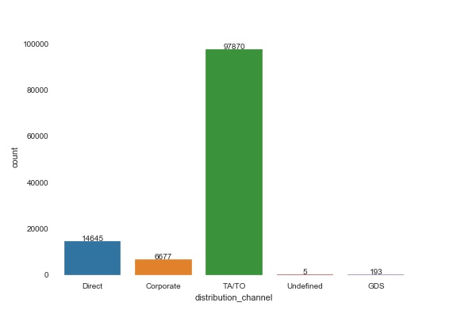
Categorical columns analysis
Graph for market segmentation
Graph for distribution channel

Slide 9
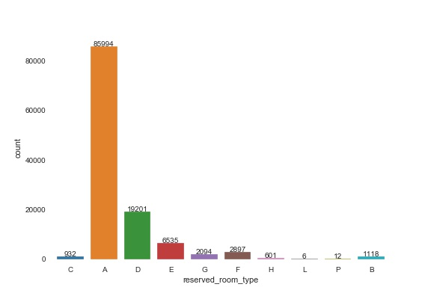
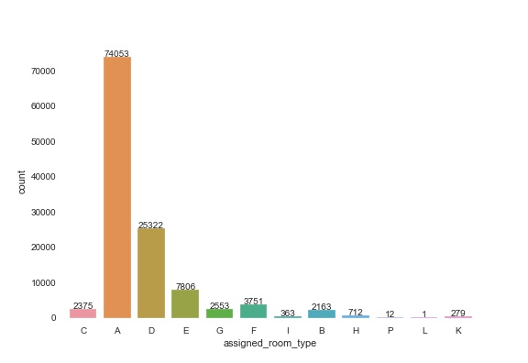
Categorical columns analysis
Graphs showing assign room type and booked room type side ways

Slide 10
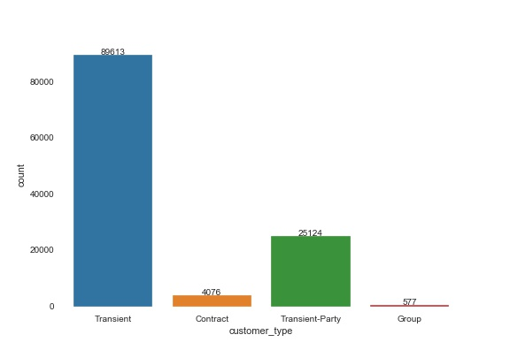
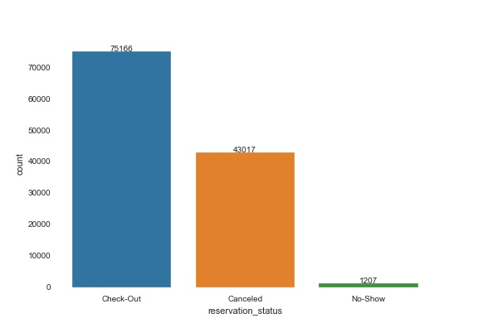
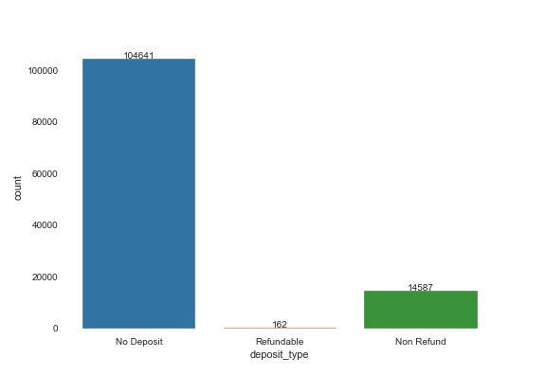
Categorical columns analysis
Count plot for customer type
Count plot for reservation status
Count plot for deposit type

Slide 11
Analysis
Year wise customer arriving in hotel in given dataset are-
1. 2015 - > 21996
% Customer arrival in 2015 is 18.423808
2. 2016 - > 56706
% Customer arrival in 2016 is 47.496838
3. 2017 - > 40687
% Customer arrival in 2017 is 34.079354

Slide 12
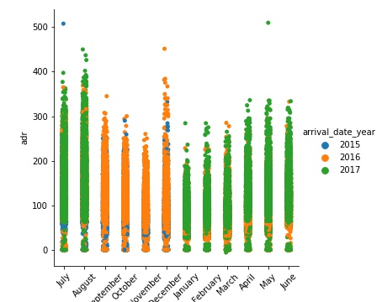
Analysis
Categorical plot showing monthly adr with hue of year

Slide 13
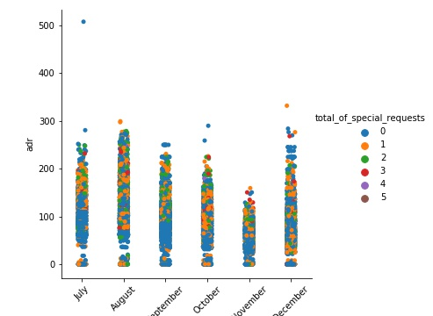
Analysis
Categorical plot showing 2015 monthly adr with hue of total special request

Slide 14
Analysis
Categorical plot showing 2016 monthly adr with hue of year

Slide 15
Analysis
Categorical plot showing 2017 monthly adr with hue of year

Slide 16
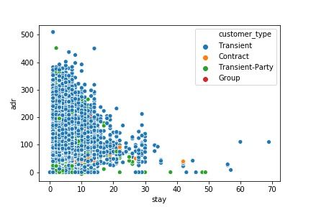
Analysis
Scatter plot showing the relation between adr and stay
With different type of customer

Slide 17
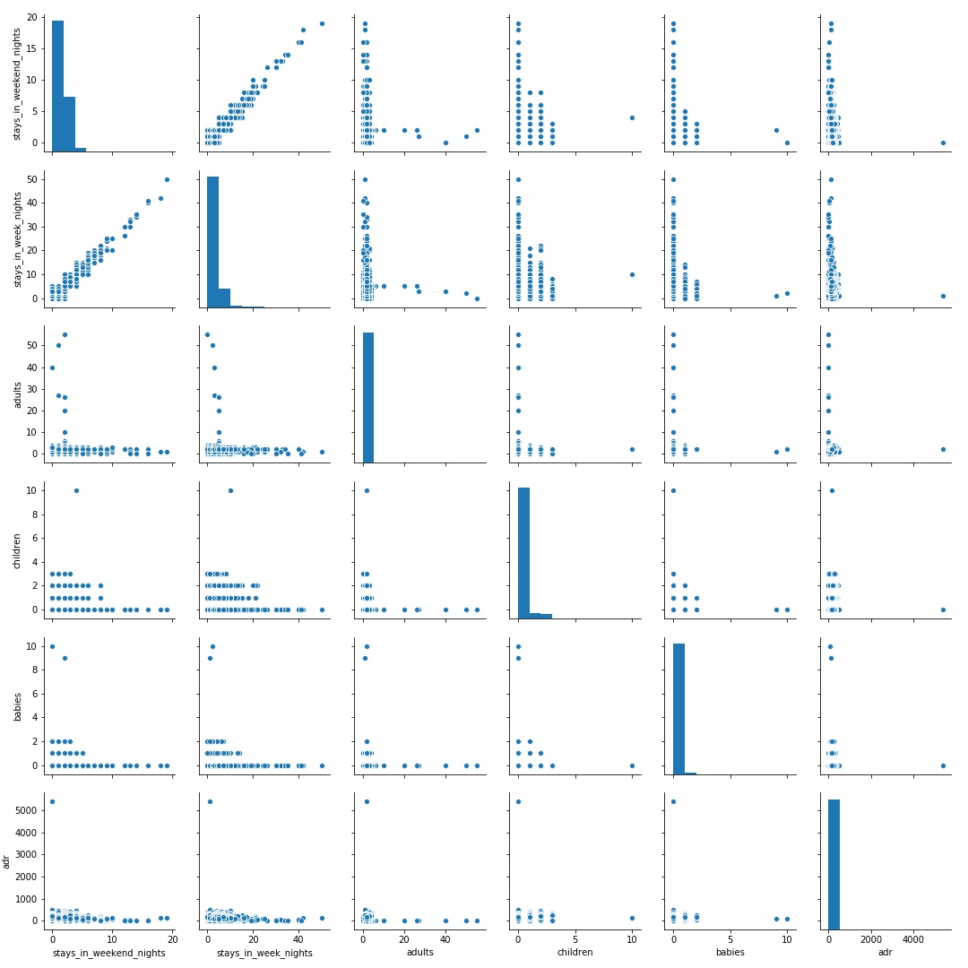
Analysis
Pair plot showing the relation between Various features

Slide 18
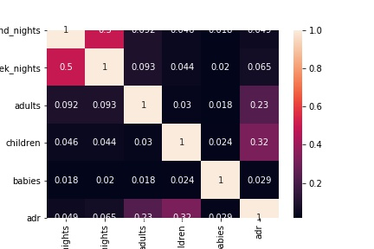
Analysis
Heat map showing co-relation between various features

Slide 19
Modeling
To predict whether a hotel was likely to receive a disproportionately high number of special requests various model were build are
1.Logistic Regression model
2. Random Forest model
Then Feature Importance was calculated
Finally grid search cv was applied on the model which gives best performance in this case Random forest perform well

Slide 20
Modeling Result
Results of logistic regression
Confusion Matrix
actual (0) actual (1)
predicted (0) 9006 3270
predicted (1) 4858 12592
Over all performance of model
precision recall f1-score support
0 0.65 0.73 0.69 12276
1 0.79 0.72 0.76 17450
accuracy 0.73 29726
macro avg 0.72 0.73 0.72 29726
weighted avg 0.73 0.73 0.73 29726

Slide 21
Modeling Result
Results of Random forest
Confusion Matrix
Actual (0) Actual (1)
Predicted (0) 10059 2217
Predicted (1) 3735 13715
Over all performance of model
precision recall f1-score support
0 0.73 0.82 0.77 12276
1 0.86 0.79 0.82 17450
accuracy 0.80 29726
macro avg 0.80 0.80 0.80 29726
weighted avg 0.81 0.80 0.80 29726

Slide 22
Modeling Result
Results of grid search and Random forest
Confusion matrix
actual (0) actual (1)
predicted (0) 10034 2242
predicted (1) 2951 14499
Over all performance of model
precision recall f1-score support
0 0.77 0.82 0.79 12276
1 0.87 0.83 0.85 17450
accuracy 0.83 29726
macro avg 0.82 0.82 0.82 29726
weighted avg 0.83 0.83 0.83 29726

Slide 23
Conclusion
Results of grid search and Random forest is the best and can be use to predict whether a hotel was likely to receive a disproportionately high number of special requests
From the data set provided one can safely say that month of Jan is best to book hotel and the stay of two days will be optimal

