Slide 1

Chinook Sales Analysis
Parikshith N K
07/02/2025

Slide 2
About the Project
Chinook is a physical music selling company which has its customers all over the world. This project is all about analyzing the sales data of chinook company.
PRIMARY OBJECTIVES:
To gain insights and make recommendations for the company's strategy in the physical music market.
To recommend the management about future promotions and adverstising campaigns.

Slide 3
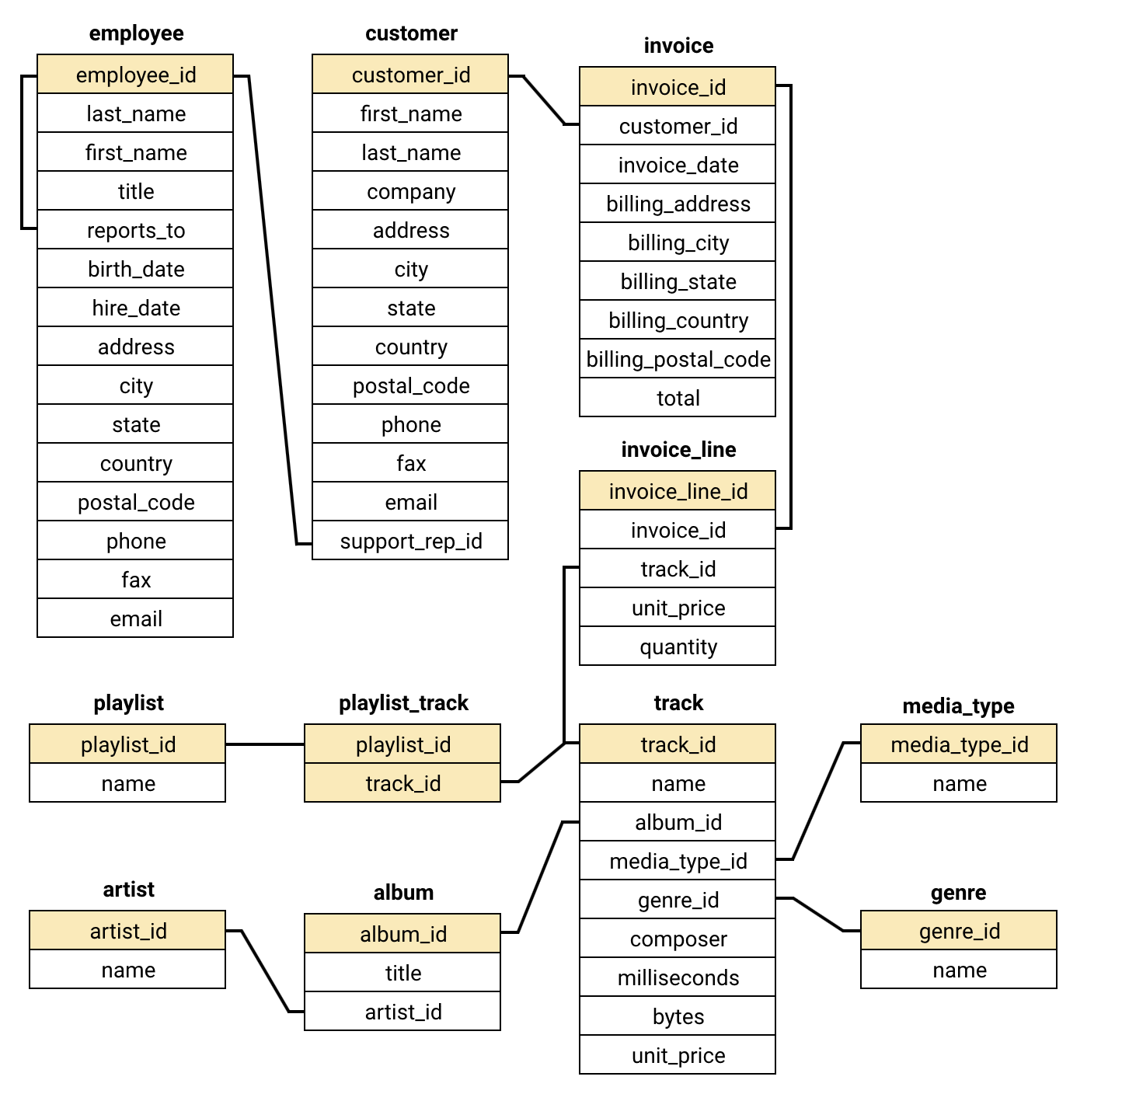
DATA OVERVIEW
Data is designed as a relational database.
Data of Chinook company is stored in 11 tables connecting each other with primary key and foreign key.
Employee, Customer, Invoice, Invoice_line and track_id tables are very significant to analyze sales data.
This schema resembles snowflake schema as the dimension tables have further sub-dimension tables.

Slide 4
ANALYTICAL APPROACH AND TOOLS
Descriptive Analysis: By using ‘SELECT’ statement and conditions like ‘IS NULL’ in mysql, data is analyzed for any existing missing or null values.
Trend Analysis: Used line chart to visualize the trend of sales of the company.
Visualization: Created Charts for data representation to help management to take future data backed decisions.

Slide 5
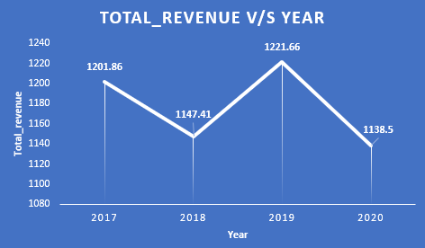
How has the Chinook sales changed over time?

Slide 6
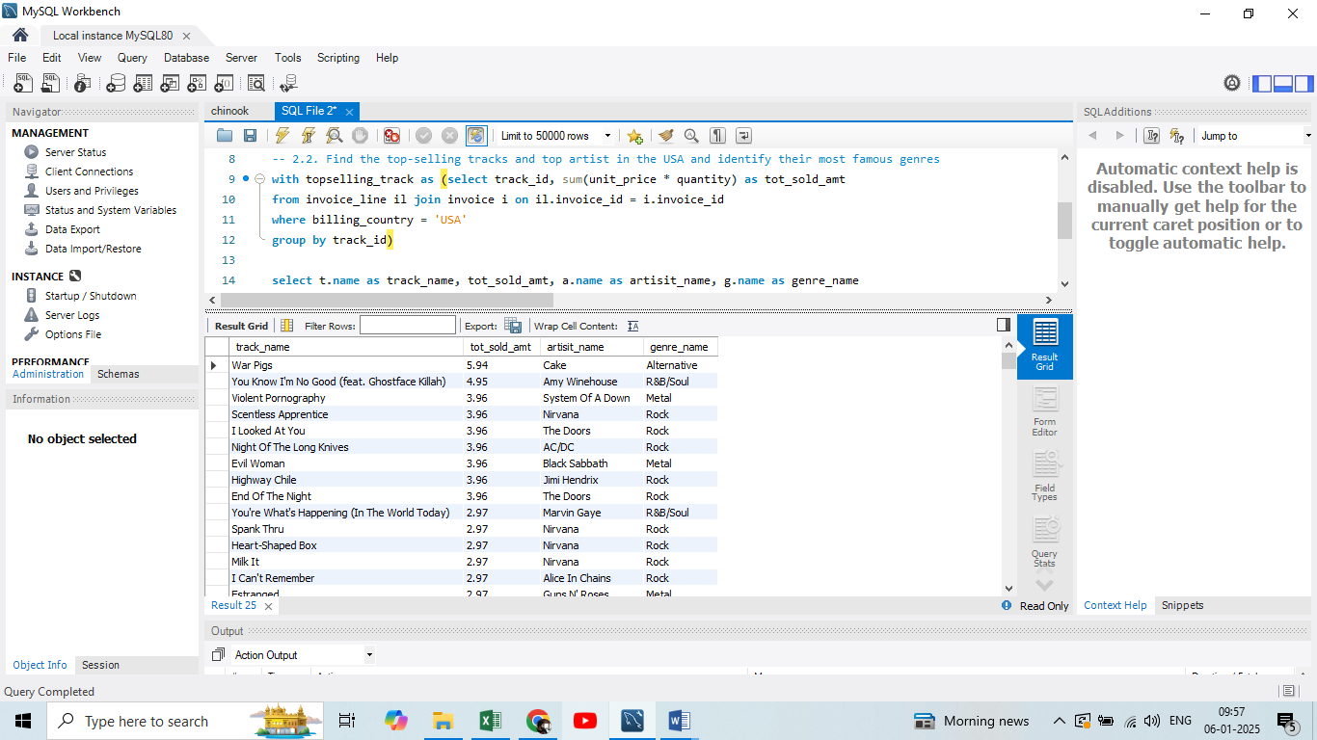
Find the top-selling tracks and top artist in the USA and identify their most famous genres.
From the inference top sold track in USA is “War Pigs”, the artist is “Cake” and genre is “Alternative”.

Slide 7
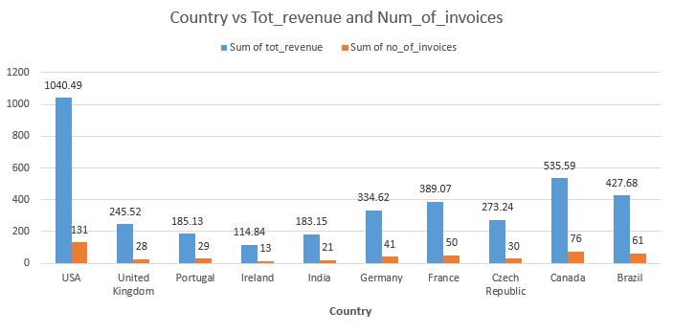
Calculate the total revenue and number of invoices for each country:
Visualisation of top 10 country’s revenue and number of invoices

Slide 8
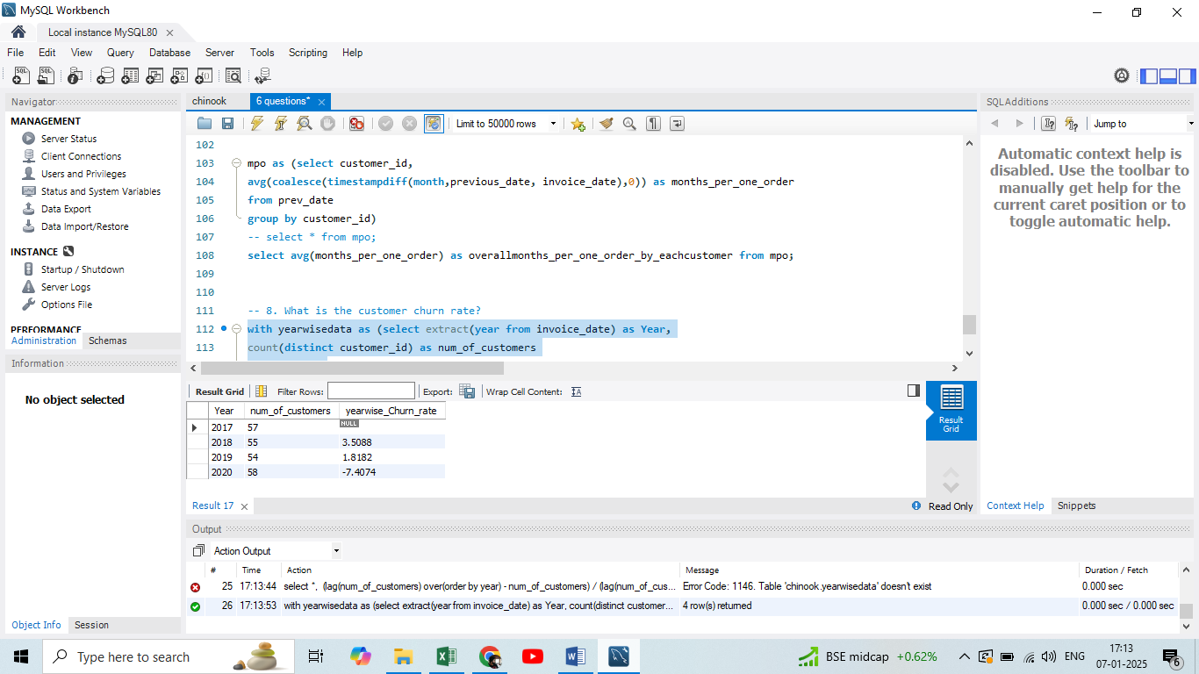
What is the customer churn rate?
In 2018 and 2019 there is a churn rate but in 2020 there is a negative churn rate. That means
In 2020 chinook’s customers are increasing in comparison with 2019.

Slide 9
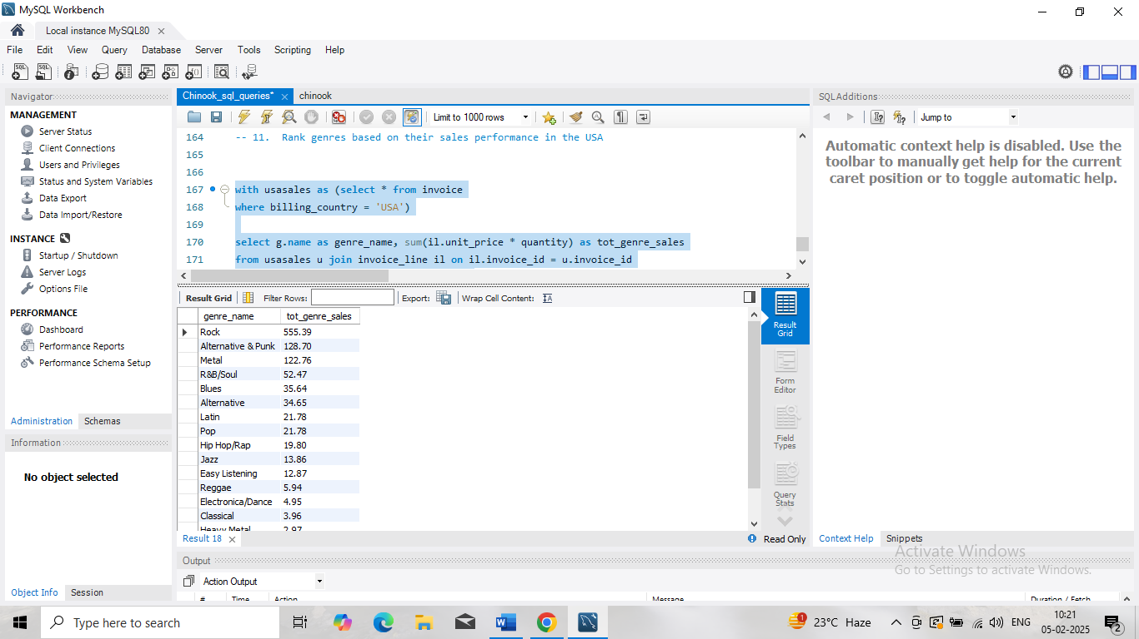
Recommend the three albums from the new record label that should be prioritised for advertising and promotion in the USA based on genre sales analysis.
The picture shows the top selling genres in USA. Rock, Alternative & Punk, Metal are three top selling genres.

Slide 10
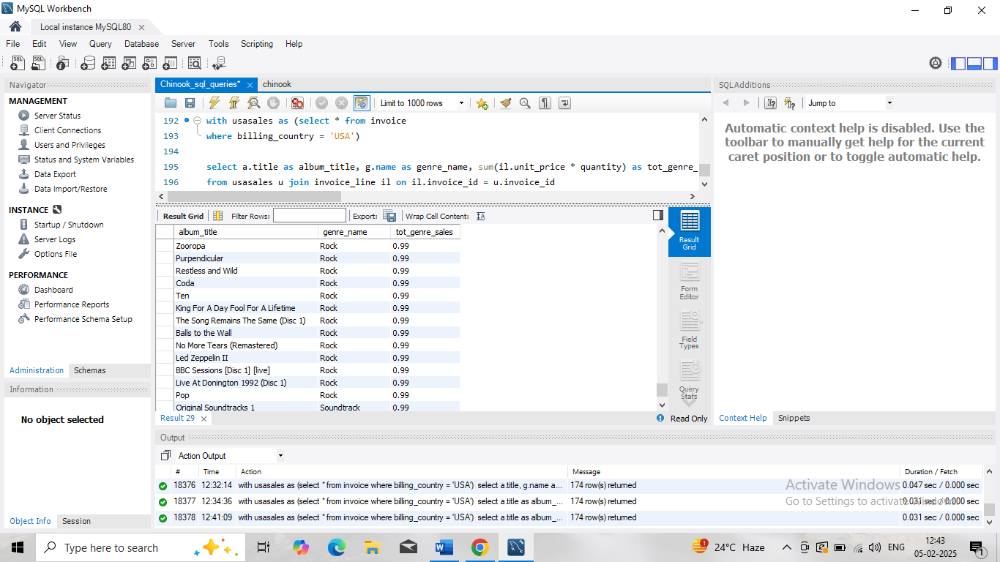
But the above data shows that despite USA people’s affinity towards Rock genre there are many albums in rock genre which are sold very less in USA.
So, any of those albums which are selling in low numbers despite being in rock genre must be advertised and promoted.
I recommend ‘King for a day fool for a lifetime’, ‘Restless and wild’, ‘No more tears’ albums for advertisement and promotion in USA.

Slide 11
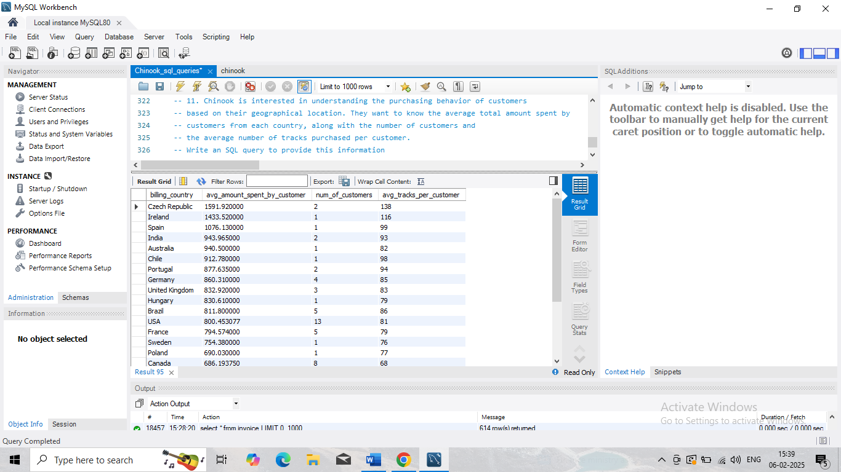
The average total amount spent by customers from each country, along with the number of customers and the average number of tracks purchased per customer

Slide 12
STRATEGIC RECOMMENDATIONS
Top selling genre is Rock but there are many albums in rock genre which are sold less. Focus has to be streamlined on Rock, Alternative & punk and Metal genres which are popular genres in both USA and other countries.
Average Turn around time for customer is 3.7 months. It has to be reduced by launching frequent popular artists albums in popular genre.
Customer base is increasing only in India, France and Canada. In other countries customer base is constant which needs an attention.

Slide 13
CONCLUSION
Analysis of past data of the team clearly highlighted that the revenues have gone down for 2020 in comparison with 2019.
It empowers decision makers to decide where to invest, that is to focus on which type of product.
My comprehensive analysis of this data paves the way to improve the efficiency and sales of chinook company, reduce turn around time of customers and also enhance customer satisfaction. It also streamlines investments into right direction which can further improve capital-output ratio of entire company.

Slide 14

Thank you

