Slide 1

MUSTER
MIT India Hackathon 2026 · Problem Statement: PSE15
01 / 12
MIT INDIA HACKATHON 2026 · PSE15
MUSTER
AI-Powered Crew Assembly for Event Staffing
Flutter Web + Android + iOS
Supabase PostgreSQL + RLS
Google Gemini API (Edge)

Slide 2
MUSTER
MIT India Hackathon 2026 · Problem Statement: PSE15
02 / 12
THE REALITY OF EVENT STAFFING
Finding a crew is harder than it looks.
Organizers have to balance all of these at once.
Single Missing Role = Event Failure
Missing just one Dante sound engineer or stage coordinator puts the entire live event at risk.
• Skills & Specific Roles Needed
• Strict Financial Budget Cap
Unmonitored Rate Spikes = Budget Overruns
Hiring people one by one through phone calls creates rate compounding that breaches the organizer's financial ceiling.
• Date & Shift Availability
• Location & Travel Distance
No-Show Risk on Event Morning
Unvetted freelance contacts suffer high no-show rates with zero accountability or standby alternatives.
• Historical Reliability Record

Slide 3
MUSTER
MIT India Hackathon 2026 · Problem Statement: PSE15
03 / 12
CURRENT PRACTICES
Too much manual work.
When organizers hire manually across fragmented chats, it takes days and errors are easy to make.
WhatsApp Chats + Spreadsheets + Phone Calls + Manual Math
Slow Confirmation
Takes 3 to 5 days to assemble a 6-person crew. Candidates drop out while waiting for responses.
Unchecked Rates
Manual rate calculations often overlook overtime, lead fees, or transit stipends, blowing the budget.
Zero Accountability
No verified reliability score. Organizers rely on blind trust with short-notice freelancers.

Slide 4
MUSTER
MIT India Hackathon 2026 · Problem Statement: PSE15
04 / 12
THE MUSTER PLATFORM
Meet MUSTER.
MUSTER helps organizers find and assemble the right crew for an event.
FOR EVENT ORGANIZERS
✓ Post role quotas, transit radius, and budget limits.
✓ Receive custom hourly bids from vetted freelancers.
✓ Deterministic solver calculates valid crew rosters in seconds.
✓ Plain-English AI explanations for each recommendation.
FOR FREELANCERS
✓ Discover shifts within daily travel radius.
✓ Submit custom hourly rate bids directly.
✓ Live status updates on application review.
✓ Verified digital QR dispatch entry pass on selection.

Slide 5
MUSTER
MIT India Hackathon 2026 · Problem Statement: PSE15
05 / 12
THE 5-STEP WORKFLOW
How it works.
A clear step-by-step path from an open brief to confirmed on-site staff.
1. Create Event
Set roles, budget cap, and location.
2. Freelancers Apply
Verified crew bid custom hourly rates.
3. Compare Pool
Filter by role, skills, distance, and rate.
4. Find Best Crew
Solver prunes budget violations with AI rationale.
5. Approve Roster
Lock shifts with atomic PostgreSQL RPC.

Slide 6
MUSTER
MIT India Hackathon 2026 · Problem Statement: PSE15
06 / 12
MULTI-CRITERIA MATCHING WEIGHTS
The cheapest person isn't always the best fit.
MUSTER balances multiple operational factors together.
40%
Skills & Experience
Direct alignment with equipment, sound consoles, stage management, and certifications.
35%
Reliability Rating
Verified historical punctuality, event completion track record, and organizer reviews.
15%
Transit Proximity
Distance from venue to guarantee timely arrival without transit risk.
10%
Rate Efficiency
Candidate hourly proposal relative to the event budget allocation.
Result: Reliable, skilled crew members who arrive on time and stay within budget.

Slide 7
MUSTER
MIT India Hackathon 2026 · Problem Statement: PSE15
07 / 12
HONEST ARCHITECTURAL SEPARATION
AI helps. The system checks.
The matching engine checks the rules. Gemini explains the result.
DETERMINISTIC MATCHING ENGINE
Guarantees Hard Rules
• 100% Budget Compliance Guarantee (Cost ≤ Budget)
• Zero Missing Roles: Fulfills exact role quota requirements
• Geographic distance constraint enforcement
• Deterministic: Zero hallucination of fake candidates
GOOGLE GEMINI 3.6 FLASH (EDGE)
Generates Human Explanations
• Synthesizes plain-English rationale for each candidate chosen
• Explains trade-offs between cost savings and senior experience
• Assists organizer with NLP brief parameter extraction
• Securely isolated server-side inside Supabase Edge Function

Slide 8
MUSTER
MIT India Hackathon 2026 · Problem Statement: PSE15
08 / 12
BUDGET ALLOCATION & PERMUTATIONS
The crew must fit the budget.
Organizers can compare different valid crews before deciding.
OPTION 1 · BALANCED FIT
₹94,000
92% Match Score
Highest multi-factor balance across skills, reliability, and proximity. Saves ₹6,000 under budget.
OPTION 2 · COST SAVER
₹84,000
85% Match Score
Prioritizes competitive rate bids while meeting all core role requirements. Saves ₹16,000 under budget.
OPTION 3 · TOP RELIABILITY
₹98,500
96% Reliability Avg
Selects top-rated 98%+ reliability crew members for mission-critical keynotes and VIP stages.

Slide 9
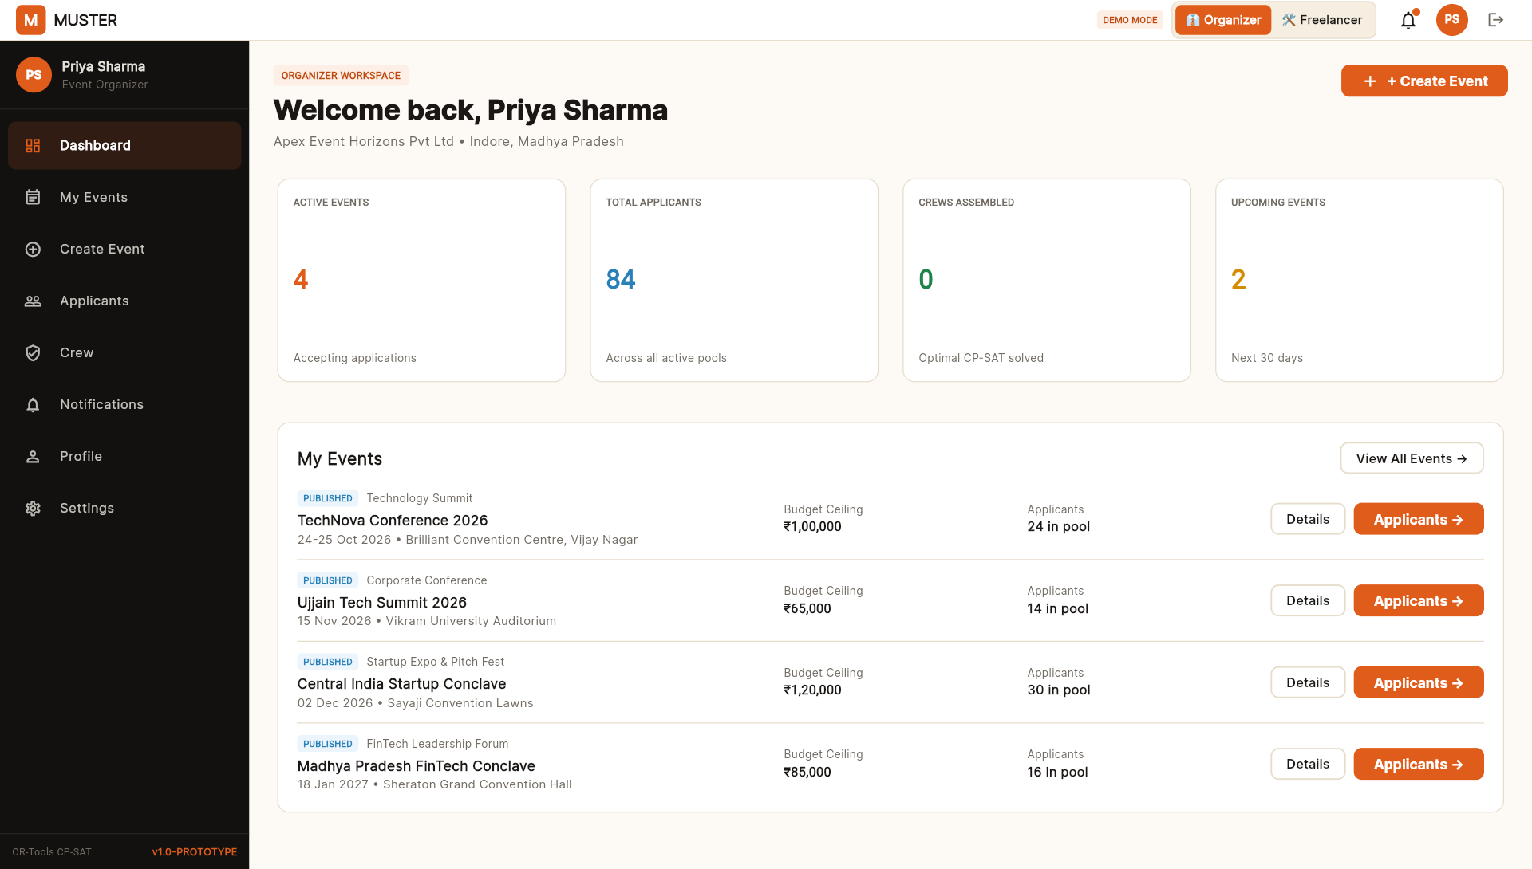
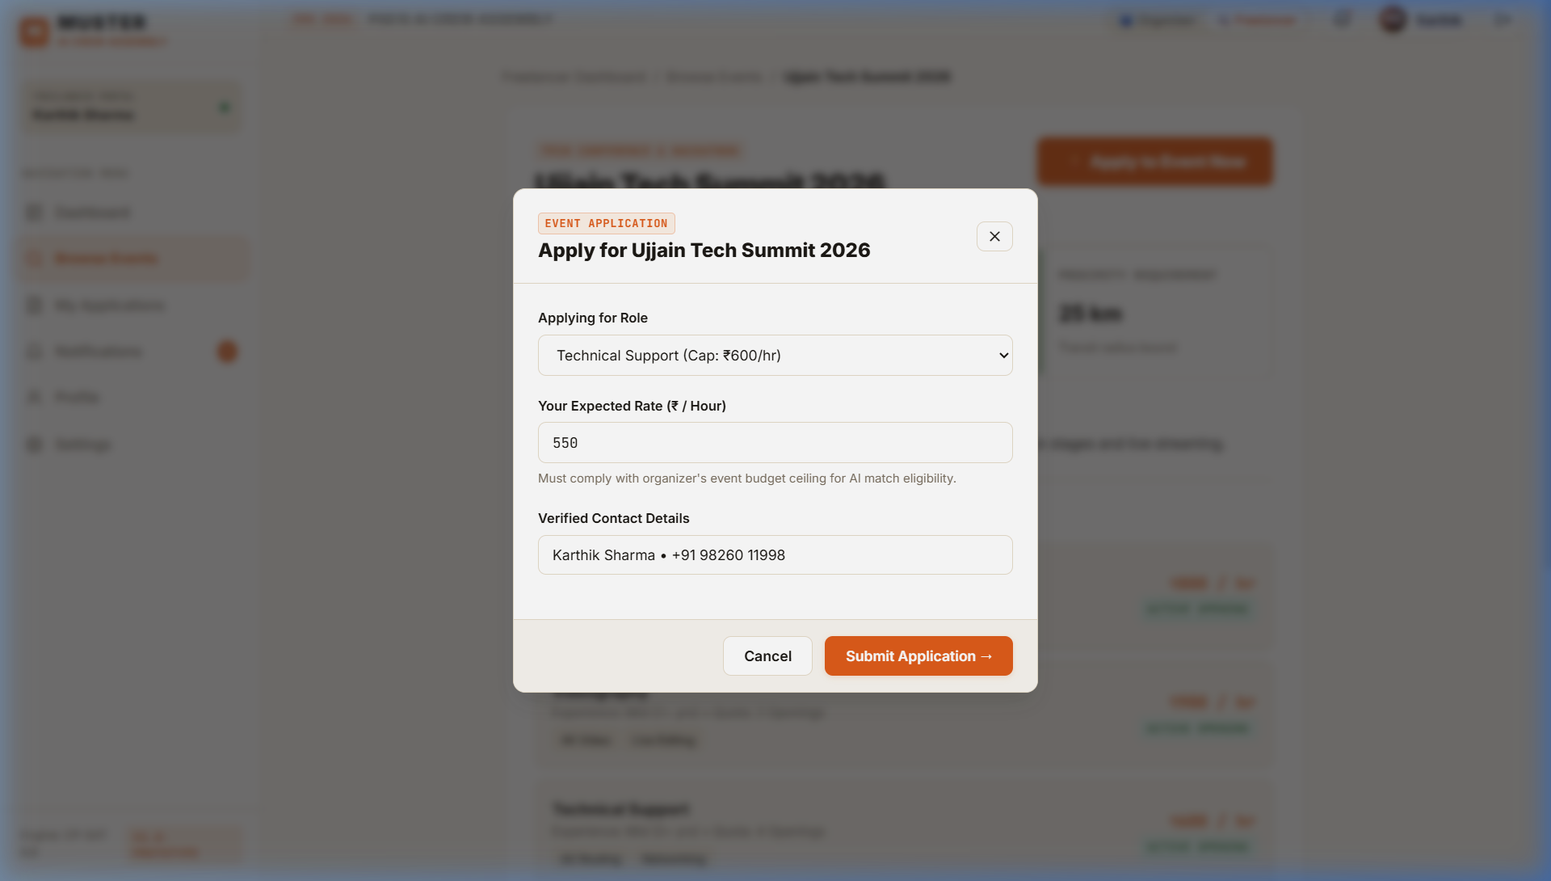
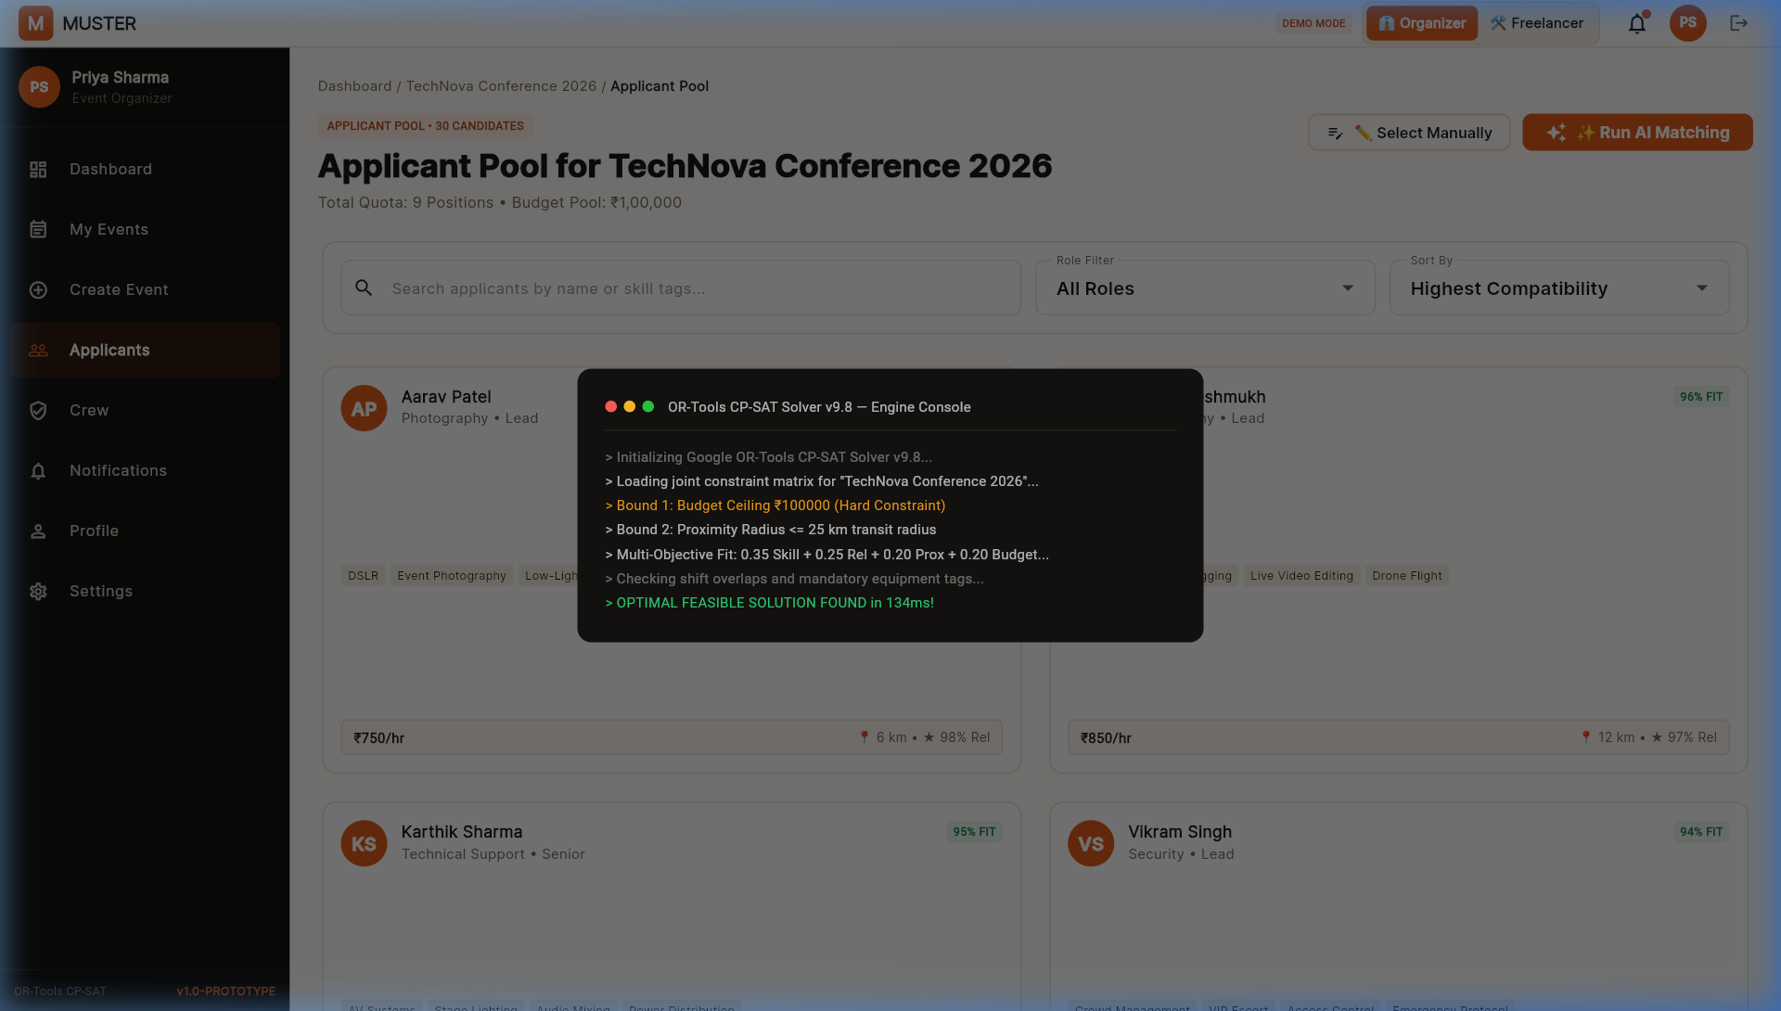
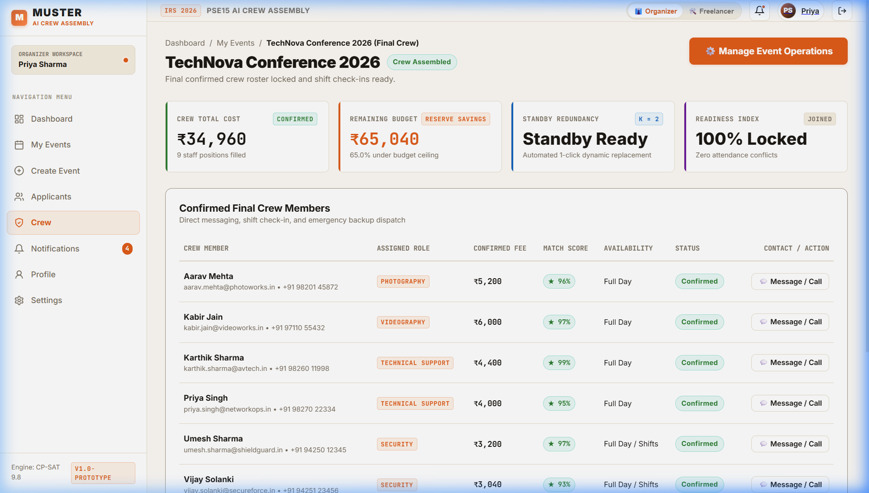
MUSTER
MIT India Hackathon 2026 · Problem Statement: PSE15
09 / 12
WORKING PRODUCT EVIDENCE
From brief to confirmed crew.
Real working screens from the running MUSTER Flutter application.
1. Active Dashboard
2. Applicant Pool
3. AI Optimizer Modal
4. Confirmed Crew

Slide 10
MUSTER
MIT India Hackathon 2026 · Problem Statement: PSE15
10 / 12
SYSTEM ARCHITECTURE
Built for Web, Android and iOS.
Clean cross-platform client talking to Supabase and Gemini Edge Functions.
FRONTEND CLIENT
Flutter (Web & Mobile)
Single responsive codebase with Riverpod state management and Lucide vector icons.
BACKEND ENGINE
Supabase PostgreSQL
13 relational tables with Row Level Security (RLS) and real-time pub/sub subscriptions.
EDGE FUNCTION
Deno Edge Runtime
Server-side function `muster-ai` coordinates with Gemini without exposing API keys.
AI LAYER
Google Gemini 3.6 Flash
Generates natural language requirement parsing and transparent hiring explanations.

Slide 11
MUSTER
MIT India Hackathon 2026 · Problem Statement: PSE15
11 / 12
KEY ADVANTAGES
Why MUSTER.
Built to solve the operational realities of live event staffing.
Constraint-aware
Strictly works within real event requirements, transit limits, and budget caps.
Explainable
Shows clear natural-language reasons why candidates were chosen for each shift.
Human-controlled
AI recommends options and highlights trade-offs; the organizer always decides.
Cross-platform
One clean codebase deployable immediately to Web, Android phones, and iOS devices.

Slide 12
MUSTER
MIT India Hackathon 2026 · Problem Statement: PSE15
12 / 12
MIT INDIA HACKATHON 2026 · PSE15
From applicants
to the right crew.
MUSTER · AI-Powered Crew Assembly for Event Staffing
VERIFIED PRODUCTION DELIVERABLES
• Web Application Live Build: Vercel SPA Deployment (build/web)
• Android Release Binary: APK/MUSTER-v1.0.apk (57.1 MB) with native network access
• Supabase Cloud Backend: 13 Relational Tables + RLS + Deno Gemini Edge Function
• Source Code Repository: https://github.com/parikshitkurel/muster.git

