Slide 1
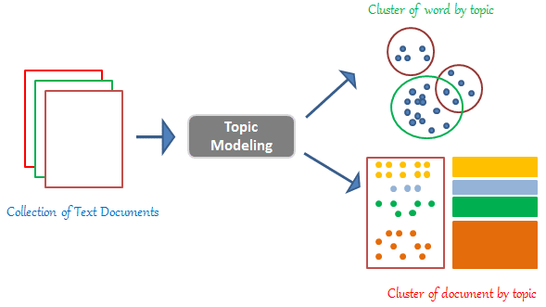
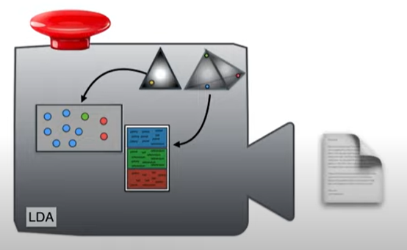
Linear Dirichlet Allocation
Q1: What are the topics for a document?
Q2: What are the words comprises a topic?

Slide 2
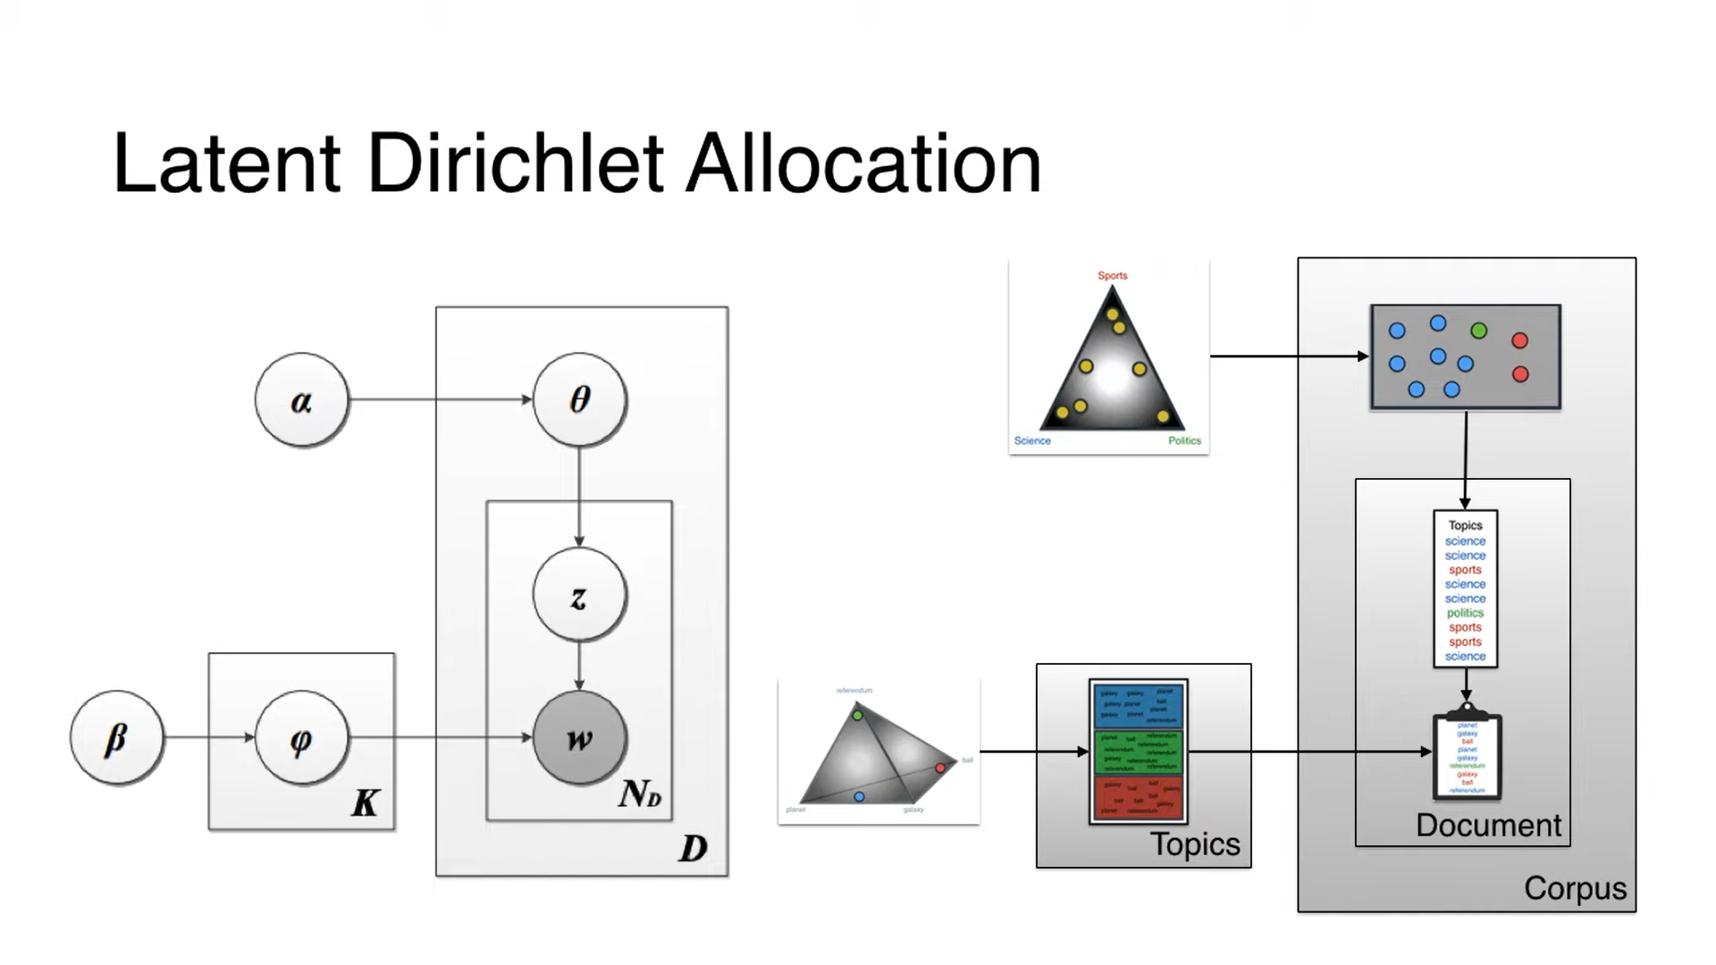
Doc-topic
Topic-word

Slide 3
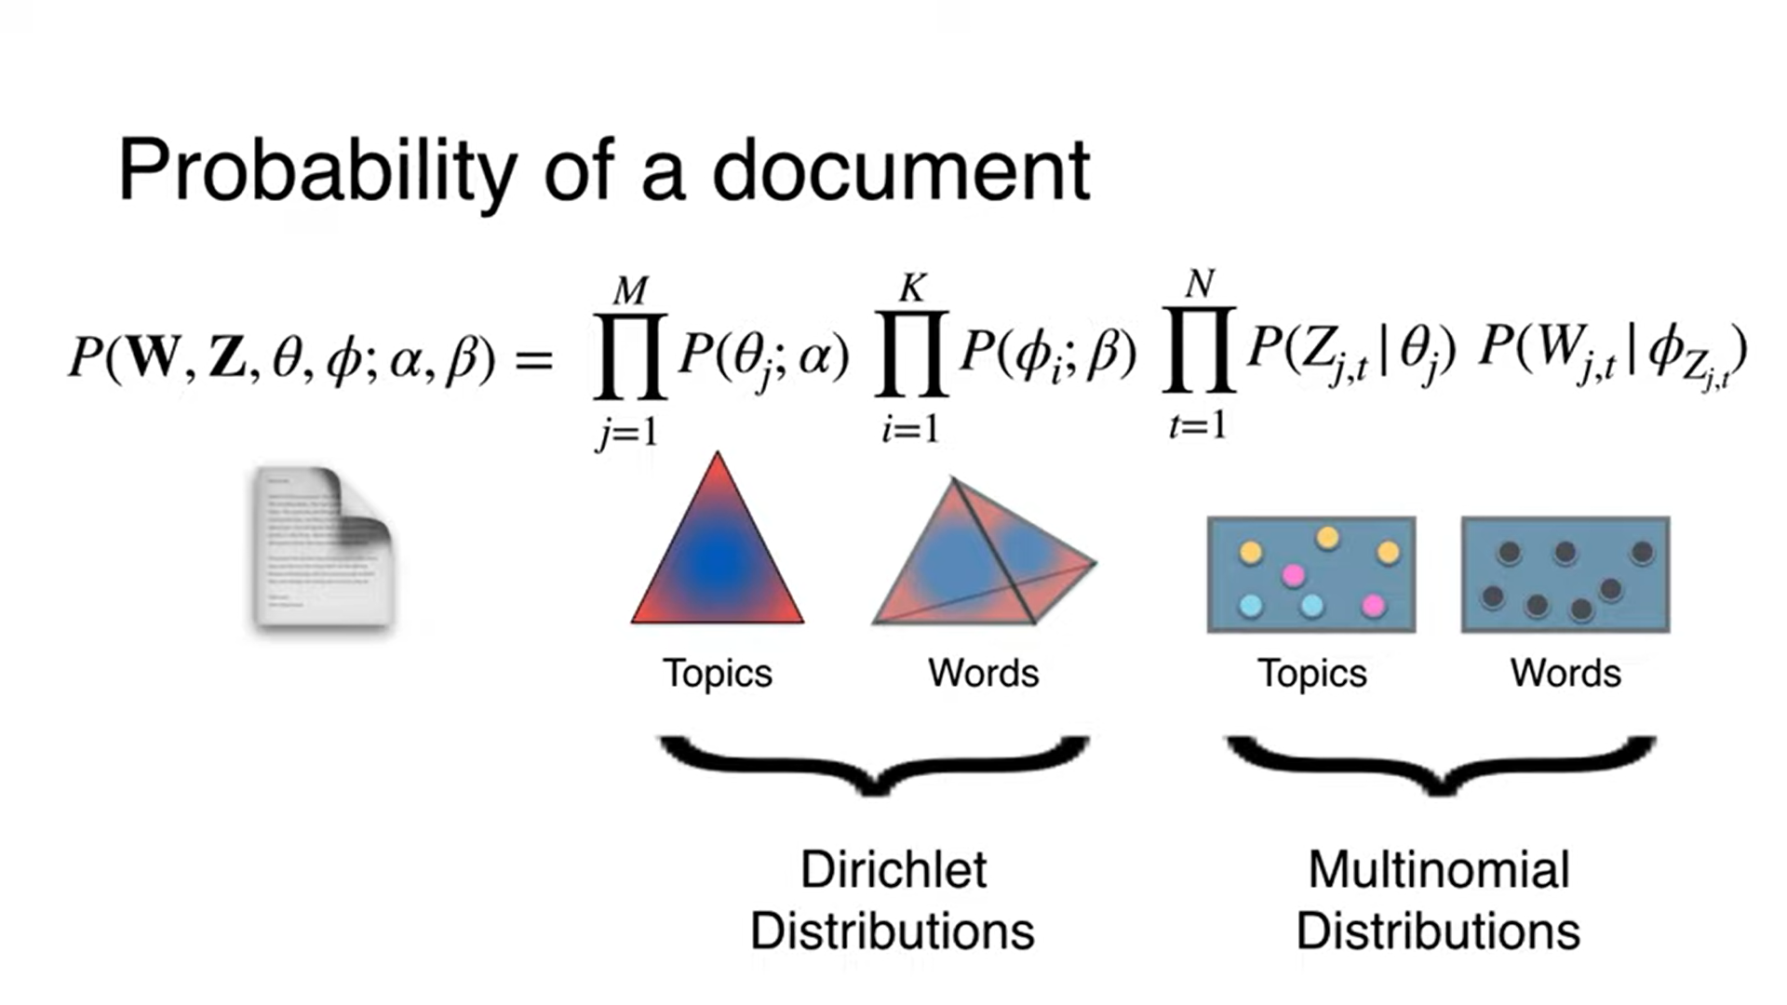

Slide 4
Gibbs Sampling

