Slide 1
INTEL UNNATI INDUSTRIAL TRAINING PROGRAM
Project Title: Enhancing Customer Experience with AI-Driven Insights
Subtitle: Sunglasses Try-On Studio
Name: Parimal Maity.
University Name: Brainware University.
Student Code: BWU/BTA/22/212.

Slide 2
TITLE: PROBLEM STATEMENT
Content:
Online shopping lacks personalized try-on experiences.
Customers hesitate to buy sunglasses online due to inability to visualize fit.
Challenge: Create an AI-driven system for seamless virtual try-on using customer-uploaded and real-time captured images.
Visuals: Include an image of a frustrated online shopper or a screenshot of an e-commerce sunglasses page without try-on features.

Slide 3
TITLE: OBJECTIVE
Content
Develop an AI-driven system to enhance online shopping experience.
Support two modes:Static Image Mode: Upload a previously captured photo to try on sunglasses. Real-Time Capture Mode: Capture a single image via webcam and apply sunglasses.
Use image analytics to personalize the try-on experience.
Provide a user-friendly interface with side-by-side comparison.

Slide 4
TITLE: PROJECT OVERVIEW
Content:
Project Name: Sunglasses Try-On Studio
Target: Online shopping try-on system for sunglasses.
Features:
Background removal for sunglasses images.
Face detection using OpenVINO for accurate overlay.
Two modes: Static Image Mode and Real-Time Capture Mode.
Modern UI with file name display and side-by-side comparison.

Slide 5
TITLE: APPROACH
Content:
Backend Development:
Flask for web server and API endpoints.
OpenVINO for face detection (face-detection-adas-0001 model).
rembg for background removal with transparency check.
Image processing: Cropping, color preservation, and overlay.
Frontend Development:
HTML/CSS/JavaScript for a responsive UI.
File uploads and webcam capture (single image, not video).
Side-by-side comparison using flexbox.

Slide 6
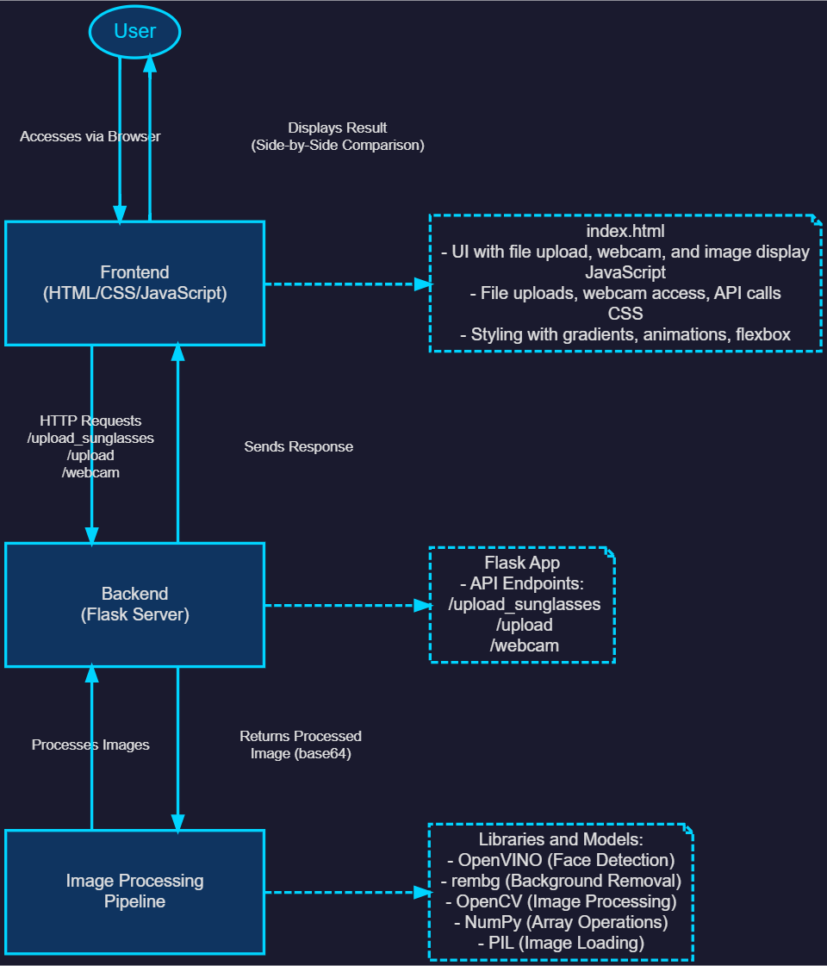
TITLE: ARCHITECTURE DIAGRAM

Slide 7
TITLE: CODE WALKTHROUGH - BACKEND
Content:
Flask Server Setup:
Uses Flask and Ngrok for public URL access.
Face Detection:OpenVINO model (face-detection-adas-0001) for detecting faces.
Background Removal:rembg library with logic to skip removal for transparent PNGs.
Image Processing:Cropping extra space using alpha channel.
Color space conversion (RGB to BGR and vice versa).
Overlay sunglasses on detected face.
API Endpoints:
/upload_sunglasses: Process sunglasses image.
/upload: Static Image Mode.
/webcam: Real-Time Capture Mode.

Slide 8
TITLE: CODE WALKTHROUGH - FRONTEND
Content:
HTML Structure:Sections for sunglasses upload, photo upload, and webcam capture.
CSS Styling:Gradient backgrounds, hover effects, and flexbox for side-by-side comparison.
JavaScript Logic:
File uploads with file name display (showFileName).
Webcam capture for single image (startWebcam, captureFrame).
API calls to backend for processing (uploadSunglasses, uploadPhoto).

Slide 9
Title: Installation and Setup for Google Colab
Content:
Step 1: Open Google Colab and create a new notebook.
Step 2: Install dependencies:flask, flask-ngrok, numpy, opencv-python, rembg, onnxruntime, pillow, openvino.
Step 3: Download OpenVINO model files:XML and BIN files for face-detection-adas-0001.
Step 4: Upload backend and frontend code into separate cells.
Step 5: Run the backend (Flask server) and frontend (generate index.html).
Step 6: Access the application via the Ngrok URL and test both modes.

Slide 10
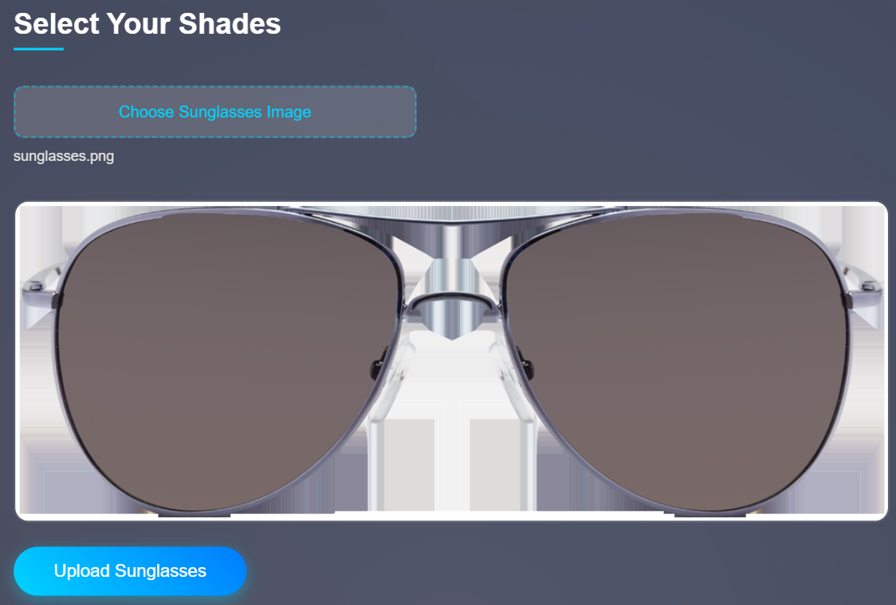
TITLE: OUTPUT - SUNGLASSES UPLOAD
Content:
Input: A PNG image of sunglasses with a solid background.
Output: Background removed, extra space cropped, and preview displayed.

Slide 11
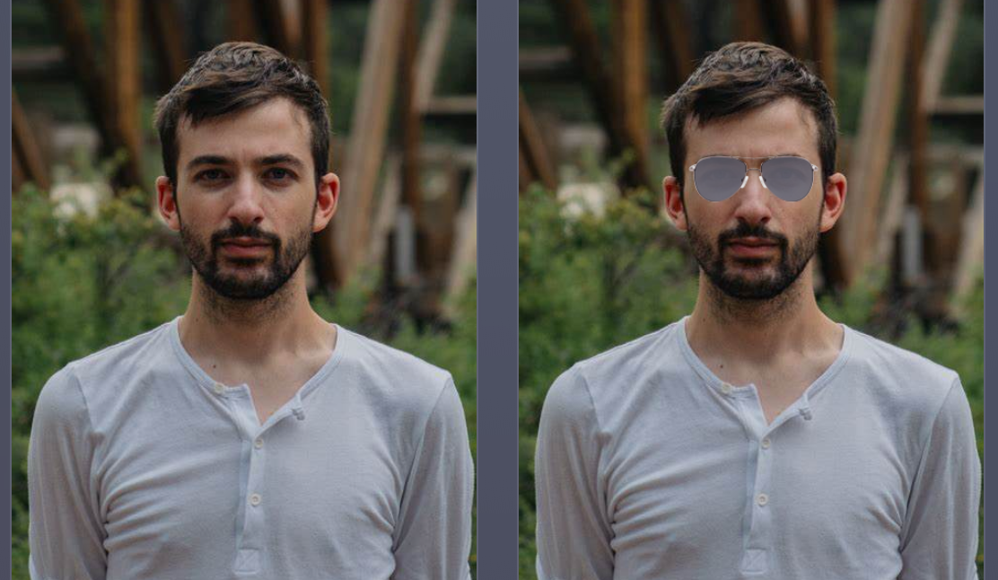
TITLE: OUTPUT - STATIC IMAGE MODE
Content:
Input: A previously captured photo of a customer’s face.
Output: Sunglasses overlaid on the face, displayed side by side with the input image.

Slide 12
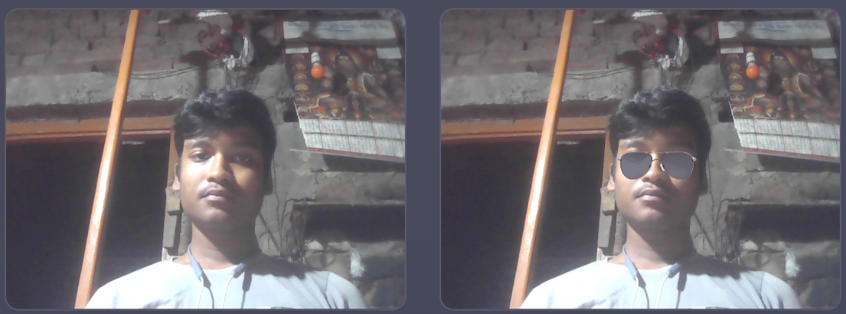
TITLE: OUTPUT - REAL-TIME CAPTURE MODE
Content:
Input: A single image captured via webcam.
Output: Sunglasses overlaid on the captured image, displayed side by side with the original.

Slide 13
TITLE: YOUTUBE VIDEO LINK FOR FULL GUIDE
Content:
Watch the full setup guide on YouTube:
Full Guide: Setting Up Sunglasses Try-On Studio in Google Colab for AI-Driven Online Shopping
Covers:
Installing dependencies and downloading model files.
Setting up the backend and frontend.
Running and testing the application.

Slide 14
TITLE: CONCLUSION
Content:
Successfully implemented a virtual try-on system for online shopping.
Supports Static Image Mode and Real-Time Capture Mode (single image via webcam).
Key Features:
Background removal, face detection, and accurate overlay.
User-friendly UI with side-by-side comparison.
Future Improvements:
Add multiple sunglasses styles for selection.
Implement head tilt detection for better alignment.
Integrate with an e-commerce platform for direct purchases.

Slide 15
THANK YOU…..

