Slide 1
ERD Diagram
The ERD diagrams are made from draw.io website.

Slide 2
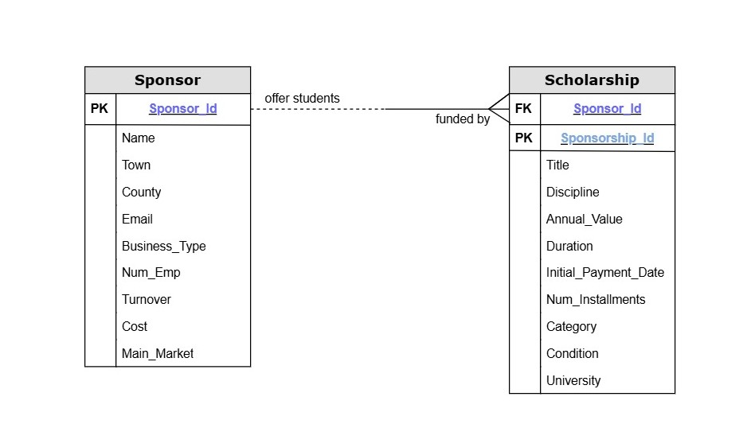
ER Diagram with attributes

Slide 3
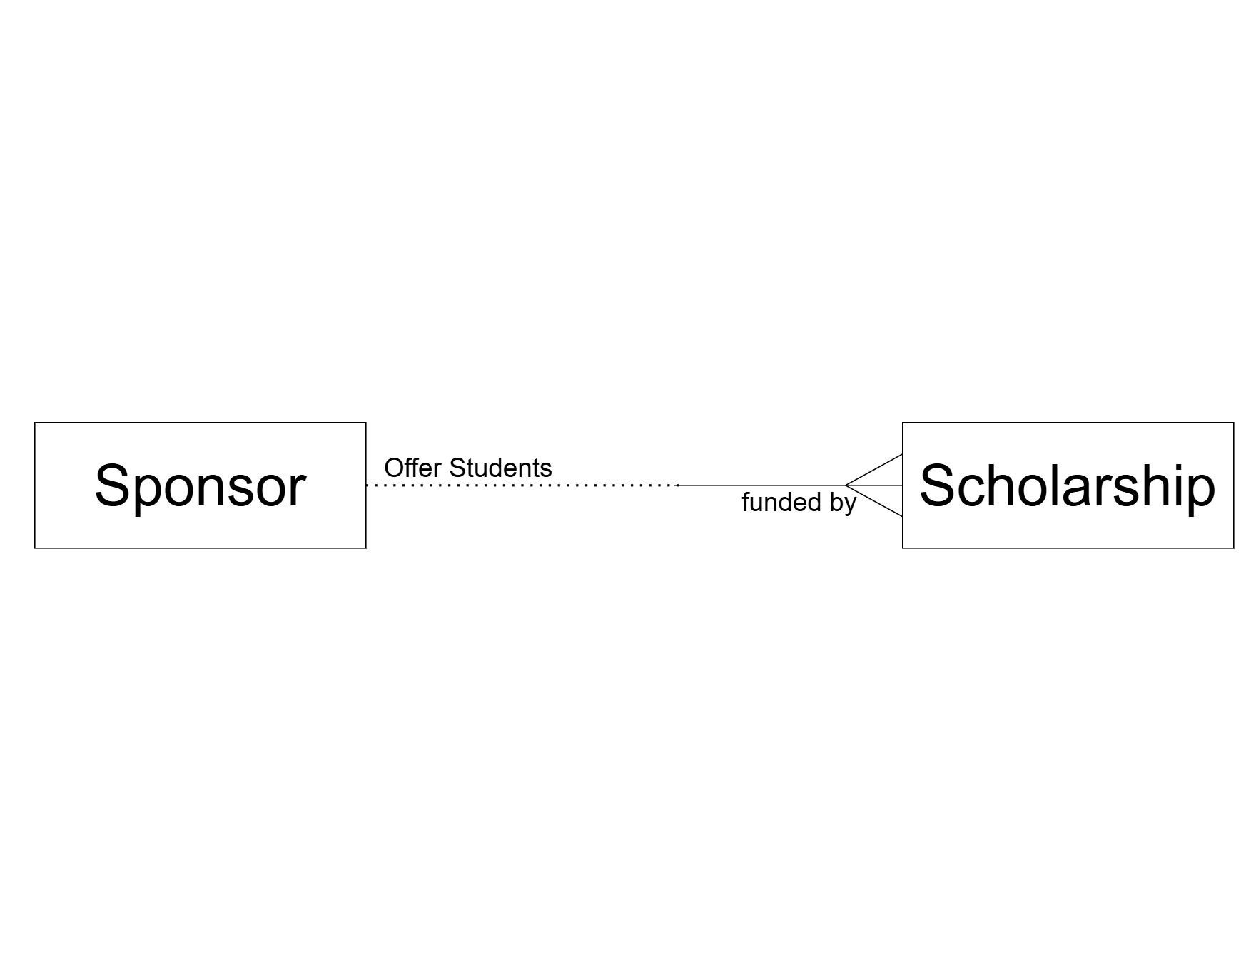
ER Diagram

Slide 4
ERD showing the entities, relationships (cardinality/optionality)
Entity / Relationship | Cardinality | Optionality
Sponsor - Scholarship | One to Many | Optional for Sponsor
Scholarship - Sponsor | Many to One | Mandatory for Scholarship

