Slide 1
3D Modelling

Slide 2
Most common methods :
Collections of photographs
Single photograph
Video footage

Slide 3
Algorithm:
Three-dimensional (3D) face modeling is a challenging topic in computer graphics and computer vision. Unlike 2D face models, 3D face models can realistically express face deformation and pose variation with depth information.
With these advantages, 3D face models have been applied to various applications, including movies, 3D animation and telecommunications.
Can be categorized into :
Active
Passive

Slide 4
Preliminary Study
In this section, we address previous works and the fundamental concept of the proposed 3D face modeling method. We categorize them into two groups:
Corresponding feature-based 3D face modeling.
Statistical model-based 3D face modeling.

Slide 5
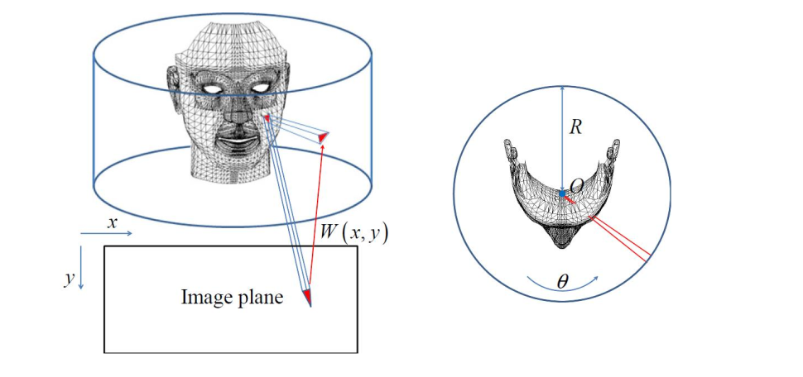
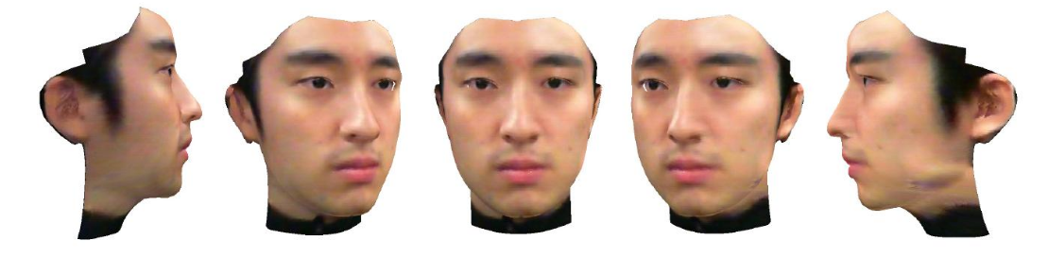
Texture Map Generation and Mapping
In this section, we introduce cylindrical mapping and address the stitching method using a seamless cloning method.
Texture Extraction Using Cylindrical Texture Mapping:
Texture Map Generation Using Modified Image Stitching Method:

Slide 6
SOFTWARE AND TOOLS
Blender
Adobe Dimensions
ZBrush

Slide 7

Why Blender ?
Free
Open Source
Platform Independent
High performance and accuracy
Keyboard shortcuts for a fast workflow
Python scripting for custom tools and add-ons

Slide 8
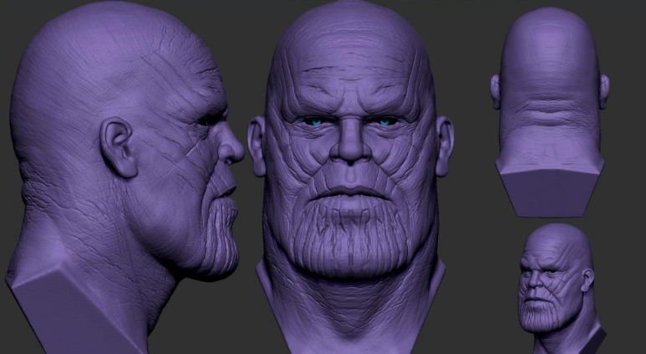
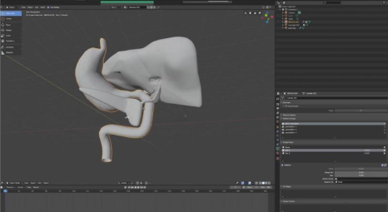
Applications
Medical Field
Gaming Field
Film Industries

