Slide 1
3D, 2D modelling of faces.
Natural interaction, virtual reality.

Slide 2
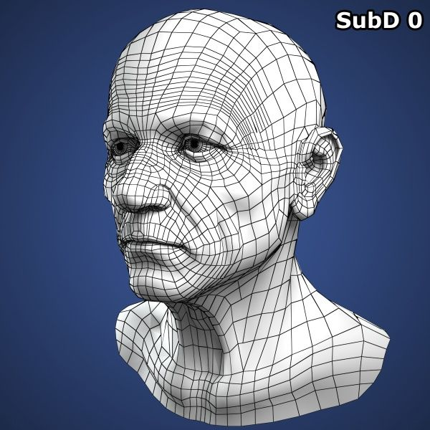
3D face models.
Challenging topic in computer graphics and computer vision.
Categorized into Active and Passive vision systems.
Preferred and most commonly used is Passive vision system. ( Because the glare from light-emitting devices can be unpleasant for the users. )

Slide 3
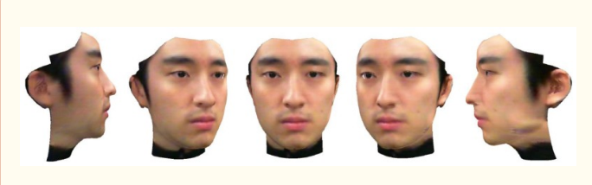
3D face modelling using
multi-resolution splining.
Methodology
Multi - Resolution splining is also known as blending method.
Operates well when the overlapped regions between images to be splined are broad enough.

Slide 4
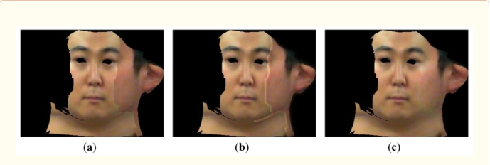
3D face modelling using
multi-resolution splining.
Methodology

Slide 5
References.
(Nov 2018) FACSHuman a Software to Create Experimental Material https://www.researchgate.net/publication/329107683_FACSHuman_a_Software_to_Create_Experimental_Material_by_Modeling_3D_Facial_Expression
2. (Sept 2012) 3D Face Modeling Using the Multi-Deformable Method
https://www.ncbi.nlm.nih.gov/pmc/articles/PMC3545547/
3. (March 2013)Immersive 3D modeling with Blender and off-the-shelf hardware
https://www.researchgate.net/publication/261041851_Immersive_3D_modeling_with_Blender_and_off-the-shelf_hardware

