Slide 1
Credit Risk Modelling
BY:
Parimal Wadhai (BT21ECE097)

Slide 2
Introduction
Objective: Develop a high-performing credit risk model for credit card loan approvals.
Functionality:
Analyze applicant data (features) to predict the likelihood of loan default.
Generate a creditworthiness score for each applicant.
Data Analysis: Utilize various relevant data points to build the model, including:
Financial Information: Credit history, income, employment status, debt-to-income ratio.
Potential Additional Factors: Age, location, spending habits (depending on data availability).
Benefits:
Minimize Loan Defaults: Reduce the bank's financial risk by identifying high-risk applicants.
Responsible Lending: Approve loans for qualified individuals who are more likely to repay.
Data-Driven Decisions: Leverage objective data analysis for informed loan approval processes.
Enhanced Risk Management: Improve the bank's ability to manage credit card loan risk.
Sustainable Growth: Promote responsible lending practices that contribute to a healthy consumer credit
sector.
Modeling Approach: Utilize machine learning techniques and statistical modeling to create the credit risk
model.

Slide 3
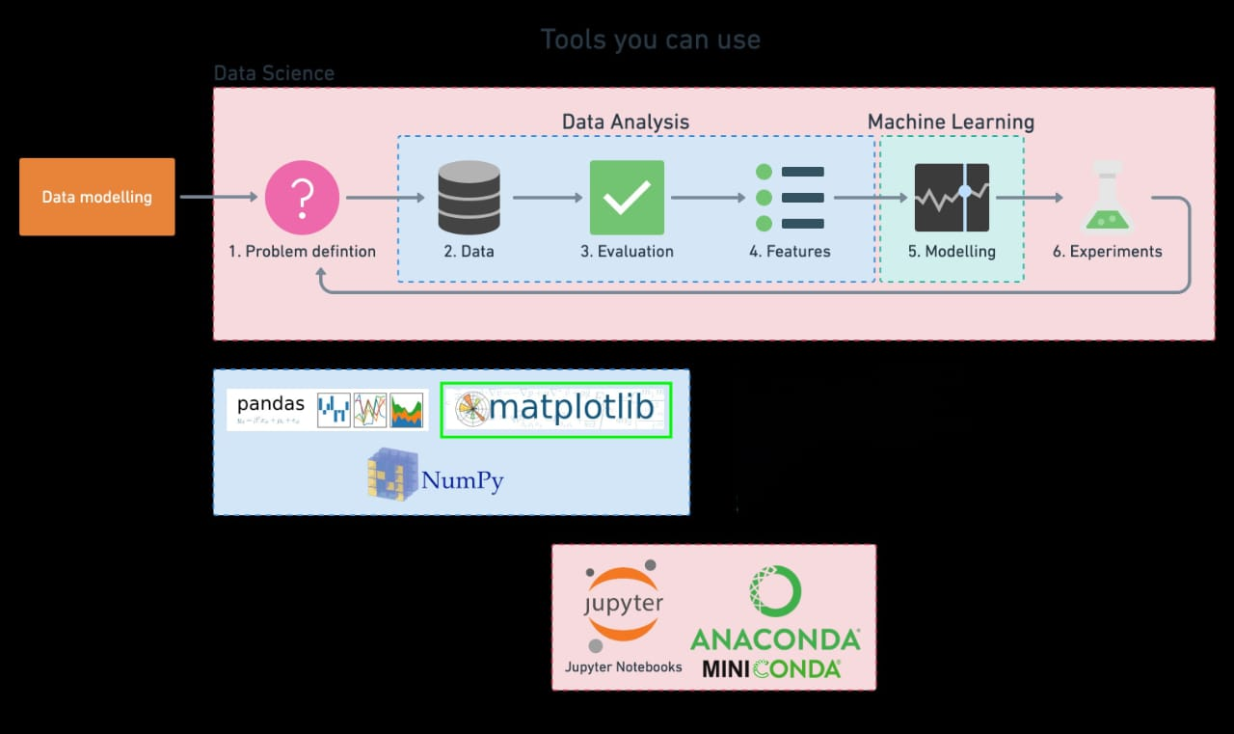

Slide 4
Domain Knowledge:
Current challenge being faced by the bank wrt credit lending
Explain the two datasets- 1. Bureau dataset, 2. Internal product dataset
Explain all the features
Explain the target variable- Multiclass (Understand the risk appetite)
What are we trying to achieve through ML modelling
Our proposed solution- How we are revising the current credit lending strategy of the bank in a more scientific way

Slide 5
Contents:
Introduction
What are we trying to achieve through ML modelling
Project workflow
Evaluation: Assess the performance of the models.
Conclusion
Data cleaning- Null values, Outliers, Imputations Feature engineering- Chi square test, ANOVA test, VIF, Multicollinearity, Label encoding, One hot encoding, Data wrangling | Model selection Choosing the appropriate loss metric Hyperparameter tuning

Slide 6
Project Workflow
Load the dataset
Feature Extraction Process:-
Removing NULL
Merge the two dataframes, inner join so that no nulls are present
Chi-square test on Cat vs Cat features (Since all the categorical features have p-val <=0.05, we will accept all)
Variance Inflation Factor which is used to identify multicollinearity among features.
ANOVA test for columns to be kept. Here, feature selection is done for cat and num features.
Label encoding for the categorical features and One Hot Coding for Nominal Data.
3. Machine Learning and model fitting:-1)Decision Tree2)Random Forest 3)Xgboost

Slide 7
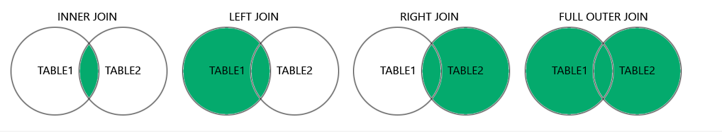
Feature Extraction Process:-
Remove nulls
Merging the 2 data-frames so no nulls are present:
3. Feature selection:

Slide 8
Measures of Association:
Correlation vs Causation
Important concept to identify the root cause behind movement of a variable
Correlation doesn’t really mean causation

Slide 9
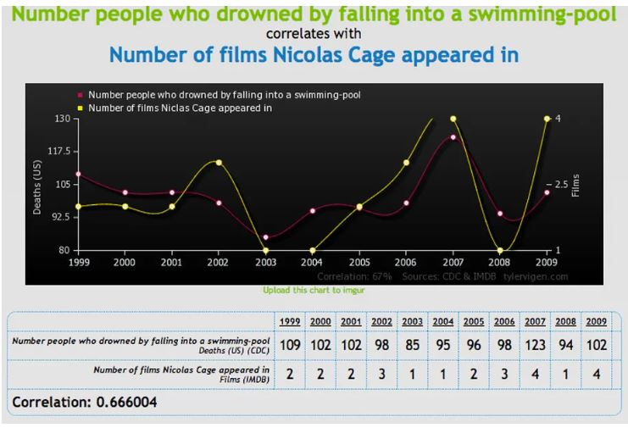
Measures of Association:
Correlation vs Causation (Some funny example)

Slide 10
Multicollinearity:-
Examples
It becomes difficult to reward/penalize the components
Just an equation but the implications are huge!
House Price = (3 x Floor_Area) – (4 x Distance_City_Centre) – (8 x House_Age)
House Price = (3 x Floor_Area) – (4 x Distance_City_Centre) + (7 x Carpet_Area)

Slide 11
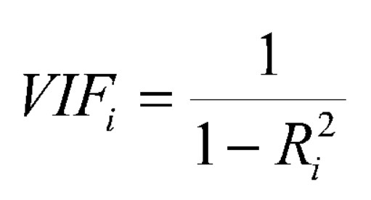
VIF:-
Variance Inflation Factor
Used to identify multicollinearity among IFs
Takes R-squared value for each IF and eliminate if crosses a threshold
VIF ranges from 1 from infinity
VIF = 1 : No multicollinearity
VIF between 1 and 5 : Low multicollinearity
VIF between 5 and 10 : Moderate multicollinearity
VIF above 10 : High multicollinearity

Slide 12
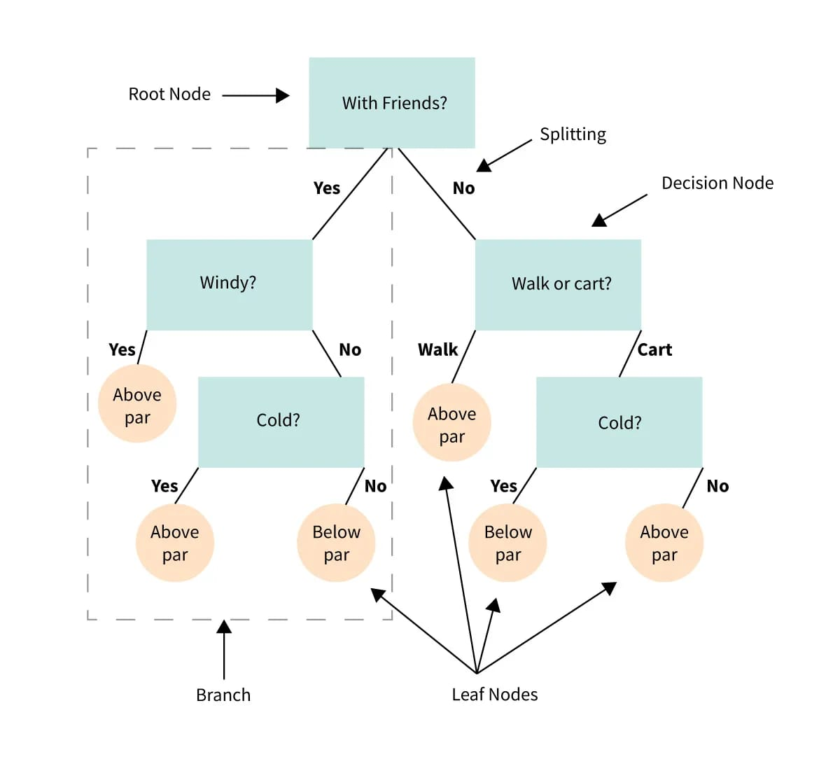
Decision Tree:
explaination

Slide 13

Random Forest:

Slide 14
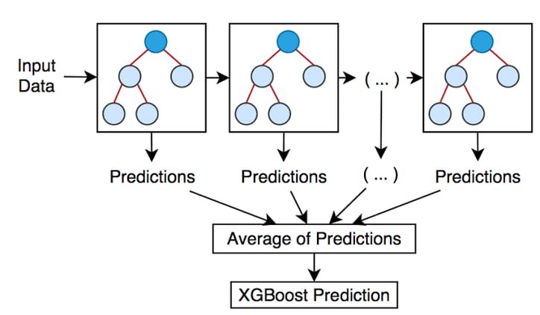
XGBoost:

Slide 15
0.7636990372043266
Evaluation of all 3 model:
Decision Tree:- The accuracy of decision tree is 0.71
Random Forest:- The accuracy of Random Forest Model is 0.76
XgBoost:- The accuracy of XgBoost Model is 0.78 and best Hyperparameters for this model: {'learning_rate': 0.2, 'max_depth': 3, 'n_estimators': 200} to get this accuracy.
So from the above content the best model is XgBoost.

Slide 16
Thank You

