Slide 2
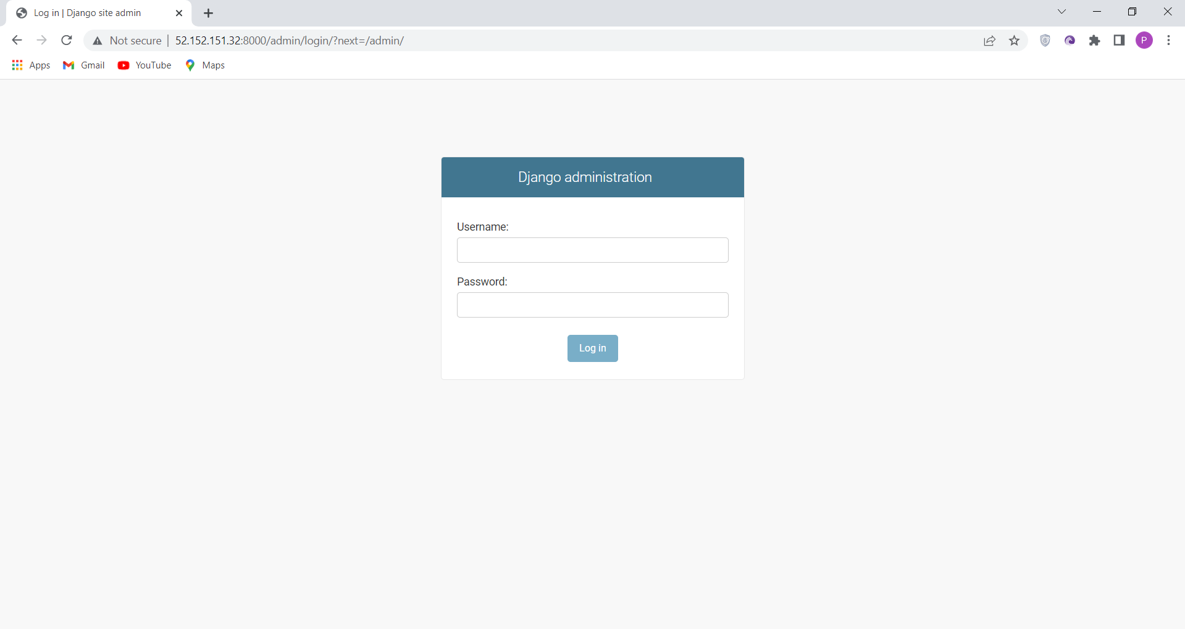
Admin Login Page

Slide 3
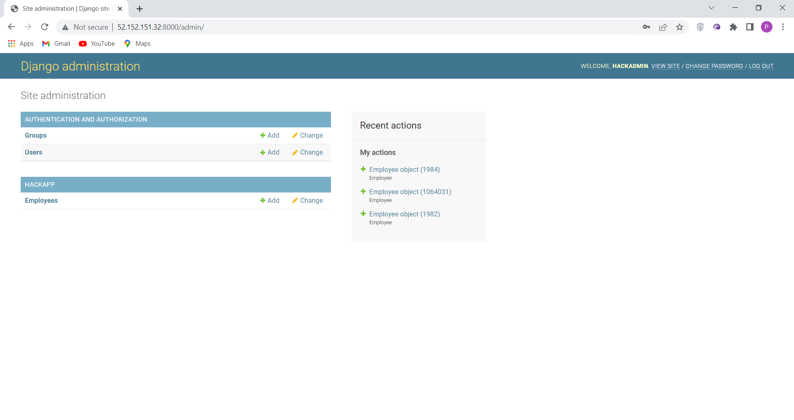
Admin Landing/Dashboard Page

Slide 4
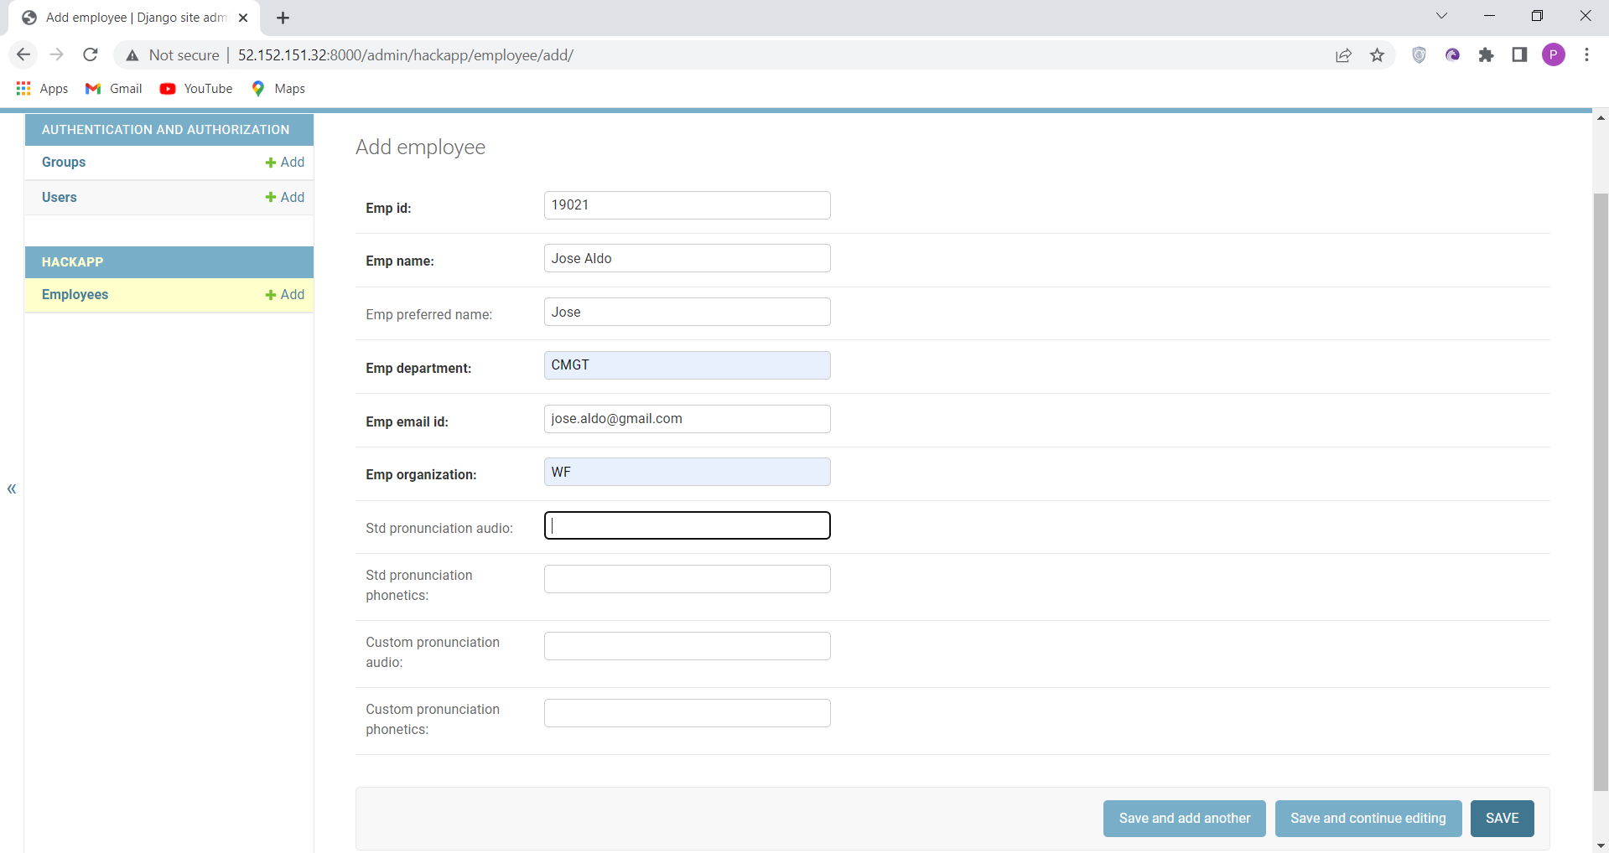
Employee Creation Page

Slide 5
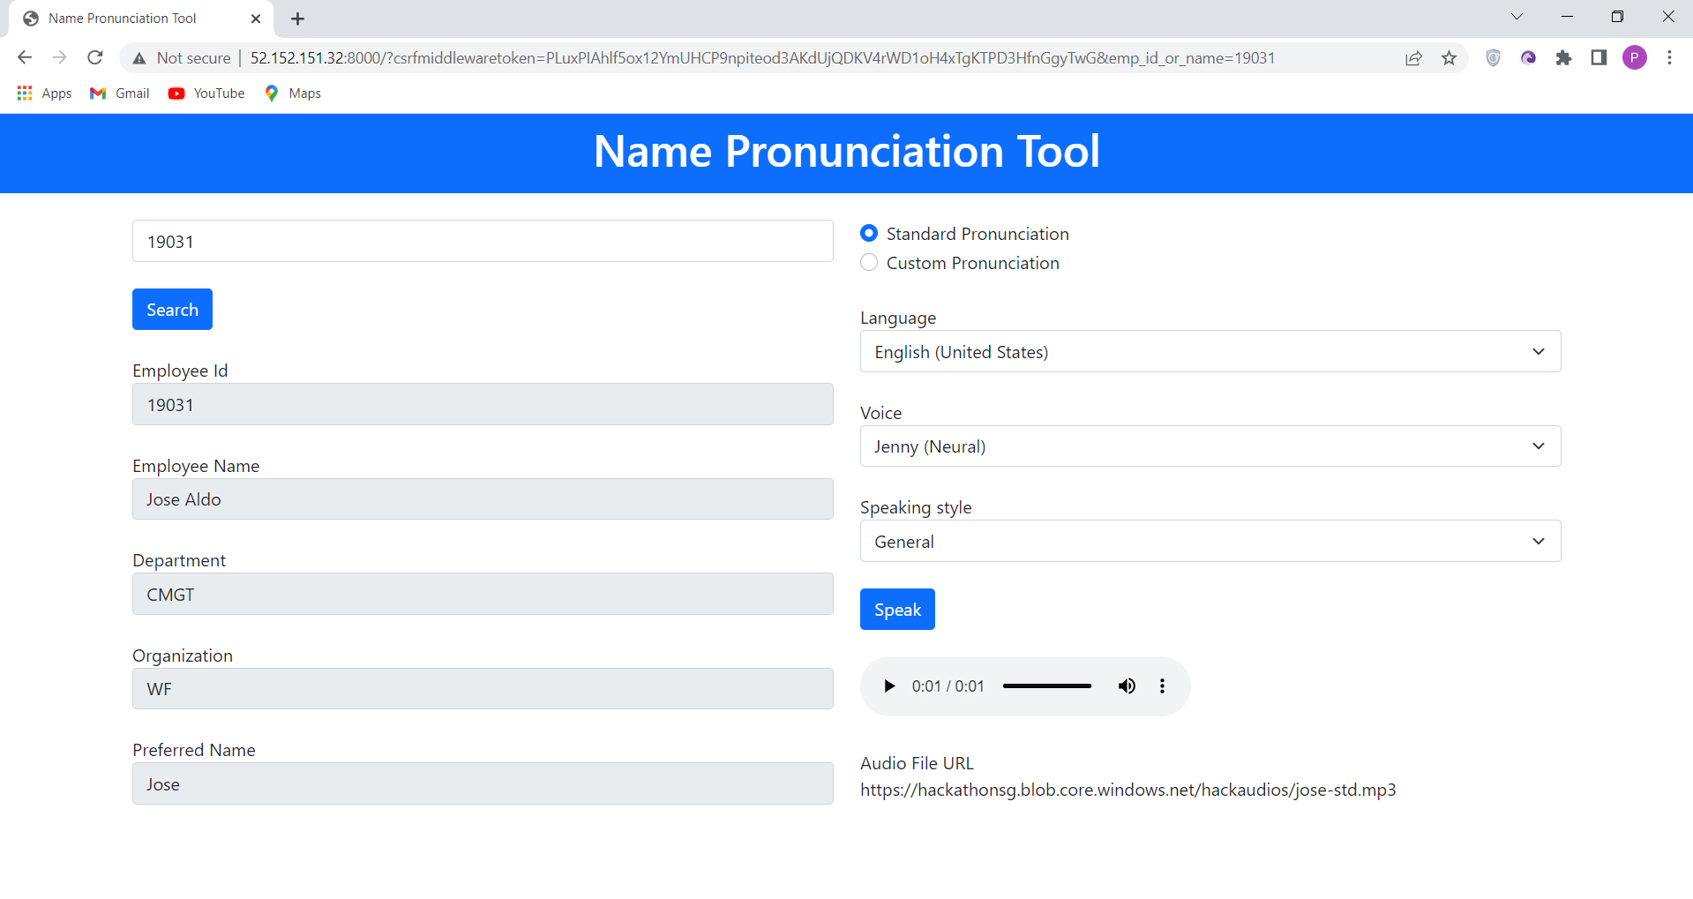
Application Landing Page – Standard Pronunciation

Slide 6
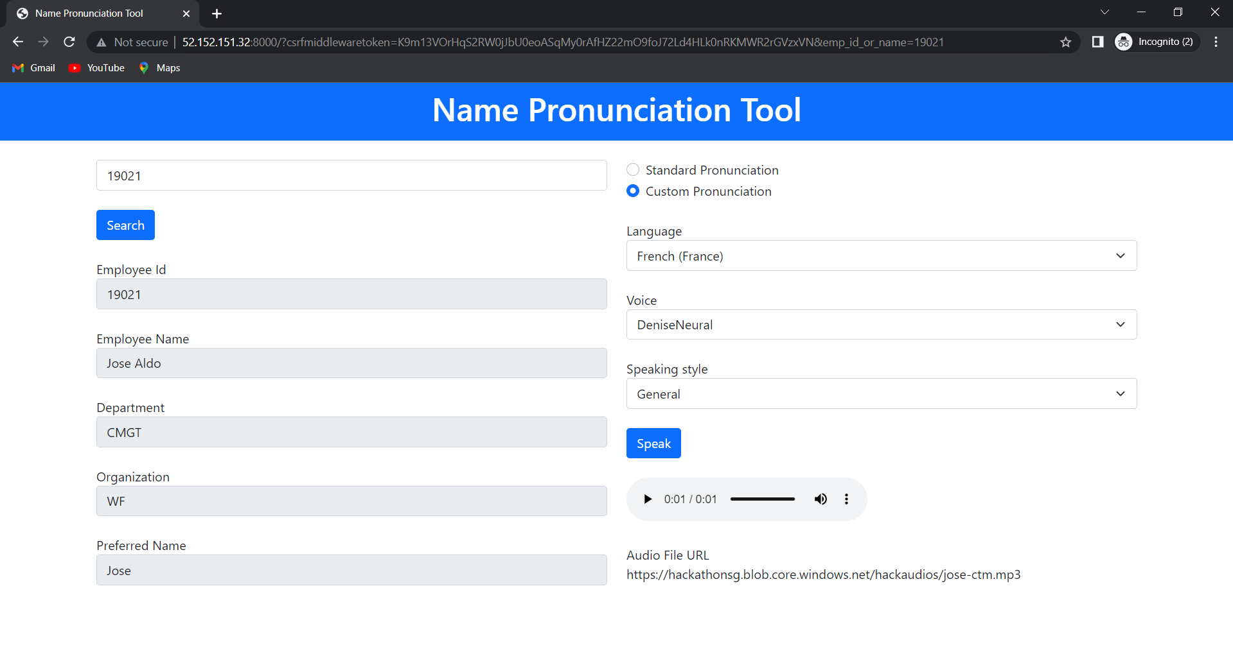
Application Landing Page – Custom Pronunciation

