Slide 1

Employee Management System (EMS)
SDJ International College
Prepared By:
Exam No Name
2019066062 Suvagiya Parin
2019066021 Mangukiya Gaurav
2019065920 Lukhi Rushabh
TYBCA SEM-6 Project Report
Guided By: Prof.Nidhi Desai

Slide 2
Overview
Introduction
Project Technical Profile
Scope & Planning
Designing
Testing
Conclusion
Bibliography

Slide 3
1. Introduction
Employees Management System is a web application for effectively managing employees. In companies handling employee data is the most important factor, so EMS provides functionalities like scheduling important meetings, events and managing employees leave, salary, attendance, working hours with effective sorting and filtering techniques. This system provides a portal for employees to interact with the company and track their daily data like attendance, leave, salary, working hours. EMS frontend is built using Reactjs, which is a javascript library. EMS Backend provides an Application programming interface (API) that is built using Nodejs, Expressjs, MongoDB. When user requests for EMS frontend will load on the web browser window and API will provide data on user needs.

Slide 4
2. Project Technical Profile
01
02
03
04
05
06
Javascript
NodeJs
ExpressJS
A programming language that web browsers can understand.
A runtime environment for javascript .
A framework of Nodejs used for creating web API and services.
ReactJS
MongoDB
UI libraries
Javascript library helps to design UI components.
A No SQL Database stores data in collections.
Full calendar, Bootstrap 5, Material Ui

Slide 5

Hardware & software specification
A computer with 4Gb ram and i3 processor for development
MongoDB cloud database
MongoDB compass
Visual studio code
Git & Github
Heroku for hosting

Slide 6
3.
Scope & Planning
The scope of this system is very large, it can be used in multiple companies.

Slide 7
Requirement Analysis
Home page
Company portal
LOGIN, REGISTER with OTP, and JWT token authentication
Dashboard
View and Update profile and password
Manage Departments
Manage Designations
Manage Employees
Scheduler
Attendance
Mange leaves
Salary
Employee portal
Login
view company profile
view my profile and update password
Scheduler
Attendance
leaves
Salary

Slide 8
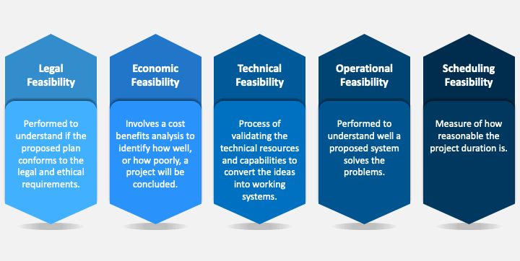
Feasibility study

Slide 9
Timeline chart
week | Work Done
Dec week 3 & 4 | Learn technologies and requirement gathering and analysis
Jan week 1 & 2 | identify proposed project profile, identifying objectives, scope definition
Jan week 3 & 4 | Design system flow, database design, company portal design, employee portal design
Feb week 1 & 2 | API architecture setup, API coding
Feb week 3 & 4 | API integration with frontend, Hosting
Mar week 1 & 2 | unit testing, navigational testings,
Mar week 3 & 4 | functional testings, environmental testings, Bug fixing

Slide 10
Future Development
Integration with attendance hardware software and attendance with face recognition
Meeting platform for online meeting
Details report generation with data science and machine learning
Goals
To Make EMS Number 1 employee Management System
Development
70%
Phase 3
50%
Phase 2
30%
Phase 1

Slide 11
Technology Details
RecatJs
Reactjs is an open-source JavaScript library that is used for building user interfaces specifically for single-page applications. It's used for handling the view layer for web and mobile apps. React also allows us to create reusable UI components.
Redux
React-Redux is the official React binding for Redux. It allows React components to read data from a Redux Store, and dispatch Actions to the Store to update data. Redux helps apps to scale by providing a sensible way to manage the state through a unidirectional data flow model. React Redux is conceptually simple.
NodeJs
Node. js (Node) is an open-source development platform for executing JavaScript code server-side. Node is useful for developing applications that require a persistent connection from the browser to the server and is often used for real-time applications such as chat, news feeds, and web push notifications.

Slide 12
Technology Details
ExpressJs
Express is a web application framework for Node. js that allows you to spin up robust APIs and web servers in a much easier and cleaner way. It is a lightweight package that does not obscure the core Node.
What is API?
An API (Application Programming Interface) is a set of functions that allows applications to access data and interact with external software components, operating systems, or microservices. To simplify, an API delivers a user response to a system and sends the system's response back to a user.

Slide 13
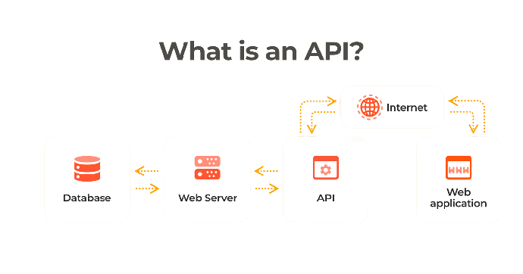
EMS API Overview
API URL: https://app-ems-system.herokuapp.com/health
Change endpoint and perform other operations
Example: /logout, /checktoken
As you can see in the examples by changing the endpoint we can do multiple operations
How does API work?

Slide 14
4.
Designing

Slide 15
Flow of the Project
Company
Request
EMS
Request
Employe
Response
Response

Slide 16
Use case diagram
Company
Employee
Company can add and manage employees data like attendance, salary, leave and much more.
Employees get credentials from the employee portal when the company adds them which helps to interact with a company.

Slide 17
Database Design
Company
Employee
Attendance
Leave
Designation
Event
Department
Eventtype

Slide 18
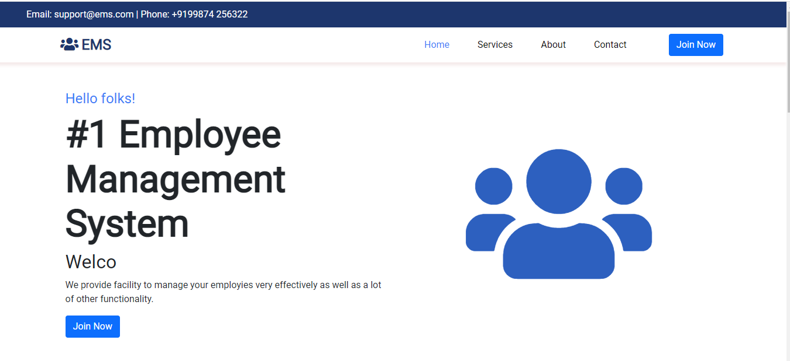
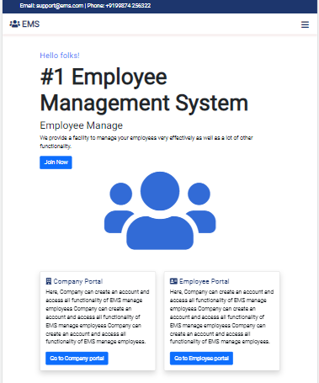
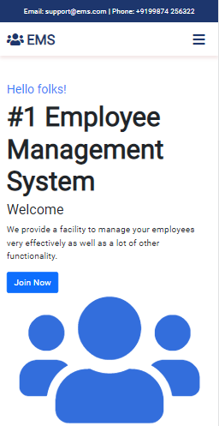
User interface
An EMS view on Desktop, tablet, mobile.

Slide 19




Hosting
ci/cd pipeline

Slide 20
5.
Testing

Slide 21
Unit Testing
01
02
03
Admin side
Attendance
Salary
Admin login, registration are working as expected
Attendance module is working as expected.
Salary calculation algorithm is working.
04
05
06
Calendar
Employee Module
Employee portal
All functionalities on calendar are working.
Manage employee, designation and department are tested.
Employee portal does not have any problem currently.

Slide 22
Functional Testing
Company login & registration are working fine with validation and authentication
Employee login working fine
Manage employees working fine
Department manager working as we expected
Designation manager working as we expected
Shift manager is working fine
Salary manager is working fine
Event module is also working fine
Leave manager is working file
Automatic mail sending functionality is working

Slide 23
Environment Testing
Firefox browser, Internet Explorer and chrome consider testing for environment operability of software.
Web server – created using nodejs
Database – MongoDB
OS – Windows
Browser – Firefox/Internet Explorer/Chrome
Postman is used for API environment testing

Slide 24
1. Conclusion
The purpose of this website is to provide functionality for managing employees. EMS is a web application where multiple companies can create their account and get access to a lot of functionality for managing employees. EMS has API which separates the frontend and backend and also helps to integrate with other websites.
Code and some guide of project

Slide 25

Bibliography
Websites
https://reactjs.org/docs/getting-started.html
https://nodejs.org/en/docs/
https://mongoosejs.com/docs/api.html
https://mui.com/
https://getbootstrap.com/docs/5.0/getting-started/introduction/
Thank You

