Slide 1

Scalar Vector Graphics

Slide 2
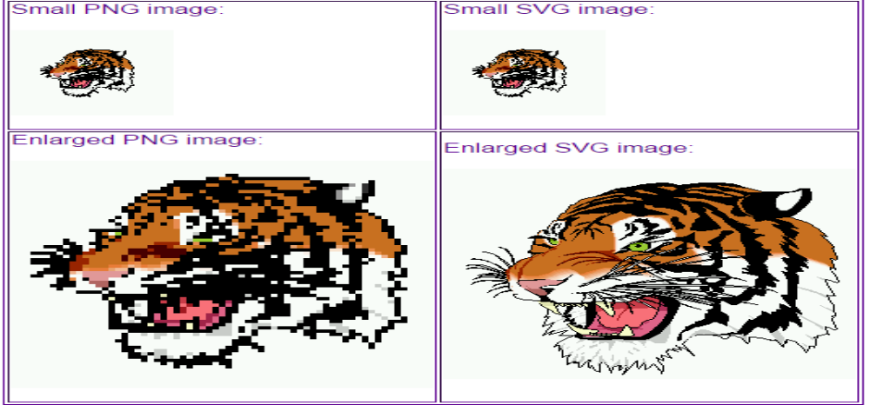
Why use SVG?
Would you like to load image which takes more time? Would you use more HTTP requests? Would you like a blur image? SVG is no different. There is money and time riding on the software you are writing.

Slide 3
Why SVG? (cont.)
Because you require resolution independent image
Because a year from now, you might like to work on SVG
Because it is scalable. Look at the two snapshots of the EMACS for OS X website when first opened in the browser
Bandwith friendly

Slide 4
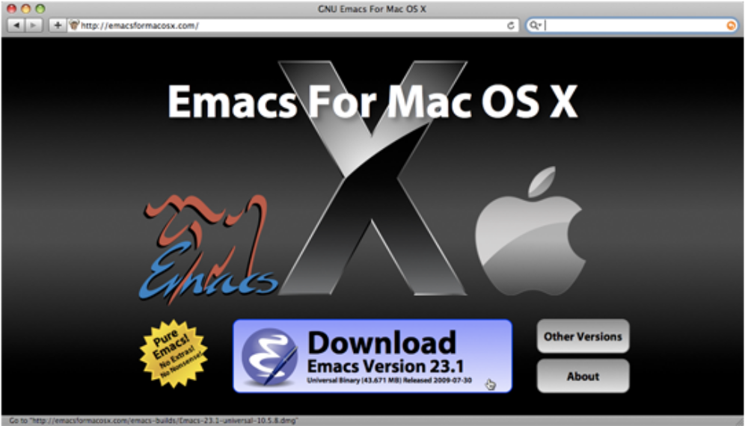
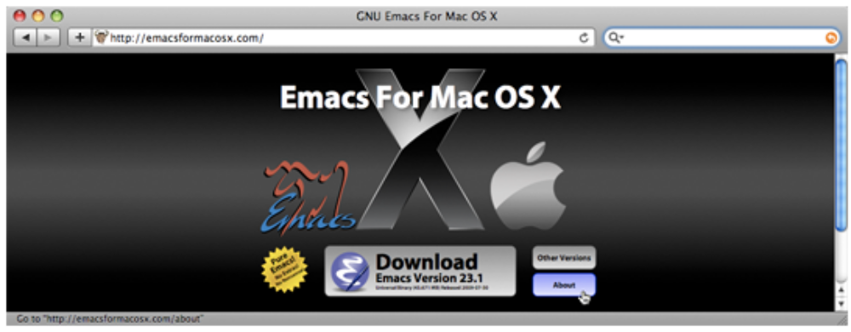

Slide 5
What is SVG?
Describe vector graphics
XML based vector image format for 2D graphics
What is not SVG?
Not a bitmap image format
Does not consist of fixed sets of dots

Slide 6
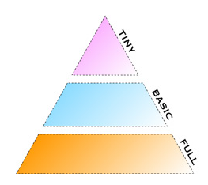
History
SVG 1.0 called Full
SVG 1.1 called Basic
SVG 1.2 called Tiny

Slide 7
Side benefits of SVG
SVG Text Based
Resolution Independent
No unnecessary HTTP Requests
Bandwidth friendly
SVG 1.2 Tiny enhancements
Other Benefits

Slide 8
Tools of SVG
Illustrator, Inkscape
Raphael.js

Slide 9
Why You Probably Aren't Using It
Developers have never heard of it.
SVG XML document looks more complicated

Slide 10
What SVG lacks?
Complex Development
Lack of Information
Limited Authoring Tools
Browser Support
Converting SVG

Slide 11
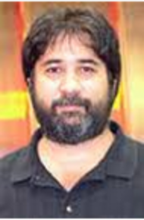

The players of SVG
Samy Rubby: uses SVG to annotate his web blogs
Erik Dahlstrom, from Opera
Jeff Schiller

Slide 12
Practical Applications:
Graph
Road Maps
Complex UI Elements
Logos
Simple games

Slide 13
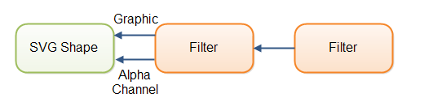
SVG Filters
Input and Output

Slide 14

Example
<defs>
<filter id="blurFilter2" y="-10" height="40" x="-10" width="150">
<feOffset in="SourceAlpha" dx="3" dy="3" result="offset2" />
<feGaussianBlur in="offset2" stdDeviation="3" result="blur2"/>
<feMerge>
<feMergeNode in="blur2" />
<feMergeNode in="SourceGraphic" />
</feMerge>
</filter>
</defs>
<ellipse cx="55" cy="60" rx="25" ry="15"
style="stroke: none; fill: #0000ff; filter: url(#blurFilter2);" />
Resulting Image:

Slide 15
Gradients
Linear
Radial

Slide 16
<svg xmlns="http://www.w3.org/2000/svg"
xmlns:xlink="http://www.w3.org/1999/xlink">
<defs>
<linearGradient id="myLinearGradient1"
spreadMethod="pad">
<stop offset="10%" stop-color="#00cc00" stop-opacity="1"/>
<stop offset="30%" stop-color="#006600" stop-opacity="1"/>
<stop offset="70%" stop-color="#cc0000" stop-opacity="1"/>
<stop offset="90%" stop-color="#000099" stop-opacity="1"/>
</linearGradient>
</defs>
<rect x="10" y="10" width="500" height="50" rx="10" ry="10"
style="fill:url(#myLinearGradient1); stroke: #005000;
stroke-width: 3;" />
</svg>

Slide 17
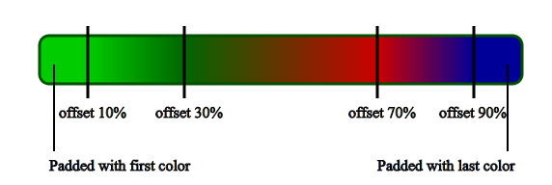

Slide 18
SVG Shapes
Circle
Rectangle
Polygon
PolyLine
Text
Path
Line
Ellipse

Slide 19
Project Example
Graphical Representation
Replicating Android start animation

Slide 20

Questions/Comments?

