Slide 1
Computer Vision
FALL 2020
Problem Set #1
Parin Patel
ppatel480@gatech.edu
Computer Vision @ GT

Slide 2
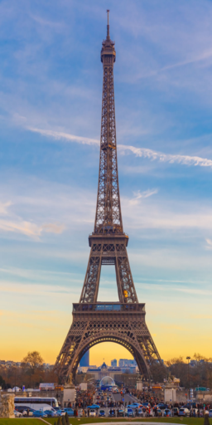
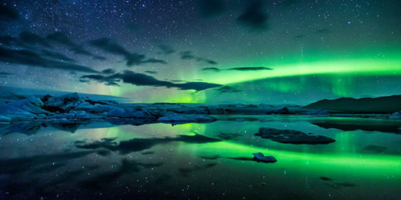
1a: Interesting Images
Image 1 - ps1-1-a-1.png
Image 2 - ps1-1-a-2.png
Computer Vision @ GT

Slide 3
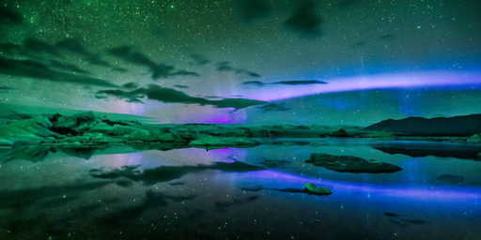
2a: Swapped Green and Blue
ps1-2-a-1.png
Computer Vision @ GT

Slide 4
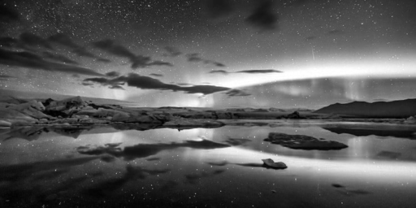
2b: Monochrome Green
Img1_green - ps1-2-b-1.png
Computer Vision @ GT

Slide 5
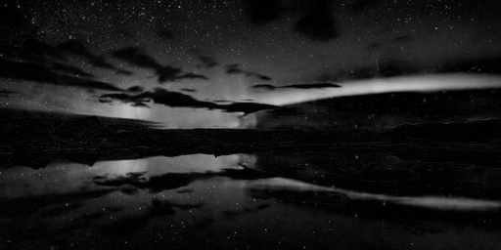
2c: Monochrome Red
Img1_red - ps1-2-c-1.png
Computer Vision @ GT

Slide 6
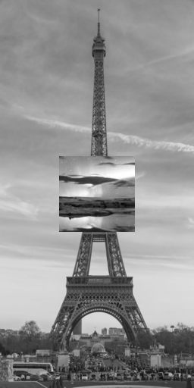
3a: Replacement of Pixels
ps1-3-a-1.png
Computer Vision @ GT

Slide 7
4a: Image Stats
Min: 0.0
Max: 255.0
Mean: 88.54009246826172
Standard deviation: 57.4633450189581
Computer Vision @ GT

Slide 8

4b: Arithmetic Operation
ps1-4-b-1.png
Computer Vision @ GT

Slide 9
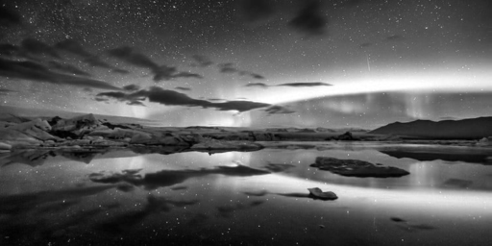
4c: Shifted Image
ps1-4-c-1.png
Computer Vision @ GT

Slide 10
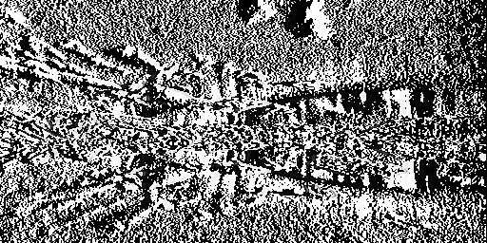
4d: Difference Image
ps1-4-d-1.png
Computer Vision @ GT

Slide 11
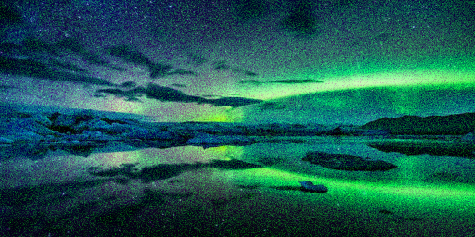
5a: Noisy Green Channel
ps1-5-a-1.png
Computer Vision @ GT

Slide 12

5b: Noisy Blue Channel
ps1-5-b-1.png
Computer Vision @ GT

Slide 13
6a: Discussion
Between all color channels, which channel, in your opinion, most resembles a grayscale conversion of the original. Why do you think this? Does it matter for each respective image? (For this problem, you will have to read a bit on how the eye works/cameras to discover which channel is more prevalent and widely used)
In my opinion, green channel resembles the most to the grayscale image. The same was the case for the example images that I had chosen. The reason behind it is that the human eye is most sensitive to the green color. According to a theory, green channel contains most details, red is associated with contrast and blue has the shortest wavelength of light associated with it. The visual system is much more sensitive to high frequency detail in luminance than in chrominance. (ref. Computer Vision – Algorithms and Applications p91) Thus, as human eye is more sensitive to green (high frequency), it usually is the case that green channel resembles the grayscale conversion and is not different across difference images.
Computer Vision @ GT

Slide 14
6b: Discussion
What does it mean when an image has negative pixel values stored? Why is it important to maintain negative pixel values?
There are mainly two reasons for negative pixel values:
1. It may be related to black noise. Since the noise has the mean of 0, it may have some values which are negative.
2. Negative pixel values simply may mean that it lies outside the scope of RGB values. They may be related to some negative coordinates that used to model some luminance signal existing outside the RGB ones. So, these values may be important to model some signals that cannot be approximated by RGB.
In both cases, not maintaining the negative pixel values may either add some noise or lose information from image. Thus, it is important to maintain negative pixel values.
Computer Vision @ GT

Slide 15
6c: Discussion
In question 5, noise was added to the green channel and also to the blue channel. Which looks better to you? Why? What sigma was used to detect any discernible difference?
Noise added to the blue channel looks better to me. As discussed in 6a, human eye is most sensitive to green channel. Thus, a very little amount of noise in the green channel gets a lot more focus of eye as compared to the noise added to the blue channel. To have any discernible difference as little as sigma = 5 worked for green channel, but when it comes to the blue channel, sigma needs to be as much as at least 25-30 to be visible to human eye.
Computer Vision @ GT

