Slide 1
Appliances Energy Consumption Prediction Using Machine Learning
Prediction, explanation and anomaly review on the UCI Appliances Energy Prediction dataset
Student: Anna
[Module code and title] | [Submission date]
Notes:
Welcome. This project predicts household appliance energy use from a Jupyter notebook analysis of the UCI Appliances Energy Prediction dataset. I will cover the data, preprocessing, modelling, evaluation, explainability and anomaly detection, and I will be careful to say what each result does and does not show. All numbers in this deck are saved outputs from my notebook. Before presenting, fill in the module and submission date on this slide.

Slide 2
Introduction
Background
Problem
Why it is hard
UCI Appliances Energy Prediction: 10-minute readings from one low-energy house in Belgium, about 4.5 months (11 Jan - 27 May 2016). Target: Appliances energy use in Wh.
Can appliance energy use be predicted reliably, which factors drive the predictions, and can unusual readings be flagged without confusing prediction errors with confirmed energy waste?
Consumption is spiky and right-skewed. Short bursts of high use dominate the error and are the hardest readings to predict.
3.39
60 Wh
576.6 Wh
1,080 Wh
skewness of Appliances
median per 10 minutes
99th percentile
maximum
Source: notebook section 2.1 (target distribution), saved output.
Notes:
Background: the dataset has 10-minute readings from one low-energy house in Belgium over about 4.5 months; the target is Appliances energy use in Wh. The central question from the notebook is whether we can predict consumption reliably, understand what drives the predictions, and flag unusual readings without confusing prediction errors with confirmed energy waste. The numbers at the bottom explain why this is hard: the target is strongly right-skewed (skewness 3.39), the median is 60 Wh but the 99th percentile is 576.6 Wh. Short bursts of high use dominate the error.

Slide 3
Project Objectives
Predict reliably
Understand the drivers
Chronological train/test split, compared against mean and hour-of-day baselines.
PCA, permutation importance and SHAP show what the models rely on.
Flag unusual readings
Two prediction tasks
Anomalies are prompts for investigation, not proof of energy waste.
Track A: time and environment only. Track B: adds recent consumption (10-minute-ahead forecast).
Workflow
Data
Preprocessing
Feature engineering
Modelling
Evaluation
Interpretation
19,735 readings
→
chronological split
→
34 candidates, 16 kept
→
baselines, Ridge, RF, LightGBM, AutoML
→
RMSE, MAE, R²
→
SHAP, anomaly review
Notes:
The project has four goals. First, predict reliably: I used a chronological split and compared every model with simple baselines, because a complex model is only useful if it beats them. Second, understand the drivers using PCA, permutation importance and SHAP. Third, flag unusual readings, but treat flags as prompts for investigation rather than evidence of waste. Fourth, compare two prediction tasks: Track A uses only time and environmental information; Track B also uses recent consumption, so it is a short-term forecast. The workflow at the bottom is the structure of the rest of the talk.

Slide 4
Dataset Description
19,735
29
97.69 Wh
10 min
readings
columns (25 predictors)
mean Appliances
exact time step
Appliances (Wh) | Value
Minimum | 10
Median | 60
Mean | 97.69
90th percentile | 196
95th percentile | 330
99th percentile | 576.6
Maximum | 1,080
Std deviation | 102.52
Period: 11 Jan 2016 17:00 to 27 May 2016 18:00
Target: Appliances, energy use in Wh per 10-minute interval
Predictors: lights, indoor T1-T9 and RH_1-RH_9, outdoor T_out, RH_out, Press_mm_hg, Windspeed, Visibility, Tdewpoint
rv1 and rv2 are identical random-noise columns and were dropped
Strongly right-skewed target with a long tail of spikes
Notes:
The dataset has 19,735 rows and 29 columns: a timestamp, the target Appliances, 25 predictors (lights, nine indoor temperature and humidity sensors each, and outdoor weather variables), plus two random-noise columns rv1 and rv2 that I dropped because they are identical. Readings are every 10 minutes from 11 January to 27 May 2016. The table shows how skewed the target is: mean 97.69 Wh, median 60 Wh, maximum 1,080 Wh. The notebook audit found no missing values or duplicates.

Slide 5
Data Preprocessing
Train: 15,788 readings (11 Jan - 30 Apr 2016)
Test: 3,947 (30 Apr - 27 May)
0
0
10 min
Train only
missing values
duplicate rows
exact time step
where scaling is learned
Why we did this
What we found
How it can help
Models must be tested on the future, so we split by time, not at random, and learn scaling from training data only.
Clean data: no missing values or duplicates. A later 3,947-reading period was held back for testing.
A fair test shows how the model would behave on new weeks, so a user can trust the reported accuracy.
Notes:
Theory: a prediction model is only trustworthy if it is tested on data it has never seen, and for time series that means data from the future. So I split by time, not at random: train on 11 January to 30 April, test on 30 April to 27 May. Scaling is learned from the training data only, otherwise information from the test period would leak into the model and make results look better than they are. The data was already clean, with no missing values or duplicates. The 15,788 training rows is derived from 19,735 minus the 3,947 test rows. How it helps: a fair test tells a real user how the model would behave on new weeks.

Slide 6
Feature Engineering
Time of day and week
Clock as a circle
Temperature gap
Sensor averages
Hour, weekday and weekend capture daily routine.
Sine and cosine make 23:00 close to 00:00.
Indoor minus outdoor temperature, a heating-demand signal.
Indoor temperature and humidity means; removed by the stability check.
34 candidate features → 16 kept after removing features whose values shifted over time
Why we did this
What we found
How it can help
Raw clocks and sensors hide patterns. Features turn them into signals about routine and heating demand.
Time features and the temperature gap survived; the sensor averages and month drifted and were removed.
Simple, meaningful inputs are easier to explain and less likely to break on new weeks.
Notes:
Theory: raw clock times and sensor values hide patterns. Energy use follows daily routine, so I turned the timestamp into hour, weekday and weekend. Hours are circular, 23:00 is next to 00:00, so I encoded them with sine and cosine. I also built an indoor minus outdoor temperature gap as a signal for heating demand, and indoor sensor averages. A stability check then compared the first and second half of the training period and removed features whose values drifted. That left 16 of 34 features. The sensor averages and month were removed; the time features and the temperature gap stayed. How it helps: simple, meaningful inputs are easier to explain and less likely to fail on new weeks.

Slide 7
PCA Results
37.3%
28.3%
65.6%
temperature pattern
humidity pattern
together
Many sensors move together, so PCA squeezes them into a few patterns. Pattern 1 is mostly temperature sensors; pattern 2 is mostly humidity sensors.
Why we did this
What we found
How it can help
Sensors are correlated. PCA reveals structure and tests whether fewer inputs predict as well.
Two patterns explain 65.6% of sensor variation, but using PCA did not improve prediction.
Shows heavy sensor redundancy, so a cheaper setup with fewer sensors may be worth testing.
Notes:
Theory: many of the 25 sensors move together, for example all the temperature sensors. Principal Component Analysis compresses them into a few independent patterns. The first pattern, 37.3% of variation, is mostly temperature; the second, 28.3%, is mostly humidity; together 65.6%. I then tested whether predicting from these patterns works better than using the original inputs. It did not: error was 97.244 with the original inputs and slightly higher with PCA, 97.471 and 97.290. Lower is better. So PCA is used to understand the data, not to improve prediction. How it helps: it shows the sensors are very redundant, so a cheaper setup with fewer sensors may be worth testing. Note: the patterns come from 25 raw sensor columns, while the Ridge test uses the 16 selected features.

Slide 8
Machine Learning Models
Baselines
Ridge
Random Forest
LightGBM
AutoML
Simple rules: the overall average, or the average for that hour. Models must beat these.
A straight-line model. Simple to explain.
Many decision trees voting together.
Trees that learn from each other’s mistakes.
Software that tries several models and picks one (Extra Trees).
91.053 | 85.482
87.366
109.943
95.567
85.447
average | hour rule error
test error (Wh)
test error, untuned
test error, untuned
test error (Wh)
Why we did this
What we found
How it can help
Comparing simple and advanced models shows whether extra complexity is actually worth it.
Untuned Random Forest and LightGBM did worse than just predicting the average (91.053 Wh error).
Starting from baselines protects against choosing an impressive model that adds nothing.
Notes:
Theory: start simple, then add complexity only if it earns its place. Baselines are the yardstick: predicting the overall average, or the average for that hour of day. Ridge is a regularised straight-line model. Random Forest averages many decision trees. LightGBM builds trees that correct each other. AutoML tries several model types automatically and picks by cross-validation; it chose Extra Trees. The big numbers are test errors in Wh, lower is better. Key result: untuned Random Forest, 109.943, and LightGBM, 95.567, were worse than just predicting the average, 91.053. Complexity alone did not help. How it helps: starting from baselines protects against choosing an impressive model that adds nothing.

Slide 9
Tuning and Model Evaluation
Model | RMSE | MAE | R²
Random Forest (tuned) | 84.513 | 44.184 | 0.138
AutoML (Extra Trees) | 85.447 | 43.867 | 0.119
Hour-of-day baseline | 85.482 | 46.947 | 0.118
LightGBM (tuned) | 86.807 | 47.315 | 0.091
Ridge (default) | 87.366 | 49.388 | 0.079
Ridge (tuned) | 87.777 | 52.865 | 0.07
Mean baseline | 91.053 | 52.685 | -0.000
LightGBM (default) | 95.567 | 56.696 | -0.102
Random Forest (default) | 109.943 | 72.211 | -0.458
Grey = baselines; orange-red = worse than the average.
Why we did this
What we found
How it can help
Tuning tunes model settings. RMSE and MAE are average errors (lower is better); R² is variation explained (higher).
Tuned Random Forest was best (84.513 Wh), but R² is only 0.138: weather and time alone explain little.
Sets realistic expectations: fine for rough planning, not for precise 10-minute prediction.
Notes:
Theory: every model has settings, like tree depth, that control how closely it fits. Tuning searches for good settings using only training data, with time-ordered validation. We judge models with three measures: RMSE and MAE are average errors in Wh, lower is better; R² is the share of variation explained, higher is better, and below zero is worse than predicting the average. The tuned Random Forest was best on RMSE, 84.513 Wh, and AutoML best on MAE, 43.867 Wh. Tuning rescued Random Forest, 109.943 to 84.513, but R² is only 0.138, so weather and time alone explain little. All scores are on the same 3,947-reading test period. The ranking is descriptive because the best model is chosen on the test set. How it helps: realistic expectations, useful for rough planning, not precise prediction.

Slide 10
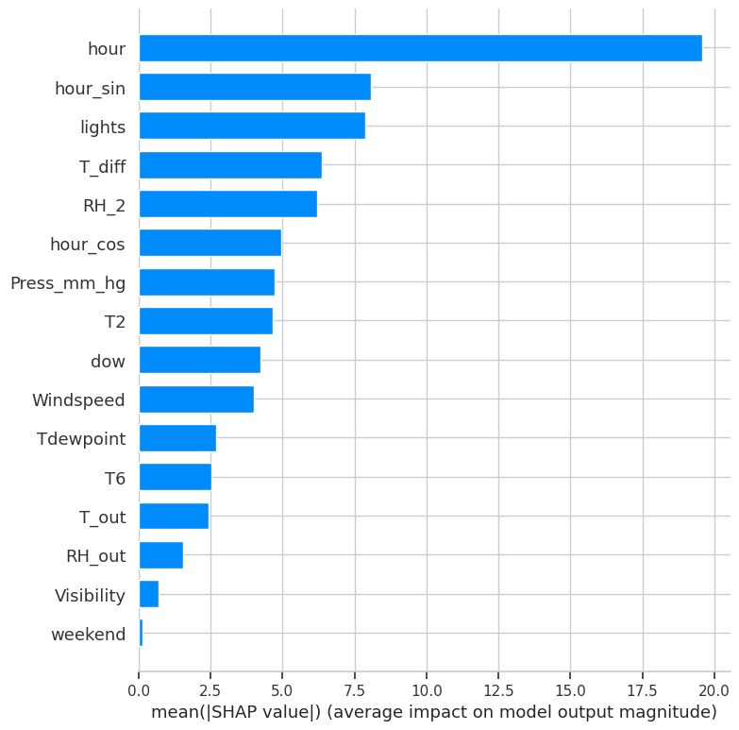
Explainable AI
Top input (SHAP) | In plain words
hour | Time of day
hour_sin | Time of day (circular clock)
lights | Lighting energy use
T_diff | Indoor minus outdoor temperature
RH_2 | Humidity sensor 2
Chart: notebook SHAP figure for the tuned LightGBM model.
Why we did this
What we found
How it can help
Explainable AI opens the black box by showing which inputs push a prediction up or down.
Time of day, lighting and the indoor-outdoor temperature gap matter most; methods only partly agree.
Shows when and why demand rises, but describes the model, not what causes energy use.
Notes:
Theory: complex models can be black boxes. Explainable AI opens them up. SHAP assigns each input a share of credit for each prediction, and permutation importance measures how much the error grows when an input is scrambled. Here time of day, lighting and the indoor to outdoor temperature gap matter most. The methods only partly agree, which is why I do not over-read one ranking. Two limits: this explains the tuned LightGBM model, not the best Random Forest, and importance shows what the model uses, not what causes energy use. How it helps: it shows when and why predicted demand rises, which makes the model easier to trust and challenge.

Slide 11
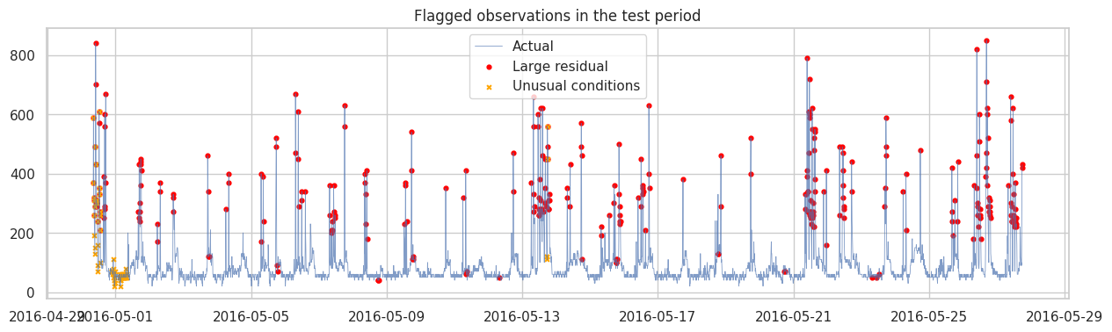
Anomaly Detection
313 (7.9 %)
large prediction error
79 (2.0 %)
unusual conditions
Red = large prediction error; orange x = unusual conditions (notebook figure).
20
Example: 26 May, 16:40. Actual 850 Wh, predicted 73.8 Wh.
flagged by both
Why we did this
What we found
How it can help
Surprising readings can mark events worth a closer look. Two methods catch different kinds of unusual.
313 readings had large errors, 79 had unusual conditions, only 20 both. Flags do not prove waste.
Could point owners to moments to check, but context is needed to confirm anything.
Notes:
Theory: an anomaly is a reading that is surprising, either because the model predicted it badly or because conditions were unusual. I used two views. A robust residual score flags readings where the prediction error is very large: 313 readings, 7.9%. Isolation Forest flags unusual combinations of conditions: 79 readings, 2.0%. Only 20 were flagged by both, so they answer different questions. Example: on 26 May 2016 at 16:40 actual use was 850 Wh and the model predicted 73.8 Wh. A big error means the model was surprised, not that energy was wasted. Both flags were computed within the test period, so they are descriptive. How it helps: it can point people to moments worth checking, but needs context to confirm anything.

Slide 12
Track A vs Track B
Track | Model | RMSE | MAE | R²
A | Mean baseline | 91.053 | 52.685 | -0.000
A | Hour-of-day baseline | 85.482 | 46.947 | 0.118
A | Ridge (tuned) | 87.777 | 52.865 | 0.07
A | LightGBM (tuned) | 86.807 | 47.315 | 0.091
B | Repeat last reading | 66.438 | 26.651 | 0.467
B | Previous-hour mean | 75.528 | 34.296 | 0.312
B | Ridge (tuned) | 61.156 | 26.301 | 0.549
B | LightGBM (tuned) | 60.226 | 27.097 | 0.562
Why we did this
What we found
How it can help
Track A uses only time and weather. Track B also sees recent use. Different tasks, so each has its own baseline.
Recent use lifts R² from about 0.09 to 0.56. Only Ridge beat the repeat-last-reading baseline on both errors.
Short-term forecasts could give near-real-time feedback, if recent meter readings are available.
Notes:
Theory: what you can predict depends on what you know. Track A uses only time and weather-type information. Track B also sees recent consumption, so it is a 10-minute-ahead forecast. They are different tasks, so each is judged against its own baseline: Track A against the hour-of-day average, Track B against simply repeating the last reading. Recent use raises R² from about 0.09 to 0.56, and the previous reading is the strongest predictor. Tuned LightGBM has the best error, 60.226 Wh, but tuned Ridge was the only model to beat repeat-the-last-reading on both RMSE and MAE. How it helps: short-term forecasts could support near-real-time feedback, but only if recent meter readings are available.

Slide 13
Key Findings and Limitations
Key findings
Limitations
Track A is hard: best RMSE 84.513 Wh (tuned RF), R² 0.138; lowest MAE 43.867 Wh (AutoML)
Time of day carries much of the signal: hour-of-day baseline RMSE 85.482 Wh
Default RF and LightGBM were worse than the mean baseline; tuning fixed the RF
PCA did not improve Ridge; kept for exploration
Recent consumption helps: Track B R² up to 0.562; lag1 is the strongest predictor
One house and one ~4-week test period
Track A margins are tiny (AutoML beats the hour baseline by 0.035 Wh RMSE)
Peaks stay hard: MAE 396.5 Wh for readings above 400 Wh (Track A, tuned LightGBM)
Distribution shift: all-feature set test R² = -0.636
SHAP and anomaly flags describe the model; no causal or waste claims
Anomaly flags computed within the test period itself
Notes:
Findings: conditions-only prediction is hard and gains over simple baselines are small; time features carry most of the signal; default Random Forest and LightGBM underperformed the mean baseline until tuned; PCA did not help; recent consumption improves forecasting a lot. Limitations matter just as much: one house and one test period of about four weeks; tiny margins between the top Track A models; peaks stay hard (MAE 396.5 Wh for readings above 400 Wh with the tuned LightGBM in Track A, 239.7 Wh in Track B); distribution shift between training and test periods; and explanation and anomaly results describe model behaviour, not causes or waste. Finally, the anomaly flags and Isolation Forest were computed within the test period itself, so they are exploratory.

Slide 14
Conclusion and Future Improvements
84.513 Wh
43.867 Wh
60.226 Wh
Track A best RMSE: tuned Random Forest (R² 0.138)
Track A lowest MAE: AutoML Extra Trees
Track B best RMSE: tuned LightGBM (R² 0.562)
Conclusions and how they help
Future improvements (proposed)
Weather and time alone give only modest accuracy
Recent use is the biggest single gain in accuracy
Can guide rough planning and awareness of peaks, not precise control; more homes and periods are needed
Test on more homes and time periods
Use rolling-origin splits to check stability
Set anomaly thresholds on training or validation data only
Add context (e.g. occupancy) before interpreting flagged peaks
Try approaches aimed at peaks, e.g. quantile models
Notes:
Summary of best results: in Track A, tuned Random Forest has the lowest RMSE at 84.513 Wh with R² 0.138, and AutoML Extra Trees the lowest MAE at 43.867 Wh. In Track B, tuned LightGBM has the best RMSE (60.226 Wh) and R² (0.562), while Ridge was the model that beat persistence on both RMSE and MAE. The first future-work item, more homes and time periods, comes from the notebook conclusion. The others are my proposals, not results: repeat with rolling-origin splits, set anomaly thresholds on training or validation data only, add context such as occupancy before interpreting flagged peaks, and try approaches aimed at peaks.

Slide 15
Questions?
Thank you
Notes:
Thank you. I am happy to take questions on the data, the evaluation design, the Track A versus Track B comparison, or the limits of the explainability and anomaly results.

